Slide 1
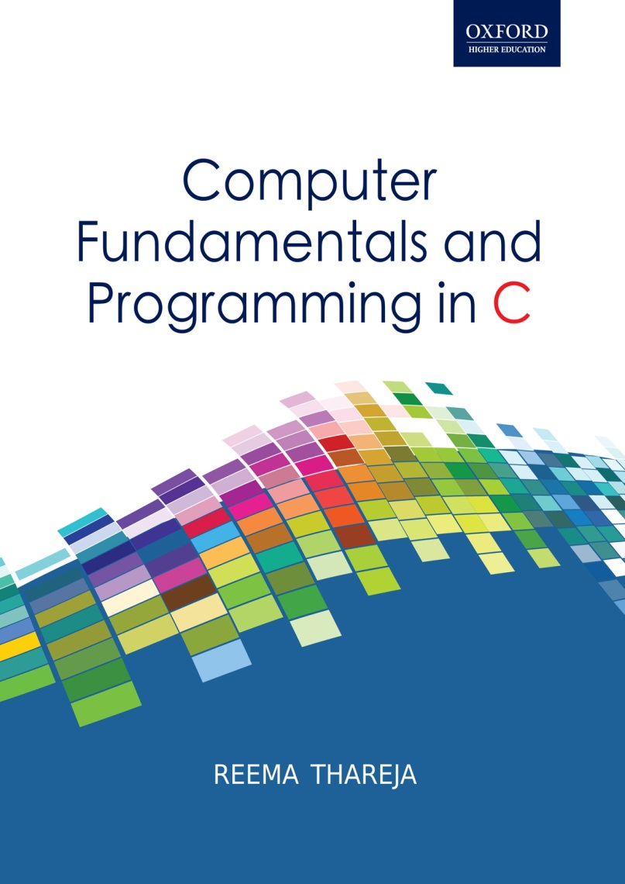
Computer Fundamentals and Programming in C
Reema Thareja, Assistant Professor, Institute of Information Technology and Management

Slide 2
CHAPTER 6
INTRODUCTION TO ALGORITHMS AND PROGRAMMING LANGUAGES

Slide 3
ALGORITHM
“Algorithm" is a formally defined procedure for performing some calculation. If a procedure is formally defined, then it must be implemented using a programming language. The algorithm gives logic of the program, that is, a step-by-step description of how to arrive at a solution.
Algorithm provides a blueprint to write a program to solve a particular problem in finite number of steps. Algorithms are mainly used to achieve software re-use
In order to qualify as an algorithm, a sequence of instructions must process the following characteristics:
Instructions must be precise
Instructions must be unambiguous
Not even a single instruction must be repeated infinitely
After the algorithm gets terminated, the desired result must be obtained

Slide 4
KEY FEARTURES OF AN ALGORITHM
Any algorithm has a finite number of steps and some steps may involve decision making, repetition. Broadly speaking, an algorithm exhibits three key features that can be given as:
Sequence: Sequence means that each step of the algorithm is executed in the specified order.
Decision: Decision statements are used when the outcome of the process depends on some condition.
Repetition: Repetition which involves executing one or more steps for a number of times can be implemented using constructs like the while, do-while and for loops. These loops executed one or more steps until some condition is true.

Slide 5
FLOWCHART
A flow chart is a graphical or symbolic representation of a process. They are basically used to design and document complex processes to help the viewers to visualize the logic of the process so that they can gain a better understanding of the process and find flaws, bottlenecks, and other less-obvious features within it.
Start and end symbols also known as the terminal symbol is always the first and the last symbol in a flowchart.
Generic processing step also called an activity is represents instructions like add a to b, save the result.
Input/ Output symbols are represented as a parallelogram and are used to get input from users or display the results to them.
A Conditional or decision symbol is used to depict a Yes/No question or True/False test.
Labeled connectors represented by an identifying label inside a circle are used in complex or multi-sheet diagrams to substitute for arrows.

Slide 6
Advantages of Flowcharts
A flowchart is a diagrammatic representation that illustrates the sequence of steps that must be performed to solve a problem. They are usually drawn in the early stages of formulating computer solutions to facilitate communication between programmers and business people.
Flowcharts help programmers to understand the logic of complicated and lengthy problems.
They help to analyze the problem in a more effective manner
Flowchart is also used for program documentation. Flowchart can be used to debug programs that have error(s).

Slide 7
Limitations of using Flowcharts
Drawing flowcharts is a laborious and a time consuming activity.
Flowchart of a complex program becomes, complex and clumsy. At times, a little bit of alteration in the solution may require complete re-drawing of the flowchart
Essentials of what is done may get lost in the technical details of how it is done.
There are no well defined standards that limits the details that must be incorporated in a flowchart

Slide 8
PSEUDOCODE
It is a form of structured English that describes algorithms. It facilitates the designers to focus on the logic of the algorithm without getting bogged down by the details of language syntax.
Pseudocode is a compact and informal high-level description of an algorithm that uses the structural conventions of a programming language. It is meant for human reading rather than machine reading, so it omits the details that are not essential for humans. Such details include keywords, variable declarations, system-specific code and subroutines.
It is commonly used in textbooks and scientific publications for documenting algorithms, and for sketching out the program structure before the actual coding is done. This would help even the non-programmers to understand the logic of the designed solution.
There are no standards defined for writing a pseudocode because a pseudocode is not an executable program. Flowcharts can be considered as a graphical alternative to pseudocode, but are more spacious on paper.

Slide 9
Example: Write a pseudocode to calculate the weekly wages of an employee. The pay depends on wages per hour and the number of hours worked. Moreover, if the employee has worked for more than 30 hours then he gets twice the wages per hour, for every extra hour that he has worked.
Read hours worked
Read wages per hour
Set overtime charges to 0
Set overtime hrs to 0
If hours worked > 30 then
  Calculate overtime hrs = hours worked – 30
  Calculate overtime charges =overtime hrs * (2 * wages per hour)
  Set hours worked = hours worked - overtime hrs
ENDIF
Calculate salary = (hours worked * wages per hour) + overtime charges
Display salary
End
Variables: hours worked, wages per hour, overtime charges, overtime hrs, salary

Slide 10
PROGRAMMING LANGUAGE
Programming languages are used to create programs that control the behavior of a system, to express algorithms or as a mode of human communication.
Programming languages have a vocabulary of keywords, syntax and semantics for instructing a computer to perform specific tasks. Such languages include s BASIC, C, C++, COBOL, FORTRAN, Ada, and Pascal to name a few.
While programming languages are easy for the humans to read and understand, the computer understands the machine language that consists of numbers only.
In between these two languages, there is assembly language which is similar to machine languages, but is much easier to program in because they allow a programmer to substitute names for numbers.
The question of which language is best depends on the following factors:
The type of computer on which the program has to be executed
The type of program
The expertise of the programmer

Slide 11
FIRST GENERATION: MACHINE LANGUAGE
Machine (or low level) language was used to program the first stored-program computer systems. It is the only language that the computer understands. All the commands and data values are expressed using 1s and 0s.
In 1950s each computer had its own native language, and programmers had to combine numbers to represent instructions such as add and subtract. Although there were similarities between each of the machine language but a computer could not understand programs written in another machine language
The main advantage of machine language is that the code can run very fast and efficiently, since it is directly executed by the CPU.
However, this language is difficult to learn and is far more difficult to edit if errors occur. Moreover, if new instructions are to be added into memory at some location, then all the instructions after the insertion point would have to be moved down to make room in memory to accommodate the new instruction.
Also code written in machine language is not portable. ue to resolve.

Slide 12
SECOND GENERATION: ASSEMBLY LANGUAGE
The second generation includes the assembly language which is a symbolic language that use symbols to represent machine-language instructions. These languages are closely connected to machine language and the internal architecture of the computer system on which they are used.
An assembly language statement consists of a label, an operation code, and one or more operands.
However, like the machine language, assembly language is also machine-dependent. This makes the code written in assembly language less portable.
Code written in assembly language will be very efficient in terms of execution time and main memory usage as the language is also close to the computer.
Programs written in assembly language need a translator often known as the assembler to convert them into machine language.
Even today, some programmers still use assembly language to write parts of applications where speed of execution is critical, such as video games

Slide 13
THIRD GENERATION PROGRAMMING LANGUAGE
It is a refinement of 2GL which spurred the great increase in data processing that occurred in the 1960s and 1970s. in these languages, the program statements are not closely related to the internal characteristics of the computer and is therefore often referred to has high-level languages.
Generally, a statement written in a high-level programming language will expand into several machine language instructions.
3GLs made programming easier, efficient and less prone to errors. They fall somewhere between natural languages and machine languages. 3GL includes languages like FORTRAN and COBOL.
A translator is needed to translate the instructions written in high level language into computer-executable machine language. Such translators are commonly known as interpreters and compilers.
3GLs makes it easier to write and debug a program and gives the programmer more time to think about its overall logic. The programs written in such languages are portable between machines.

Slide 14
Fourth Generation: Very High-Level Languages
4GLs are nonprocedural languages. When writing code using a procedural language, the programmer has to tell the computer how a task is done. In striking contrast, while using a nonprocedural language the programmers define only what they want the computer to do, without supplying all the details of how it has to be done.
Characteristics of 4GLs include:
the code is written in English-like sentences;
the code is easier to maintain
4GL code enhances the productivity of the programmers as they have to type fewer lines of code to get something done. A typical example of a 4GL is the query language that allows a user to request information from a database with precisely worded English-like sentences.
4GLs are still evolving and its only down side is that it does not make efficient use of machine’s resources. However, the benefit of executing a program fast and easily far outweighs the extra costs of running it.

Slide 15
Fifth-Generation Programming Language
5GLs are centered on solving problems using constraints given to the program, rather than using an algorithm written by a programmer. They are widely used in artificial intelligence research. Typical examples of a 5GL include Prolog, OPS5, and Mercury.
Another aspect of a 5GL is that it contains visual tools to help develop a program. A good example of a fifth generation language is Visual Basic. 5GLs are designed to make the computer solve a given problem without the programmer.

Slide 16
STRUCTURED (MODULAR) PROGRAMMING
It is a subset of procedural programming that enforces a logical structure on the program to make it more efficient and easier to understand and modify.
It employs a top-down approach which allows the code to be loaded into memory more efficiently and also be reused in other programs. Modules are coded separately and once a module is written and tested individually, it is then integrated with other modules to form the overall program structure.
Modularization makes it easier to write, debug, and understand the program.
In structured programming, the program flow follows a simple sequence and usually avoids the use of GoTo statements. Besides sequential flow, structured programming also supports selection and repetition.
Advantages
Helps to write programs that are easy to write, understand, change, debug, and re-use.
Modules enhance programmer's productivity
Takes less time to be written than other programs.

Slide 17
Requirements Analysis
INTRODUCTION TO THE DESIGN AND IMPLEMENTATION OF CORRECT, EFFICIENT AND MAINTAINABLE PROGRAMS
The design and development of correct, efficient and maintainable programs depends on the approach adopted by the programmer to perform various activities that needs to be performed during the development process. The entire program or software (collection of programs) development process is divided into a number of phases where each phase performs a well defined task. Moreover, the output of one phase provides the input for its subsequent phase.
The phases in software development process is shown in the figure.
Design
Implementation
Testing
Software Deployment, Training and Support
Maintenance

