Slide 1
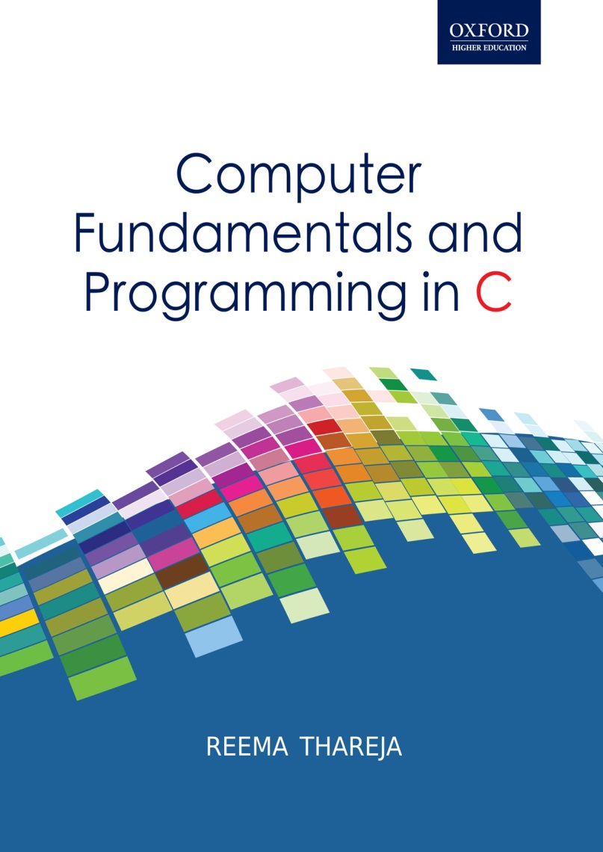
Computer Fundamentals and Programming in C
Reema Thareja, Assistant Professor, Institute of Information Technology and Management

Slide 2
CHAPTER 5
COMPUTER SOFTWARE

Slide 3
INTRODUCTION
COMPUTER SYSTEM
COMPUTER HARDWARE
COMPUTER SOFTWARE
SYSTEM SOFTWARE
APPLICATION SOFTWARE
The computer hardware cannot think and make decisions on its own. So, it cannot be used to analyze a given set of data and find a solution on its own. The hardware needs a software (a set of programs) to instruct what has to be done. A program is a set of instructions that is arranged in a sequence to guide a computer to find a solution for the given problem. The process of writing a program is called programming.
Computer software is written by computer programmers using a programming language.

Slide 4
Examples of computer software include:
Computer Games
Driver Software
Educational software
Media Players and Media Development Software
Productivity Software such as word processors, database management utilities, and presentation software, Operating Systems software , etc.

Slide 5
System Software | Application Software
It is a collection of programs that enable the users to interact with hardware components efficiently | It is a collection of programs written for a specific application. Like, we have library system, inventory control system, etc
It controls and manages the hardware | It uses the services provided by the system software to interact with hardware components
System software is machine dependant | It is machine independent
The programmer must understand the architecture of the machine and hardware details to write a system software | The programmer ignores the architecture of the machine and hardware details to write an application software
Interacts with the hardware directly | Interacts with the hardware indirectly through system calls provided by system software
Writing a system software is a complicated task | Writing application programs is relatively very easy
Example: compiler, operating system | Example: MS-WORD, PAINT
USER 1
USER 2
USER N
Application programs
For example, games, spreadsheets, word processor, database, web browsers
System Software
For example, Operating System
Computer Hardware
For example, printer, mouse, scanner, keyboard, CPU, disk

Slide 6
BASIC INPUT OUTPUT SYSTEM (BIOS)
BIOS provides basic functionality to operate and control the hardware connected to or built into the computer.
It is a de-facto standard defining a firmware interface. The BIOS is built into the computer and is the first code run by the computer when it is switched on. The key role of the BIOS is to load and start the operating system.
When the computer starts, the first function that BIOS performs is to initialize and identify system devices such as the video display card, keyboard and mouse, hard disk, CD/DVD drive and other hardware. The code in the BIOS chip runs a series of tests called POST (Power On Self Test) to ensure that the system devices are working correctly.
The BIOS then locates software held on a peripheral device such as a hard disk or a CD, and loads and executes that software, giving it control of the computer. This process is known as booting.
BIOS is stored on a ROM chip built into the system.

Slide 7
Operating System: The primary goal of an operating system is to make the computer system convenient and efficient to use.
An operating system ensures that the system resources (such as CPU, memory, I/O devices, etc) are utilized efficiently. For example, there may be many service requests on a web server and each user request need to be serviced. Similarly, there may be many programs residing in the main memory. Therefore, the system needs to determine which programs are active and which need to wait for some I/O operation.
Utility Software: It is used to analyze, configure, optimize, and maintain the computer system. Some of them are listed below.
Disk defragmenters; Disk checkers; Disk cleaners; Disk space analyzers; Disk partitions; Backup utilities; Disk compression; File managers; System profilers; Anti-virus utilities; Cryptographic utilities;
Launcher applications ; Registry cleaners ; Network utilities;
Command line interface (CLI); and Graphical user interface (GUI)

Slide 8
A compiler is a special type of program that transforms source code written in a programming language into machine language comprising of just two digits- 1s and 0s. The resultant code in 1s and 0s is known as the object code.
Interpreter: Like the compiler, the interpreter also converts machine level language instructions into machine level language. However, it translates the instructions into an intermediate form, which it then executes. Usually, a compiled program executes faster than an interpreted program.

Slide 9
Linker: Also called link editor and binder, a linker is a program that combines object modules to form an executable program. Generally, in case of a large program, the programmers prefer to break a code into smaller modules. Eventually, when the source code of all the modules has been converted into object code, all the modules must be put together. This is the job of the linker. The compiler automatically invokes the linker as the last step in compiling a program.
Loader: A loader is a special type of program that copies programs from a storage device to main memory, where they can be executed. Most loaders are transparent to the users.

Slide 10
Application software is a type of computer software that employs the capabilities of a computer directly to perform a user-defined task. Examples of software applications are word processors, spreadsheets, media players, education software, CAD, CAM, data communication software, statistical and operational research software, etc.
Productivity Software is any software that is used to attain something productive, especially in the office or home, as opposed to game software or entertainment software.
Word processing program, spreadsheet application or graphic design software, are actually the tools people use to create and produce documents, presentations, databases, charts, graphs, calendars, labels, to-do lists, etc.

Slide 11
Graphics software or image editing software is a program that allows users to create and edit digital images and illustrations. Examples of such software’s include Adobe Photoshop Illustrator, Paint Shop Pro, MS Paint, etc. Some of the graphics applications are given below:
Paint, Presentation, Animation, CAD and Desktop Publishing programs
Multimedia Software is a comprehensive term which means different types of media like text, audio, still images, animation, video, and interactivity.
Multimedia content can be broadly divided into two groups: linear and non-linear. While the linear active content progresses without any navigational control for the viewer, non-linear content, supports user’s interaction to control progress.
Multimedia presentations can be live or recorded.

Slide 12
Multimedia is widely applied in areas such as advertisements, education, entertainment, engineering, medicine, mathematics, business, scientific research and spatial temporal applications.
Edutainment is now emerging as a trend in school as well as higher education. Moreover, visually impaired or people with other kinds of disabilities can pursue their careers by using training programs specially designed for them.

Slide 13
DATABASE MANAGEMENT SOFTWARE
DBMS is a collection of programs which helps the users to store, edit, and extract data from a database.
Today, different types of DBMSs are available in the market such as Microsoft Access, FileMaker, DB2, SQL Server, and Oracle etc.
DBMS is used in computerized library systems, automated teller machines, flight reservation systems, computerized parts inventory systems, etc.
Information from a database is extracted in the form of a query, which is a stylized question. Consider a query written below.
SELECT ALL FROM STUDENTS WHERE MARKS > 90

Slide 14
The information from a database can be presented to the users in a variety of formats. For example, many DBMSs include a report writer program that outputs the data in the form of a report. Many DBMSs also include a graphics component to display the information in the form of graphs and charts.
All in all, DBMS facilitates its users to control data access, enforce data integrity, manage concurrency, and restore the database from backups.

Slide 15
OBJECTIVES OF OPERATING SYSTEM
Manages the computer hardware
Provides a user interface
Process Management
Memory Management
Security Management
TYPES OF OPERATING SYSTEM
TYPES OF OPERATING SYSTEMS
BATCH PROCESSING TASKING
SINGLE USER SINGLE TASKING
SINGLE USER MULTI TASKING
MULTI USER MULTI TASKING
MULTI PROCESSING
REAL TIME
VIRTUAL MACHINE

Slide 16
Windows Operating System
Windows operating system is given by Microsoft. When designing this operating system, Microsoft has taken two separate approaches in which one is suited for home users and the other is intended for the IT professionals. The home edition supports more user’s functionalities and multimedia features but has limited support for security and networking. The professional edition on the other hand is well suited for server environment, has limited multimedia features but offer enhanced networking capability and security.

Slide 17
UNIX
UNIX is a stable, multi-user, multi-tasking operating system for servers, desktops and laptop computers. It also supports GUI and is made up of three parts.
The kernel: The kernel of UNIX is the hub of the operating system as it allocates CPU time and memory to programs and handles the communications when a system call is invoked.
The shell: The shell acts as an interface between the user and the kernel.
Files and processes: Everything in UNIX is either considered to be a file or a process.

Slide 18
LINUX
Linux is a very powerful, free open-source operating system based on Unix. It was originally created by Linus Torvalds with the assistance of developers from around the globe. Users can freely download Linux from the Internet and also make changes in it. This operating system is gradually becoming popular throughout the world.
Advantages of Linux include:
Low cost
Stable
Better Performance
Networking
Flexible
Compatible
Fast and easy to install
Better use of hard disk
Multitasking
Security

