Slide 1
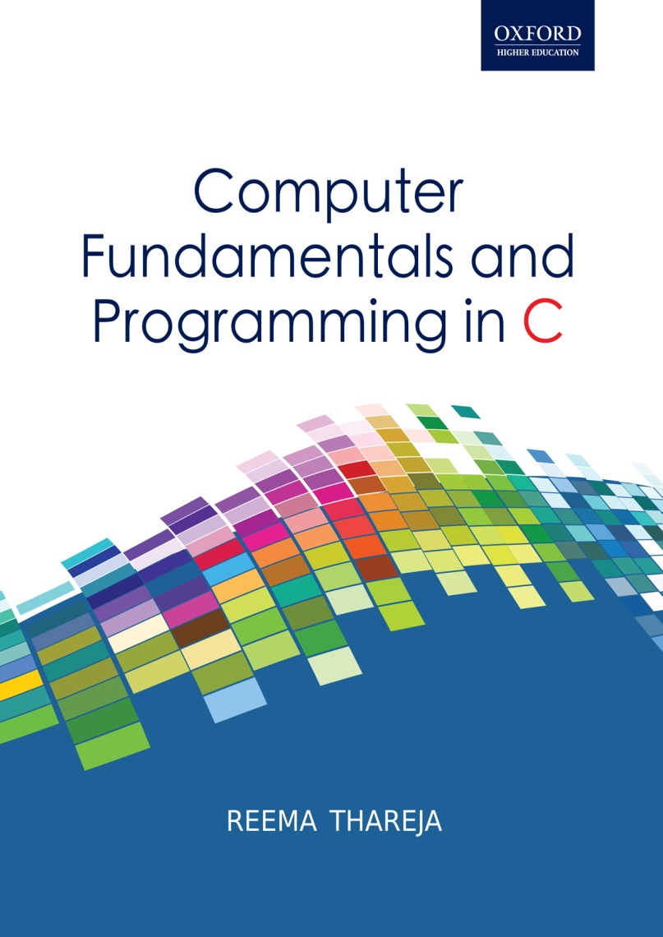
Computer Fundamentals and Programming in C
Reema Thareja, Assistant Professor, Institute of Information Technology and Management

Slide 2
CHAPTER 2
INPUT AND OUTPUT DEVICES

Slide 3
INPUT DEVICES
An input device is used to feed data and instructions into the computer. In the absence of an input device, a computer would have only been a display device.
INPUT DEVICES
Keyboard
Pointing Devices
Hand Held Devices
Optical Devices
Audio/Visual Devices
Mouse
Track Ball
Track Pad
Pen
Touch Screen
Joystick
Bar code readers
Scanners
OCR
OMR
MICR

Slide 4
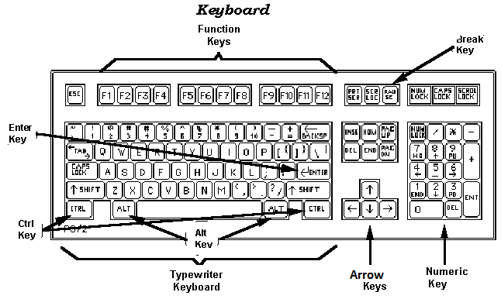
KEYBOARD
With a keyboard , the user can type a document, use keystroke shortcuts, access menus, play games and perform numerous other tasks. Most keyboards have between 80 and 110 keys which include:
Typing keys
Numeric keys
Function keys
Advantages: Easy to use and cheap
Disadvantages:
Keyboard cannot be used to draw figures
The process of moving the cursor to some other position is very slow. Mouse and other pointing devices are more apt for this purpose

Slide 5
MOUSE
The mouse is the key input device to be used in a graphical user interface (GUI). The users can use mouse to handle the pointer easily on the screen to perform various functions like opening a program or file.
With mouse, the users no longer need to memorize commands, which was earlier a necessity when working with text-based command line environment such as MS-DOS.
Advantages:
Easy to use; Cheap; Can be used to quickly place the cursor
anywhere on the screen; Helps to quickly and easily draw figures;
Point and click capabilities makes it unnecessary to remember certain commands
Disadvantages:
Needs extra desk space to be placed and moved easily
The ball in the mechanical mouse must be cleaned to remove dust from it

Slide 6
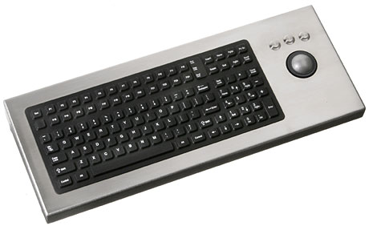
TRACKBALL
A trackball is a pointing device which is used to control the position of the cursor on the screen. These are usually used in notebook and laptop computers where it is placed on the keyboard. The trackball is nothing but an upside-down mouse that rotates in place within a socket. The user rolls the ball to position the cursor at an appropriate position on the screen and then clicks one of the buttons to select objects or position the cursor for text entry.
Advantages:
Trackball provides better resolution; Occupies less space
Easier to use as compared to mouse as its use involves
less hands and arms movements
Disadvantage:
The trackball chamber is often covered with dust, so it must be cleaned regularly

Slide 7
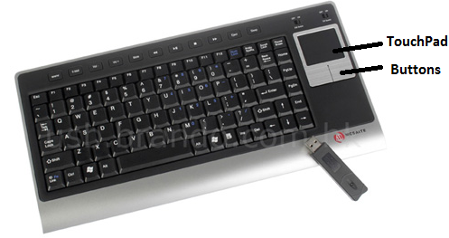
TOUCHPAD
A touchpad (or track pad) is a small, flat, rectangular stationary pointing device with sensitive surface of 1.5 or 2 inches square. The user has to slide his finger tips across the surface of the pad to point to a specific object on the screen.
The surface translates the motion and position of user’s fingers to a relative position on the screen. There are also buttons around the edge of the pad that work like mouse buttons. Touchpad is widely used in laptops and is built-in on the keyboard.
Advantages:
Occupies less space
Easier to use as compared to mouse as its use involves
less hands and arms movements
It is built-in the keyboard, so no need to carry an extra device separately

Slide 8
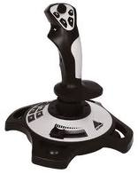
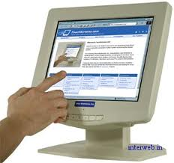
Joystick is a cursor control device widely used in computer games and CAD/CAM applications. It consists of a hand-held lever that pivots on one end and transmits its coordinates to a computer. It has one or more push-buttons, called
switches, whose position can also be read by the computer.
A stylus is a pen-shaped input device used to enter information or write on the touch screen of a phone. Stylus is a small stick that can also be used to draw lines on a surface as input to a computer, choose an option from a menu, move the cursor to another location on the screen, take notes and create short messages. The stylus usually slides into a slot built into the smart phone for that purpose.
A touch screen is a display screen which can identify the occurrence
and position of a touch inside the display region. The user can touch
the screen either by his finger or by using a stylus. These displays
can be connected to computers, laptops, PDAs, cell phones etc.

Slide 9
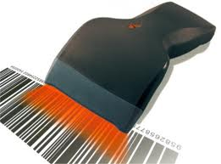
BARCODE READERS
A barcode reader (or price scanner or point-of-sale scanner) is a hand-held input device which is used to capture and read information stored in a barcode. A barcode reader consists of a scanner, a decoder, and a cable used to connect the reader with a computer.
The barcode reader merely captures and translates the barcode into numbers and/or letters. To make use of the information captured it must be connected to a computer for further processing. For this purpose, the barcode reader is connected to a computer through a serial port, keyboard port, or an interface device called a wedge.
Advantages:
Cheap
Portable
Used to read data stored in bar codes
Handy and easy to use

Slide 10
IMAGE SCANNER
It is a device that captures images, printed text, handwriting from different sources and converts it into a digital image for computer editing and display.
Scanners come in hand-held, feed-in, and flatbed types.
In the flat bed scanner, the object to be scanned is placed on a glass pane and a sensor and light moves along the pane, reflecting off the image placed on the glass.
A hand image scanner has to be manually moved across an object or image to be scanned. The scanner produces light from green LEDs which highlight and scan the image onto a computer for further processing.
Film scanners are usually used in photography and slides. The slide or negative film is first inserted in strips of six or less frames into the film scanner, and then moved across a lens and censor to capture the image.

Slide 11
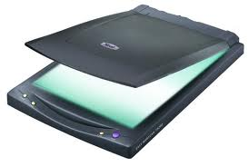
Optical Character Recognition (OCR)
OCR is the process of converting printed materials into text or word processing files that can be easily edited and stored. The steps involved in OCR include:
Scanning of the text character-by-character
Analyzing the scanned-in image to translate the character image into character codes (ex ASCII)
Advantages:
Printed documents can be converted into text files
Advanced OCR can recognize handwritten text and convert them into computer readable text files
Disadvantages:
OCR cannot recognize all types of fonts
Documents that are poorly types or have strikeover cannot be recognized
Very old documents when passed through OCR may not have an exact copy of the text file.
Printed Documents
OCR Technology
Computer readable Text files of size 2-3KB per page
Scans the documents and makes a bitmap of size 50-150KB per page

Slide 12
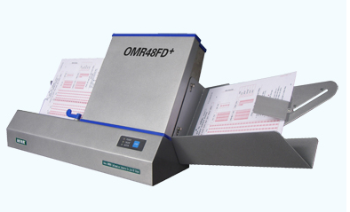
OPTICAL MARK RECOGNITION
OMR is the process of electronically extracting data from marked fields, such as checkboxes and fill-infields, on printed forms. The optical mark reader is fed with an OMR sheet to detect the presence of a mark by measuring reflected light levels. The OM reader interprets this pattern marks and spaces and stores the interpreted data in computer for storage, analysis and reporting.
The error rate for OMR technology is less than 1%.
It is used for applications in which large numbers of hand-filled forms have to be quickly processed with great accuracy, such as surveys, reply cards, questionnaires, ballots or sheets for multiple choice questions.
Advantages:
Optical mark readers works with a very fast speed. They can read
up to 9,000 forms per hour
They are accurate machines with error rates of just 1%

Slide 13
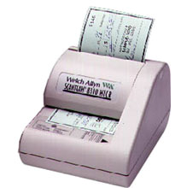
Fourth Generation (1971-1989) Microprocessors
The microprocessor started the fourth generation of computers with thousands of integrated circuits built onto a single silicon chip.
MAGNETIC INK CHARACTER READER (MICR)
MICR is used to verify the legitimacy or originality of paper documents, especially checks.
MICR consists of magnetic ink printed characters which can be recognized by high speed magnetic recognition devices .
The printed characters provides important information (like check number, bank routing number, checking account number and in some cases the amount of the check) for processing to the receiving party.
MICR is widely used to enhance security, speed up the sorting of documents and minimize the exposure to check fraud.

Slide 14
Audio Devices
Audio devices are used to either capture or create sound. They enable computers to accept music, speech or sound affects for recording and/or editing. Microphone and CD player are examples of two widely used audio input devices. Microphone feeds audio input to the computer. The computer must have a sound card to convert analog signals generated through microphone into digital data so that it can be stored in the computer. When the user wants to hear the pre-recorded audio input, the sound card converts the digital data into analog signals and sends it to the speakers.
Advantages:
Audio devices can be used by people who have visual problems; It is best used in situations where users want to avoid i/p through keyboard or mouse
Disadvantages:
Audio input devices are not suitable in noisy places; With audio input devices it is difficult to clearly distinguish between two similar sounding words like “sea” and “see”

Slide 15
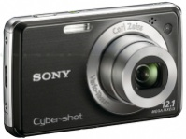
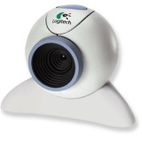
Video Input Devices
Video input devices are used to capture video from the outside world into the computer.
Digital camera is used to capture images or videos. It digitizes the image or video and stores them on a memory card. The data can then be transferred to the computer using a cable which connects computer to the digital camera.
Web cameras also capture videos which can be transferred via internet in real time.
Advantages:
Video input devices are very useful for applications like video conferencing
Video input devices can be used to record memorable moments in one’s life
Video input devices can be used to check security
Disadvantages:
Videos and images captured using video input devices have a very big file size and there must be compressed before being stored on the computer.

Slide 16
CLASSIFICATION OF COMPUTERS
Computers can be broadly classified into four categories based on their speed, amount of data that they can hold and price.
CLASSIFICATION OF COMPUTERS
Computers can be broadly classified into four categories based on their speed, amount of data that they can hold and price.
OUTPUT DEVICES
Any device that outputs/gives information from a computer is called an output device.
Output devices are electromechanical devices which accept digital data from the computer and converts them into human understandable language.
SOFT COPY DEVICES
Soft copy output devices are those output devices which produce an electronic version of an output. For example, a file which is stored on hard disk, CD, pen drive, etc and is displayed on the computer screen (monitor).
Features of a soft copy output include:
The output can be viewed only when the computer is on.
The user can easily edit the soft copy output
Soft copy cannot be used by people who do not have a computer
Searching data in a soft copy is easy and fast.
Electronic distribution of a soft copy is cheaper. It can be done easily and quickly

Slide 17
CATHODE RAY TUBE MONITORS
CRT monitors work by firing charged electrons at a phosphorus film. When electron hit the phosphor coated screen, it glows thereby enabling the user to see the output.
In a cathode ray tube, the "cathode" is a heated filament which is placed in a vacuum created inside a glass "tube." The "ray" is a stream of electrons which comes out from a heated cathode into the vacuum.
The focusing anode focuses the stream of electrons to form a tight beam which is then accelerated by an accelerating anode.
This tight, high-speed beam of electrons flies through the vacuum in the tube and hits the flat screen at the other end of the tube.
This screen is coated with phosphor, which glows when struck by the beam, thereby displaying the picture which the user sees on the monitor.

Slide 18
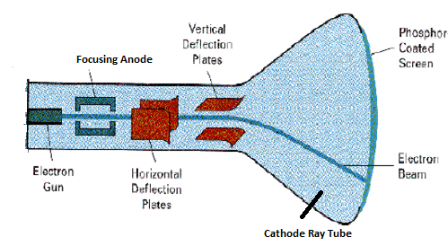
CATHODE RAY TUBE MONITORS
Schematic diagram of a Cathode Ray Tube

Slide 19
LIQUID CRYSTAL DISPLAY MONITORS
LCD monitor is a thin, flat electronic visual display that uses the light modulating properties of liquid crystals which do not emit light directly.
LCD screens are used in a wide range of applications ranging from computer monitors, television, instrument panels, aircraft cockpit displays, signage, to consumer devices like such as video players, gaming devices, clocks, watches, calculators, and telephones.
Liquid crystal display technology is based on blocking light. The LCD consists of two pieces of polarizing filters (or substrates) that contain a liquid crystal material between them. A backlight creates light which is made to pass through the first substrate. Simultaneously, the electrical currents cause the liquid crystal molecules to align to allow varying levels of light to pass through to the second substrate and create the colors and images are seen on the screen.

Slide 20
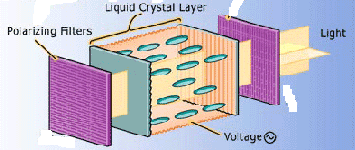
LIQUID CRYSTAL DISPLAY MONITORS
Schematic diagram of a Liquid Crystal Display Monitor

Slide 21
PLASMA MONITORS
Plasma monitors are thin and flat monitors widely used in TVs and computers. The plasma display contains two glass plates that have tiny cells filled with xenon and neon gas.
The display electrode is covered by a magnesium oxide protective layer and is arranged in horizontal rows along the screen while the address electrodes are arranged in vertical columns thereby forming grid like structure.
To ionize the gas in a particular cell, the electrodes that intersect at that cell are charged at least thousands of times in a small fraction of a second
An electric current begins to flow through the gas in the cell. The current creates a rapid flow of charged particles thereby stimulating the gas atoms to release ultraviolet photons.
When these UV photons hit a phosphor atom in the cell, one of the phosphor's electrons jumps to a higher energy level and the atom heats up. When the electron falls back to its normal level, it releases energy in the form of a visible light photon.

Slide 22
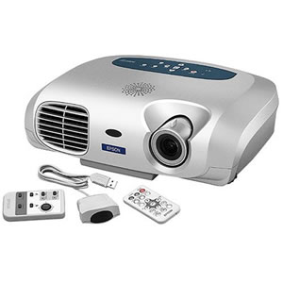
PROJECTOR
A projector is a device which takes an image from a video source and projects it onto a screen or other surface. These days, projectors are used for a wide range of applications varying from home theater e systems to organizations for projecting information and presentations onto screens large enough for rooms filled with people to see.

Slide 23
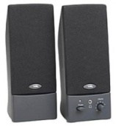
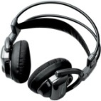

SPEAKERS
Today all business and home users demand sound capabilities and thus different types of speakers to enable users to enjoy music, movie, or a game and the voice will be spread through the entire room. With good quality speakers, the voice will also be audible even to people sitting in another or room or even to neighbors.
However, in case the user wants to enjoy loud music without disturbing the people around him, he can use a headphone.
Another device called headset was developed to allow the users to talk and listen at the same time, using the same device.

Slide 24
HARD COPY OUTPUT DEVICES
Hard copy output devices produces a physical form of output. For example, the content of a file printed on a paper is a form of hard copy output.
PRINTERS
Printer is a device that outputs text and graphics information obtained from the computer and prints it on to a paper. Printers are available in the market in a variety of size, speed, sophistication, and cost. The qualities of printer which are of interest to users include:
Color: Colored printouts are needed for presentations or maps and other pages where color is part of the information. They are more expensive,

Slide 25
PRINTERS contd.
Memory: Most printers have a small amount of memory that can be expanded by the user. Having more memory makes enhances the speed of printing
Resolution: The resolution of a printer means the sharpness of text and images on paper. It is usually expressed in dots per inch (dpi). Even the least inexpensive printer provides sufficient resolution for most purposes at 600 dpi.
Speed: Speed means number of pages that are printed in one minute. While high speed printers are a little expensive, the inexpensive printers on the other hand can print only about 3 to 6 sheets per minute. Color printing is even slower.

Slide 26
PRINTERS contd.
Impact Printer. They create characters by striking an inked ribbon against the paper. Ex., dot-matrix printers, daisywheel printers, and most types of line printer.
Non Impact Printer: Non-impact printers are much quieter than impact printers as their printing heads do not strike the paper. They offer better print quality, faster printing and the ability to create prints that contain sophisticated graphics.
Non-impact printers use either solid or liquid cartridge-based ink which is either sprayed, dripped or electro statically drawn onto the page. The main types of non-impact printer are: inkjet, printer, laser printer and thermal printer.

Slide 27
DOT MATRIX PRINTER
A dot matrix printer prints characters and images of all types as a pattern of dots. It has a print head (or hammer) that consists of pins representing the character or image. The print head runs back and forth, or in an up and down motion, on the page and prints by striking an ink-soaked cloth ribbon against the paper, much like the print mechanism on a typewriter.
Advantages
It can produce carbon copies; offers lowest printing cost per page;
widely used for bulk printing where quality of the print is not of
much importance; is cheap; When the ink is about to finish, the
printout gradually fades rather than suddenly stopping partway through a job
It can use continuous paper rather than individual sheets, making them useful for data logging.
Disadvantages
It creates a lot of noise when the pins strike the ribbon to the paper.
It can only print lower-resolution graphics, with limited quality
It is very slow
Poor print quality

Slide 28
DAISY WHEEL PRINTER
Daisy wheel printers use an impact printing technology to generate high-quality output comparable to typewriters but three times faster.
The print head of a daisy wheel printer is a circular wheel, about 3 inches in diameter with arms or spokes. The characters are embossed at the outer end of the arms.
To print a character, the wheel is rotated in such a way that the character to be printed is positioned just in front of the printer ribbon.

Slide 29
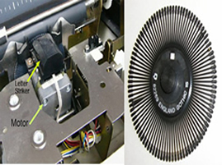
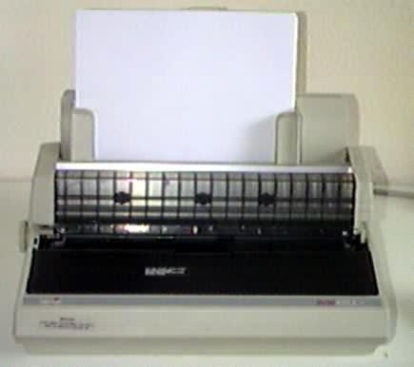
The spoke containing the required character is then hit by a hammer thereby striking the ribbon to leave an impression on the paper placed behind the ribbon. Movement of all these parts is controlled by microprocessor in the printer.
The key benefit of using a daisy wheel printer is that the print quality is high as the exact shape of the character hits the ribbon to leave and impression on paper.

Slide 30
LINE PRINTER
Line printer is a high speed impact printer in which one typed line is printed at a time. The speed of a line printer usually varies from 600 to 1200 lines-per-minute or approximately 10 to 20 pages per minute. They are widely used in datacenters and in industrial environments. Band printer is a commonly used variant of line printers.
Band Printer: A band printer (loop printer) is an impact printer . The set of characters are permanently embossed on the band and this set cannot be changed unless the band is replaced. The band itself revolves around hammers that push the paper against the ribbon, allowing the desired character to be produced on the paper. However, band printers cannot be used for any graphics printing as the characters are predetermined and cannot be changed unless the band is changed.

Slide 31
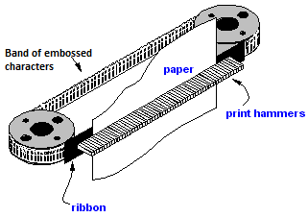
Band Printer
Schematic diagram of a band printer

Slide 32
INKJET PRINTERS
In inkjet printers , the print head has several tiny nozzles, also called jets.
As the paper moves past the print head, the nozzles spray ink onto it, forming the characters and images.
The dots are extremely small (usually between 50 and 60 microns in diameter) and are positioned very precisely, with resolutions of up to 1440x720 dots per inch (dpi).
There is usually one black ink cartridge and one so-called color cartridge containing ink in primary pigments (cyan, magenta, and yellow).

Slide 33
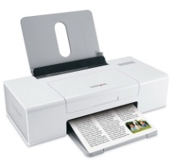
INKJET PRINTERS Contd.
While inkjet printers are cheaper than laser printers, they are more expensive to maintain. The cartridges of inkjet printers have to be changed more frequently and the special coated paper required to produce high-quality output is very expensive. So the cost per page of inkjet printers becomes ten times more expensive than laser printers. Therefore, inkjet printers are not well-suited for high-volume print jobs.

Slide 34
LASER PRINTER
It is a non-impact printer that works at a very high speed and produces high quality text and graphics.
It uses the photocopier technology. When a document is sent to the printer, a laser beam "draws" the document on a drum (which is coated with a photo-conductive material) using electrical charges.
After the drum is charged, it is rolled in toner (a dry powder type of ink).
The toner sticks to the charged image on the drum.
The toner is transferred onto a piece of paper and fused to the paper with heat and pressure.

Slide 35
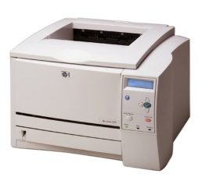
LASER PRINTER Contd.
After the document is printed, the electrical charge is removed from the drum and the excess toner is collected.
While color laser printers are also available in the market but users prefer only monochrome printers because a color laser printer is up to 10 times more expensive than a monochrome laser printer.

Slide 36
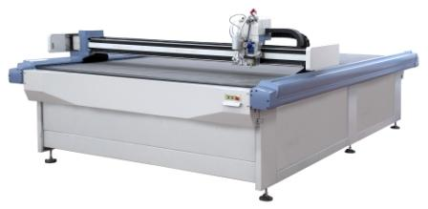
PLOTTERS
A plotter is used to print vector graphics with a high print quality. They are widely used to draw maps, in scientific applications and in applications like CAD, CAM and CAE
A drum plotter is used to draw graphics on a paper that is wrapped around a drum. It works by rotating the drum back and forth to produce vertical motion. The pen which is mounted on a carriage is moved across the width of the paper. Hence, the vertical movement of the paper and the horizontal movement of the pen create the required design under the control of the computer.

Slide 37
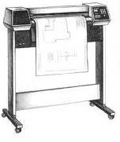
In a flatbed plotter, the paper is spread on the flat rectangular surface of the plotter and the pen is moved over it. Flatbed plotters are less expensive and used in many smaller computing systems. In this type of plotter, the paper is not moved rather plotting is done by moving an arm that moves a pen over paper.

