Slide 1
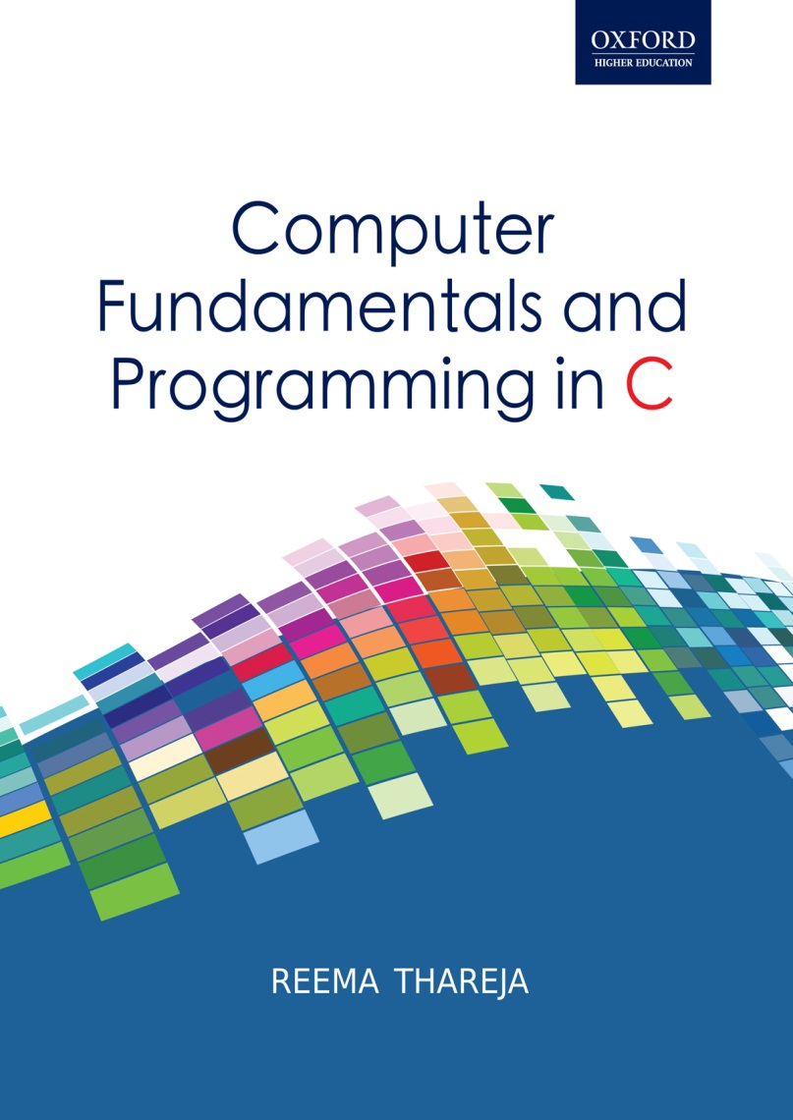
Computer Fundamentals and Programming in C
Reema Thareja, Assistant Professor, Institute of Information Technology and Management

Slide 2
CHAPTER 7
COMPUTER NETWORKS

Slide 3
INTRODUCTION TO COMPUTER NETWORK
A computer network is a collection of computers and devices interconnected to facilitate sharing of resources (printer, CD-ROM), information and electronic documents and among interconnected devices.
Advantages of Computer Networks
File Sharing
Resource Sharing
Increased Storage Capacity
Load Sharing
Facilitate communications

Slide 4
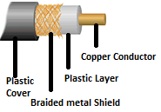
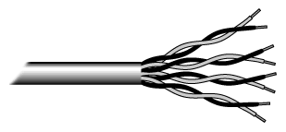
THE CONNECTING MEDIA
The computers on a network can be separated by a few meters or nearly unlimited distances. They are connected to other devices via a variety of media, which includes twisted-pair cable, coaxial cable, optical fiber, and wireless technologies
Twisted pair wire consists of copper wires that are twisted into pairs is the most widely used medium for telecommunication. It reduces crosstalk and electromagnetic induction. The Tx speed of twisted pair cable varies from 2 mbps to 100 mbps. These cables are cheap and easy to install and use. However, they easily pick up noise signals and become prone to error when their length extends beyond 100 meters.
Coaxial cable is used for cable TVs and for connecting computers within short distances. It is highly resistant to signal interference and can support greater cable lengths between network devices than twisted pair cable. Its Tx speed varies from 200 mbps to more than 500 mbps. But it is difficult to install.

Slide 5
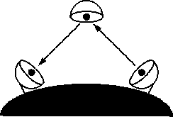
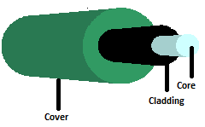

Fiber Optic Cable in which the core is the actual glass, or fiber, conductor which is covered with a refractive coating called cladding that causes the light to travel in a controlled path along the entire length of the glass core. The next layer is a protective covering or an insulating jacket made of Teflon or PVC to protect the core and coating from any kind of damage. It also prevents light from escaping the assembly.
They carry data by light pulses. It transmits light which can travel over extended distances. Fiber-optic cables are not affected by electromagnetic radiation. Tx speed of an optical fiber cable is faster than that of coaxial cables.
Wireless technologies connect computers and other devices to form a network and include terrestrial microwave, communication satellites, cellular systems and infrared systems.

Slide 6
DATA TRANSMISSION MODE
DATA TRANSMISSION MODE
Direction of Data Flow
Number of Bits Transferred Simultaneously
Synchronization between sender and receiver
Simplex
Half Duplex
Duplex
Serial
Parallel
Synchronous
Asynchronous
Direction of Data Flow
Device A
Device B
Data/Signal Transmitter
Data/Signal Receiver
Communication Channel
Direction of Data flow at time T2
Device A
Device B
Data can flow in both the directions simultaneously
Computer A
Computer B
Communication Channel
Computer A converts the parallel data into serial data to transmit it on the communication channel
Computer B accepts serial data from the channel and converts it into parallel data for further processing

Slide 7
Asynchronous Transmission
The sender transmits the data character by character to the receiver at any point of time. It is best suited for connecting I/P devices, printers, modems, fax machines, etc to the computer.
Since the data comes abruptly at any time, the receiving device must recognize a character when it arrives. For this, each character is preceded by a START bit and ends by sending end-of-transmission information (called STOP bit).
Basically, an asynchronous line that is idle is identified with a value ‘1’. The devices connected first checks whether the line is idle or disconnected. If the line is free, sender sends a start bit that has a value ‘0’. Thus, when the line switches from a value of 1 to a value of 0, the receiver is alerted that a character is coming.
Advantages: Simple and cheap to implement
Disadvantage: Overhead is involved in sending control bits (start bit, stop bit, etc) which actually do not carry any information

Slide 8
Synchronous Transmission
The sender and the receiver are synchronized with each other using a clock. Characters or bytes are grouped together to form a data block. Then a header and trailer are added to the data block to form a frame.
The header contains useful information that is needed by the receiving device to synchronize its clock with the sender’s clock. The header is followed by the block of data containing variable number of bits which is again followed by a trailer. The trailer is used to terminate the message and contains an EOF character followed by a check character that helps to detect any transmission error.
Advantages: Lower overhead and higher throughput
Disadvantages:
The sender and receiver must have a buffer area to assemble blocks of data
More complex than asynchronous mode of transmission
The hardware is more expensive
For error free transmission the clocks of the receiving and sending devices must be synchronized

Slide 9
NETWORK TOPOLOGIES
Topology refers to the schematic description of the arrangement of a network. Network topology refers to the actual geometric layout of computers and other devices connected to the network.
BUS TOPOLOGY in which each computer is connected to the single cable. When a node wants to send data, it creates a message and adds the address of the recipient to it. Then, it checks whether the line is free or not. If the line is free it puts the message on the line else wait till it becomes available.
When the message is placed, every node connected to the bus checks the destination address mentioned on it. If the node’s address does not match the intended address, it ignores the message otherwise it picks it and sends an acknowledgement to the sending device before it frees the line.
Advantages: Easy to install and connect a new device to the network
Requires less cable length than a star topology., thus inexpensive
Failure of a single node does not affect the network
Disadvantages: Failure in the cable results in shut down of the entire network
As the number of nodes increases, the speed of the network slows down

Slide 10
STAR TOPOLOGY
It is considered the easiest topology to design and implement. In this topology, each node is connected to a central hub with a point-to-point connection. All traffic that traverses the network passes through the central hub. So, the host node that controls communication between other nodes.
The hub also regenerates the message (because signals become weak due to noise) and then send it to the destination node.
Advantages: Easy to install
New nodes can be connected easily
the network does not get disturbed when any device is added or removed from it
Easy to detect faults
Failure of any other node (except the hub) does not affect the network
Disadvantages:
Requires more cable length than bus topology.
If the central hub fails, the entire network is shut down
More expensive bus topologies because of the cost of the hubs, cables etc.

Slide 11
RING TOPOLOGY
All the nodes are connected to each other in the shape of a closed loop, so that every node is connected directly to two other nodes, one on either side. The messages travel through the ring in a circular fashion. A failure in any cable or device breaks the loop and can cause the network to shut down.
A node receives message from any of its two adjacent nodes. Then it checks the destination address. If the message is addressed to it, it accepts it otherwise just regenerates the signals and passes it to the next node in sequence.
Advantages: Best suited for networks that does not have a hub
More reliable , easy to install , can span over larger distances
Every node has equal chance to transmit data
Disadvantages: Delay in communication.
In case of network failure, it is difficult to diagnose the fault
If one node fails, the entire network is shut down because the ring is not complete
Difficult to add or remove nodes from the network

Slide 12
MESH TOPOLOGY
Also known as a completely connected network, every node is connected to every other node using a separate physical link. Mesh topology involve the concept of routes. Unlike other topologies, in a mesh network, a message can take any of the several possible paths from the source to the destination. For example, if a message has to be sent from A to B via C, then if node C fails, then the message can be sent to B via any other node in the network.
Advantages: Failure of a node does not affect the entire network.
Communication is fast as there is a direct link between the nodes
Each connection can have its own data load, so the traffic problem is eliminated.
Mesh network ensures security of data because every message travels along a dedicated link.
It is easy to detect network errors
Disadvantages: It is the most expensive network as for n nodes, n*(n-1)/2 physical links (cables) are required.
It is difficult to install

Slide 13
HYBRID TOPOLOGY
Each of the topologies has their own advantages and disadvantages. So in the real world, a pure start or pure ring or bus is rarely used. Rather a combination of two or more topologies is used.
Hence, hybrid network topology uses a combination of any two or more topologies in such a way that the resulting network does not exhibit one of the standard topologies (e.g., bus, star, ring, etc.). Two very commonly used hybrid network topologies include the star ring network and star bus network.
If an organization has two departments where one department has connected its computers using the bus network and another department is using ring network. Now the networks of the two departments can be connected by a central hub thereby using the star topology.

Slide 14
Local Area Network (LAN) was first invented for communication between two computers but later was used to connect computers and devices in a limited geographical area such as home, school, computer laboratory, office building, or closely positioned group of buildings. Owing to limited scope and cost of operation, LANS are typically owned, controlled, and managed by a single person or organization.
These days, most of the wired LANS are based on Ethernet technology. However, they can also be created using wires like coaxial cables, phone lines and power lines. However, a LAN can be one of two types: wired or wireless.

Slide 15
Wireless Area Networks (WAN) spans a large geographic area such as a city, country, or even intercontinental distances, using a communications channel that combines many types of media such as telephone lines, cables, and air waves. WAN can be created by linking LANs together.
When individual networks connect together to form a larger network (or a bigger WAN), the resulting network is called an internetwork, which is generically abbreviated to ‘an internet’. Moreover, when all WANs all over the world connect to form a global internet, it is called The Internet.

Slide 16
METROPOLITAN AREA NETWORK (MAN) The size of the n/w varies in between LAN and WAN. A MAN covers an area of 5 – 50 kms.
A MAN (like a WAN) is usually not owned by a single individual or an organization. It is owned by either a consortium of users or by a network service provider who sells the service to the users.
A MAN is a high speed network that allows sharing of regional resources. Though MAN is not a very widely used area network but it has its own importance for some government bodies and organizations on larger scale.
Campus Area Networks (CANs) is a computer network created by interconnecting LANs within a limited geographical area. The network is almost entirely owned by the campus of an enterprise, university, government, military bases, etc. The size of the area that CANs covers is larger than LAN and smaller than MAN or WAN.
These days, CANs are mostly formed using the wireless communication mediums rather than cabling and wirings. CANs are economical, beneficial and easy to implement in the specific kilometers of locality.

Slide 17
PERSONAL AREA NETWORK (PAN) is a computer network designed for communication between computer devices like mobile computers, cell phones and PDAs that are close to one person. The scope or the reach of a PAN is a few meters (less than 10 meters).
PANs are used to communicate with the personal devices themselves or for connecting to a higher level network and the Internet. PANs can either be wired with computer buses such as USB and FireWire or be wireless with network technologies such as Infra red and Bluetooth. Bluetooth PANs are also called piconets.

Slide 18
PANs can be used to transfer files including email and calendar appointments, digital photos and music. These days PANs are also used to enable wearable computer devices using the electrical conductivity of the human body as a data network. For ex, two people can wear business card-size transmitters and receivers to exchange information by shaking hands. Human body is a good conductor of electricity. When two people shake hands, an electric field passes tiny currents and the electric circuit becomes complete thereby enabling each person's data, such as e-mail addresses and phone numbers to be transferred.

Slide 19
A hub is a device to which different devices are connected so that they can communicate with each other. Every computer on the network is directly connected with the hub. When data packets arrive at hub, it broadcast them to all the devices connected to it. So every device picks the message but only the destined device processes the packet and all other computers just discard them.
Repeaters are devices that regenerate incoming electrical, wireless or optical signals. Without a repeater the data can only span a limited distance before the quality of the signal degrades. Repeaters attempt to preserve signal integrity by removing unwanted noise from the incoming signal, restoring the weak/distorted signal thereby extending the distance over which data can safely travel.

Slide 20
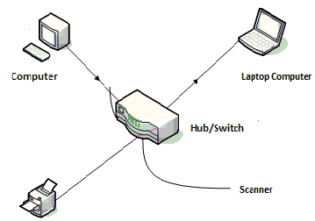
A repeater connects two segments of the network cable. It regenerates the signals which cause a propagation delay which can affect network communication especially when there are several repeaters in a row. To avoid such a long delay, many network architectures limit the number of repeaters that can be used in a row

Slide 21
Switch: A device which is used in all the places where a hub is used. It is better than the hub because a switch has a switching table with in it which stores the address of every device connected to it and sends the data only to the destined device rather than broadcasting the data to all the devices connected to it. Therefore, the switch is considered to be an intelligent device as it selects the devices among many devices connected to it to forward the data.
Bridges: A bridge is a device that connects two or more LANs. When a bridge receives data from one LAN to forward it to another LAN, it first regenerates the signals and then forward the data to the other LAN. A bridge reads the address of the receiving device specified on the data packet, to identify the destination of the packet. It then forwards the packet only to the network to which the receiving device is connected thereby reducing the traffic on other network segments. Bridges can be programmed to reject packets from particular networks. However, bridges do not normally allow connection of networks with different architectures.

Slide 22
Router is an intelligent device which routes data to destination computers. It is basically used to connect two logically and physically different networks, two LANs, two WANs and a LAN with WAN. Cisco routers are the most widely used all over the world.
They use a special software known as routing table that stores the addresses of devices connected to the network. The major task of the router is to route the data packets between two networks on the best possible path for fast data transmission. For this, it reads the information in each packet to know where the packet has to be sent. If the packet is destined for an immediate network it has access to, it will forward the packet to the appropriate network so that it can reach the destination device. However, if the packet is destined for another network, the router will forward the packet to another router.

Slide 23
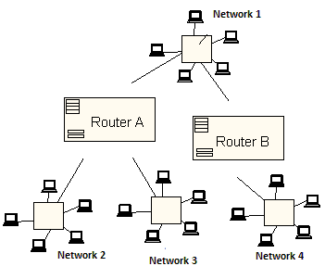
Routers can connect networks with different architectures. Even wireless routers that are being widely used work in similar fashion as that of wired routers with an exception that they do not have any wires.

Slide 24
GATEWAY is the most complicated networking device which is basically used to connect two or more dissimilar networks that uses an entirely different protocol. The gateway also acts as a translator between two dissimilar networks. It accepts data formatted by one network and converts it into a format which can be accepted by the other network. A gateway can either be implemented in software or hardware. The other key role that the gateway performs is to provide security to the network. They can be used to monitor incoming/outgoing traffic to check for any malicious activity within the network which can be harmful to network integrity.
NIC Card: Network services can be used through a NIC or network adapter or LAN card. No computer can communicate with other devices without a properly installed and configured LAN card. The communication cables that connect devices are connected via this card.
Every LAN follows a set of protocols (like Ethernet, Token Ring) So, when forming a LAN, all NICs in the network must support the same protocol. NICs are available in two varieties- wired or wireless.

Slide 25
INTERNET: A global network that connects billions of computers all over of the world. It is a network of networks. The internet links different organizations, academic institutions, government offices and home users
Internet lacks a central authority that controls it. Although there are different governing boards that work to establish policies and standards, the Internet is bound by few rules and answers to no single organization.
History
The roots of Internet can be traced in the year 1969 when the Advanced Research Projects Agency (ARPA) of the U.S. government formed the very first network that was widely known as the ARPANET. This network was initially created to interconnect computers so that the users in the research organizations and universities could communicate with each other and share information.
However, it was in 1989 that the U.S. government had lifted restrictions on the use of Internet and allowed it to be used for commercial purposes as well. Since then, the Internet has grown rapidly to become the world’s largest network across the world.

Slide 26
Electronic mail means the transmission of messages over communications networks. These messages may vary from notes entered from the keyboard to electronic files stored on disk. Companies that are fully computerized make extensive use of e-mail because it is fast, flexible, and reliable.
Email is one of the most widely used services on the internet. Anyone that has an e-mail account can send an electronic mail to any other person who also has an e-mail account. Usually the structure of the email can be given as: username@domain name
File Transfer Protocol (FTP) is one of the oldest applications of the Internet which is basically used for transferring files from one computer to another like from a user’s personal computer to a web server. FTP is the preferred method of exchanging files because it is faster and reliable. FTP is usually used to:
Enable the users to share files, computer programs and/or data
Enhance the use of remote computers,
Provide authentication and security to the stored files and programs
Transfer data reliably and efficiently.

Slide 27
Internet chatting allows two or more online users to talk using an instant messenger. It helps users to stay connected with concerned people in business or family who live miles apart.
Chatting involves the exchange of messages between users who take part from anywhere on the Internet. These days, even the business organizations use chatting to host online business meetings, or to answer any queries of customers or provide them online support.
Internet Conferencing is being used to arrange virtual meetings to reduce the extra costs involved in travelling and making telephone calls thereby resulting in better time management and enhanced productivity.
Many internet conferencing s/w allow 25 online participants participating in the web meeting. For internet conferencing the users need a computer with internet connection, related software, a webcam and a microphone). During the conference, users can share information, files, video.

Slide 28
Electronic Newspaper is a newspaper on the Internet, which is either published separately or as an online version of a printed periodical.
Users can read news in a timely manner. The credibility and strong brand recognition of well-established newspapers plus the savings in overhead costs has led to the movement away from the printing process.
Online newspapers are almost similar to the hard-copy newspapers and have the same legal boundaries, such as laws regarding privacy and copyright issues.
Online shopping means buying goods/services from merchants who sell on the Internet. Shoppers can now visit web stores 24X7. These days, the number of people who want to shop online is increasing day by day.
With online shopping, a shopper logs onto the Internet, visits the store's website, and selects the products. Once all the products have been selected, the user can click the option to calculate the invoice and pay for the purchase using their debit/credit card.
But with online shopping, shoppers cannot touch products or have any social interaction. People fear that their credit card information will be compromised or the products they purchase are not accurately portrayed

Slide 29
World Wide Web (www) include all the resources and users on the Internet that are using the Hypertext Transfer Protocol (HTTP). On the World Wide Web, all the documents are formatted in a special markup language called HTML (HyperText Markup Language) that supports links to other documents, graphics, audio, and/or video files.
www was created in 1989 by Tim Berners-Lee. The Web in easy terms is the user part of the Internet. Users make use of the Web to communicate and access information for business and recreational purposes. There are several applications called Web browsers that make it easy to access it.
Some popular Web browsers are Mozilla Firefox, Opera, Google Chrome, Netscape Navigator and Microsoft's Internet Explorer.
Internet and the World Wide Web is not the same. Rather the Internet and the Web work together. While the Internet provides the underlying structure, the Web on the other hand, utilizes that structure to offer content, documents, multimedia, etc. For example, Internet is like the highway, and the World Wide Web is like a truck that uses that highway to get from place to place.

