Slide 1
ERD for Daikin Industries - Industry Visit Project
Project: Industry Visit at Daikin Industries
Objective: Create an Entity Relationship Diagram (ERD) for Daikin Industries
Focus: Modeling key business processes and data flow

Slide 2
Problem Statement
During the industry visit to Daikin Industries, the goal was to understand the company's operations and data management practices. The challenge was to design an ERD that accurately reflects the company's data flow, including order processing, inventory management, customer interactions, and supplier coordination. The ERD helps in identifying data relationships and streamlining operational efficiency.

Slide 3
Data and Analysis
The ERD includes the following entities:
- Orders, Customers, Payments, and Shipments
- Products, Inventory, and Warehouses
- Suppliers and Supplier Orders
- Employees, Departments, and Service Technicians
- Service Requests and Manufacturing Plants
Relationships include many-to-one, one-to-one, and many-to-many connections to model real-world business interactions.

Slide 4
Observations
1. Comprehensive coverage of data relationships ensures efficient data flow.
2. Proper normalization of entities reduces data redundancy.
3. Clear linkages between orders, products, and inventory enhance order processing.
4. Incorporation of payment and shipment details ensures end-to-end tracking.
5. Employee and technician data management is well-organized for service handling.

Slide 5
Insights and Recommendations
1. Implementing the ERD can enhance operational efficiency by minimizing data inconsistencies.
2. Automating the data entry and validation process can further reduce manual errors.
3. Establishing data integrity constraints will ensure the accuracy of critical data points.
4. Regular audits and data validation can help maintain data accuracy and consistency over time.

Slide 6
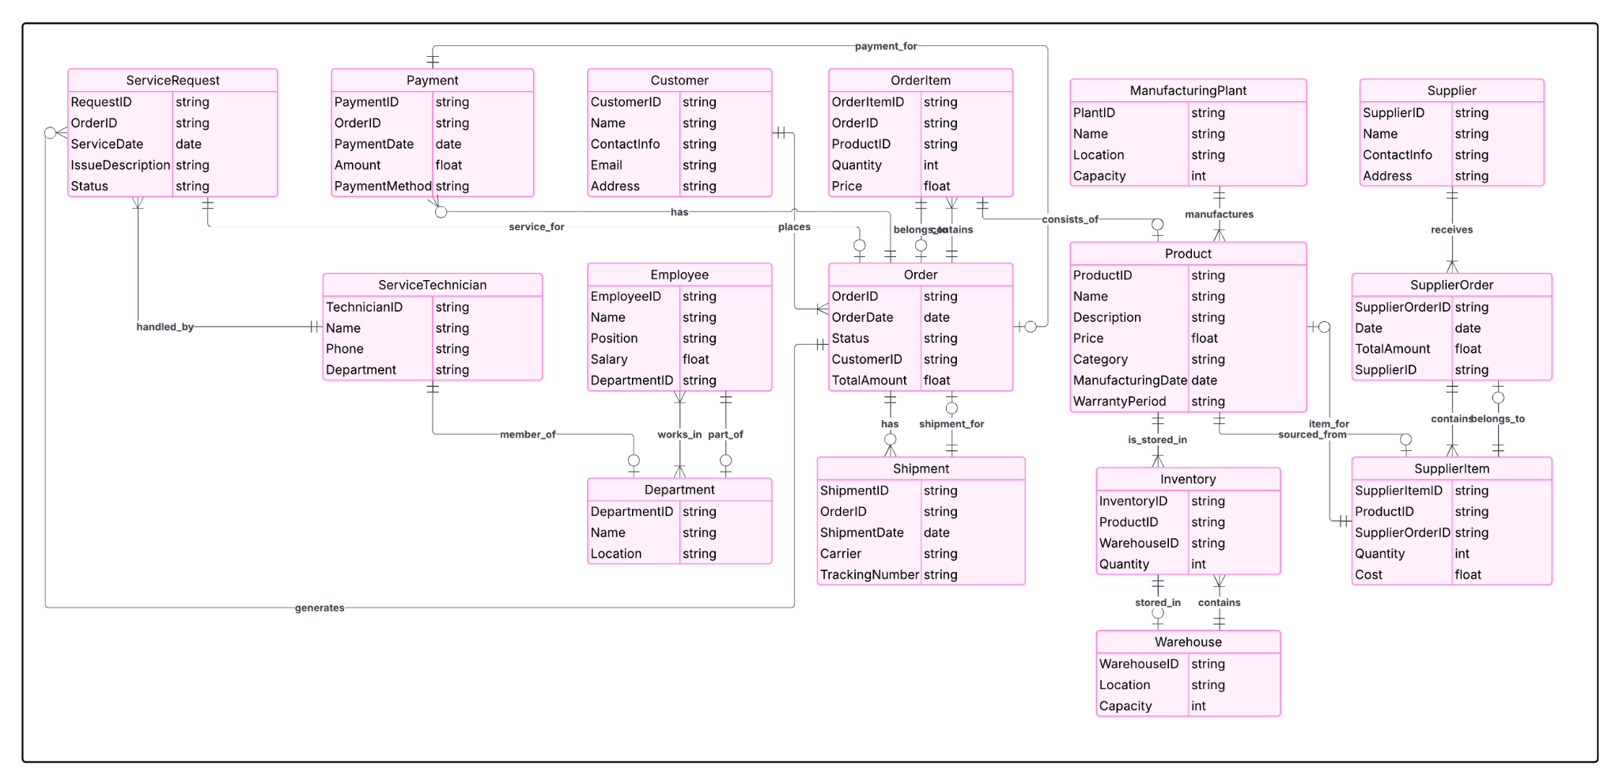
ERD Diagram

