Slide 1






l
Nebula Space Organisation
CAB CASE STUDY
- By Divyaranjan Sahoo (21053386)

Slide 2
Highlighted Topics of the Presentation
It’s not a bug; it’s an undocumented feature. ― Anonymous
1
2
3
4
5
Introduction
Approach
Trends and studies
Exploratory Data Analysis
Conclusionary Note
Introduction to the problem statement and business requirements for this case study
A short note on the approach to study and analyse the data set using python and it’s modules like pandas, matplotlib,etc.
Understanding the data trends and identifying decision points to conclude the result.
Investigating considering hypothesis, engaging with the data, thinking critically, and using various analytical approaches to produce unique insights.
Concluding the results , analytics of the dataset, insights of the case study and presenting the final decision

Slide 3

INTRODUCTION
Problem Description
XYZ, a private equity firm based in the United States, is strategically considering an investment in the rapidly expanding Cab Industry.
Given the significant growth witnessed in recent years and the presence of numerous key players in the market, XYZ is poised to explore opportunities within the cab sector for potential investment.
The Engagement
We have received several datasets containing information on two cab companies. Each dataset represents distinct facets of customer profiles.
Our objective is to derive actionable insights that will aid us in identifying the most suitable company for investment.

Slide 4

Assessing the datasets
Below are the list of datasets which are provided for the analysis with their properties and attributes
Cab_Data.csv
Transaction_ID.csv
Transaction ID
Date of Trave
Company
City
KM Travelled
Price Charged
Cost of Trip
Transaction details for two cab companies.
Properties -
359393 Rows 7 Columns
Maps transactions to customers .
Properties -
440099 rows 3 columns
Transaction ID
Customer ID
Payment_Mode
Customer_ID.csv
City.csv
Customer ID
Gender
Age
Income (USD/m)
Mapping table with a unique identifier linking customer demographic details.
Properties -
49172 Rows 4 Columns
Lists US cities, their population and number of cab users
Properties -
21 Rows 3 Columns
City
Population
Users

Slide 5

Analysis Approach
Descriptive Statistics
The Developement Perspecive
Data is summarized to understand key characteristics like average fare, distance traveled, payment modes, and company-wise distributions.
To effectively analyze the relationship between cab company and customer preferences,analysis methods are deployed.
This combination of techniques, coupled with the use of data visualization libraries like Matplotlib and data manipulation tools like Pandas and statistical libraries like SciPy...
Provides a comprehensive understanding of the relationship, allowing you to identify key trends, test hypotheses, and extract actionable insights.
Exploratory Analysis:
Explores and identifies relationships between variables correlation coefficients and statistical test at different time periods to know seasonal info.
Hypothesis Testing:
Forming and testing hypotheses using appropriate statistical tests
to determine the strength of evidence and Quantify the significance of the results
DIV

Slide 6

TRENDS
Studying the trends
Delving into the trends of cab company preferences reveals a fascinating interplay of factors that influence customer choices.

Slide 7
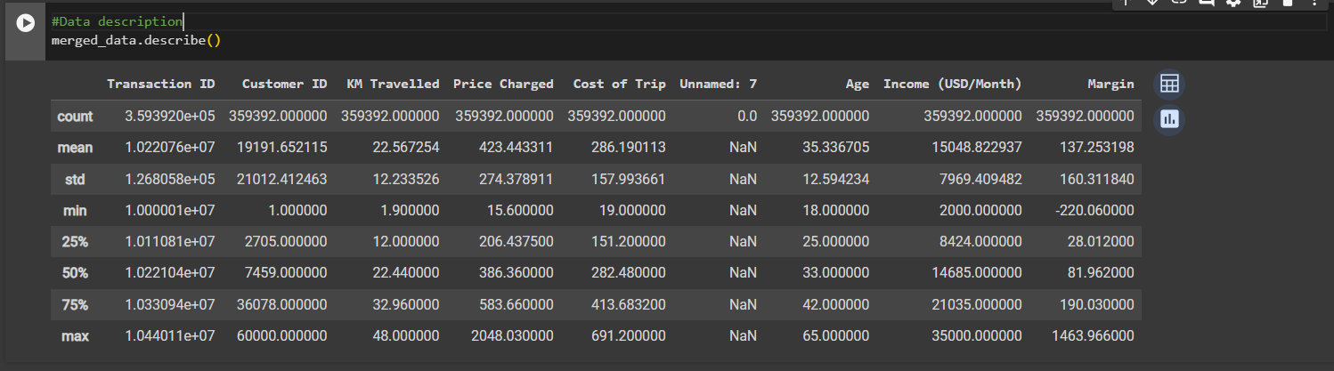
Data Description
Data description is the process of summarizing and organizing data to provide a clear and concise understanding of its key characteristics. It involves generating descriptive statistics, creating data visualizations, and identifying trends and patterns.

Slide 8
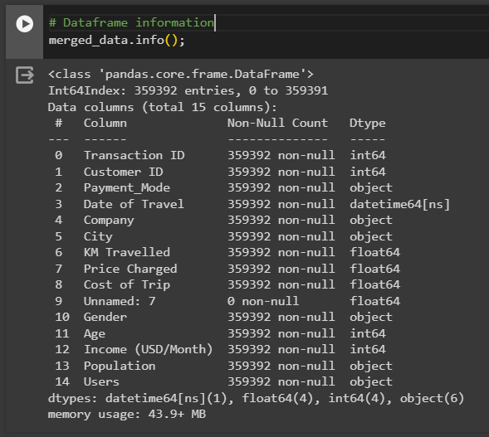
Data Info
The info() method in Pandas is a descriptive tool that provides a quick overview of a DataFrame's structure and contents. It summarizes key information about the DataFrame, including missing values, descriptive statistics:, data types, etc.

Slide 9

Trend Analysis Approach
Data Exploration
Helps understand the underlying patterns and relationships within data.
Data Imputation
Data Collection
The missing values in a dataset is filled using various techniques such as mean, median, mode.
Data Analysis
Data is loaded into Google Colaboratory, panda is used with read_csv command.
Helps gain valuable insights into customer preferences and assist in decision making.

Slide 10

HYPOTHESIS TESTING
Investigation
Hypothesis testing is a statistical method used to make inferences about a population based on sample data. Here I have done hypothesis testing by:
Formulating
a hypothesis
Connecting
it to data analysis
Emphasizing
the value of insights

Slide 11
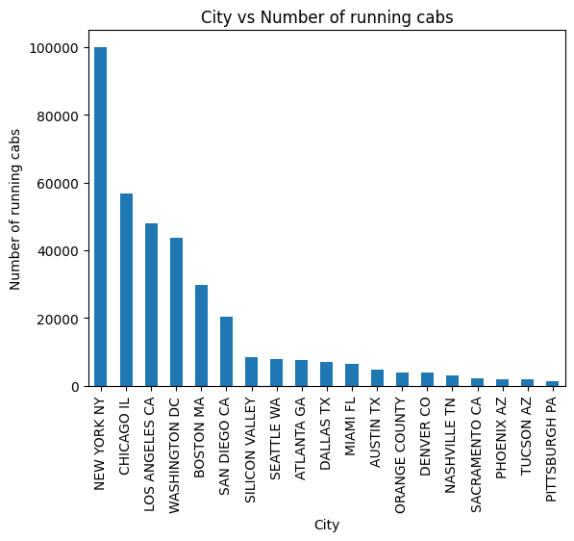
Presumed Assumptions
Here, we'll procceed with our investigation on certain assumptions and
get analysis results to encourage/foster our decision to invest.
Hypotesis 1
H0 ~ Los angeles is the city with maximum number of running cabs
Inference
The analysis results and plot shows New york is the city is the one with maximum number of running cabs.
Hypothesis failed to be true.

Slide 12
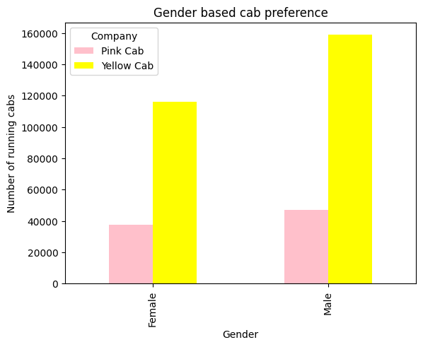
Hypotesis 1
H0 ~There's no gender based preferences for chosing cab
Inference
The analysis output shows that male are more consumers of cab in US than female.
Hypothesis failed to be true.
Nevertheless yellow cab are more prefered by consumer of each segment.

Slide 13
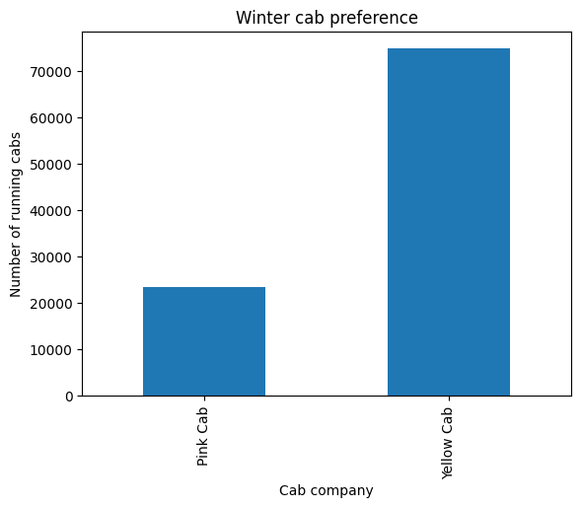
Hypotesis 3
H0 ~ People prefer yellow cabs more in winter (November (11) to January (1))
i.e showing seasonal dependency.
Inference
The analysis results and plot shows that yellow cab is more prefered in winter than pink.
Same also verifies in non winter seasons.
Hypothesis true.

Slide 14
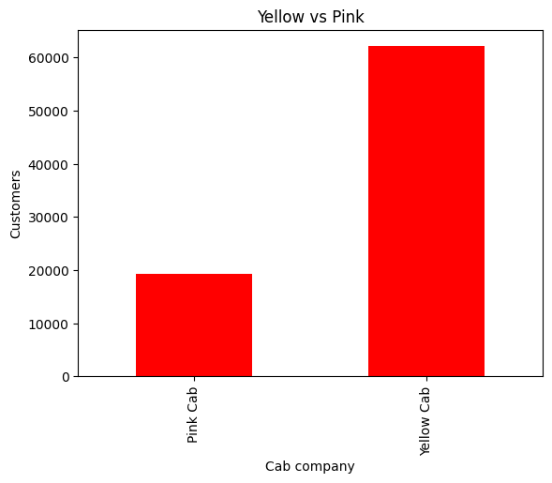
Yellow vs Pink Cab Company
The data from 2018 to 2020 gave the statistics about the yellow cab vs pink cab company as follows
84711
274681
Pink Cab
2012
Yellow Cab
Yellow cab company seems to have more customers than pink cab company, and hence this analytics inclines towards yellow cab.

Slide 15



Insights of the investigation
Lets throw lights on the insights extracted through the case study
In a nutshell
A thorough analysis of the data reveals Yellow Cab's dominance in terms of both ride count and user preference across a significant portion of the cities considered.
1
Yellow cab has higher customer preference in most
cities while Pink cab has higher customer preference in few.
2
Age wise Reach: Most of the users are 20 to 30 years in age.Amongst them, most prefer yellow rides.
3
Yellow cab has maximum bookings in new york city (85918) and minimum in Pittsburg (631/)
The above facts and statistics are evident that yellow cabs are better investments than pink cabs.
XYZ should invest into yellow cab company

Slide 16

CONCLUSIONARY
EPILOGUE
The conclusionary statement can be presented that the report included the insight analytics and cognitive investigation in the field of Cab case study ; modelling a transparent presentation for the lucid concepts and parallely demistyfing the convoluted anectdote associated with the classical approach to the cyberlife concerns.
Furthermore, the final decision can be presented that YELLOW CAB would be the best to invest upon in cab industry.
Epilogue

Slide 17








THANK YOU

