Slide 2
What is PyTorch?
PyTorch is an open source Deep Learning Framework and a scientific computing package.
Scientific computing aspect of PyTorch is because of PyTorch’s Tensor library and the associated Tensor operations.
PyTorch is mainly used for building neural networks and accelerated computations using GPUs(Graphics Processing Unit).
What is a Tensor?
The fundamental unit of PyTorch is the Tensor.
Tensors can be considered as multi-dimensional arrays.
Tensors in PyTorch are similar to NumPy arrays.
Tensors can be used on a GPU that supports CUDA (Compute Unified Device Architecture).

Slide 3
Brief History of PyTorch:
PyTorch was initially released in October 2016.
Before, PyTorch was created, there was a Machine Learning Framework called Torch which is based on Lua programming language.
Soumith Chintala is the creator of PyTorch framework. It was created at FAIR (Facebook AI Research).
Reason for building PyTorch was that the existing Torch framework was fading out and the need for newer version written in Python.
Most of the internals that are performance bottlenecks are written in C++
Source code of PyTorch is written mostly in Python.

Slide 4
Components of PyTorch:
Package | Description
torch | Top-level PyTorch package & tensor library with GPU support
torch.nn | A sub package that contains modules & extensible classes for building neural networks.
torch.autograd | A sub package that supports all the differentiable Tensor operations in PyTorch
torch.nn.functional | A functional interface that contains typical operations used for building neural networks like loss functions, activation functions, and convolution operations.
torch.optim | A sub package that contains standard optimization operations like SGD and Adam.
torch.utils | A sub package that contains utility classes like data sets and data loaders that make data pre-processing easier.
torchvision | A package that provides access to popular datasets, model architectures, and image transformations for computer vision.

Slide 5
PyTorch Philosophy:
Stay out of the way
Cater to the impatient
Promote linear code-flow
Full interop with the Python ecosystem
Be as fast as anything else
Writing in PyTorch is nothing but extending standard Python classes.
To debug PyTorch code, we make use of the normal Python debugger.
Source code is readable as it is written in Python and only changed to C++ and CUDA code if it is related to performance issues.

Slide 6
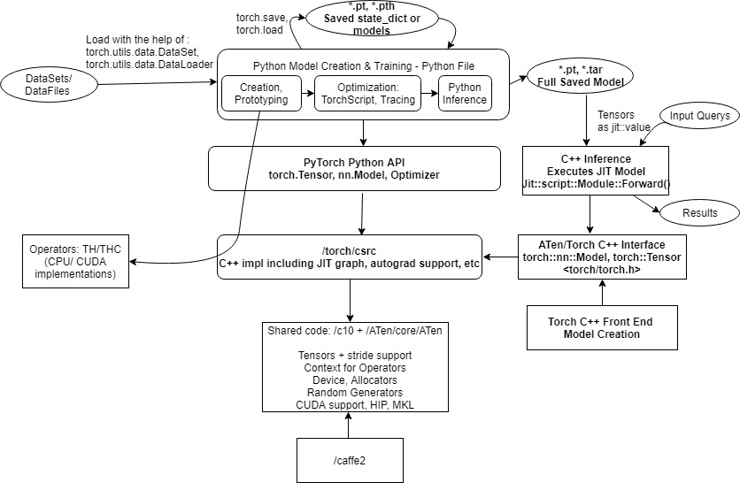
Data Flow & Interface Diagram of PyTorch:

Slide 7
Data Flow & Interface Diagram of PyTorch:
In PyTorch, model development can be done in a single Python file which can be used for prototype building, and later extended with TorchScript tags or traced for optimization.
Inference can be done directly on the trained data or specifically in C++ under “C++ Inference”.
Data Files/ DataSet: Data can come from variety of formats such as .csv or custom data bases. This data can be loaded directly into PyTorch/Caffe or it can be pre-processed before loading to PyTorch.
DataSet Class:
torch.utils.data.Dataset is an abstract class representing a dataset. Our custom dataset can inherit Dataset and override the given below methods :
__len__ so that len(dataset) returns the size of the dataset.
__getitem__ to support the indexing such that dataset[i] can be used to retrieve sample i.
Data is loaded directly into Python and accessed with the help of DataSet abstraction. torch.utils.data.DataLoader can be used to support batching, shuffling and loading the data in parallel using multiprocessing workers.

Slide 8
Data Flow & Interface Diagram of PyTorch:
PyTorch Model Creation & Training File - Main Python file which can be developed by user with help of PyTorch APIs. This file defines the model, loads data and runs the training process. The file can also do inference directly, or export an optimized model through the use of tracing or TorchScript for execution in later stages.
Model Creation / Prototyping - Network is created through torch.nn.Model derived class, defining layers and a forward() function that connects them in the class. The model can then be trained or exported.
Loading / Saving Model State :
1) Internal state of PyTorch model is represented by state_dict and it can be saved to a file with help of torch.save and loaded with model.load_state_dict.
2) Loading models allows them to be used for inference without running training again. Common file extensions are .pt or .pth and internally, Python's pickle format is used for serialization whereas the full models have the extension as .tar

Slide 9
Saving & Loading Models
torch.save: Saves a serialized object to disk. This function uses Python’s pickle utility for serialization. Models, tensors, and dictionaries of all kinds of objects can be saved using this function.
torch.load: Uses pickle’s unpickling facilities to deserialize pickled object files to memory. This function also facilitates the device to load the data into CPUs, GPUs.
torch.nn.Module.load_state_dict: Loads a model’s parameter dictionary using a deserialized state_dict.
Tracing & TorchScript -
An existing model can be converted to a serializable graph with help of tracing, which requires deriving model from torch.jit.ScriptModule and using torch.jit.trace. Alternatively the methods can be labeled with TorchScript, which allows them to include control flow logic.
In either case, the model can be saved to a .tar checkpoint file so as to be later loaded from C++.

Slide 10
Inference:
Inference: Inference refers to using trained model to make predictions on the dataset; it generally involves in fetching input values and getting outputs by running the model. This can be done directly in PyTorch, or in a C++ file in further stages.
Torch C++ Inference - The saved PyTorch model can be loaded and executed from C++. This may offer many performance/memory benefits for inference since we don't have to include or execute Python as Python is slow compared to C++ in terms of faster execution.
Torch C++ Front End Model Creation and Tensors - You can create models directly through C++ Front End, by including torch.h and using its classes such as torch.nn.Module, torch.optim.SGD . The tensor library can be directly used by including <ATen/Aten.h>

Slide 11
PyTorch Internals:

Slide 12
Extending the Python Interpreter:
PyTorch defines a new package torch.
Extension modules such as ._C module (a Python module written in C) allow to define new built-in object types like Tensor and to call C/C++ functions.
The init_C()/PyInit__C() function creates the module and adds the method definitions as appropriate.
These __init() functions add the Tensor object for each type to the ._C module so that they can be used in the module.

Slide 13
The THPTensor Type
A generic Tensor is defined in PyTorch that can take different data types.
Python runtime sees all Python objects as variables of type PyObject *, which serves as a “base type” for all Python objects.
The formula for defining a new type is as follows:
The new object is defined by a struct.
The type of the object is defined.
Type of object is defined as a set of fields that holds its properties.
There is a pre set list of fields that can be view in th object header file in the CPython backend

Slide 14
PyTorch cwarp
In order for the Python backend to utilize the TH Tensor method it requires a cwrap which is implemented by PyTorch
The cwarp generates an array of PyMethodDefs that can be stored or appended to the THPTensor’s tp_methods field in order to interface with the CPython backend.
Steps to executed in the wrapper function:
YAML “declaration” is parsed and processed
Source code is generated:
for instance, defining the method header, the actual call to the underlying library such as TH
The cwrap tool allows for processing the entire file at a time.

Slide 15
PyTorch codebase
The PyTorch codebase has a variety of components:
The core Torch libraries:
TH, THC, THNN, THCUNN
Vendor libraries:
CuDNN, NCCL
Python Extension libraries
Additional third-party libraries:
NumPy, MKL, LAPACK

Slide 16
PyTorch- Build Design
Setuptools and PyTorch’s setup( ) function
The information required to build the project is contained in setup.py file present in Setuptools
NN Wrappers contains the generate_nn_wrappers() function:
It parses the header files which generats cwrap YAML declarations. This is then written to output .cwrap files
Calls cwrap with the appropriate plugins on the output .cwrap files to generate source code.
The header files are parsed a second to generate THNN_generic.h.
THNN_generic.h. finally calls into the appropriate THNN/THCUNN library function based on the dynamic type of the Tensor

Slide 17
PyTorch- Build Design
Building” the Pure Python Modules
Once the dependencies are in place Setuptools runs the build.py file. This builds the Pure Python Modules in the Library.
Building the Extension Modules
The PyTorch Modules in C++ the CPython backend are the Extension Modules.
We take the YAML declarations in TensorMethods.cwrap, and use them to generate output C++ source files that contain implementations that work within PyTorch’s C++ Ecosystem

Slide 18
Neural Networks & OOPs

Slide 19
Neural Networks & OOPs:
By using an object-oriented approach to the design of software systems, we can achieve advantages in terms of flexibility, extensibility, and portability.
We can design object-oriented neural network simulation systems to achieve advantages mentioned above.
Why Object oriented Programming?
For example, consider a backpropagation network which is a specialized learning algorithm for specific application domains. A consequence of this is lack of flexibility.
If a recurrent network architecture is required for an application domain, then the system has to be redesigned to accommodate the changes.
The main motivation for an object-oriented approach to a neural network simulation system is to design reusable components that facilitate a flexible configuration of an application.

Slide 20
Neural Networks & OOPs:
What are objects of a Neural Network?
From a computational point of view, neural network objects consist of matrices, vectors and mathematical operations.
This view concentrates on a functional approach to neural networks, which is not what the object-oriented paradigm encourages.
Object-oriented methodology focuses on modelling concepts in terms of collaborating objects, rather than functions. In a neural network system, concepts can be represented by the objects such as model, neuron, weight, and pattern.
Using object-oriented methodology in the development of the Neural Network system, a unified view of the problem domain can be achieved in all development phases from analysis to maintenance. The requirements for the system are :
a) Abstraction
b) Flexibility
c) Extensibility

Slide 21
Neural Networks & OOPs:
An important requirement of Neural Network system is to provide different levels of abstraction.
The neural network is conceptually separated in general and specific properties.
General properties : Neuron Layers and weights among them
Specific properties : Different learning algorithms. (broadly classified to supervised, unsupervised)
A flexible solution is required to obtain a comprehensible and powerful user interface so that any modification of the network model should be done by changing the existing network definition, not the code itself.
A major achievement of Modular Neural Network design approach is extensibility.
For instance, if a new learning algorithm is added to the system, only learning specific behaviour is needed and the remaining general properties are provided from the Neural Network system enabling a high degree of reuse.

Slide 22
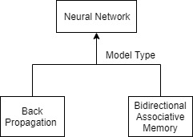
Neural Network & OOPs:
Specific properties are different specializations of a neural network. For instance, the below diagram has two levels of abstractions.
The general properties are partitioned in modules for logical grouping of classes, associations, and generalizations. There are basically four modules in this design: layer, weight, pattern, and parameters.

Slide 23
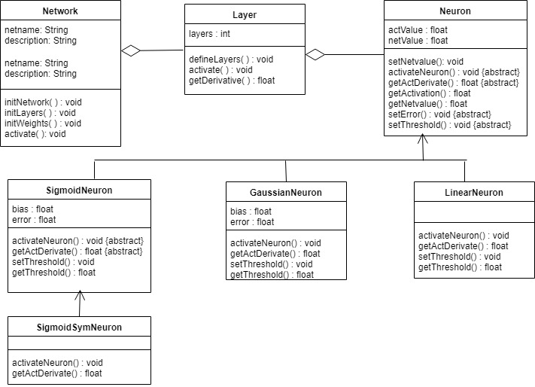
Neural Networks & OOPs:
Different neurons have specific behaviour. There are 3 different types of neurons and the sigmoid symmetric neuron which is a derived neuron uses different activation method instead of standard activation function.

Slide 24
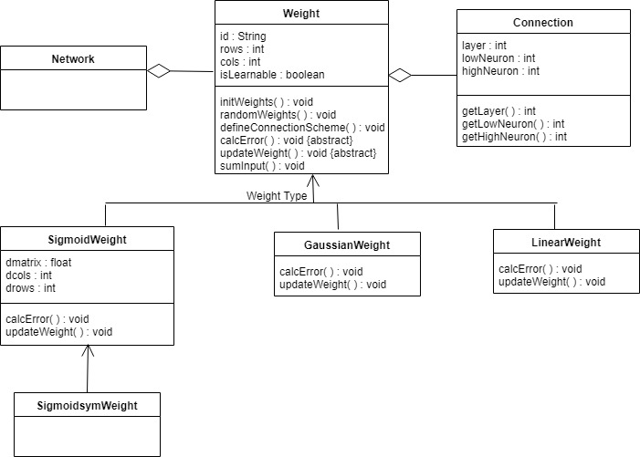
Neural Networks & OOPs:
Weight class is dependent on the type of neurons it connects to. A connection class is provided to make connections among neurons in the layers. Different weight classes have different behaviours associated with them. (All different weights inherit from weight class).

Slide 25
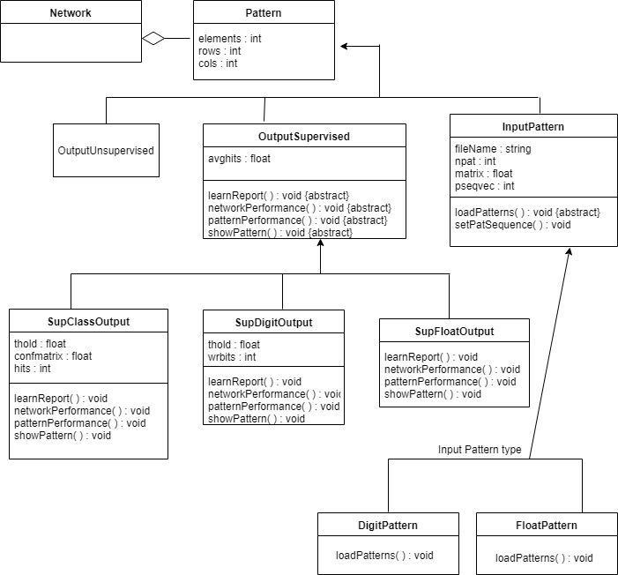
Neural Networks & OOPs:
Pattern interface is used for Unsupervised, Supervised and input patterns.(pattern input files)
Digit output is a binary output, Float output is a continuous value output.

Slide 26
Pytorch Implementation Example

Slide 27
PyTorch: Tensor
Tensor is the fundamental data structure used in Pytorch
We transform the data into tensors in order to pass it through the neural network.
Instances of the torch.Tensor/ torch.tensor class
Tensor attributes
torch.dtype: Tensors contain uniform (of the same type) numerical data eg. torch.float32
torch.device: specifies the device (CPU or GPU) where the tensor's data is allocated. This determines where tensor computations for the given tensor will be performed
torch.layout: specifies how the tensor is stored in memory
torch.Tensor is the constructor of the torch.Tensor class
torch.Tensor() constructor lacks configuration options, hence we are unable to pass dtypes
torch.tensor a factory function gets called constructs torch.Tensor objects
dtype is selected based on the incoming data i.e. the dtype is inferred based on the incoming data

Slide 28
Build the model
PyTorch’s neural network library contains all of the typical components needed to build neural networks. The primary component to build a neural network is a layer.
Each layer in a neural network has two primary components:
A transformation (code)
A collection of weights (data)
A class Module within the neural network package is the base class for all neural network modues with layers.
This is an instance of inheritance in action.
Neural networks and layers in PyTorch extend the nn.Module class. This means that we must extend the nn.Module class when building a new layer or neural network in PyTorch.

Slide 29
Building a neural network in PyTorch
In order to build the network:
We first design a neural network class that extends the nn.Module base class.
As we instantiate a neural network we pass the network’s layers as class attributes using pre-built layers from torch.nn through the class constructor
We use operations from the nn.functional API the network’s layer attributes as well as to define the network’s forward pass.
Code Sample
class Network:
def __init__(self):
self.layer = None
def forward(self, inp):
inp = self.layer(inp)
return inp

Slide 30
Building a neural network in PyTorch
To make our Network class extend nn.Module, we must do two additional things:
Specify the nn.Module class in parentheses on line 1.
Insert a call to the super class constructor inside the Network constructor.
Code Sample
class Network(nn.Module): # line 1
def __init__(self):
super(Network, self).__init__()
self.layer = None
def forward(self, t):
t = self.layer(t)
return t

Slide 31
Define the network’s layers as class attributes
In the previous slide the Network class has a single dummy layer as an attribute.
We now build some real layers that come pre-built for us from PyTorch's nn library.
We’re building a CNN, so the two types of layers we'll use are linear layers and convolutional layers.
Code Sample
class Network(nn.Module):
def __init__(self):
super(Network, self).__init__()
self.conv1 = nn.Conv2d(in_channels=1, out_channels=6, kernel_size=5)
self.conv2 = nn.Conv2d(in_channels=6, out_channels=12, kernel_size=5)
self.fc1 = nn.Linear(in_features=12 * 4 * 4, out_features=120)
self.fc2 = nn.Linear(in_features=120, out_features=60)
self.out = nn.Linear(in_features=60, out_features=10)
def forward(self, t):
# implement the forward pass
return t

Slide 32
Citation
Ellinger, Barry Kristian; An Object-Oriented Approach to Neural Network; https://pdfs.semanticscholar.org/e582/181b2b722e00f6db92f2f64a1f5b7713dc37.pdf
Vasilev Ivan et.al. ; Python Deep Learning
Tianqi Chen et.al.; MXNet: A Flexible and Efficient Machine LearningLibrary for Heterogeneous Distributed Systems; https://www.cs.cmu.edu/~muli/file/mxnet-learning-sys.pdf
Abadi, Martín,; TensorFlow: A System for Large-Scale Machine Learning; https://www.usenix.org/system/files/conference/osdi16/osdi16-abadi.pdf
Lerer Adam et.al., Pytorch-Biggraph: A large scale graph embedding system https://www.sysml.cc/doc/2019/71.pdf
Liao, Qianli ; Object Oriented Deep Learning; https://dspace.mit.edu/bitstream/handle/1721.1/112103/CBMM-Memo-070.pdf?sequence=1
Deep Learning with PyTorch: A practical approach to building neural network models using PyTorch

Slide 33
Citation
Bradbury, James et,al. ;Automatic Batching as a Compiler Pass in PyTorch; http://learningsys.org/nips18/assets/papers/107CameraReadySubmissionMatchbox__LearningSys_Abstract_%20(2).pdf
https://pytorch.org/features
https://pytorch.org/docs/stable/index.html
https://pytorch.org/blog/a-tour-of-pytorch-internals-1/
https://pytorch.org/blog/a-tour-of-pytorch-internals-2/
https://github.com/PyTorch/PyTorch/wiki
https://github.com/PyTorch/PyTorch/wiki/PyTorch-Data-Flow-and-Interface-Diagram
https://github.com/PyTorch/PyTorch/wiki/Code-review-values
https://docs.python.org/3.7/extending/index.html

