Slide 1
Sales Chatbot | Proposal
October 7, 2020

Slide 2
Section 1
Framework Survey

Slide 3
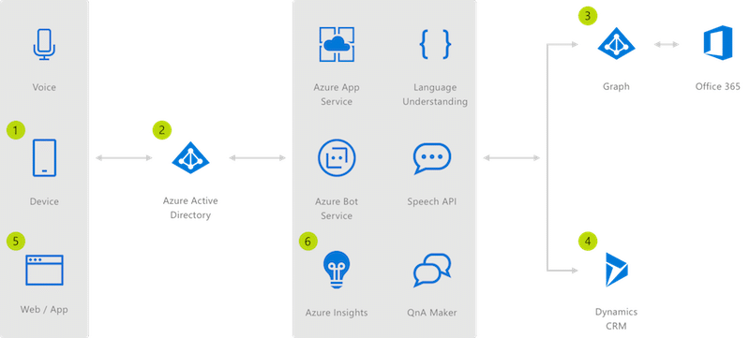
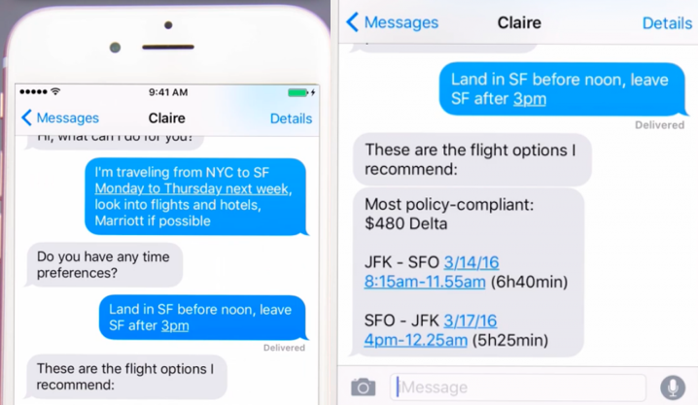
Popular Frameworks
1. Microsoft Bot Framework (with Luis.ai)
The Bot Framework by Microsoft is a set of services, tools and SDKs that give a rich foundation or framework to the AI chatbot developers. Using this framework, we can build and connect intelligent bots. These enterprise-grade bots provide you with the complete ownership and control of your data.
Pros:
SDKs for multiple computer languages
Prebuilt entities
Machine learning speech to text
Open-Source
Cons:
One must choose either Node.js or C# platforms for development.
Integrate with:
Skype, Slack, Facebook Messenger, Websites, Cortana, Microsoft team, Kik
Pricing:
There are both Open-Source and paid versions in the Microsoft Bot Framework. It is free upto 10,000 messages per month.
Used By: Sabre, Applied Materials, Nokia

Slide 4
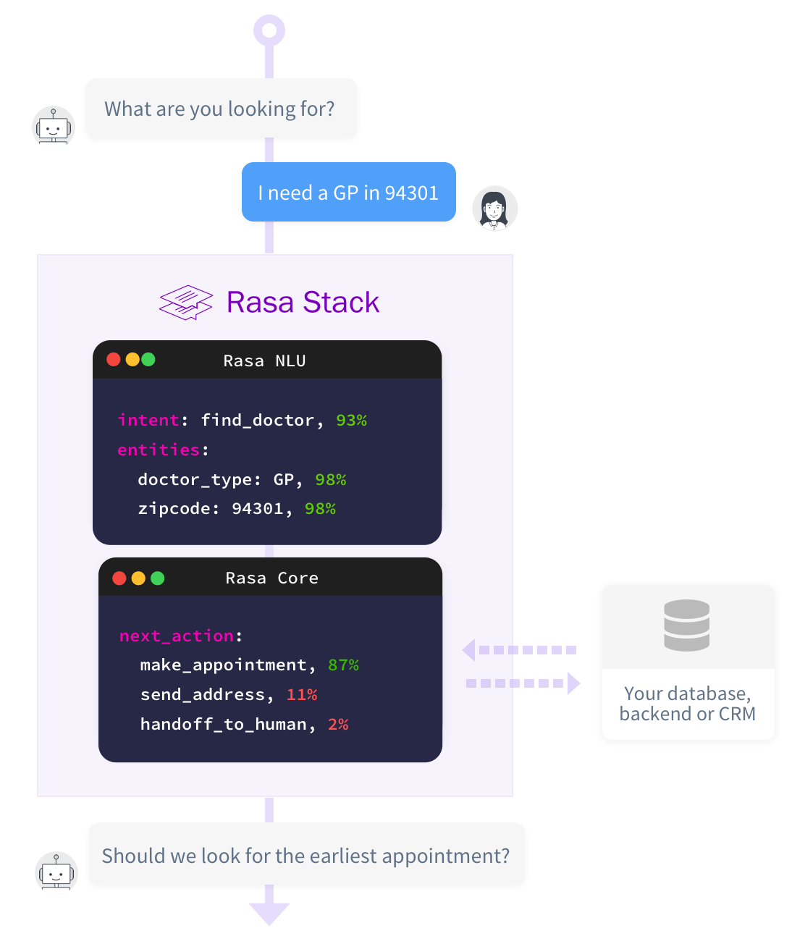
2. RASA
Rasa is an open-source framework that has 2 major components: Rasa NLU and Rasa Core. Rasa NLU is responsible for natural language understanding while Rasa core helps create intelligent, conversational chatbots. Rasa Stack is actually leading in the open-source machine learning toolkits that help developers create better AI chatbots with minimal training data.
Pros:
It can be deployed on your own server by keeping all the components in-house.
Highly customizable, so it allows developers to create a chatbot with desired features.
It allows multiple environments for development, staging and production.
Rasa offers analytics for various data that allows you to understand customers better.
This AI chatbot framework works on the basis of interactive learning, hence it keeps learning on its own as it interacts with people.
Cons: Rasa isn’t exactly suitable for beginners so new developers could be a little intimidated by this AI chatbot framework.
Integrate with:
Facebook Messenger, Rocket.Chat, Slack, Telegram, own server
Pricing:
Although open-source, Rasa also has a paid version for its AI chatbot framework. It is called Rasa platform and it is available for enterprises that need heavy functionalities and better performance.
Used By: Adobe

Slide 5
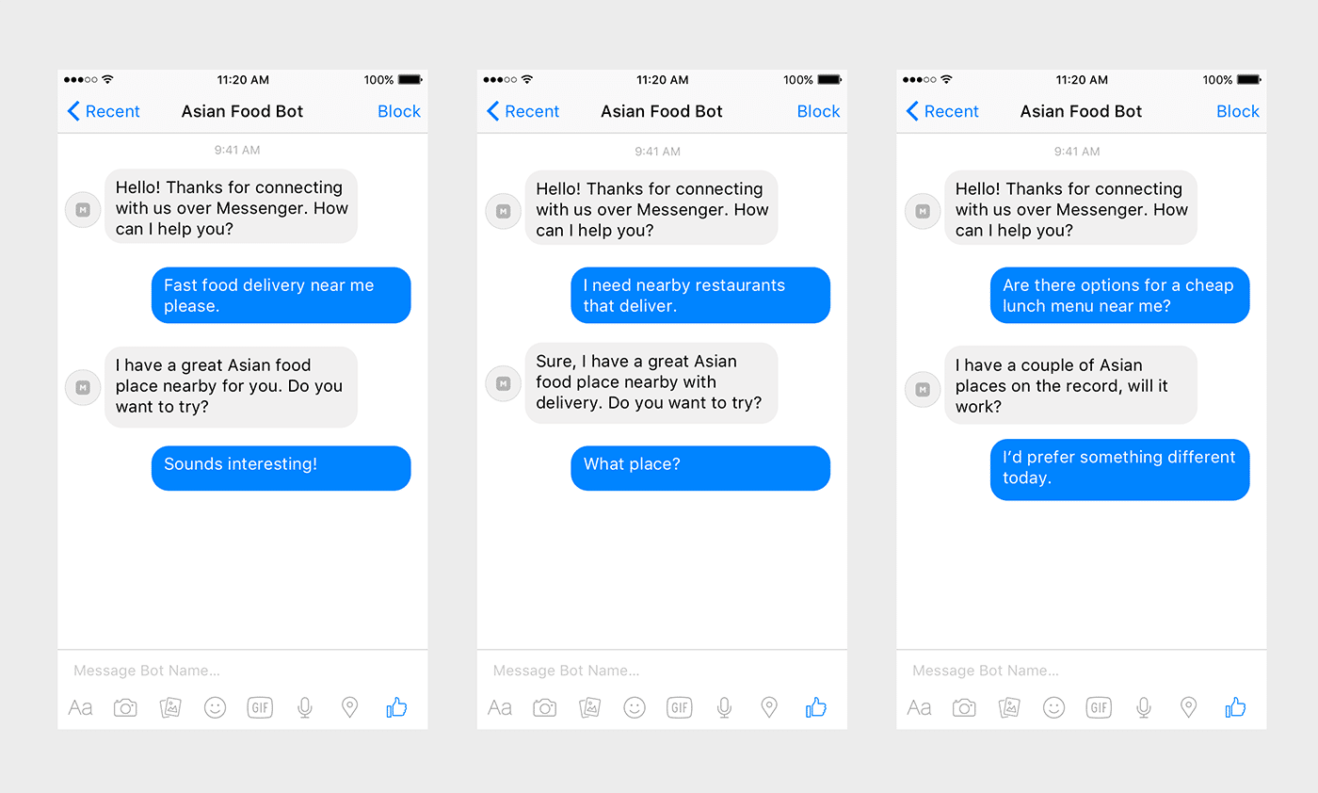
3. Wit.ai
Wit.ai has been acquired by Facebook and is free for commercial usage. This NLP platform lets the developers create the entities and intent. Since it is still an open-source project with open tools, the developers can easily create bots with human-level intelligence without having to teach the bot the basics of human conversations.
Pros:
Easy to deploy it on Facebook Messenger, so if you want to create a bot just for that platform, this is the best AI chatbot framework.
It has a large developer community. The NLP engine in Wit.ai’s AI chatbot framework is undeniably amongst the best and can hold its own against bigger bot-building tools. It offers SDKs in iOS, Node.js, Python, Ruby.
Wit.ai supports around 80+ languages from around the world, allowing developers to easily translate data worldwide.
Cons: Some of the developers have stated that it might be harder to retrieve missing parameters in Wit.ai as compared to other AI chatbot frameworks.
Integrate with: One's app, website, Slack, Facebook Messenger, Wearable devices, Home automation
Pricing: Free of cost (The data is shared to the community).

Slide 6
4. Dialogflow
Dialogflow is an AI chatbot framework that is a subsidiary of Google. It comes with machine learning capabilities, built-in NLP features and integrations with many other popular communication platforms. With Google Dialogflow, developers are able to create highly intelligent chatbots that can understand the nuances of language and keep improving over time. This is because it is supported by Google’s Cloud Natural Language, making it easier to train the bot to understand human emotions and sentiments.
Pros:
Supports both voice-based and text-based assistants.
Easy to understand and learn, even for beginners.
Best quality and rich conversations using natural language.
It offers SDKs for more than 14 platforms.
Google Dialogflow supports more than 20 languages from around the world.
With an in-line editor, the coding becomes speedier.
It helps you do sentiment analysis for every query.
Cons:
Fine control over dialogue processing is not available to the programmer.
Integrate with:
Facebook Messenger, Google Assistant, Slack, Alexa, Cortana, Kik, Line, Skype, Telegram, Twilio, Viber
Pricing:
The standard edition is free of cost (till 10K messages). The paid version starts at $0.002 per text request, the prices vary and can go up to $0.075 per minute for all the phone calls that you process.

Slide 7
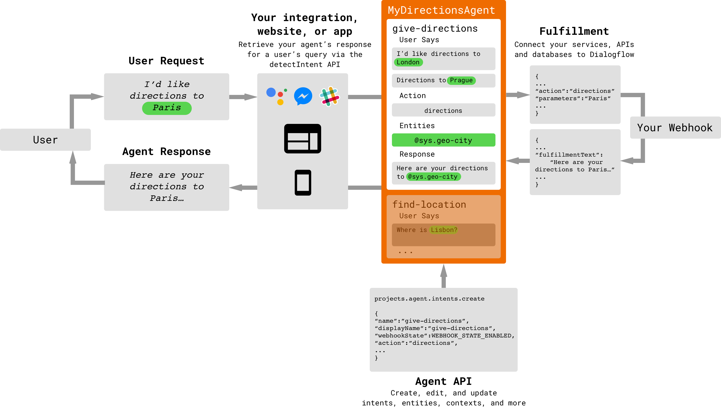

Slide 8
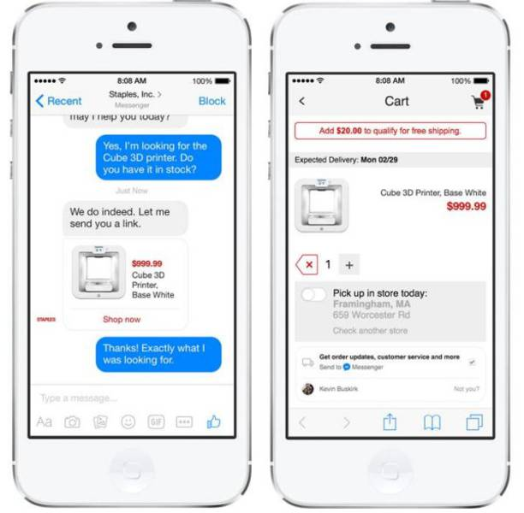
5. IBM Watson
Watson is one of the most widely known AI chatbot frameworks used by developers. It offers a variety of bot-building tools. It has built-in machine learning capabilities and in comparison to other big players in the AI chatbot framework race, IBM Watson holds its own in terms of features, integration and flexibility. Large companies are using IBM Watson for building sophisticated AI chatbots for their internal purposes. Moreover, it offers the developers advanced cognitive capabilities.
Pros:
IBM Watson is loaded with a highly advanced and capable machine learning engine.
It allows automated predictive analysis.
For non-technical business users, there is a Watson Assistant GUI that they can use easily.
IBM doesn’t collect the data that you use for building the bot and lets you store it on a private cloud, thus ensuring maximum security and confidentiality.
It also has visual recognition security.
Currently, Watson supports more than 10 languages from around the world and it also has an in-built language translator.
It has a tone analyzer that helps you understand and distinguish negative and positive responses from the users and customers.
Cons: No support for native code, Free version only allows for selective deployment.
Integrate with:
Facebook Messenger, Intercom, Slack, WordPress site
Pricing:
The pricing model starts from the Lite version which is free of cost and allows up to 10,000 messages per month. Other chargeable plans are Standard, Plus, Premium, and Deploy Anywhere.
Used By: TacoBell, Staples, TripBru

Slide 9

Proposed Option: Build using open-source modules
Pros:
Flexibility: We have a plethora of choices in terms of platforms to deploy the chatbot.
Customizability: A scratch build allows to use any UI we need (NLU or Menu-driven). A hybrid approach will be preferrable.
Integration with our data: We can wholly define how to use our CRM data, Product Catalog data in the chatbot rather than rely on use-cases.
Cons:
1. Dataset Creation: Time-consuming task of creating intents and responses.

Slide 10
Section 2
Web-Scraping and Database Creation

Slide 11

Proposed Option: Scrapy with Multiple proxies / GoogleBot (To bypass throttling)
Alternatives considered:
BeautifulSoup with multiple proxies: Issue: Multiple crawlers would work better and Scrapy provides better support for this.
Amazon_Scraper: Python package which works with the amazon API. Issue: is outdated.
Open-source implementations with Selenium (and BS): A decent alternative but can't find the possibility of using multiple proxies, location alteration, automatic retries, proxy management, and concurrent requests.

Slide 12
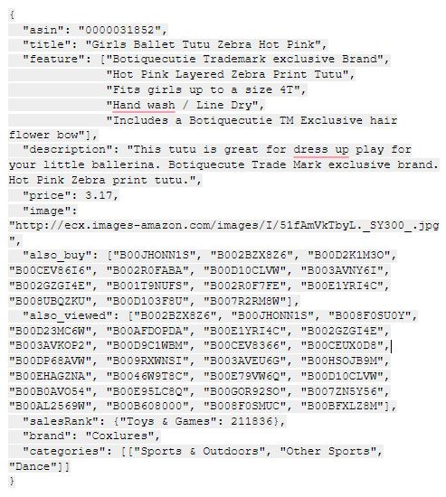
Ideal Contents (Product Catalog) Relational .json Database: (according to ASIN-ID)
asin - ID of the product, e.g. 0000031852
title - name of the product
feature - bullet-point format features of the product
description - description of the product
price - price in US dollars (at time of crawl)
image - url of the product image
related - related products (also bought, also viewed, bought together, buy after viewing)
salesRank - sales rank information
brand - brand name
categories - list of categories the product belongs to
tech1 - the first technical detail table of the product
tech2 - the second technical detail table of the product
similar - similar product table
dimensions – length width and height of product in mm.

Slide 13
Datasets for Cartops (Created by user)
Cart | ItemID | Item_Quantity | Item_price
 | "B00GOR92SO" | 5 | 90
 | "B00GOR78SO" | 1 | 1299
 | "B00GOR46SO" | 2 | 75
Subscriptions | ItemID | Item_price | Monthly_Qty | Renewal_Date
 | "B00GOR92SO" | 90 | 2 | 13-11
 | "B00GOR46SO" | 75 | 1 | 17-11
History | ItemID | Item_price | Item_Quantity | Order_date | Delivery_date
 | "B00GOR92SO" | 90 | 2 | 19-9 | 25-9
 | "B00GOR46SO" | 75 | 4 | 17-9 | 21-9
 | "B00GOR42SO" | 900 | 1 | 13-9 | 21-9
 | "B00GOR98SO" | 784 | 2 | 13-9 | 19-9
Saved for Later | ItemID | Item_price | Item_Quantity
 | "B00GOR42SO" | 900 | 2
 | "B00GOR98SO" | 784 | 1
Cart - The Current cart of the user
Subscriptions - The repeated orders of the user.
History - The order history of the user
Saved for Later - Consists of items shifted either shifted from cart or saved to be ordered later.

Slide 14
Section 3
Intents

Slide 15
Casual Intents
Casual Intents | Examples | Response
Greeting | "hello", "hi", "boot up" | "Hi, <Intent_list>."
Exit Salutation | "exit", "bye" | "Bye."
Affirmitive | "yes", "yeah","yup" | --
Negative | "no", "nope", "nah" | --
Bot Info | "What's your name?", "Who made you?" | "Hi my name is $bot_name"
Small Talk | "What are you thinking about?", "What does it all mean?" | $Generative
They can be expanded upon a lot as there​ are numerous opensource conversational datasets for small talk and such.
Some examples of such intents and responses are tabulated here.
The entities begin with "$".
Another Viable option is to handle Casual Intents and Small talk using an advanced text generator like GTP-3.
The context is derived from the previous conversations and purchases.

Slide 16
Business Intents - 1
Product Search Intents | Responses
"Show me some $Category." | "Here are the products from $category."
"Show me some $Category according to $Rank" | "Here are the top products from $categoy."
"Show me some $Category according to $Brand" | "Here are the some $category from $brand products."
"Show me some $Category with $Feature" | "Here are $Category with $Feature"
"Show me some $Category with $rating_condition" | "Here are some products with a rating > $min_rating"
"Show me some $Category within $minimum_Price and $maximum_Price" | "Here are some $category in the price range from $minimum_Price to $maximum_Price"
"Show me some $Category with $minimum_Discount discount" | "Here are some $Category with $minimum_Discount discount"
"Show me some $Category with $DeliveryOption" | "Here are some $Category with $DeliveryOption"
Product Search: A retail chatbot must help in narrowing down the search of a prospective customer. The entities involved for this are discussed ahead.
Response: To simplify the user's interaction a menu containing the options should be displayed (with an option to display more products) from which the user can choose by clicking the menu or entering the choice number.

Slide 17
Business Intents - 2
Product Inquiry Intents | Responses
Does $prod_title have $spec? | $Affirmation, the $prod_title does/doesn't have $spec. $pdt_lst
Does $prod_title work with $feat? | $Affirmation, the $prod_title does/doesn't work with $spec.
Is $prod_title good for $feat? | $Affirmation, the $prod_title is/isn't good for $feat. $pdt_lst
Does $prod_title come with $feat? | $Affirmation, the $prod_title does/doesn't come with $feat. $pdt_lst
Does $prod_choice have $spec? | $Affirmation, the $prod_choice does/doesn't have $spec. $pdt_lst
Does $prod_choice work with $feat? | $Affirmation, the $prod_choice does/doesn't work with $spec.
Is $prod_choice good for $feat? | $Affirmation, the $prod_title is/isn't good for $feat. $pdt_lst
Does $prod_choice come with $feat? | $Affirmation the $prod_choice does/doesn't come with $feat. $pdt_lst
Does $prod_choice come in $color? | $Affirmation, the $prod_title is/isn't available in $color.
Product Inquiry: We aim to answer user questions by matching their queries with the features, technical specs data associated with the product title.
Responses: We print out an affirmation if the product enquiry matches with the product title/choice or not. Then we print out the list of the relevant features of the product.​

Slide 18
Business Intents - 3
CartOps: A customer will have current orders (stored in cart), subscriptions, and the past orders are stored in order history. One can add/remove from the cart, subscriptions and saved items while also shifting items from one to another.
Recommendations: Given the fact that we cannot apply collaborative filtering, my suggestion is to use the "related" matrix recommended by Amazon itself rather than relying only on a small order history from the user.
After every purchase or addition to cart we can recommend products based on that single purchase.
If the user asks for recommendation herself:
Recommend the products that appear most frequently in the "related" matrix (aggregated for all the orders.
Recommend the most popular products from the user's preferred categories and brands.

Slide 19
Section 4
Entities

Slide 20
Product_ID
Features
Description
Image
Related
Price
Sales Rank
Rating
Categories
Specification
Also Bought
Also Viewed
Tech1
Tech2
Product Entities

Slide 21
CartOps Entities
Subscriptions
ItemID
Product_fetures
Item_quantity
Price
Renewal_date
Cart
ItemID
Product_fetures
Item_quantity
Price
Order_History
ItemID
Product_fetures
Item_quantity
Price
Order_date
Delivery_date

Slide 22
Section 5 - A
Stanford NLP Entity Clustering | Proposal 1

Slide 23
ENTITY EXTRACTION​
STANFORD NLP​
CoreNLP is a library for natural language processing in Java! CoreNLP enables users to derive linguistic annotations ​for text, including token and sentence boundaries, parts of speech, named entities, numeric and time values, dependency and ​constituency parses, coreference, sentiment, quote attributions, and relations. ​
To use it for python, we have to use CoreNLP Client which is hosted on the Stanford NLP Server.​
FEATURES:
1) Part of Speech​​
2) Named Entity Recognition​​
3) Basic Dependencies​​
4) Enhanced Dependencies​

Slide 24
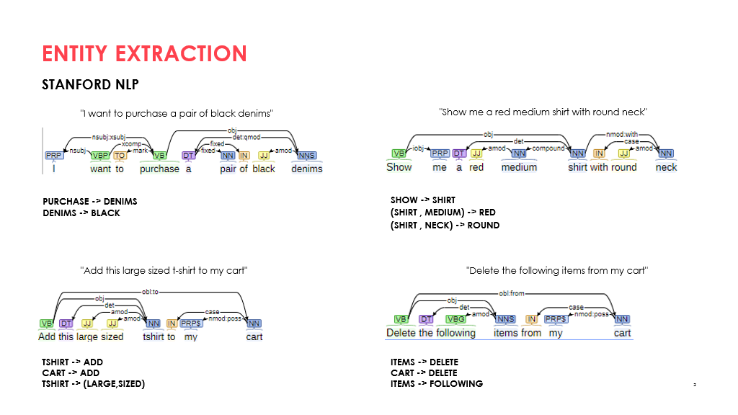

Slide 25
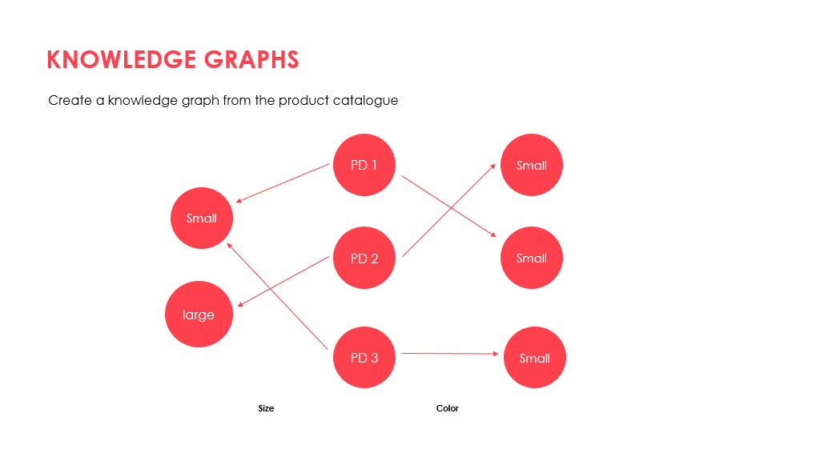

Slide 26
Section 5 - B
Wit.ai | Proposal 2

Slide 27
Proposed Framework
Entity Updation
(search, inquiry, cart)
Response (msg)
Utterance
Native Code
Wit.ai App
User
Python client
Utterance
Classified Intent / Response (Action)
Allows to use:
Entities
Intents
Context
Actions
Natural Language Process (NLU) (No need of separate generator for casual intents and small talk)
Voice-to-Text
Response_type | Description
msg | Message from the bot as a string
action | Name of the action you need to perform
stop | When the conversation is over

Slide 28
Section 6
Chatbot Design

Slide 29
Order History
Similar Products
Recommendation
Product Catalog
Key: Product_ID
Cart
Search and Inquiry
Native Actions
Text-Gen
Cartops
Saved for Later
Business Intents​
Casual Intents​
Intent Classification
Responses
Subscriptions
Current Query
Customer
State: Active

Slide 30
Section 7
Deployment

Slide 31
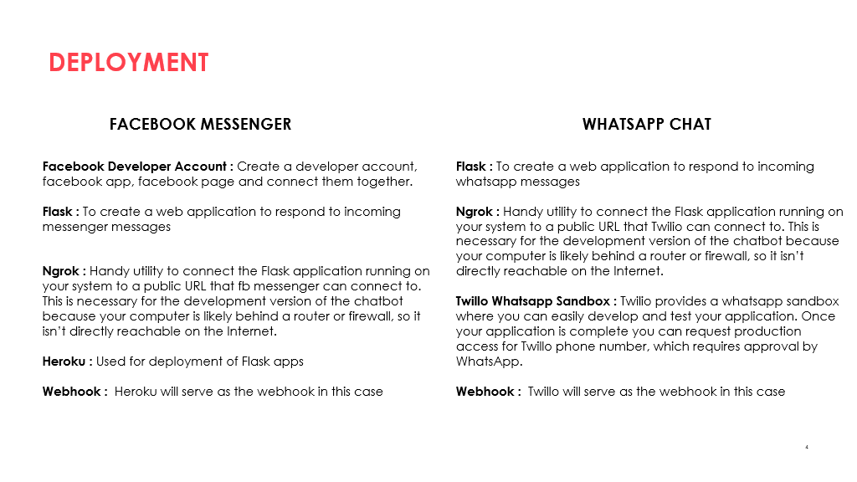

Slide 32
Section 8
Tech Stack

Slide 33
Order History
Similar Products
Recommendation
Product Catalog
Key: Product_ID
MySQL & Scrapy
Cart
Search and Inquiry
Native Actions
Gen
Cartops
Saved for Later
Business Intents​
Casual Intents​
Intent Classification
Responses
Subscriptions
Current Query
Customer
NoSQL

Slide 34
Order History
Similar Products
Recommendation
Product Catalog
Key: Product_ID
Cart
Search and Inquiry
Native Actions
Gen
Cartops
Saved for Later
Business Intents​
Casual Intents​
Intent Classification
Responses
Subscriptions
Current Query
1. Wit-AI PyClient
2. Core-NLP Client
Customer

Slide 35
Tech-Stack
Deployment​
Facebook Messenger | Whatsapp
Flask | Flask
Heroku | Ngrok
Ngrok | Twillio Sandbox
For Data and Chatbot Architecture
Scraping & DBM (Python Packages Req) | Intent and Entity Handling
Scrapy | 1. CoreNLP (Stanford NLP-Py Client)
BeautifulSoup | 2. Wit.ai (Py Client)
Requests
Pandas

Slide 36
Thank You.

Slide 37
Further Scope
NLU Sentiment Analysis (to update state and intents).
Spell-Correction (http://docs.deeppavlov.ai/en/master/features/models/spelling_correction.html#levenshtein-corrector)
Voice to text module

Slide 38
Alternative Option: Build using existing High-Level API DialogFlow, Watson, Alexa
Pros:
Excellent NLU: Given that these organizations have a lot of resources and data available the conversational AI is excellent.
Easy Deployment: They support many platforms (not all) and can be integrated using few clicks.
Automatic Entity Recognition
Cons:
1. Customizability: Potential of integrating with user and functional entities (created by the user and our own dataset) cannot be realized fully.
2. Limits on usage at scale: Dialogflow, Watson, Alexa all of them have an upper limit on the number of users and the number of intents.

Slide 39
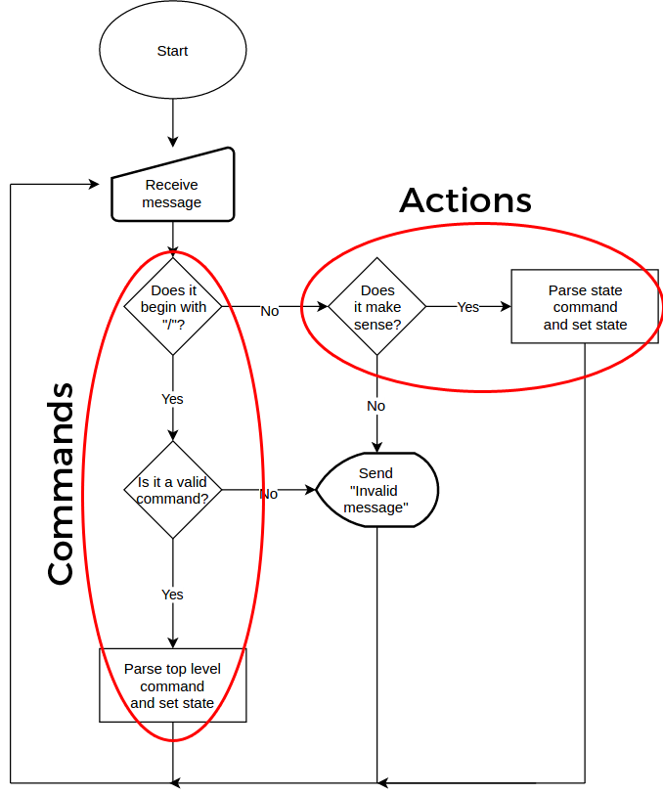
Finite State Management
Updation criteria:
On completion of goal.
On changing criteria of the user (Request is updated).
When user affrims or negates request completion.

