Slide 1
GrabYourJob
Job Portal Presentation
TREY research

Slide 2

About Portal
Job Portal application.
A job portal application with following slides
User Registration,
Login page,
Add details in profile,
View the list of jobs, and
Apply in those jobs
Job Portal Application

Slide 3
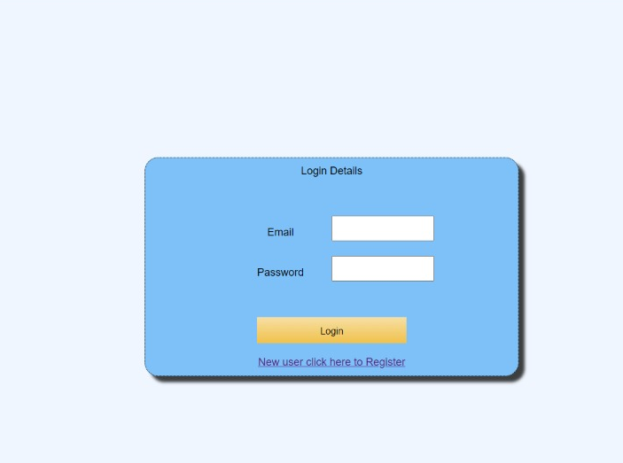
Login Page
Details
Login to your account
Register as New User

Slide 4
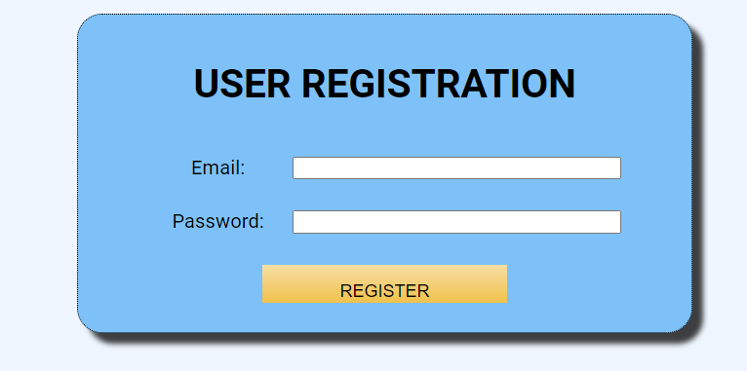
User Registration
Email
Password
Details

Slide 5
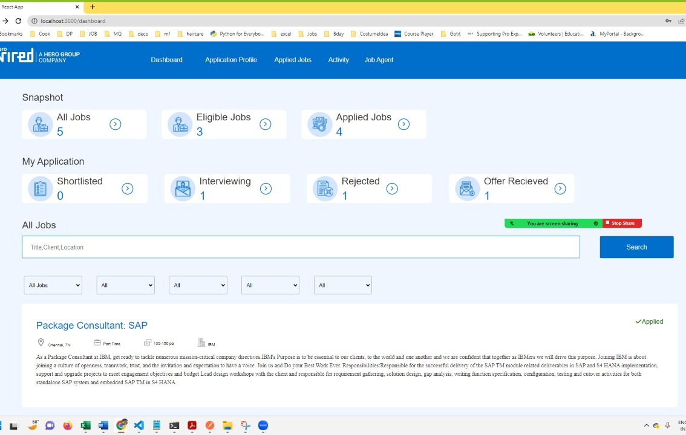
Dashboard
Details
Job details
Job snapshot
Job Search

Slide 6
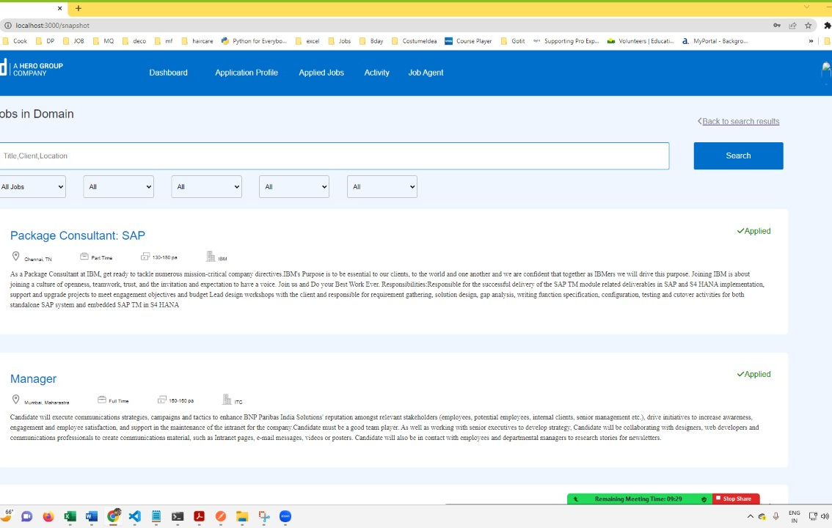
Jobs In Domain
Details
Job name
Job description
Job application status

Slide 7
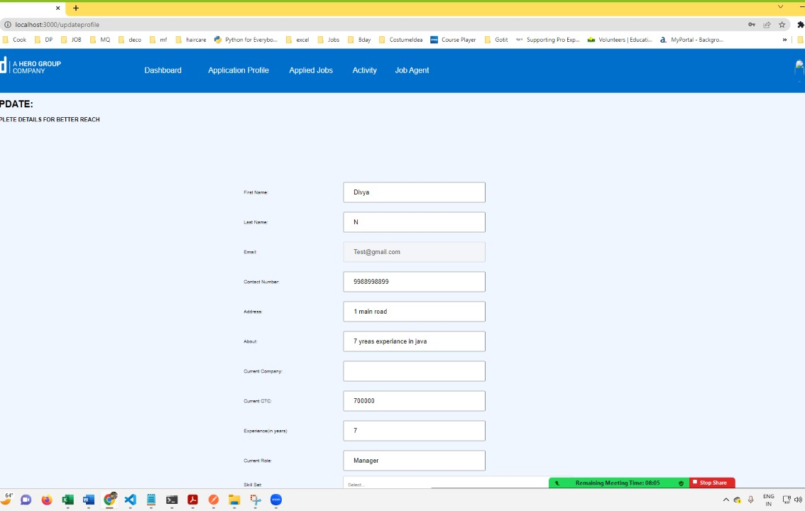
Profile Update
Details
User details
Email address

Slide 8

APIs & Resources
Details
User,
Login,
Skill,
Candidate Profile, and
Job

Slide 9




Thank You
Divya, Riswana
dninjoor@gmail.com, Riswana.begam.87@gmail.com
GrabYourJob

Slide 10

Questions
Your queries.

