Slide 1
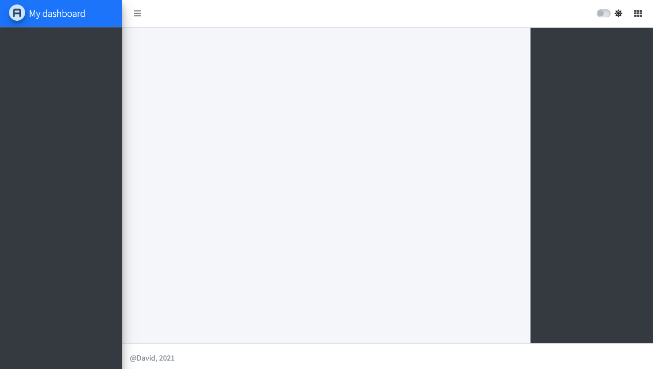
<nav></nav> (dashboardHeader())
<aside></aside> (dashboardSidebar())
<aside></aside> (dashboardControlbar())
<footer></footer> (dashboardFooter())

