Slide 1
Introduction to Cloud Computing Trends 2025

Slide 2
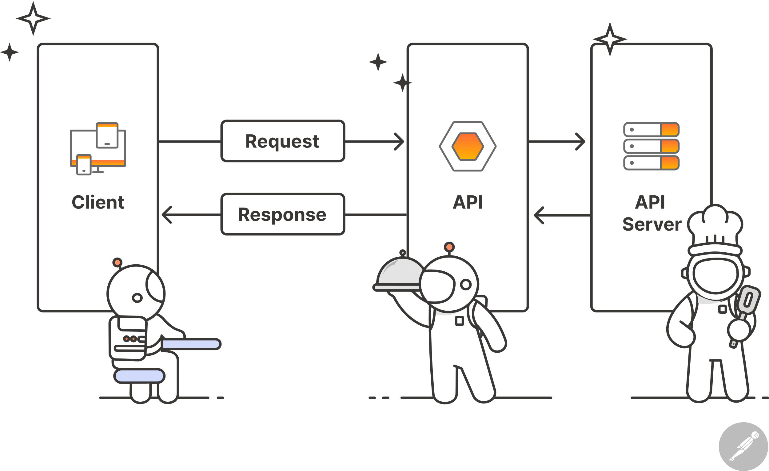
Trend 1: Increased Adoption of Hybrid Cloud
Hybrid cloud allows for flexibility and scalability
Combines the benefits of public and private cloud infrastructure
Expected to be a major driver of cloud growth in 2025

Slide 3
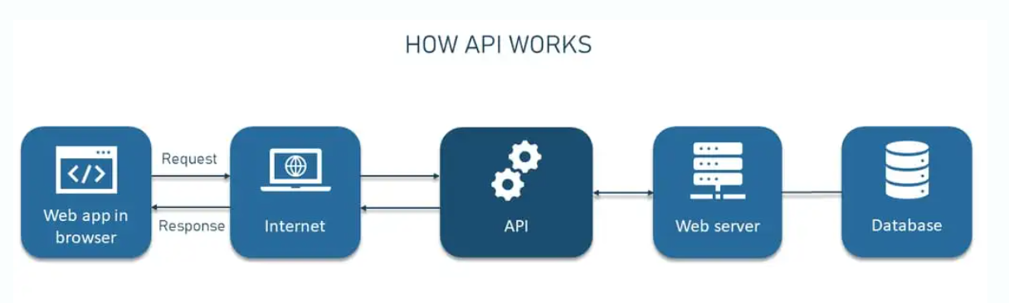
Trend 2: Serverless Computing
Serverless computing reduces costs and increases efficiency
Allows developers to focus on writing code, not managing infrastructure
Expected to see significant growth in serverless computing adoption

Slide 4
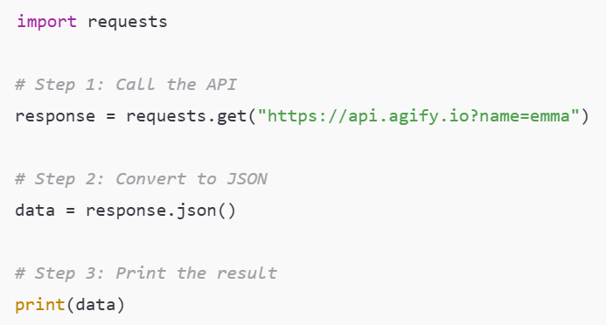
Trend 3: Artificial Intelligence (AI) and Machine Learning (ML) in Cloud
AI and ML are being used to optimize cloud operations and improve security
Expected to see increased adoption of AI and ML in cloud-based applications
Will enable more efficient and automated cloud management

Slide 5
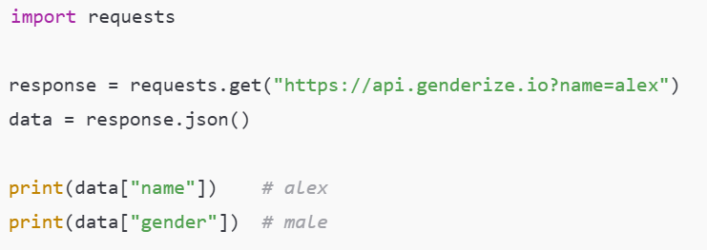
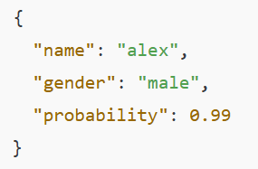
Trend 4: Edge Computing
Edge computing reduces latency and improves real-time processing
Expected to see increased adoption in IoT, gaming, and other applications
Will enable more efficient and secure data processing
Example: Simple JSON Access
Sample API Response:

Slide 6
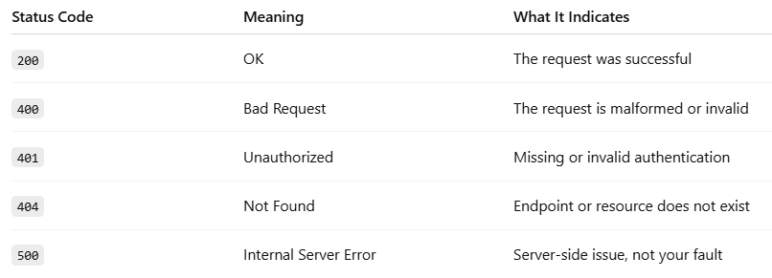
Trend 5: Cloud Security and Compliance
Cloud security and compliance are top priorities for businesses
Expected to see increased investment in cloud security measures
Will enable more secure and compliant cloud environments
Common HTTP Status Codes:

Slide 7
Trend 6: Quantum Computing in Cloud
Quantum computing is emerging as a new trend in cloud computing
Expected to see increased adoption in areas such as cryptography and optimization
Will enable more efficient and secure data processing

Slide 8

Trend 7: Cloud-Native Applications
Cloud-native applications are designed to take advantage of cloud infrastructure
Expected to see increased adoption of cloud-native applications
Will enable more efficient and scalable application development

Slide 9
Trend 8: Multi-Cloud Strategy
Multi-cloud strategy allows for flexibility and avoids vendor lock-in
Expected to see increased adoption of multi-cloud strategies
Will enable more efficient and secure cloud management

Slide 10
Trend 9: Cloud-Based Data Analytics
Cloud-based data analytics enables faster and more efficient data processing
Expected to see increased adoption of cloud-based data analytics
Will enable more informed business decisions

Slide 11
Trend 10: Sustainability in Cloud Computing
Sustainability is becoming a major concern in cloud computing
Expected to see increased investment in sustainable cloud infrastructure
Will enable more environmentally friendly cloud environments

Slide 12
Conclusion
Cloud computing trends are evolving rapidly
Businesses must stay up-to-date with the latest trends and technologies
Will enable more efficient, secure, and sustainable cloud environments

