Slide 1
Interacting with APIs and Extracting Data from PDFs using Python

Slide 2
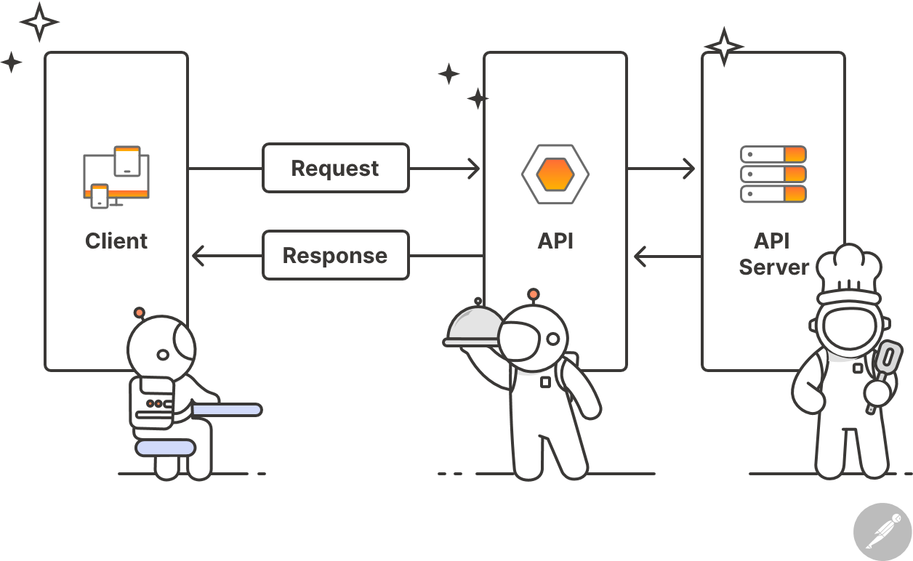
What is an API?
API stands for Application Programming Interface
It allows two applications to communicate with each other
You send a request, and the API returns a response, usually in JSON format
APIs are used to get or send data from external services

Slide 3
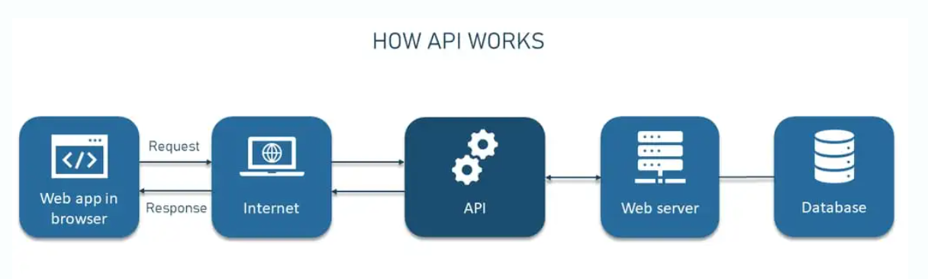
How APIs Work – Behind the Scenes
An API works over the internet using the HTTP protocol (same as websites)
You send a request to an API endpoint (a URL), and get a response back
Requests often include:
HTTP Method (e.g., GET, POST)
Headers (like API keys)
Query Parameters (e.g., ?name=emma)
Responses usually return JSON data, along with a status code

Slide 4
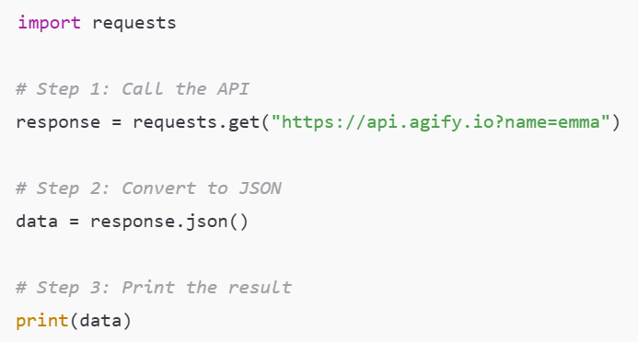
Making API Calls Using Python – requests Module
Python provides a built-in way to make HTTP requests using the requests library
Most APIs are accessed using the GET method (for fetching data)
The basic steps:
Import the requests module
Use requests.get() with the API URL
Access the returned JSON using .json()

Slide 5
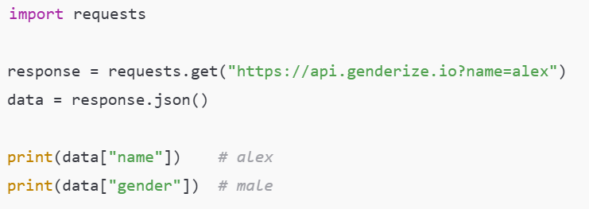
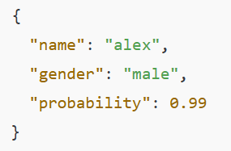
Handling JSON Responses in Python
Most APIs return data in JSON (JavaScript Object Notation) format
JSON looks like a Python dictionary: key–value pairs, can be nested
Python’s .json() method automatically converts JSON to a dictionary
You can then access data using standard dictionary methods
Example: Simple JSON Access
Sample API Response:

Slide 6
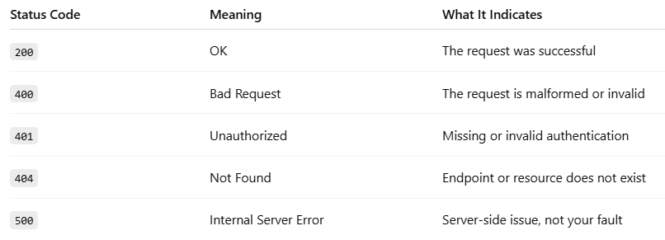
API Response Errors & Status Codes
Every API response comes with an HTTP status code
It tells you whether the request was successful or if an error occurred
Always check the status code before processing the response
Common HTTP Status Codes:

Slide 7
Introduction to PDF Data Extraction
What is PDF Data Extraction?
The process of retrieving text, images, tables, or metadata from PDF documents using code.
Commonly used with: Invoices, research papers, government documents, scanned forms.
Why Is It Important in GenAI Projects?
Real-world data often exists in unstructured formats like PDFs.
GenAI models require structured or preprocessed text.
PDF extraction helps transform content into a usable input for AI workflows, search, summarization, or analytics.

Slide 8
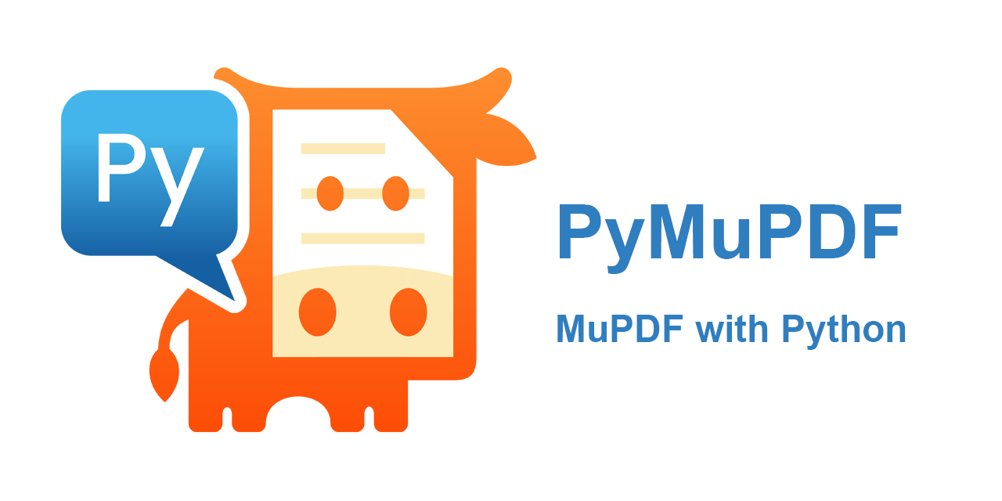
Introduction to PyMuPDF
What is PyMuPDF?
PyMuPDF (also known as fitz) is a lightweight Python library to access and manipulate PDFs and other documents.
Supports text, images, annotations, and page-level operations.
Ideal for fast and accurate text extraction from text-based PDFs.

Slide 9
OCR for Scanned PDFs – PyMuPDF/Docling
Why OCR is Needed
Scanned PDFs are just images – there's no extractable text.
OCR (Optical Character Recognition) is required to convert image-based text into machine-readable text.
Libraries like PyMuPDF allow image access, but OCR tools like Tesseract or Docling are needed for text extraction.
Typical Workflow
Use PyMuPDF to access and render PDF pages as images.
Pass each image to an OCR engine (e.g., Tesseract).
Extract and collect the recognized text.

Slide 10
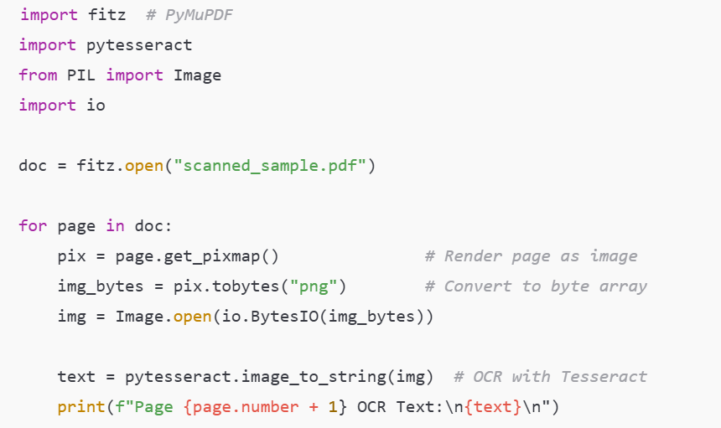
Code Example: PyMuPDF + Tesseract for OCR

