Slide 1
Introduction to Python

Slide 2
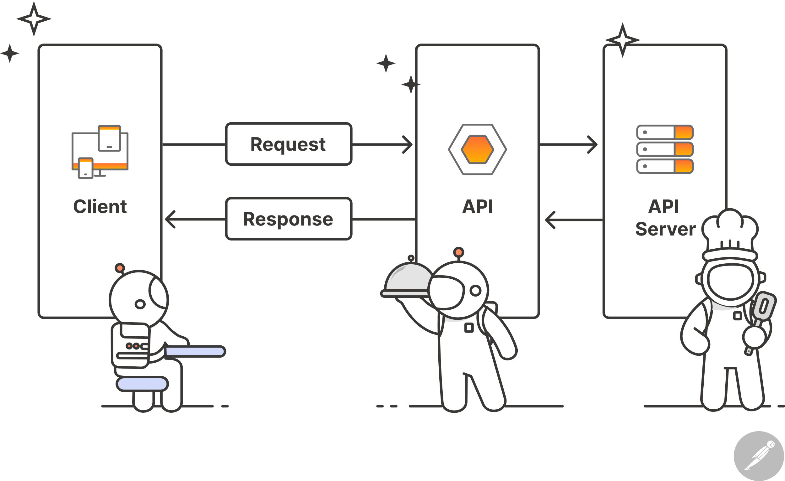
Features of Python
Simple syntax
Large standard library
Cross-platform compatibility
Extensive community support

Slide 3
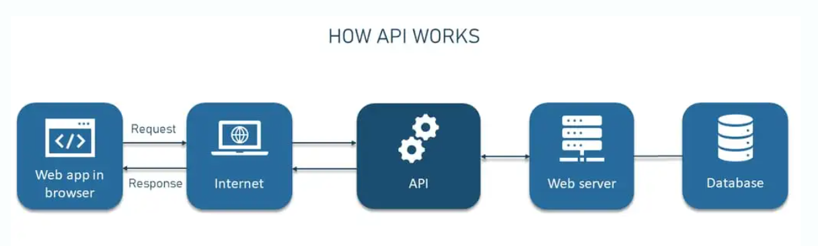
Setting Up Python
Download and install Python from the official website
Choose a text editor or IDE (Integrated Development Environment)
Familiarize yourself with the interface

Slide 4
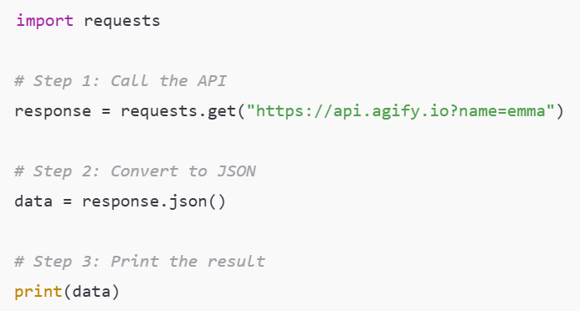
Basic Syntax
Indentation is used to define code blocks
Variables are used to store and manipulate data
Print function is used to output text

Slide 5
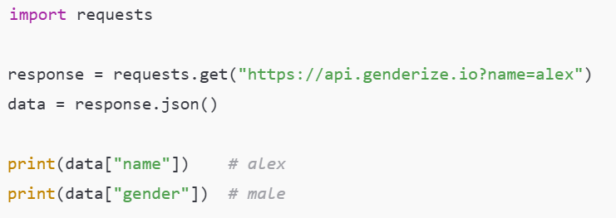
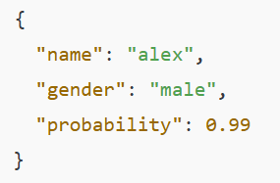
Data Types
Integers (int)
Floats (float)
Strings (str)
Boolean (bool)
Example: Simple JSON Access
Sample API Response:

Slide 6
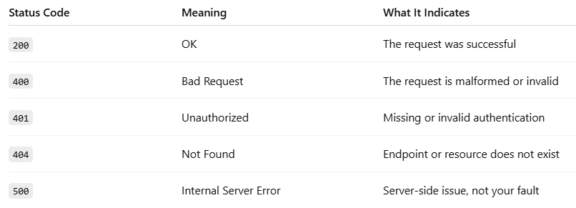
Operators
Arithmetic operators (+, -, *, /, %)
Comparison operators (==, !=, >, <, >=, <=)
Logical operators (and, or, not)
Common HTTP Status Codes:

Slide 7
Control Structures
If-else statements
For loops
While loops

Slide 8
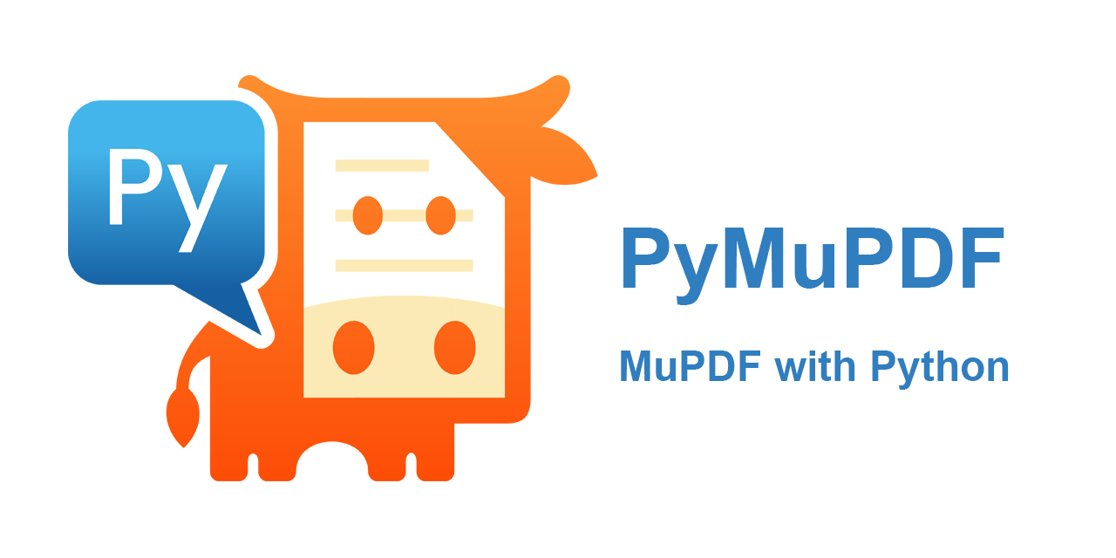
Functions
Reusable blocks of code
Take arguments and return values
Used to organize and simplify code

Slide 9
Lists
Ordered collections of items
Defined using square brackets []
Support indexing and slicing

Slide 10
Dictionaries
Unordered collections of key-value pairs
Defined using curly brackets {}
Support lookup and modification

Slide 11
Best Practices
Use meaningful variable names
Follow PEP 8 style guide
Test and debug your code regularly

Slide 12
Conclusion
Python is a versatile and widely-used language
Continuously learn and practice to improve skills
Join online communities for support and resources

