Slide 1
AI FOR A
GREENER FUTURE
Predicting air pollution and sorting waste smarter
TWO MACHINE LEARNING PROJECTS FOR A CLEANER ENVIRONMENT
Notes:
Introduce the project as two machine learning approaches for environmental monitoring and sustainable waste management. The first project works with structured air-quality records; the second works with waste images. The presentation moves from shared architecture to the documented air-model baseline, then to the waste-classification workflow.

Slide 2



One environmental challenge,
two ways to use ML
The data is different, but the aim is the same: make information useful.
Structured records
Waste images
Explainable prototypes
Use air-quality records to estimate pollution levels.
Sort waste images into the categories in the dataset.
Build simple prototypes and make each step easy to follow.
Notes:
This slide frames the two projects as two data lenses on one sustainability challenge. The air project uses tabular regression, while the waste project uses image classification. Both are treated as explainable engineering prototypes rather than unsupported deployment claims.

Slide 3
How the projects work: data to decision
Both projects follow the same basic steps, from data to a useful result.
Data capture
Make a prediction
Support a decision
Preprocessing
Evaluation
Tabular regression
Computer vision classification
Air-quality monitoring
Waste sorting
Notes:
Use this as the shared architecture for the presentation. “Inference” means producing a prediction from a trained model. The two branches share the same engineering rhythm, even though their data and model types differ.

Slide 4
Project 1 — Predicting RSPM
from air-quality data
The goal is to estimate RSPM from pollutant readings, location details and date-related features.
50,000
13
Linear Regression
We use Linear Regression in a preprocessing pipeline, with RSPM as the value to predict.
rows in the dataset
columns to work with
Notes:
Define RSPM as the target the notebook predicts from pollutant, location and time information. The dataset contains 50,000 rows and 13 columns. The model is Linear Regression inside a preprocessing pipeline, so the next slides focus on whether the records are usable and how they become features.

Slide 5
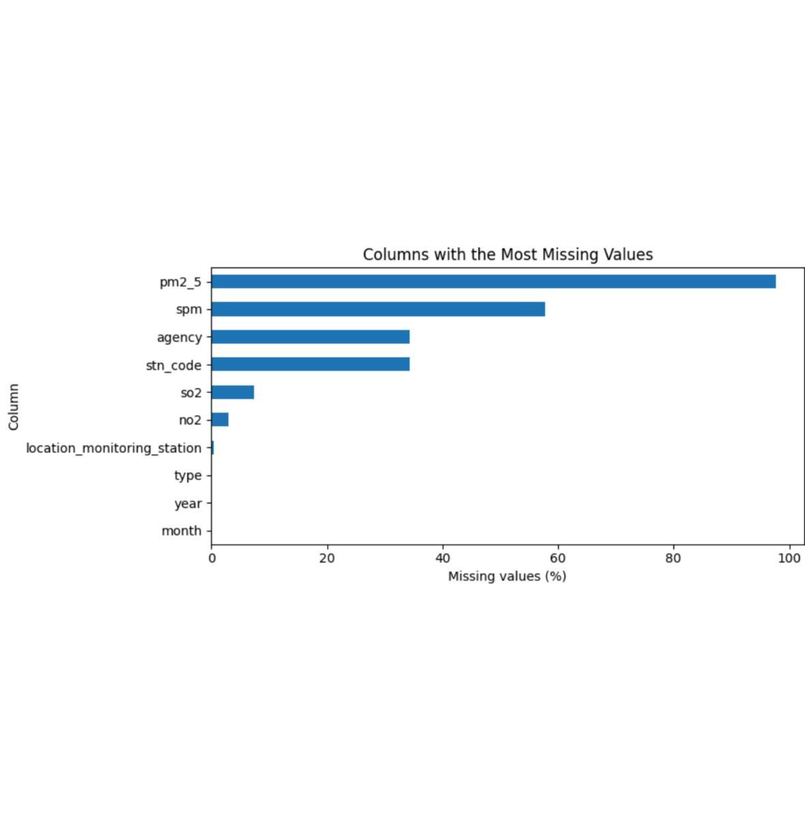

The air-quality data was useful,
but had gaps
Some important readings are missing, so cleaning the data is a key part of this project.
1
2
3
PM2.5
SPM
SO2 · NO2
97.72% missing
57.79% missing
7.37% · 2.90% missing
10 DUPLICATES REMOVED · 49,990 ROWS WITH VALID RSPM KEPT
Notes:
Read the missingness values exactly as documented. PM2.5 and SPM have substantial gaps, while SO2 and NO2 are more complete. The notebook removes 10 duplicate records and retains 49,990 rows with valid RSPM, which makes the preprocessing decisions important before modeling.

Slide 6
Getting the data ready for the model
01
02
Prepare
Expand time
Clean up column names and read the dates.
Add the year and month as features.
03
04
Remove leakage
Impute numbers
Leave out ID fields and raw date text that should not be used as inputs.
Fill missing numbers using the median.
05
06
Encode categories
Split fairly
Fill missing categories with the most common value, then convert categories into numeric columns.
Use 80% of the data for training and 20% for testing (random_state 42).
Notes:
Walk through the pipeline from left to right. Imputation fills missing values using a rule learned from the available data, while one-hot encoding turns categories into numeric indicators. The final 80/20 split, with random_state 42, creates the held-out test set used for the baseline results.

Slide 7
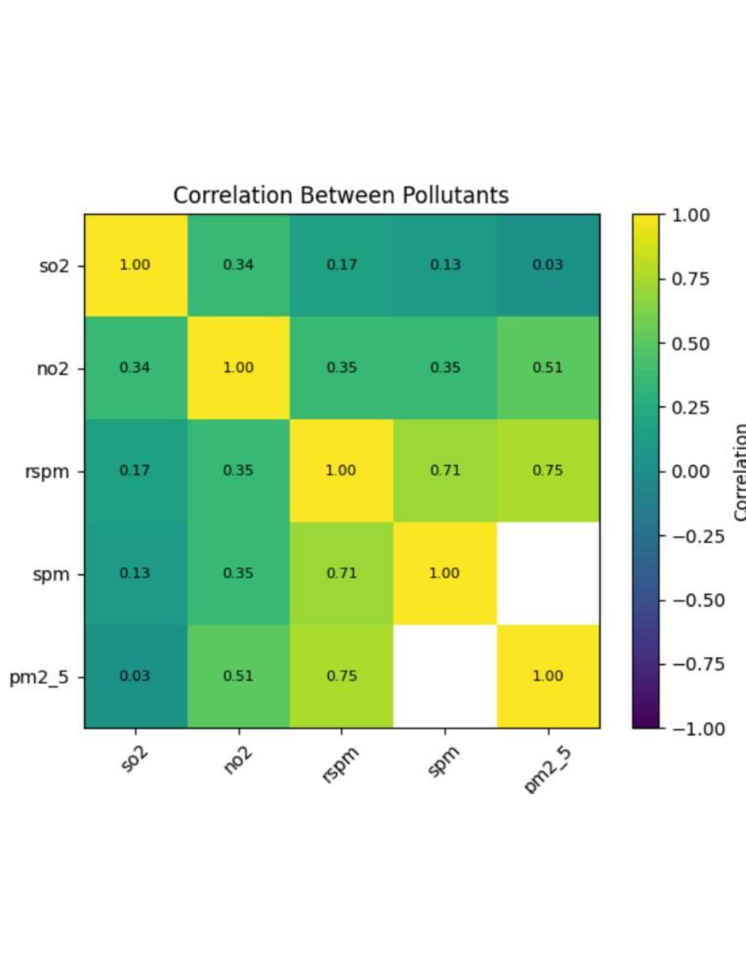

Some pollutant readings
move together
Correlation helps us spot patterns, but it does not prove that one pollutant causes another to change.
1
2
3
0.75
0.71
0.35
RSPM–PM2.5 correlation
RSPM–SPM correlation
RSPM–NO2 correlation
Notes:
The heatmap is an inspection tool. The RSPM–PM2.5 and RSPM–SPM relationships are stronger than the RSPM–NO2 relationship in the notebook. Emphasize the boundary: correlation identifies a relationship in the records, but it does not establish causality.

Slide 8
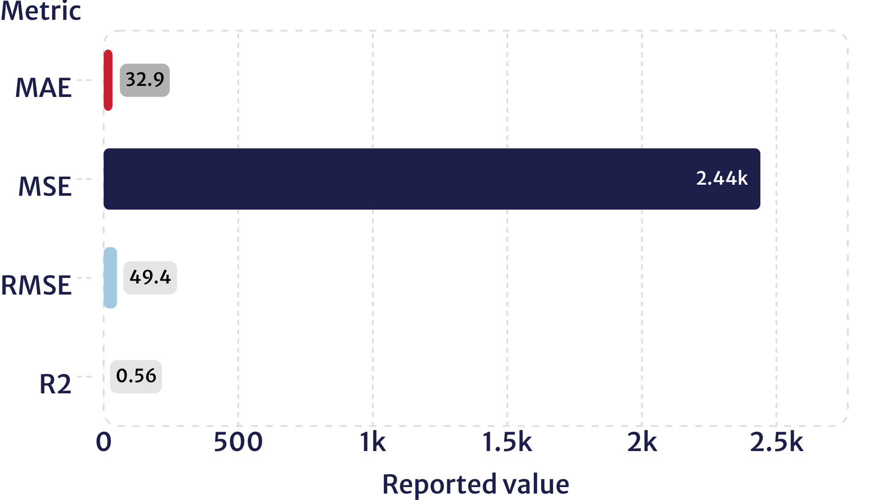
Air-quality model results:
our first baseline
Linear Regression gives us a starting point for predicting RSPM and measuring how well it works.
HELD-OUT TEST RESULTS
It finds patterns, but errors remain
The model picks up some useful patterns, although its predictions can still be quite far off.
BASELINE · NOT A DEPLOYMENT CLAIM
Notes:
Explain the four reported metrics without treating them as interchangeable. MAE is average absolute error, MSE squares the errors, RMSE returns to the target scale, and R² describes explained variation. The notebook reports a measurable baseline, but the material error means this is not a deployment claim.

Slide 9
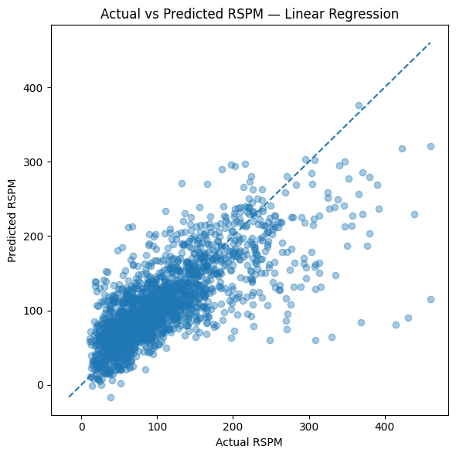




What the air model can tell us
(and what it cannot)
A useful starting point
for air-quality monitoring.
Inspect errors
Comparing predicted and actual values helps show when the model predicts too high or too low.
Signal is limited
With so much PM2.5 and SPM data missing, the model has less information to learn from.
Next engineering step
Next, try other regression models and test them on different places and time periods.
Notes:
This slide separates what the baseline can support from what it cannot establish. The actual-versus-predicted view helps inspect under- and over-estimation patterns, while missing PM2.5 and SPM limit available signal. The next engineering step is stronger regressors and validation across locations and time.

Slide 10

Project 2 — Classifying waste images
with a 2D CNN
The goal is to identify which dataset category a waste image belongs to.
EVIDENCE BOUNDARY
Load the images
The workflow is documented
Resize to 128 × 128
The notebook explains how the model should be evaluated, but the supplied files do not include results from an actual run.
Run the 2D CNN
80/20 VALIDATION · SEED 42 · 10 EPOCHS
80/20 split (seed 42)
Notes:
Introduce the second project as computer vision classification. A 2D CNN is a convolutional neural network designed to learn visual patterns from image grids. The supplied notebook documents image loading, input size, validation split and training duration, but it does not provide actual run metrics, so do not report accuracy, loss or deployment performance.

Slide 11
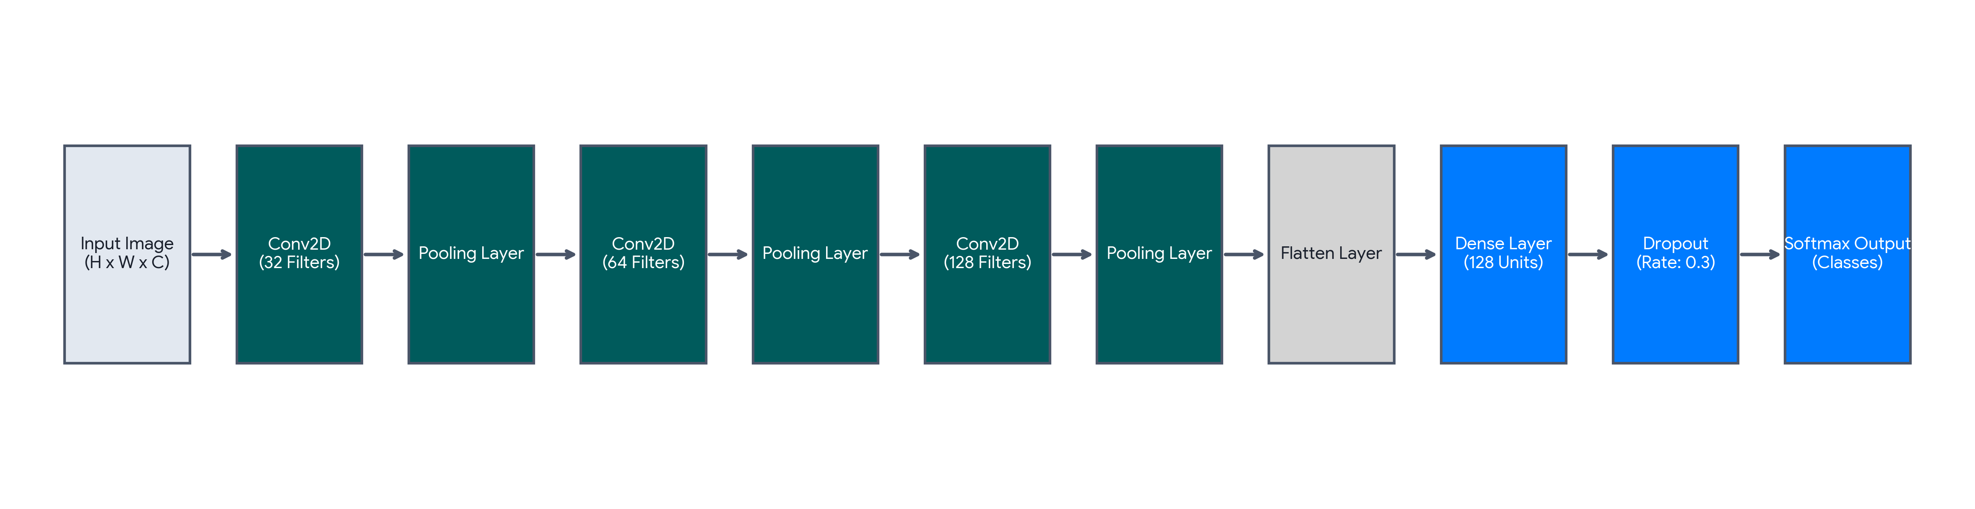
How a CNN turns an image
into a waste label
Convolution layers look for patterns such as edges, textures and shapes
Pooling makes the feature maps smaller
Softmax gives a score for each waste category

Slide 12
Getting the images ready for training
Resize each image to 128 × 128
Scale pixel values from 0–255 to a range of 0–1
Prefetch batches so the next images are ready when the model needs them
Use Adam for optimisation and sparse categorical cross-entropy to calculate the loss
Track accuracy and loss for both training and validation

Slide 13
Accuracy alone does not tell the whole story
Validation accuracy and loss show how the model performs on images it has not seen during training
A confusion matrix shows which waste categories the model tends to confuse
Precision, recall and F1-score help us assess performance for each category
A high Softmax score does not guarantee that the prediction is correct
The notebook describes these evaluation checks, but it does not include actual test results

Slide 14
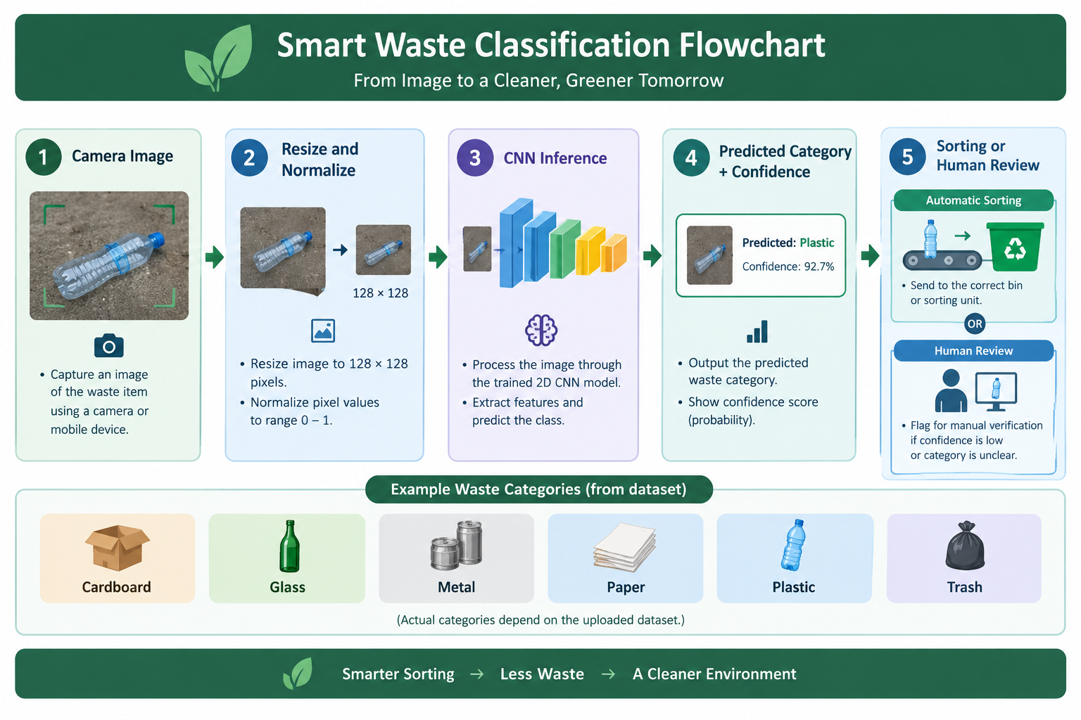
Using image predictions to guide waste sorting
When confidence is high, predictions could help direct items to the appropriate sorting stream
If the model is uncertain, the item should be checked by a person
Before real-world use, the model needs representative images and further testing

Slide 15
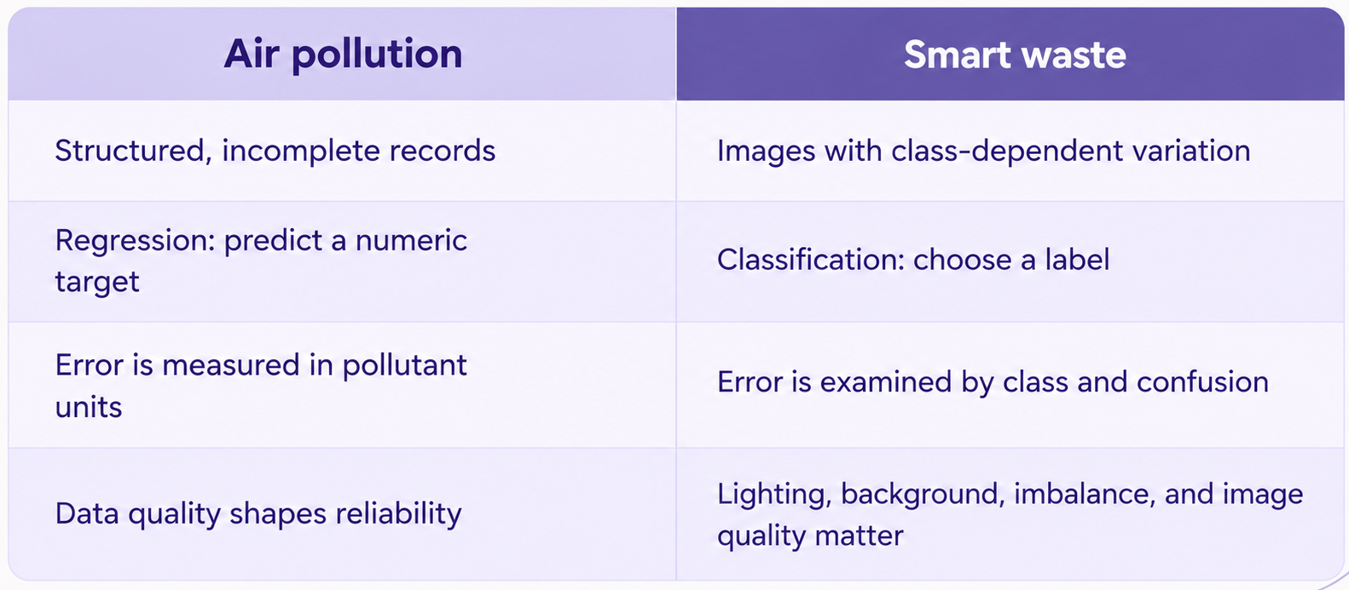
What both projects teach us about responsible ML

Slide 16
What we could improve next
Air model: add richer time-based features, compare other regression models and test across different locations
Waste model: check class balance, use image augmentation, explore transfer learning and calibrate confidence scores
Both: track data versions, make experiments reproducible, analyse errors and include human review
Measure real environmental impact only after field testing

Slide 17
Conclusion — two models, one shared goal
Prediction can help us monitor air quality
Image classification can help direct waste towards the appropriate handling process
Both projects lead to the same lesson: useful environmental tools depend on clear data, careful testing and honest reporting

