Slide 1

Solving Tetris using Reinforcement Learning
By Divan van der Bank
Notes:
Good afternoon, Prof Kamper and Prof Evans
I will give a short presentation on the progress I have made thus far on my skripsie, which is to solve the game of Tetris using Reinforcement learning.

Slide 2
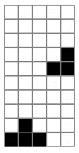
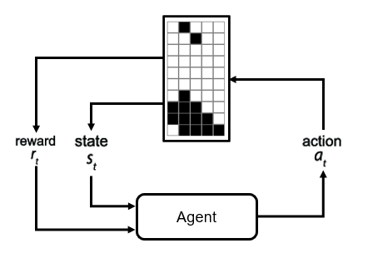
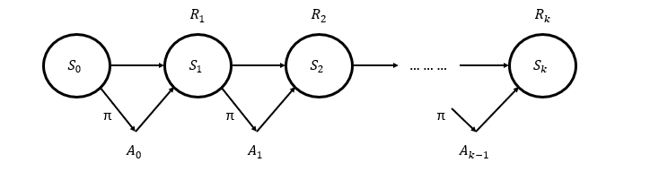
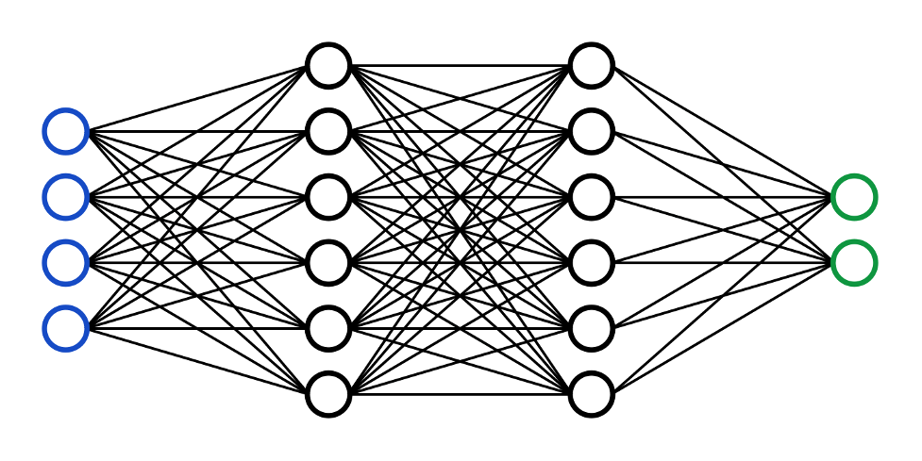
Overview of the project
What is Reinforcement Learning?
Reinforcement Learning Basics
Reviewing the Current Results
Notes:
In this presentation I will give an introduction to what RL is and how the interactions between the different components of this machine learning strategy interacts.
Then I will go through the basic concepts of RL and explore the technical side thereof.
Lastly I will look at how the RL is applied to the Tetris environment and analyze the results and challenges thus far.

Slide 3
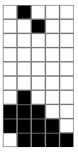



What is Reinforcement Learning?
Markov Decision Process:
Environment
A process in which the next state can be known by only knowing the information of the previous state.
Agent
Value function
V_{f}
policy
π
Notes:
RL has two main components, the Environment which will be affected and an agent which will explore the environment.
In our case the environment will be the Tetris game. The agent will be some estimator or function such as a neural network that takes has an input and output.
The environment will provide the agent with an observation or state, which will serve as an input to the agent. The agent will then generate an output, namely the action for the given the input state. This action will then affect the environment in some way.
The environment will now provide the next state and a reward, giving the agent feedback on the quality of the action that it has chosen. The agent will then update the function or policy that it used to choose the action based on this feedback. The agent will also use a value function to determine how good it is to be in state that it reached and use this to further update the policy to maximize the reward that it would receive in the future.
This structure is based on the Markov Decision Processes. This means that this is a process in which the next state can be known by only knowing the information of the previous state.

Slide 4
Reinforcement Learning Basics - Policy
Mapping of the input environment observation to a probability distribution of the available actions that can be taken
$$π_{θ}(S_{t})=P\left[A_{t}=a \right|S_{t}=s]$$
Probability Distribution
Agent
All Available Actions
Expected Future Rewards
Notes:
An important concept to understand in RL is the Policy of the agent. This describes how the agent chooses the actions from the input states and can formally be defined as the mapping of the input environment observation to a probability distribution of the available actions that can be taken.
An is denoted by pi in the following function. But what does this mean?
Let's look a bit closer at the agent that we are using, this agent is nothing more than a function or a non-linear approximator such as a neural network, which will take the current state as the input to the function and output either a probability distribution of the actions or the expected future reward for all the available actions in the environment.

Slide 5

Reinforcement Learning Basics – Value Function
Mapping of the input environment observation (or action-value pair) to the expected future reward (value) of the current policy
$$v\left(S_{t}\right)=E[G_{t}|S_{t}=S]$$
$$G_{t}=R_{t+1}+γR_{t+2}+γ^{2}R_{t+3}+…$$
Expected Future Rewards
Current State
Notes:
This differs somewhat from the value function, which aims to estimate the value of being in a specific state.
In other words, this is the mapping of the input environment observation (or action-value pair) to the expected future reward (value) of the current policy and is denoted by v_f in the following function.
The G_t represents the expected discounted return and is the sum of all the expected future rewards that the agent will receive given that it is starting in the input state St
The value function works much the same as the policy in that it has a function or estimator, with the same weights and biases as the policy estimator. It also has a state as the input, but this time instead of producing multiple outputs for each of the available actions, the estimator will have one output which is the expected future reward of the current input state.

Slide 6

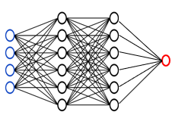
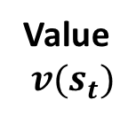
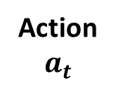
Relationship between the Policy and Value Function
Policy Estimator
Action
$$a_{t}$$
Backpropagate
Value
$$v(s_{t})$$
Loss Function
Value Estimator
Notes:
The relationship between the policy and the value function is important as this is the method in which the RL agent will be updated to learn the correct actions for the input states to maximise the reward that it receives.
We start with the policy estimator and the value estimator that have the same weights and biases. The policy estimator takes the current state as an input.
The policy estimator will produce an action from this input state. The action will then change the environment and this next state is fed to the value estimator.
The value function will produce an estimation of the value of reaching the next state. The environment will also produce a reward and will be combined with the value estimation in the loss function to produce the error of the estimators.
This error will then be used to backpropagate through the networks and update the weights and biases.

Slide 7


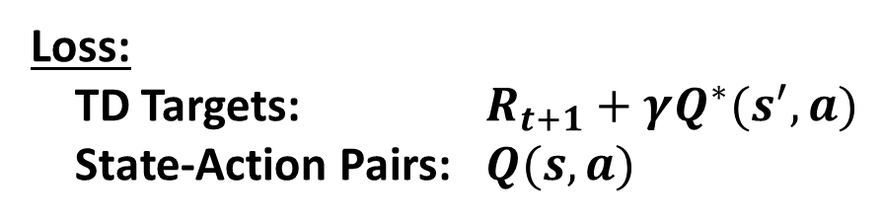
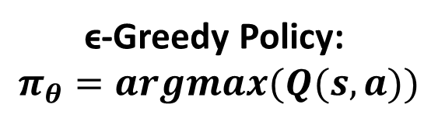
Types of Reinforcement Learning
Model-Free Reinforcement Learning
Q - Learning
Policy Optimization
Policy Estimator
Approximated Q Values – Each Action
$$Q(s,a)$$
Loss:
TD Targets: $R_{t+1}+γQ^{∗}(s^{′},a)$
State-Action Pairs: $Q(s,a)$
ϵ-Greedy Policy:
$$π_{θ}=argmax(Q(s,a))$$
Approximated Q Value – Next State
$$Q^{∗}(s′,a)$$
Value Estimator
Notes:
There are many types of RL, but the only category that I will be focusing on is the Model Free Methods and the two main methods in this category is Q – Learning and Policy Optimization.
For both methods there are two estimators that take states as inputs. These can be labelled as the policy and value estimators.
Focussing on just Q – Learning, the policy will produce the Q values for each of the available actions and the value function will produce the approximated Q-value of the input state. This can be denoted in the following format.
An Action is chosen by choosing the option that will yield the maximum reward.
The networks are updated through the loss function that compares the TD Targets and the State-Action Pairs.

Slide 8
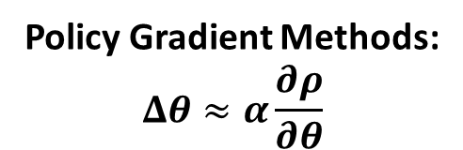
Types of Reinforcement Learning
Model-Free Reinforcement Learning
Q - Learning
Policy Optimization
Policy Estimator
Probability Distribution for Actions
Policy Gradient Methods:
$$Δθ≈α\frac{∂ρ}{∂θ}$$
Estimated Value of the taken action
Value Estimator
Notes:
For the policy optimization however, the policy estimator will produce a probability distribution for all the available actions. An action is selected by sampling from this distribution.
The value estimator will then estimate the value of the action taken and use this parameter to update the networks through policy gradient methods.

Slide 9
Types of Reinforcement Learning
Model-Free Reinforcement Learning
Q - Learning
Policy Optimization
OFF-Policy:
This method can learn from all the experience gained by interacting with the environment, even with older versions of the policies
ON-Policy:
This method can only learn from the experience gained by the previous policy, limiting the sampling efficiency of the experience
Notes:
Another thing to note is that…

Slide 10

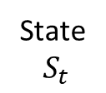
Reinforcement Learning Applied to Tetris
State
$S_{t}$
Melax Tetris
5
10
[1,50]
Notes:
Before we apply RL to the Tetris environment, we must understand how the playing field works. Thus far I have only worked on a smaller version of Tetris, namely Melax’s Tetris which is only half the size of normal Tetris and uses simpler pieces.
The game field is a matrix of black and white blocks which denote the pieces and the open spaces, respectively.
This allows us to flatten the matrix into a 1x50 state vector that serves as an input to the estimators. Quickly looking at the policy estimator, this neural network will output a 1x4 vector for the action space that either denotes the probability distribution or the expected return for each action.

Slide 11

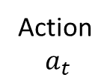
Reinforcement Learning Applied to Tetris
State
$S_{t}$
Melax Tetris
Actions:
Rotate
Left
Right
Drop
Action
$a_{t}$
Rewards:
+1 : Clearing a line
- 1 : Game Over
+0.1 : Time Step
[1,4]
[1,50]
Notes:
That serves as an input to the estimators. Quickly looking at the policy estimator, this neural network will output a 1x4 vector for the action space that either denotes the probability distribution or the expected return for each action.
There are 4 actions that are available to take, namely Rotating the piece, moving the piece left or right or dropping the piece into a position.
There are three main rewards that can be given to the agent which is +1 for clearing a line, -1 for game over and +0.1 for a time step to encourage the game to play longer.

Slide 12
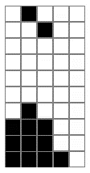
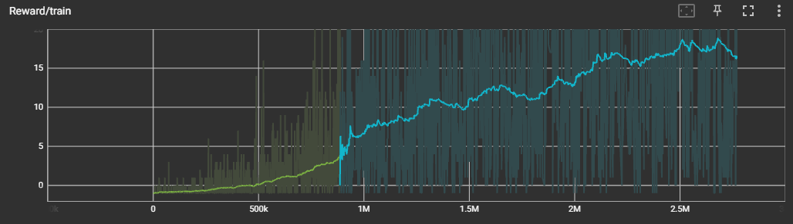
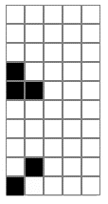
Reinforcement Learning Results
Deep – Q Learning
DQN Statistics:
Training Time: 2.5 Million
Maximum Score: 324
Average Score: 20
Average Game Length: 150
10000 Time Steps
2.5 Million Time Steps
Notes:
We can now look at the results of the best DQN method applied to the Tetris environment.
The Reward for the training is plotted against the timesteps. From this we can see that the training has a strong upward trend and can be left to train for even longer to improve the model.
We can compare the model at 10000 timesteps where it would take random actions and the model at 2.5 Million steps where it would clear lines consistently.
Some statistics for the model at the training time of is 2,5 Million steps – this model reached a high score of 324, however only an average score of about 20 lines. The average game also lasts around 150 timesteps.

Slide 13
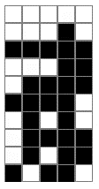
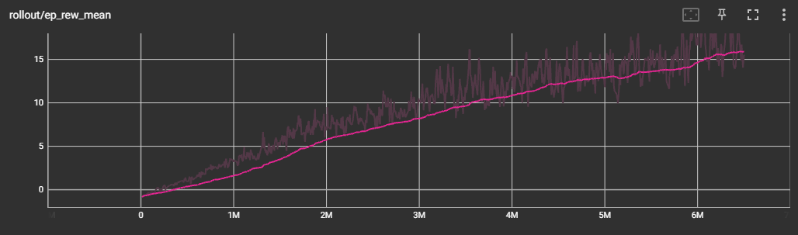
Reinforcement Learning Results
Proximal Policy Optimization
- Using StableBaselines V3
PPO Statistics:
Training Time: 2.5 Million
Maximum Score: 1200
Average Score: 330
Average Game Length: 1250
10000 Time Steps
2.5 Million Time Steps
Notes:
I also applied PPO to the environment, however so far I have only used the StableBaselines v3 libraries to do so.
Once again, the Reward for the training of the model. The trend for this method is upward at a gentler slope than it’s DQ Learning counterpart, however this method is still in the early phase of development and still needs some work.
Comparing the model at 10000 timesteps we see the model does not perform very well, however at X timesteps the model clears lines consistently.
Some statistics for the model at the training time of is 2,5 Million steps – this model reached a high score of 324, however only an average score of about 20 lines. The average game also lasts around 150 timesteps.

Slide 14
Challenges Remaining
Challenge:
Gameplan:
Imitation Learning
Sparse Rewards
Reward Shaping
Large Input Space
Convolutional Neural Network
Small Replay Buffer
Vectorize the Gym Environment
Large Training Time
Notes:
Lastly, we will look at some of the challenges remaining in this project.
The first challenge is Sparse Rewards: In the normal 10x20 Tetris environment the models do not clear lines consistently enough through random actions to learn a better policy. The gameplan for this is to use imitation learning for Q-Learning, where a player would create a training set for the model, and reward shaping for both methods to guide the agent in the right direction.
The second problem is the large input space that the environment has. This could be mitigated through a CNN, however previous attempts to implement this have proven unsuccessful.
The third problem which is exclusive to PPO is the small replay buffer that it can use, resulting in a long training times. The solution is to vectorize the environment and have multiple games playing in parallel to generate more training data.
Lastly the models take a long time to train and sometimes need to be left overnight. This is the newest issue and will be dealt with once all the methods have been properly setup.

Slide 15
Solving Tetris using Reinforcement Learning
By Divan van der Bank

Slide 16

$$Q_{1}$$
$$Q_{2}$$
$$Q_{3}$$
$$Q_{4}$$
0
0
0
1
0
0
1
.
.
.
1
0
0
0
1
1
1

Slide 17

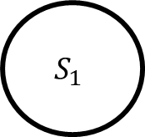

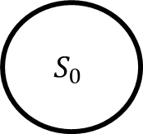

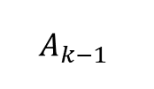
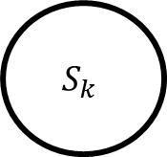

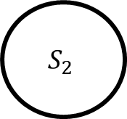
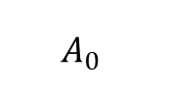

Reinforcement Learning Basics – MDP
$$R_{1}$$
$$R_{2}$$
$$R_{k}$$
$$S_{0}$$
$$S_{1}$$
$$S_{2}$$
$$S_{k}$$
… … …
π
π
π
$$A_{0}$$
$$A_{1}$$
$$A_{k−1}$$
Discounted Future Reward:
Expected Future Reward:
$$G_{t}=R_{t+1}+γR_{t+2}+{γ^{2}R}_{t+3}+…$$
$$G_{t}=R_{t+1}+R_{t+2}+R_{t+3}+…$$
$$γ∈[0,1]$$

