Slide 1
Emotion Mining and Sentiment Analysis in Software Engineering Domain

Slide 2
Objective
To detect the presence or absence of emotions in the comments of software developers.
To collect data consisting of comments on issues faced by software developers.
To obtain an unbiased manual labelling on the extracted comments.
To perform sentiment analysis on extracted comments using existing standard tools.
Compare the agreement between manual labelling and sentiment analysis tools.

Slide 3
Introduction
Data and knowledge are of prime importance in today’s world. Data is available all across the internet, knowledge is what gives you lead.
A better insight of industry, your employees and workers can be gained if one knows what people think.
Study of sentiments in various domains around us gives us useful information as to what kind of emotions people are experiencing while working.

Slide 4
Cont…
Hello Mikhail Khludnev, your patch works nicely!
This comment tells us that the author is happy with the work of a colleague and the atmosphere of the forum is positive.
What on earth did this comment mean? Why would a user have to (in the past) manually rewrite their query before searching.
This one indicates that the author of this comment is little angry about an arte-fact or a fellow programmer, which creates a sense negativity in the working environment.

Slide 5
Related Study
Pang and Lee 2008, “Emotion mining tries to identify the presence of human emotions like joy or fear from text, voice and video artefacts produced by humans”.
Murgia, Tourani, Adams, & Ortu. 2014, showed that humans can show numerous amounts of emotions like sadness, happiness, anger, fear etc in their comments.
Jongeling, Sarkar, Datta, & Serebrenik 2017, tried to study the agreement between different tools and human evaluators.

Slide 6
Methodology Used
Data Collection
Collected data from the issue reports of MTOMCAT, RAT and LUCENE which are open source Apache JIRA softwares.
Python’s BeautifulSoup, urllib and openpyxl libraries were used to scan the whole HTML pages and extract the comments along with their authors, date, time and comment ID.
For the purpose of analysis, 500 comments were selected out of a total of 1117.
We choose the comments in groups of 10 to maintain the flow of context.

Slide 7
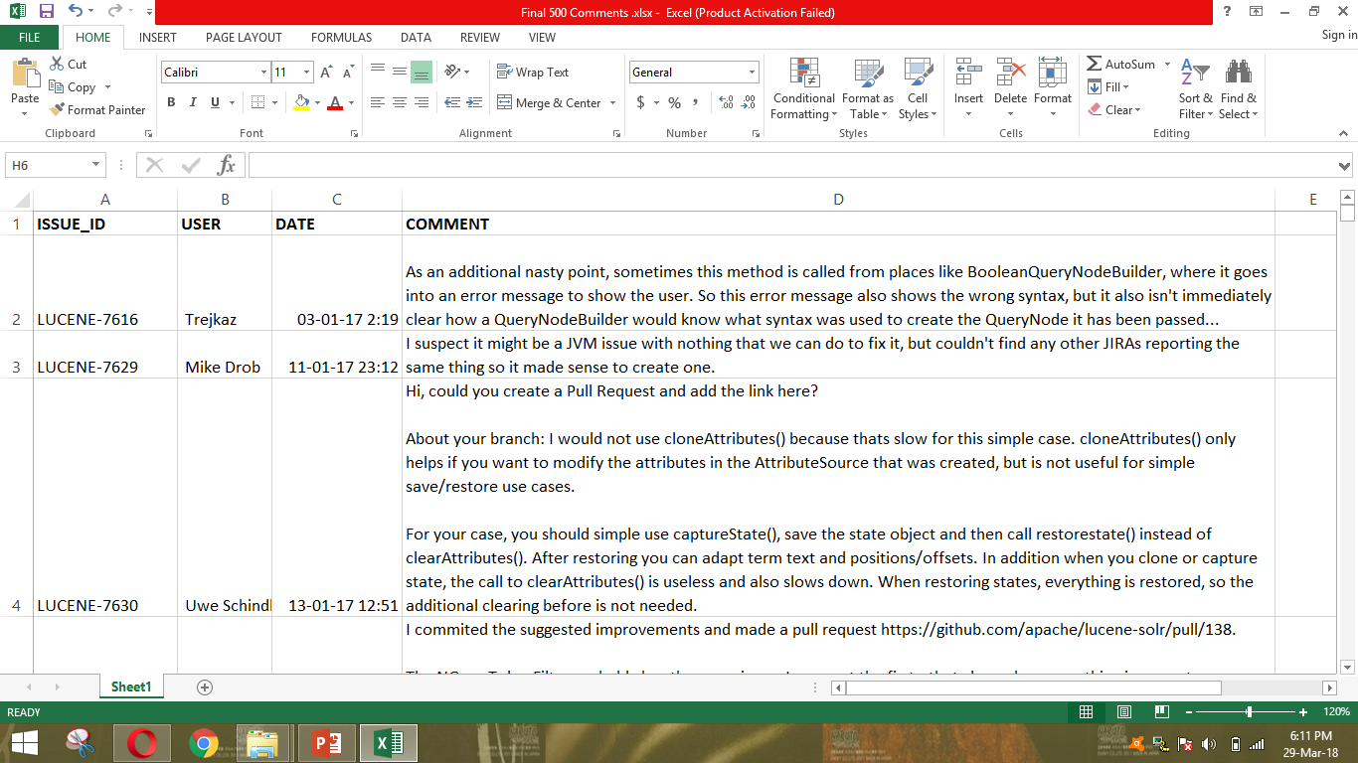
Dataset Description

Slide 8
Emotion Mining
Comments were rated based on Parrott’s framework.
Emotions like joy or love indicated positive emotion whereas sad, fear or anger indicated negative emotion.
Comment is identified as positive(+1) if 3 or more evaluators have labelled it with positive emotion and no evaluator has labelled it with negative emotion.
Comment is marked neutral if 3 or more evaluators have shown neither positive nor negative sentiment.
Comments were labelled contradictory if they were labelled joy by one rater and fear by another.
At last we were left with 386 comments out of 500 in our dataset.

Slide 9
Sentiment Analysis
SentiStrength, calculates polarity by assigning a positive integer p between 1 and 5 and a negative integer n between -1 and -5. A text was rated as positive if p + n > 0, negative when p + n < 0 and neutral when p + n = 0 and p < 4.
NLTK API at text-processing.com2 was called using the textual comments as parameters. The API call returned the probabilities of a sentence being negative, positive and neutral. If the probability of comment being neutral is more than 0.5, then it is marked neutral. Else, whichever other probability is greater, comment was marked having that sentiment.

Slide 10
Cont…
Watson Natural Language Understanding (WNLU) which is IBM’s sentiment analysis tool. This tools is an API which returns a score that is between [-1, 1]. A negative score signifies negative sentiment, a positive score indicates positive sentiment and 0 for neutral.
Microsoft Azure’s Text Analytics API was also used for classification of the texts. Comments with a score less than 0.26 were identified as negative, those having score greater than 0.74 were considered positive and the remaining 50% bracket was left for comments showing no sentiments.

Slide 11
Evaluation Metrics
Weighted Kappa is an agreement measure which also takes agreement by chance into consideration.
Adjusted Rand Index which evaluates whether two comments are tagged with same sentiments or not. The value of ARI ranges from 0 to 1, where 0 indicates independent partitions and 1 denotes identical partitions
Kappa Value | Interpretation of Agreement btw Raters
<0 | Poor
0 - 0.20 | Slight
0.21 - 0.40 | Fair
0.41 - 0.60 | Moderate
0.61 - 0.80 | Substantial
0.81 - 1.0 | Almost perfect

Slide 12
Results
When identifying emotions, only in 29.2% (146 out of 500) comments all the four raters had the same rating. From these 146 comments, 117 showed absence of emotion and were marked nil by all the four raters.
Results clearly indicate that the sentiment analysis tools do not agree with the manual labelling as no tool could achieve substantial or better agreement value of Kappa (0.6 or more).
WatsonNLU scores best with Kappa=0.43 and ARI=0.177, followed by Text Analytics and SentiStrength.

Slide 13
Agreement of sentiment analysis tools with the manual labeling and with each other
TOOLS | KAPPA | ARI
NLTK​ ​ vs​ ​ Manual | 0.3 | 0.06
SentiStrength​ ​ vs​ ​ Manual | 0.39 | 0.139
WatsonNLU​ ​ vs​ ​ Manual | 0.43 | 0.177
TextAnalytics vs Manual | 0.4 | 0.112
NLTK​ ​ vs​ ​ SentiStrength | 0.3 | 0.069
NLTK vs WatsonNLU | 0.49 | 0.221
NLTK vs TextAnalytics | 0.38 | 0.119
SentiStrength vs WatsonNLU | 0.49 | 0.202
SentiStrength vs TextAnalytics | 0.31 | 0.07
WatsonNLU vs TextAnalytics | 0.36 | 0.114

Slide 14
Conclusion
Most of the comments were marked as ‘nil’ indicating that either software developers rarely show emotions in issue reports or even human evaluators are not substantially sufficient to find sentiments in software developers' comments.
Hence an effective machine learning model may be quite difficult to create for software engineering domain.
However, a regular use of emoticons by software developers might help future researchers to mine emotions more accurately and precisely and make appropriate machine learning models that will in turn automate the process of emotion mining.

Slide 15
THANK YOU

