Slide 1
Deep Learning – Recurrent Neural Networks (RNN)
By,
Divesh R. Kubal
Data Scientist, eClerx Services
Center of Excellence – Machine Learning

Slide 2
Table of Contents
Time Series
Sequence Problems
Word Embeddings
Recurrent Neural Nets
Long Short Term Memory

Slide 3
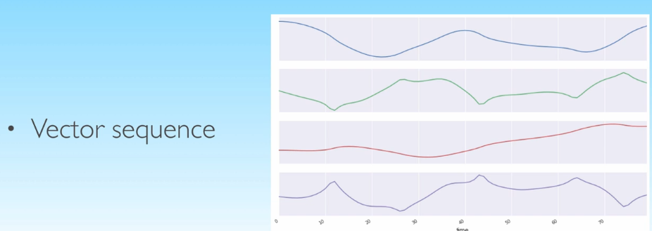
Time Series

Slide 4
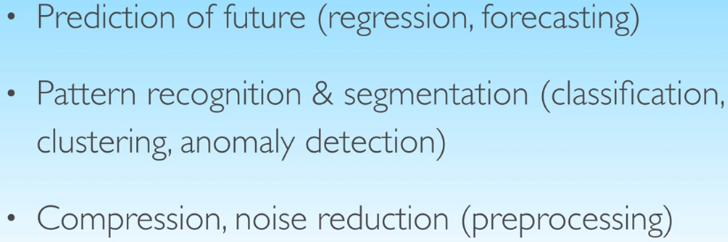
ML for Time Series

Slide 5
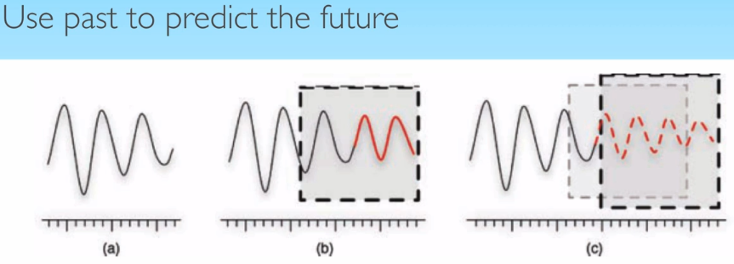
Prediction

Slide 6
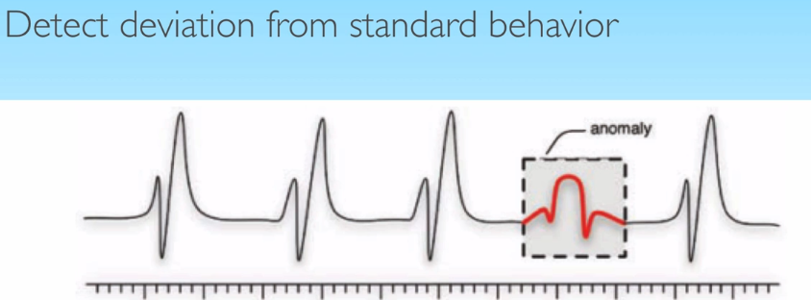
Prediction

Slide 7
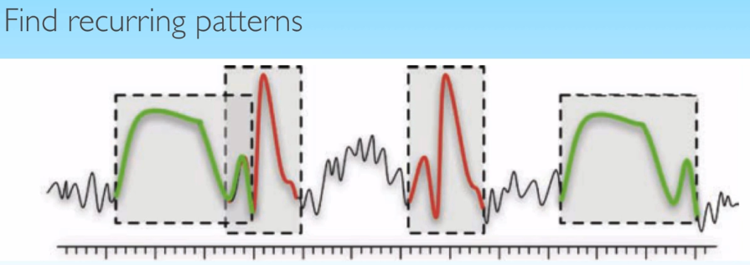
Prediction

Slide 8
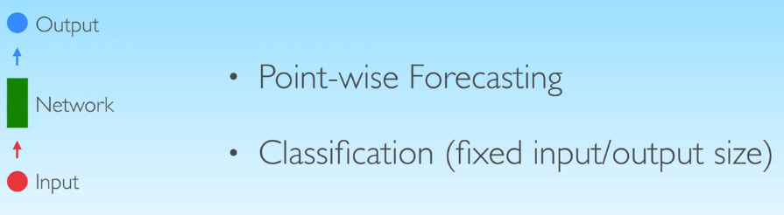
Sequence Problems One to One

Slide 9
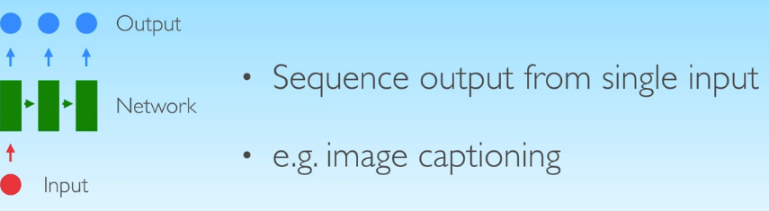
One to Many

Slide 10
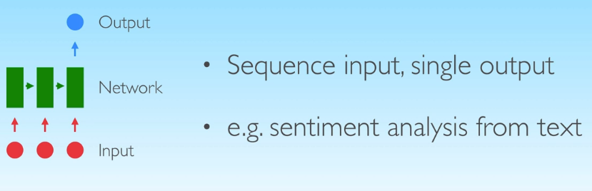
Many to One

Slide 11
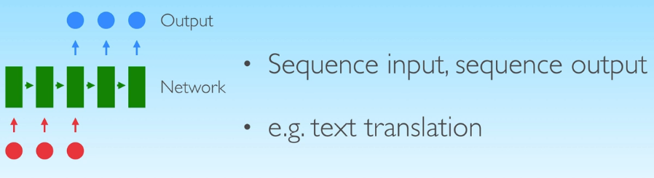
Many to Many

Slide 12
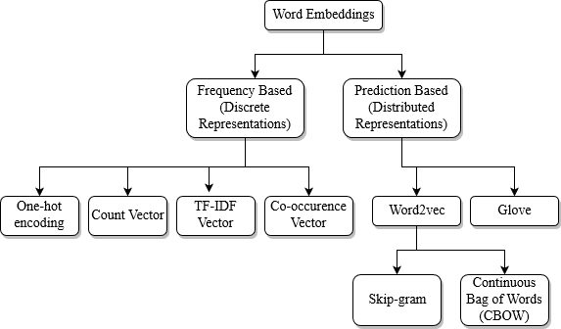
Word Embeddings
Word Embeddings are the texts converted into numbers and there may be different numerical representations of the same text.

Slide 13
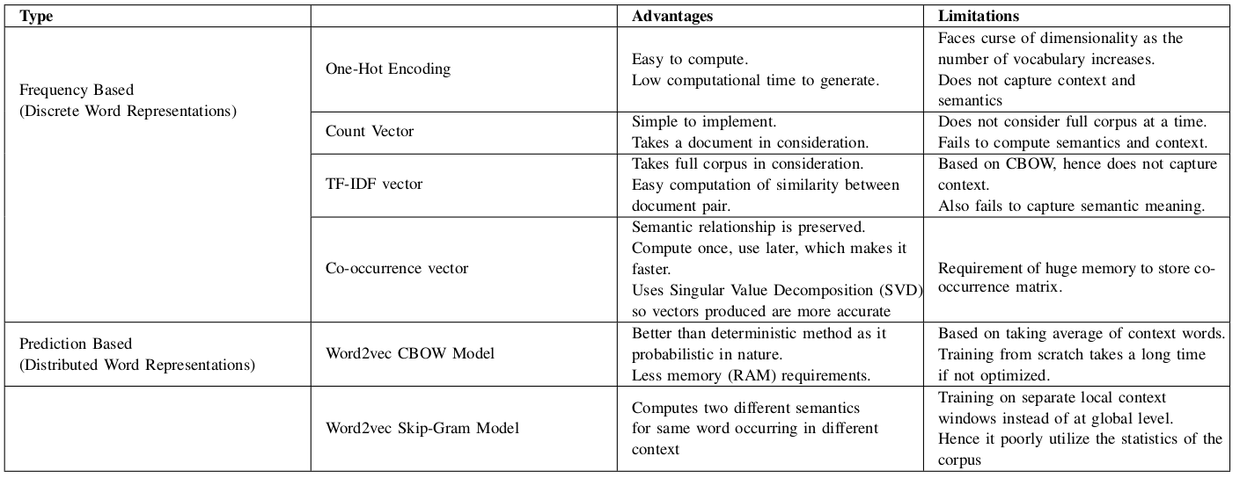
Word-Embedding Approaches Comparison

Slide 14
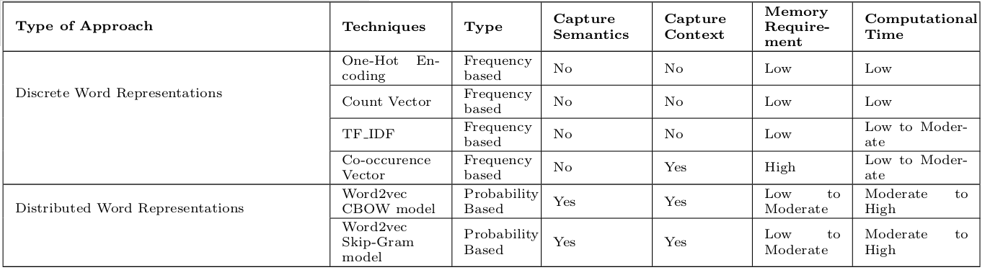
Word-Embedding Approaches Comparison

Slide 15

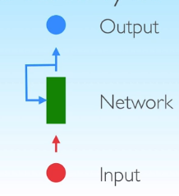
RNN
Connections between units form a directed cycle
Networks with internal state

Slide 16
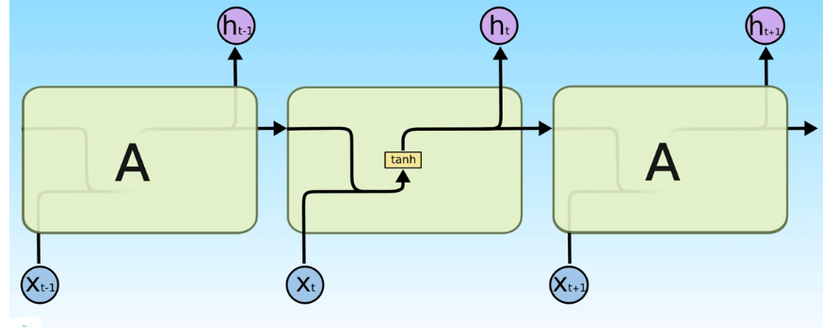
Vanilla RNN

Slide 17
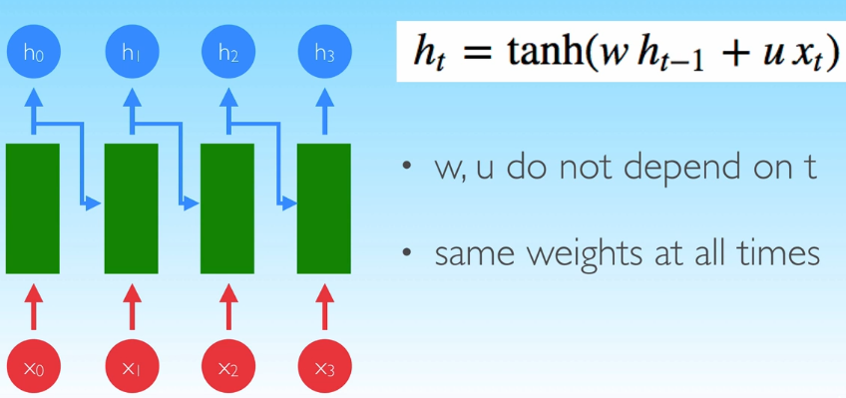
Unroll Time

Slide 18
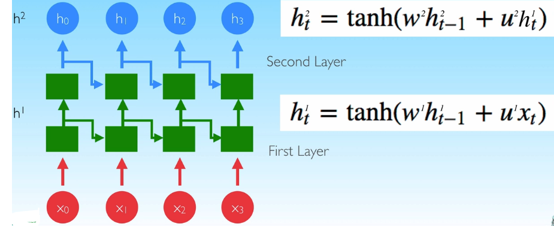
Deep RNN

Slide 19
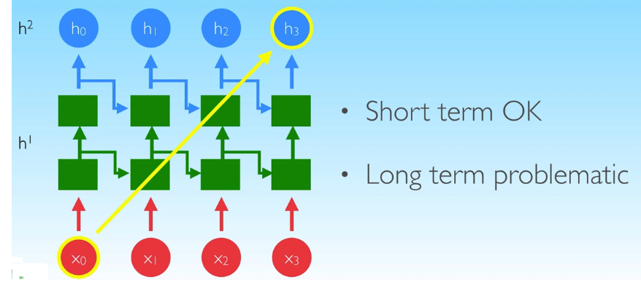
Long Term Dependency Problem

Slide 20
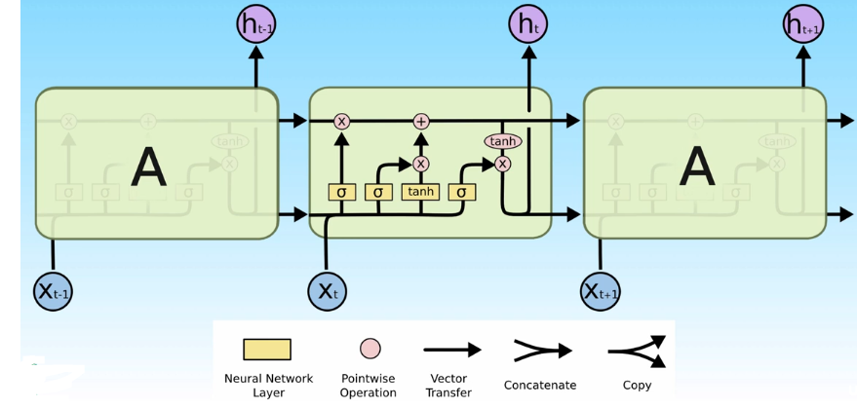
LSTM
Learn to selectively remember and forget

Slide 21
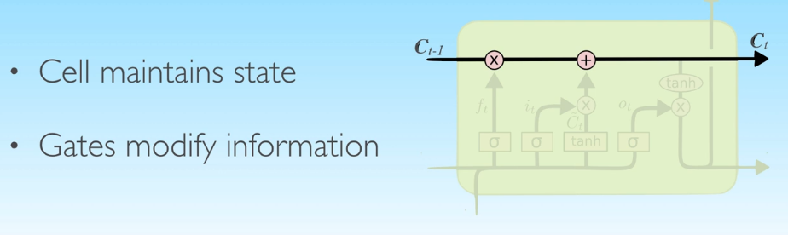
Cell State

Slide 22
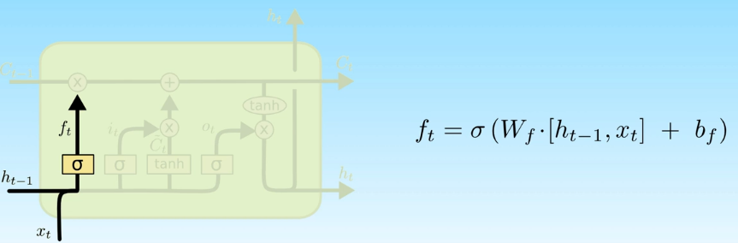
Forget Gate

Slide 23
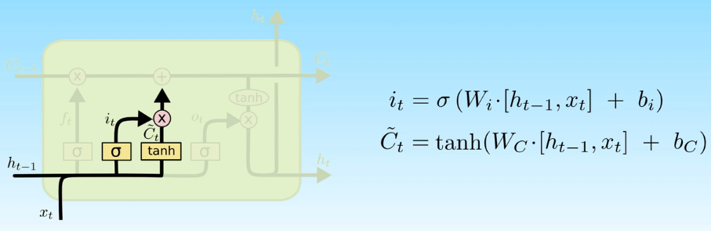
Input Gate

Slide 24
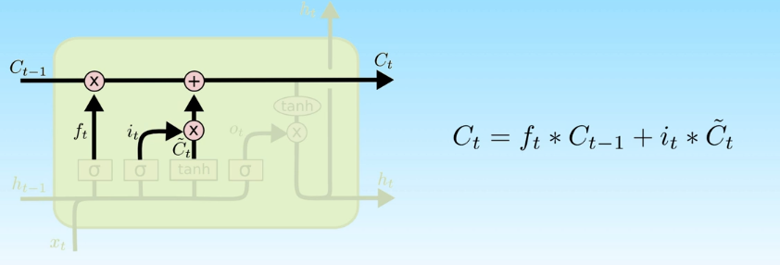
State Update

Slide 25
Github Link
https://github.com/DiveshRKubal/GreyAtom-Deep-Learning/tree/master/GreyAtom-Deep-Learning/RNN

