Slide 1
Campus Lost & Found
LOST
FOUND
CLAIMED
A DevOps capstone: from a git push to a watched Kubernetes app
Divijaa · github.com/Divii2205/campus-lost-and-found

Slide 2
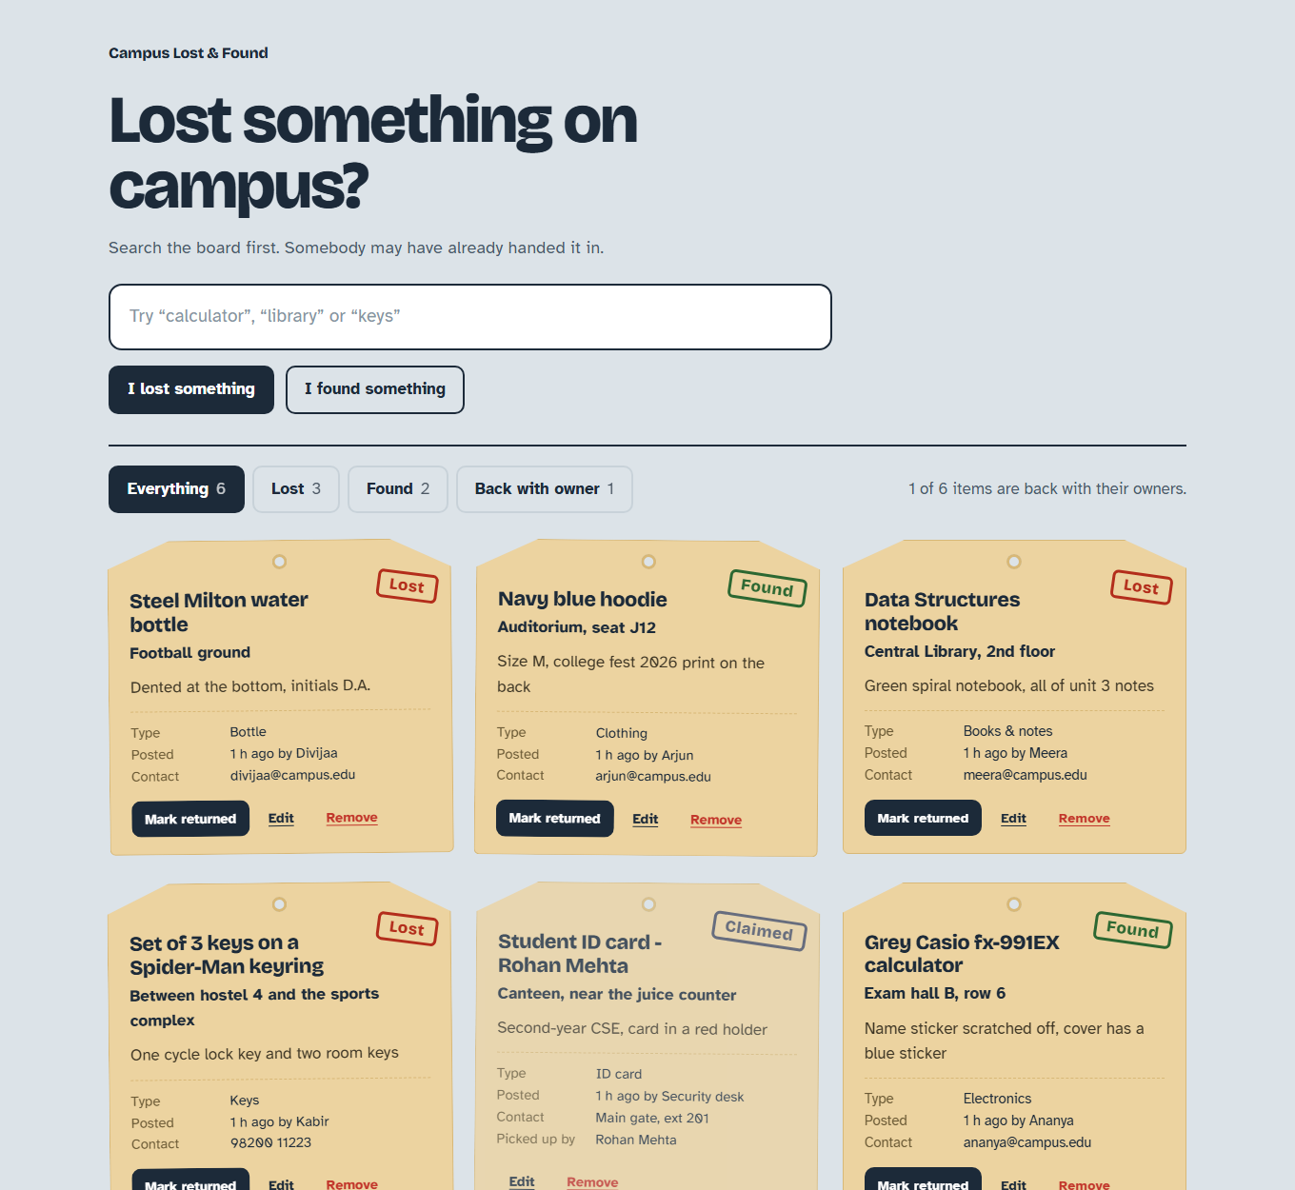
Project overview
THE APP
Lost something?
Search the board, then post a Lost report with the place and a contact.
Found something?
Post a Found report so the owner knows where it is.
Back with owner
Mark it returned and it gets a Claimed stamp.
Under the hood
FastAPI, 7 item endpoints, PostgreSQL, 11 tests.
What I built around it
Every change is tested, scanned, packed into a SHA tagged image, deployed from Git by Argo CD and watched with Prometheus and Grafana.
The real app: each report is a paper tag with an ink stamp

Slide 3
Tech stack
TOOLS
App
React 18 + Vite, FastAPI, SQLAlchemy, PostgreSQL 16, Alembic
Tests
pytest with a throwaway SQLite database per test
Containers
Docker non-root images, multi-stage frontend, Docker Compose
CI/CD
GitHub Actions, GitHub Container Registry, commit SHA tags
Security
Trivy image scan gate, gitleaks secret scan
Infrastructure
Terraform on AWS: VPC, subnets, IGW, EKS, node group, IAM
Kubernetes
kind, Helm 3, ingress-nginx, metrics-server, HPA
GitOps
Argo CD with auto sync, prune and self heal
Observability
kube-prometheus-stack: Prometheus, ServiceMonitor, Grafana

Slide 4
Architecture
BIG PICTURE
Developer
git push
GitHub repo
main branch
GitHub Actions
pytest, build, Trivy
GHCR
image:<sha>
Terraform
AWS VPC + EKS
values-gitops
.yaml (tags)
frontend x2
nginx + React
Kubernetes cluster (kind locally, EKS on AWS)
Argo CD
syncs from Git
Ingress
lostfound.local
Prometheus
scrapes /metrics
backend 2 to 5
FastAPI (HPA)
PostgreSQL
+ PVC
Grafana
live dashboard
Argo CD manages the frontend, backend, database, ingress, HPA and ServiceMonitor

Slide 5
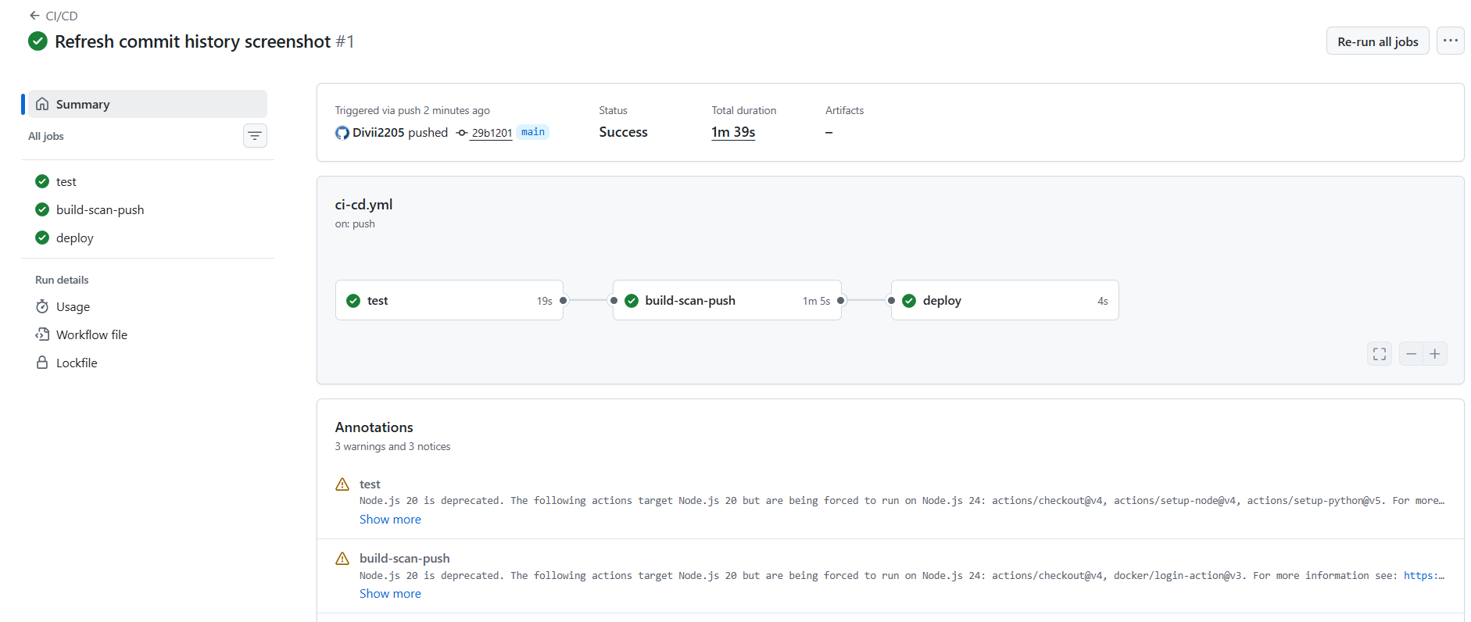
CI/CD flow
EVERY PUSH
1 test
pytest -v (11 tests)
npm ci and build
2 build
backend and frontend
images, tag = SHA
3 Trivy
fail on fixable
HIGH or CRITICAL
4 push
both images
to GHCR
5 deploy
Argo CD syncs the
new tag from Git
Runs on every push and pull request to main
A failed test or scan stops the pipeline, so no bad image reaches GHCR
Image tags are the commit SHA, never latest

Slide 6
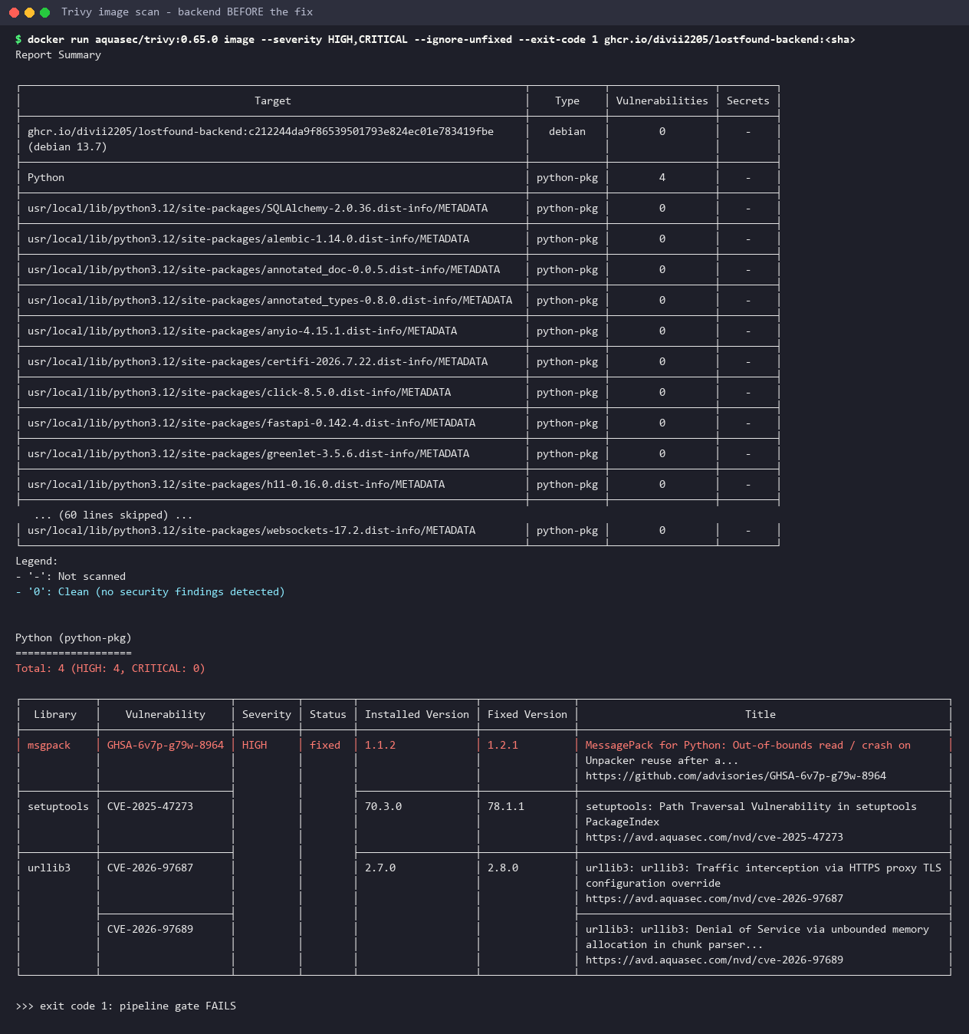
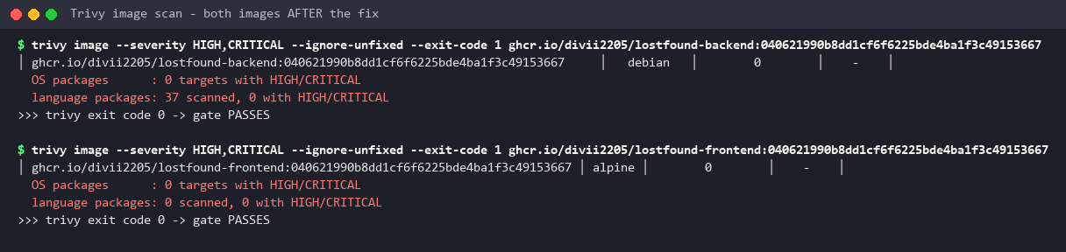
Security: a real Trivy finding
FIXED
CVE-2025-47273
A path traversal bug in setuptools 70.3.0. It came from pip and setuptools left in the image, not from the app.
The fix
Remove pip and setuptools after pip install. The app never needs them while it runs.
After: 0 HIGH or CRITICAL in both images. gitleaks also found no secrets in Git.
Before: 4 HIGH problems in the first backend image

Slide 7
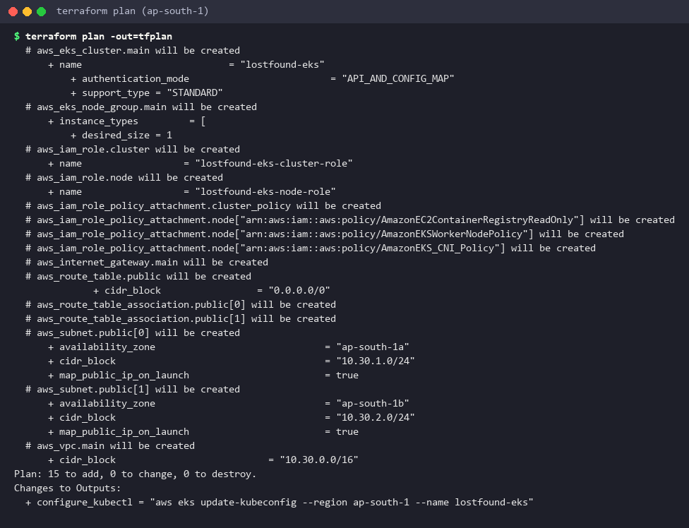
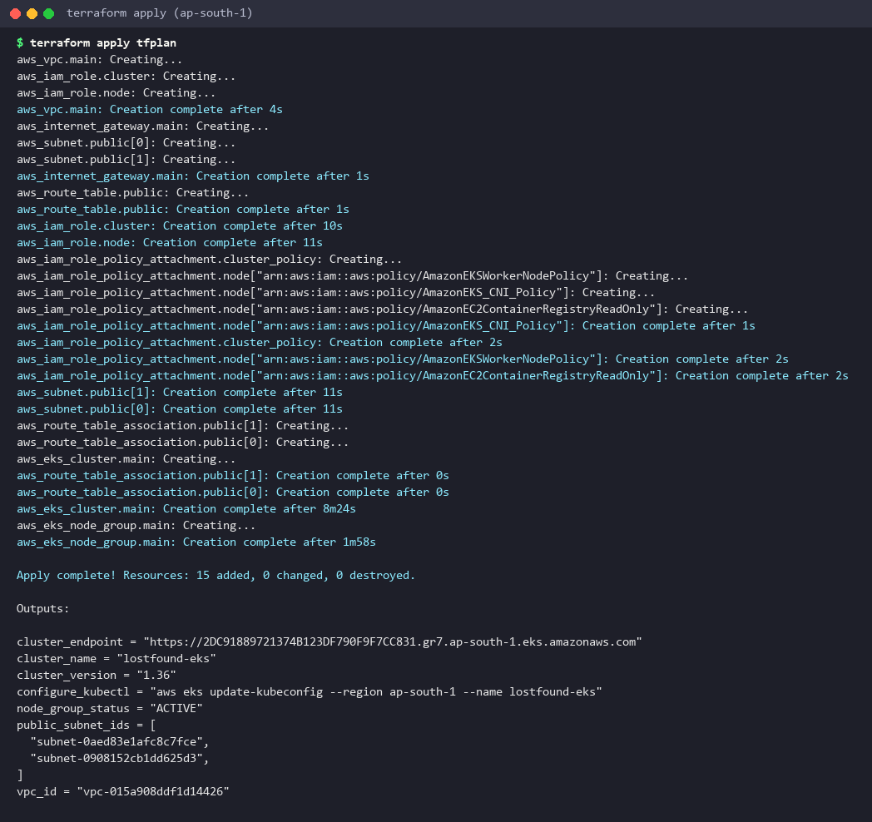
Infrastructure with Terraform
AWS
15
resources
2
public subnets
12 min
to apply
$0
left after destroy
main.tf: VPC 10.30.0.0/16, 2 public subnets in 2 zones, internet gateway, route table
eks.tf: IAM roles, EKS cluster lostfound-eks, managed node group (t3.small)
variables.tf and tfvars.example: no keys saved anywhere
No NAT gateway, to keep the cost low
terraform plan: 15 to add
terraform apply: 15 added

Slide 8
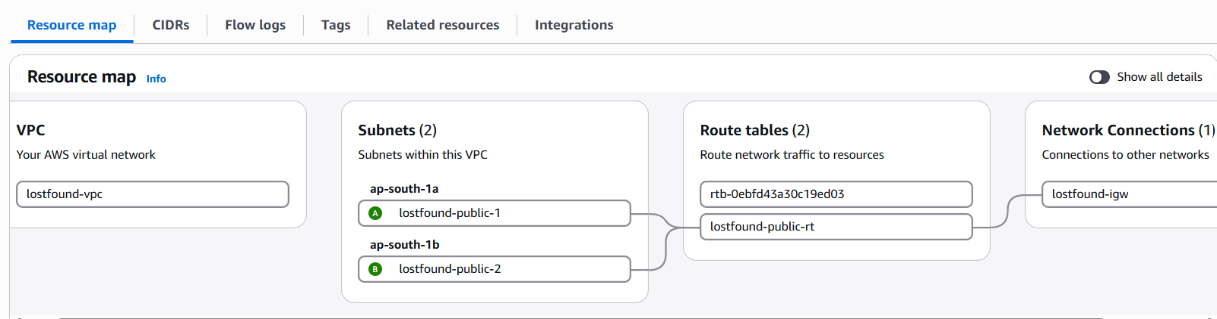
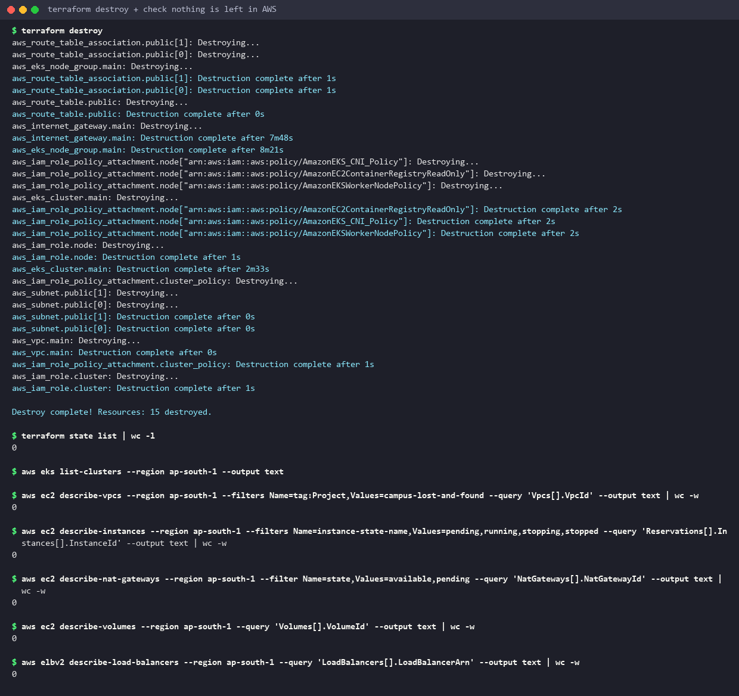
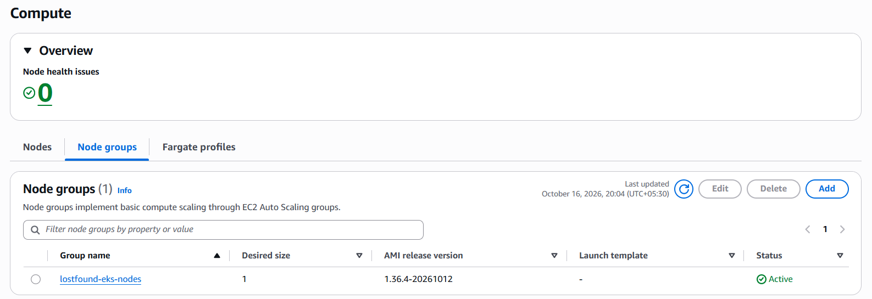
Proof on AWS: VPC and EKS
BUILT
AWS Console: the VPC with 2 public subnets, route table and internet gateway
Then terraform destroy: nothing left running
AWS Console: EKS cluster lostfound-eks with node group Active

Slide 9
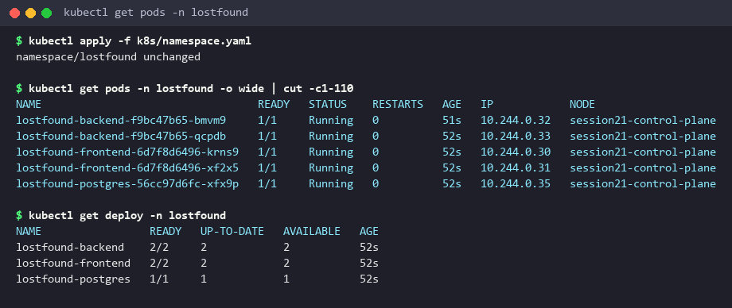
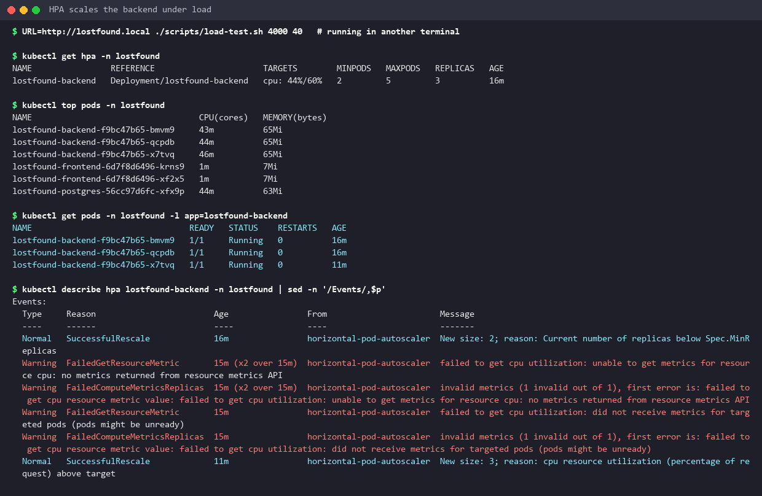
Kubernetes setup with Helm
HELM
Deployments
frontend x2, backend x2, PostgreSQL with a 1Gi PVC
Services + Ingress
ClusterIP Services. / goes to frontend, /api to backend
Probes + initContainer
startup, readiness, liveness. wait-for-db stops crash loops
Config
ConfigMap for settings, Secret for the database password
HPA
backend grows from 2 to 5 pods at 60% CPU

Slide 10
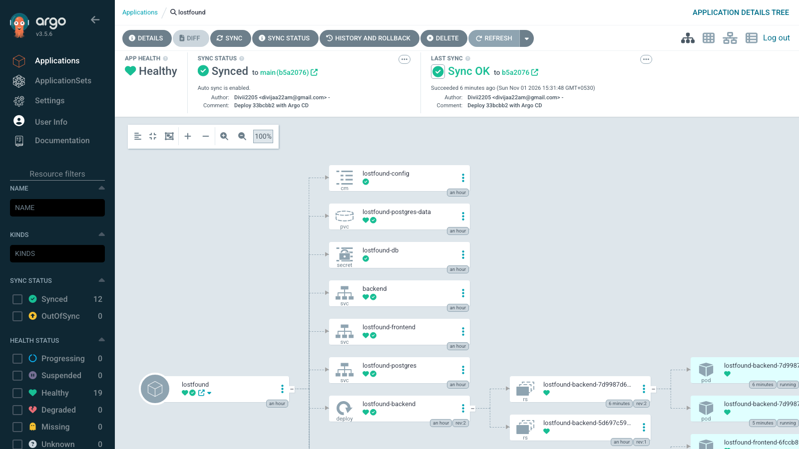
GitOps with Argo CD
SYNCED
git push
code change
CI green
tested, scanned, in GHCR
new SHA in Git
values-gitops.yaml
Argo CD sync
Synced + Healthy
new pods
rolling update
argocd/application.yaml points Argo CD at helm/lostfound on main
Auto sync, prune and self heal: Git is the only way to change the cluster
A release is a commit, so every deploy has a history and an easy rollback

Slide 11
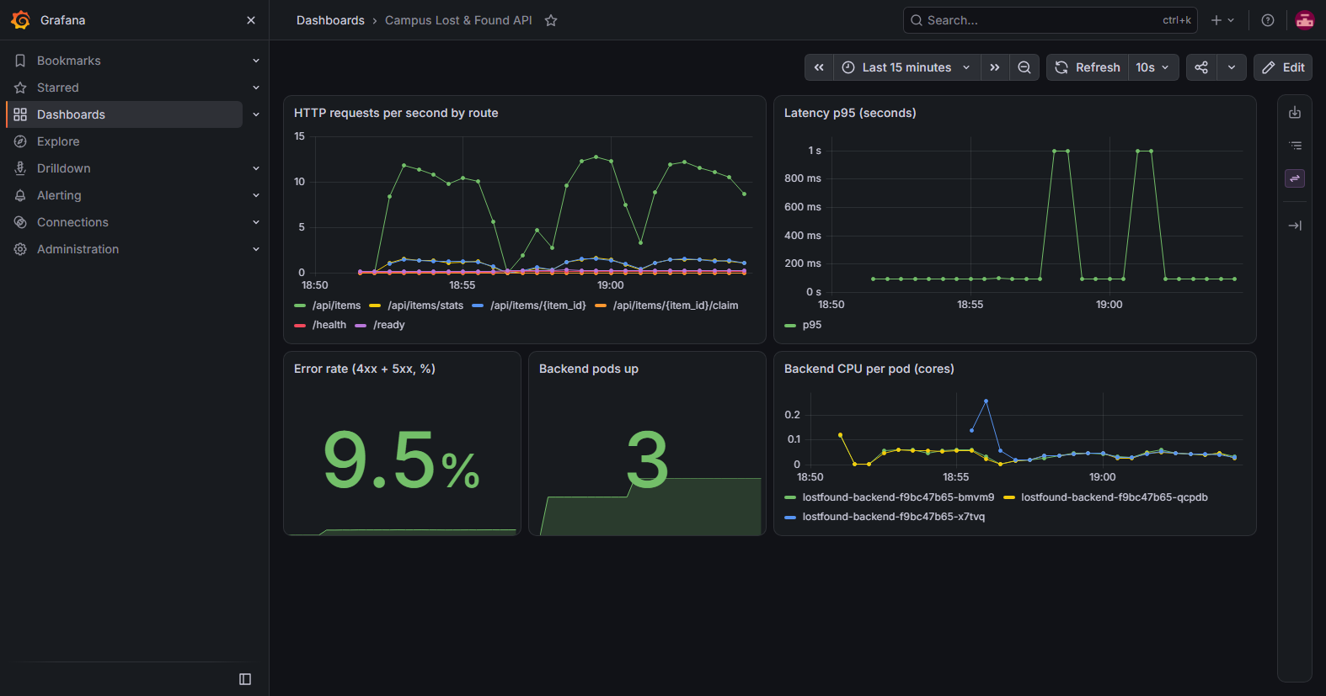
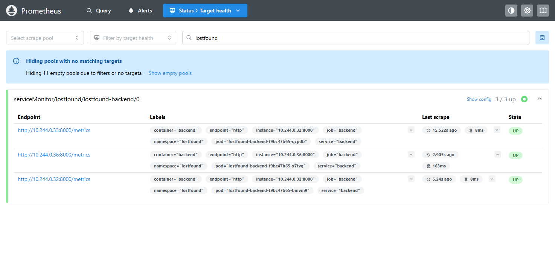
Observability
WATCHED
Prometheus Targets: every backend pod UP
Backend exposes /metrics in the Prometheus format
A ServiceMonitor tells Prometheus to read it every 15 seconds
The dashboard is a ConfigMap, so it is code too
Grafana: requests per second, p95 latency, error rate, pods up, CPU per pod

Slide 12
Problems I hit and fixed
RUNBOOK
Backend crash loop
Trivy gate failed
Why: Backend ran migrations before PostgreSQL was ready.
Fix: wait-for-db initContainer with pg_isready
Why: pip and setuptools carried 4 HIGH CVEs.
Fix: remove them from the runtime image
ImagePullBackOff
Service with no endpoints
Why: A tag that does not exist in the registry.
Fix: describe pod, then set a real SHA tag
Why: Selector app=lostfound-api matched no pods.
Fix: fix the selector to the pod label

Slide 13
Key learnings
LEARNED
1
Ready is not alive
/health says the process runs. /ready also checks the database, so traffic only goes to pods that can help.
2
Start order matters
Compose has depends_on. Kubernetes has no start order, so an initContainer does the waiting.
3
Most CVEs are leftovers
The app libraries were clean. The holes came from build tools left in the image.
4
SHA tags make deploys traceable
Every pod maps to one commit, and a rollback is one revert in Git.
5
Cloud costs money while it exists
No NAT gateway, one small node and destroy right after use kept AWS under a dollar.

Slide 14
Thank you
CLAIMED
Repository: github.com/Divii2205/campus-lost-and-found
Demo video: demo/demo-video.mp4
Every screenshot in these slides is real output from this project.
Divijaa

