Slide 1
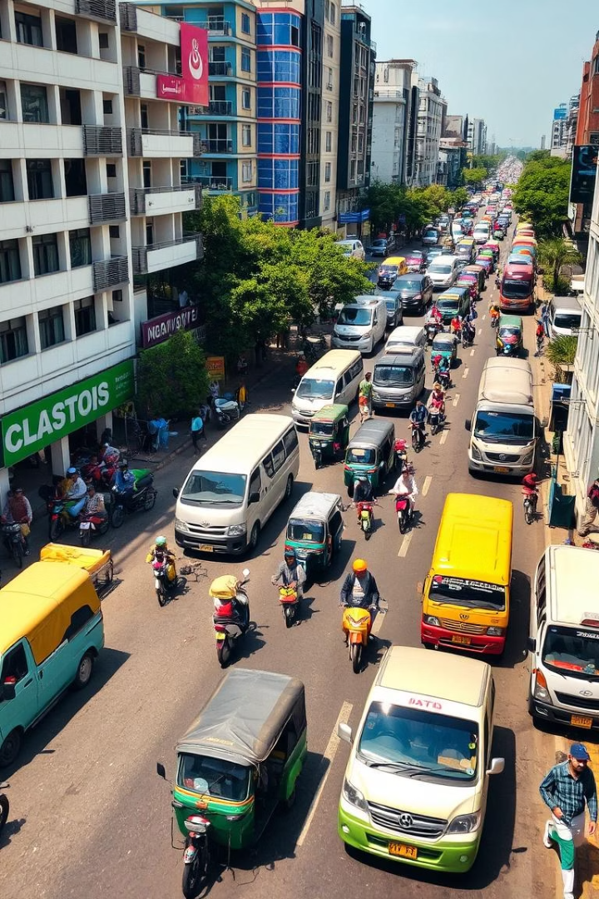
Comprehensive Analysis of Vehicle Detection System using YOLOv8
This project provides a detailed analysis of the vehicle detection system implemented using the YOLOv8 architecture. The project aims to detect and classify various types of vehicles in traffic scenarios, including cars, trucks, bikes, rickshaws, vans, taxis, and other vehicle categories. By utilizing advanced object detection techniques and custom data augmentation methods, this system demonstrates significant potential for real-world applications in traffic monitoring, autonomous driving, and urban planning.

Slide 2
Dataset Management and Preparation
Dataset Composition
Data Splitting Strategy
The dataset consists of traffic scenes captured from various perspectives, including dashboard camera footage with timestamp overlays, street-level views capturing diverse traffic patterns, varied lighting conditions, multiple camera angles and distances, and urban road environments with different densities of traffic.
The implementation uses a validation split approach to separate the dataset into training and validation sets. A 7% validation split was used to maximize training data and computational efficiency.

Slide 3
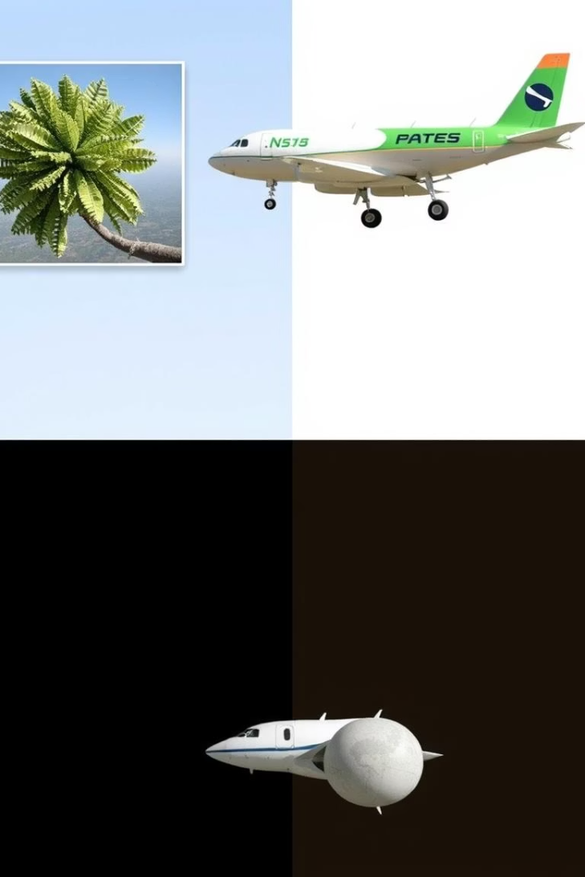



Data Augmentation: Cut-Paste Technique
Class Imbalance Mitigation
Contextual Learning
By placing vehicle objects in various positions and scenes, the model learns to identify vehicles in diverse contexts.
Allows for selective augmentation of underrepresented vehicle classes, improving model performance on rare vehicle types.
Occlusion Handling
The technique can simulate partial occlusions, improving the model's ability to detect partially visible vehicles.

Slide 4




Technical Details and Implementation Choices
Alpha Blending (α=0.8)
80% of the pixel values come from the pasted object, and 20% come from the target image background, creating a natural transition.
Overlap Prevention
The algorithm actively checks for overlaps before placing objects, preventing unrealistic scenarios.
Selective Class Augmentation
The implementation specifically focuses on augmenting non-class 0 objects, addressing class imbalance issues.

Slide 5
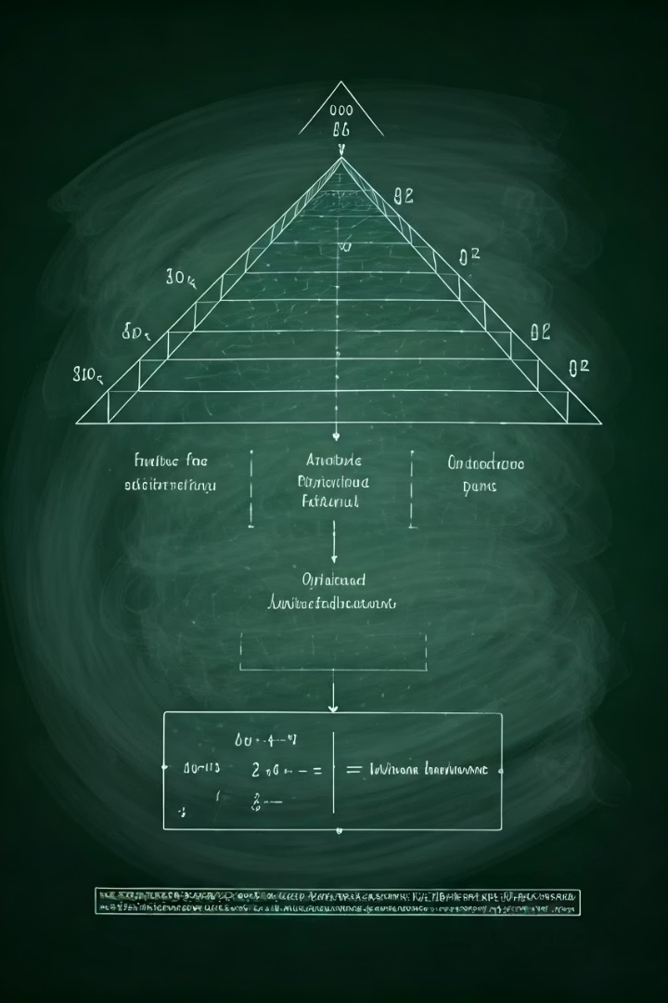
Model Architecture and Training
YOLOv8 Architecture
Training Process
YOLOv8 offers single-stage detection, feature pyramid network, anchor-free detection, advanced loss functions, and an optimized backbone.
Typical YOLOv8 training involves transfer learning, batch normalization, data augmentation, learning rate scheduling, and early stopping.
Hyperparameter Considerations
A confidence threshold of 0.001 was used during evaluation, prioritizing recall and comprehensive mAP calculation.

Slide 6
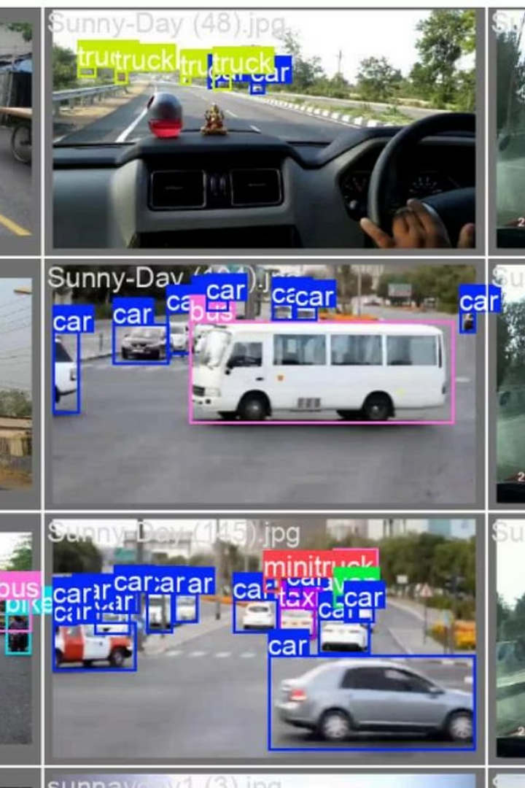
Model Performance Analysis
82%
73%
Precision
Recall
Approximately 82% of the model's detections are correct.
The model detects nearly three-quarters of all vehicles present in the images.
79%
mAP@0.5
Strong overall detection performance across all vehicle classes.

Slide 7
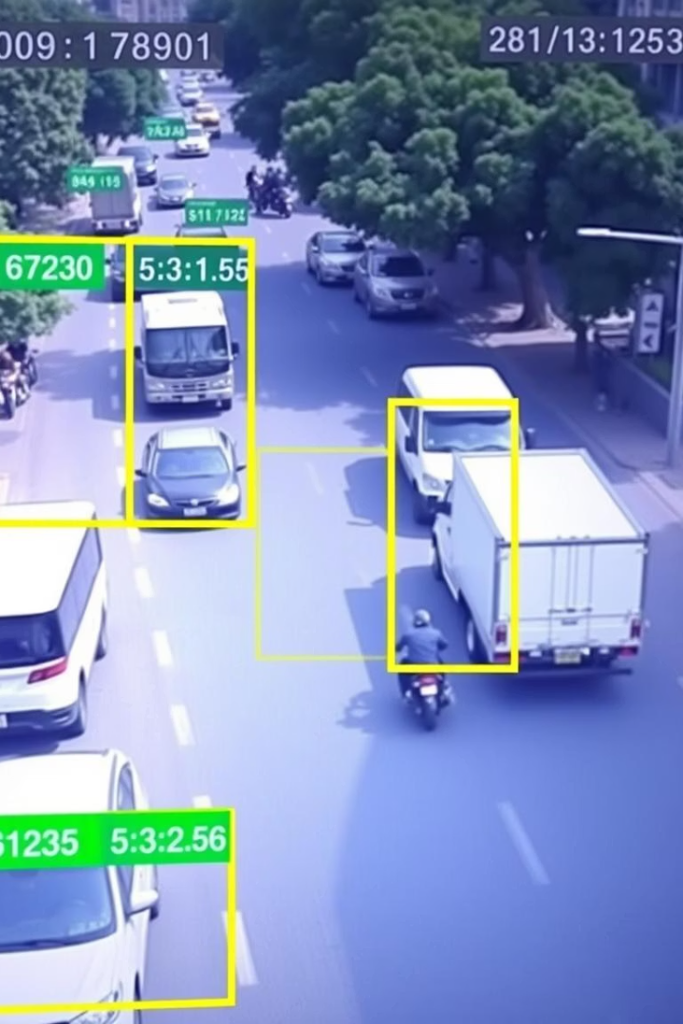


Inference Application
Video Processing
Process video files from various sources including live cameras and recorded footage, ensuring compatibility with multiple formats and resolutions.
Visualization
Visualize detections in real-time with bounding boxes and class labels overlaid on the video feed for clear and immediate understanding.
Output Saving
Optionally save output videos with detailed annotations, including timestamps and detection confidence scores, enabling later review and analysis.

Slide 8






Technical Limitations and Challenges
Model Performance
Precision-recall trade-off and localization precision.
Data Augmentation
Placement failures and fixed alpha blending.
Implementation
Hardcoded parameters and limited error handling.
The cut-paste augmentation technique has limitations such as placement failures and fixed alpha blending. The performance metrics reveal challenges such as precision-recall trade-off and localization precision. Several implementation aspects present challenges such as hardcoded parameters and limited error handling.

Slide 9



Practical Applications
Traffic Monitoring
Smart City
Security
Estimating traffic density and analyzing lane occupancy.
Optimizing traffic signals and managing parking.
Controlling access and detecting unusual activity.
The vehicle detection system has significant potential for traffic monitoring applications, smart city initiatives, and security contexts. The model's ability to distinguish between vehicle types makes it particularly valuable for comprehensive traffic analysis.

