Slide 1
DMA Transfer
Team Details : Divij – 2210090292
Keshav – 2210990506
Nishtha – 2210990621
Yashika – 2210990977
Chitkara University Institute of Engineering and Technology, Chitkara University, Punjab

Slide 2
DMA
DMA stands for Direct Memory Access.
DMA is used to transfer large block of data at high speed between the I/O devices and main memory.
DMA increases the data transfer rate.
DMA allows I/O devices to transfer data directly to main memory without CPU intervention.

Slide 3
In this we need Data Memory Access Controller(DMAC).
The DMAC requests the CPU to hold the system for sometime.
In response to this CPU sends the acknowledgement
Starting address → Starting From where data transfer should be performed.
2. Data Count → Number of bytes to be transferred.

Slide 4
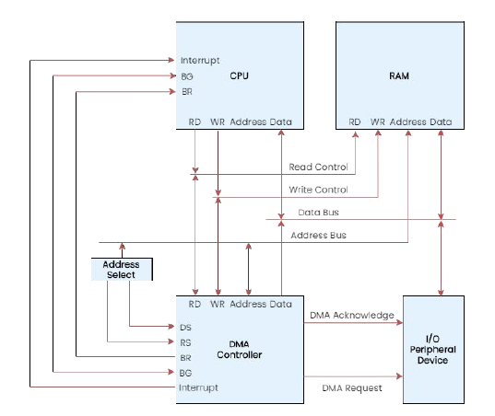
DMA Transfer
I/O Device sends a DMA request.
➜ DMA Controller activates the BR line.
➜ CPU responds with BG line.
➜ The DMA puts the current value of its address register into the address bus, initiates the RD or WR signal, and sends a DMA acknowledge to the I/O device.
➜ I/O device puts a word in the data bus (for
write) or receives a word from the data bus
(for read).
➜ The peripheral unit can then communicate
with memory through the data bus for direct
transfer between the two units while the CPU
is momentarily disabled.

Slide 5
➜ For each word that is transferred, the DMA
increments its address register and decrements its word count register.
➜ If the word count does not reach zero, the DMA checks the request line coming from the I/O Device.
➜ If there is no request ,the DMA disables BR so that the CPU continues to execute its own program.
➜ When CPU requests another transfer, DMA
requests bus again.
➜ If the word count register reaches zero, the DMA stops any further transfer and removes its bus request. It also informs the CPU of the termination by an interrupt

Slide 6
Modes Of DMA Transfer
There are 3 modes of Transfer
Burst Mode → Burst of data is transferred before CPU takes the control of the buses back from DMAC.
This is the quickest mode of DMA transfer since at once a huge amount of data is being transferred.
PROS → Fastest mode of DMA transfer.
CONS → Less user friendly because during the DMA transfer CPU will be blocked.

Slide 7
Cycle Stealing Mode --> Slow IO device will take some time to prepare data (or word) and within that time CPU keeps the control
of the buses.
Once the data or the word is ready CPU give back control of
system buses to DMAC for 1-cycle in which the prepared word is transferred to memory.
PROS → CPU won’t be blocked entire time.
CONS → Rate of DMA Transfer will be less.

Slide 8
3. Interleaving Mode →Whenever CPU does not require the system buses then only control of buses will be given to DMAC.
In this mode, CPU will not be blocked due to DMA at all.
This is the slowest mode of DMA Transfer since DMAC has to wait might be for so long time to just even get the access of system buses from the CPU itself.
PROS → CPU will not be blocked at all.
CONS → Slowest DMA transfer rate.

Slide 9


