Slide 1
Donation System
A web project for users to create projects to raise funds

Slide 2
Donation System
Donation system can be used to create projects to raise funds to support humanitarian issues.
Most humanitarian movements die due to the lack of funds.
This web project can help people to reach out to potential donors.

Slide 3
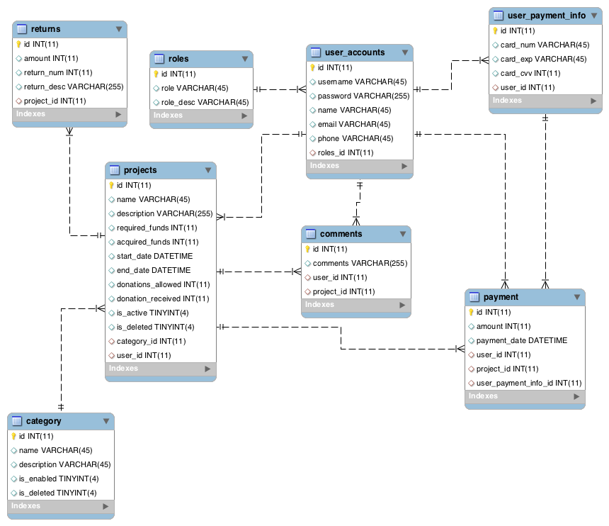
Database design

Slide 4
Application Architecture
FRONT END(Angular)
We use Angular on the front end and we have Controllers, Services and Views for this.
Services are used to connect to the REST Application and GET, POST or PUT data.
Views are the html pages used to display the data.
Controller gets the input and converts it to present to the service or view
BACK END(REST)
For the back end we use REST.
Models are used to capture the request and response.
Controllers capture the request and forward it to the services.
The services convert the model to entity and forward them to the Dao.
DAOs use the entities and interact with database using hibernate sessions.
Spring injection is used to make the service a part of controllers state.

Slide 5
Application flow - ROLES
ADMIN
Admin can add, delete or disable categories and can view, delete projects in a selected category.
Admin can also view all the payments made to a particular project.
Admin can access the reports generated for all the projects in the system
CREATOR
Creator can create projects in a category and set services to the project.
Creator can also limit the services to a project, upon reaching which, the project wont accept any donations.
DONOR
A donor can view all the projects available and check what services are offered for a particular project.
A donor can donate funds after logging into the system.
A donor can also view and add comments to a particular project.
GUEST
A guest can only view the categories and respective projects in a category

Slide 6
KPI
There are 3 KPIs in the system each represented by a pie chart.
Number of payments received for all projects
Number of projects in all categories.
Number of comments in all projects.

Slide 7
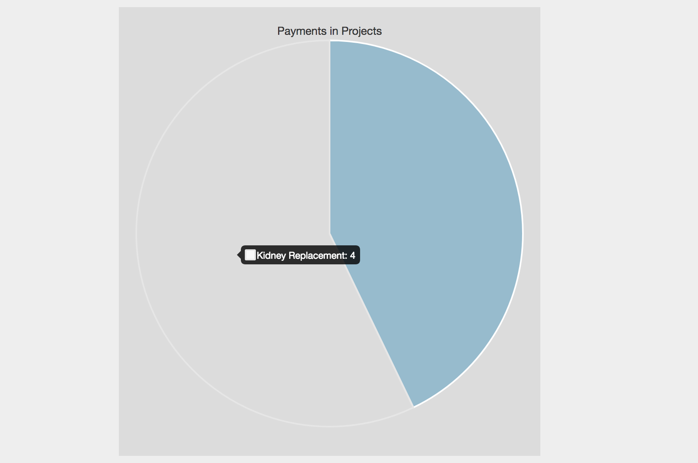
KPI – Payments in projects

Slide 8
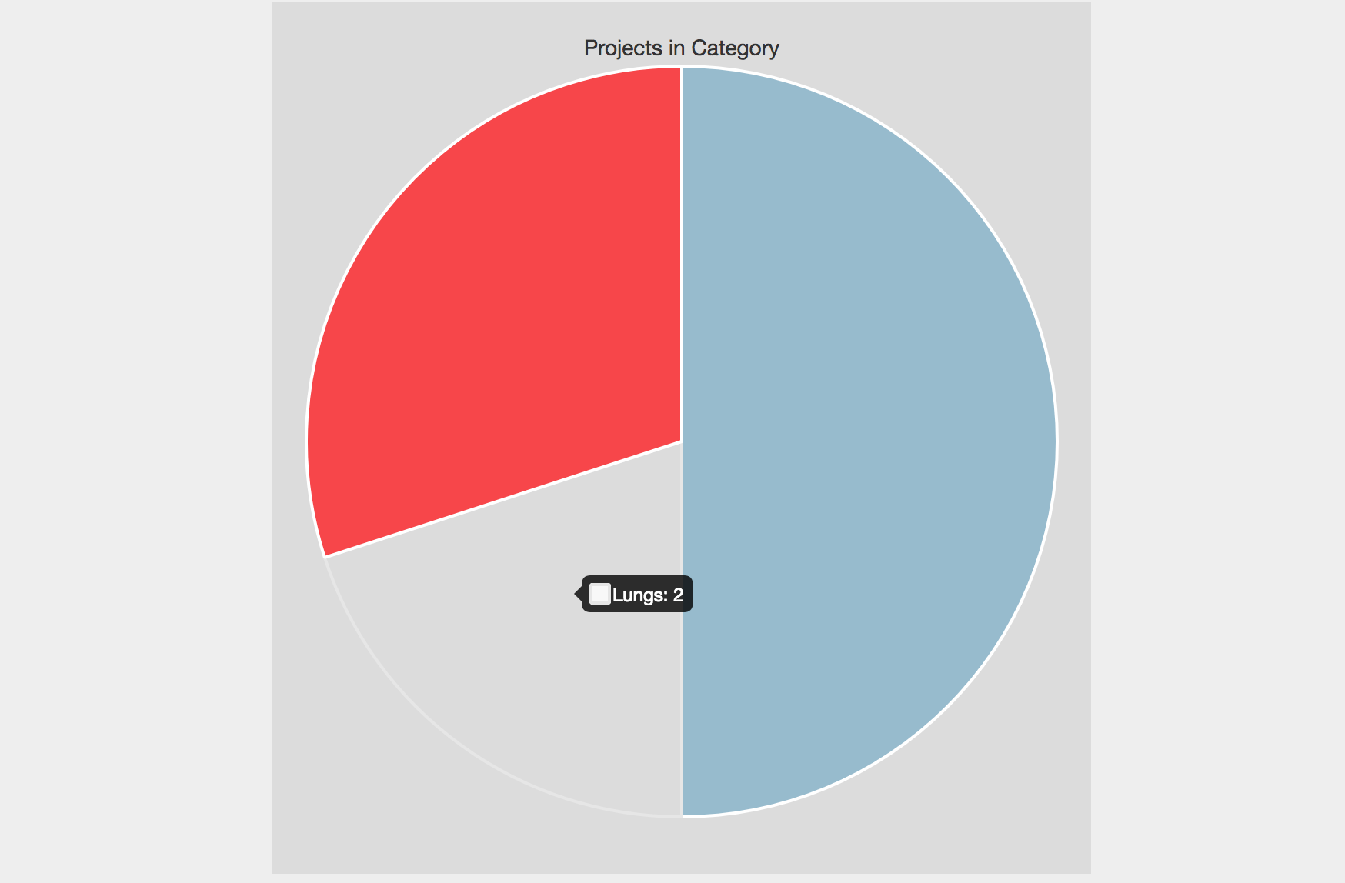
KPI – Projects in category

Slide 9
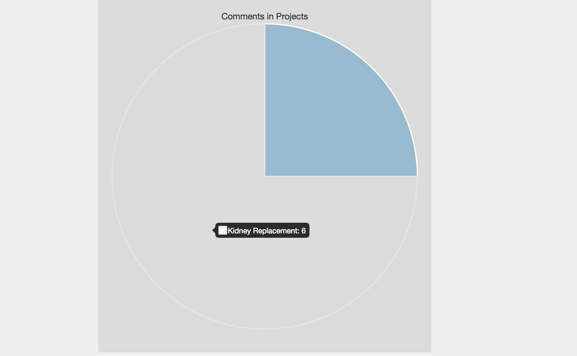
KPI – Comments on projects

