Slide 1
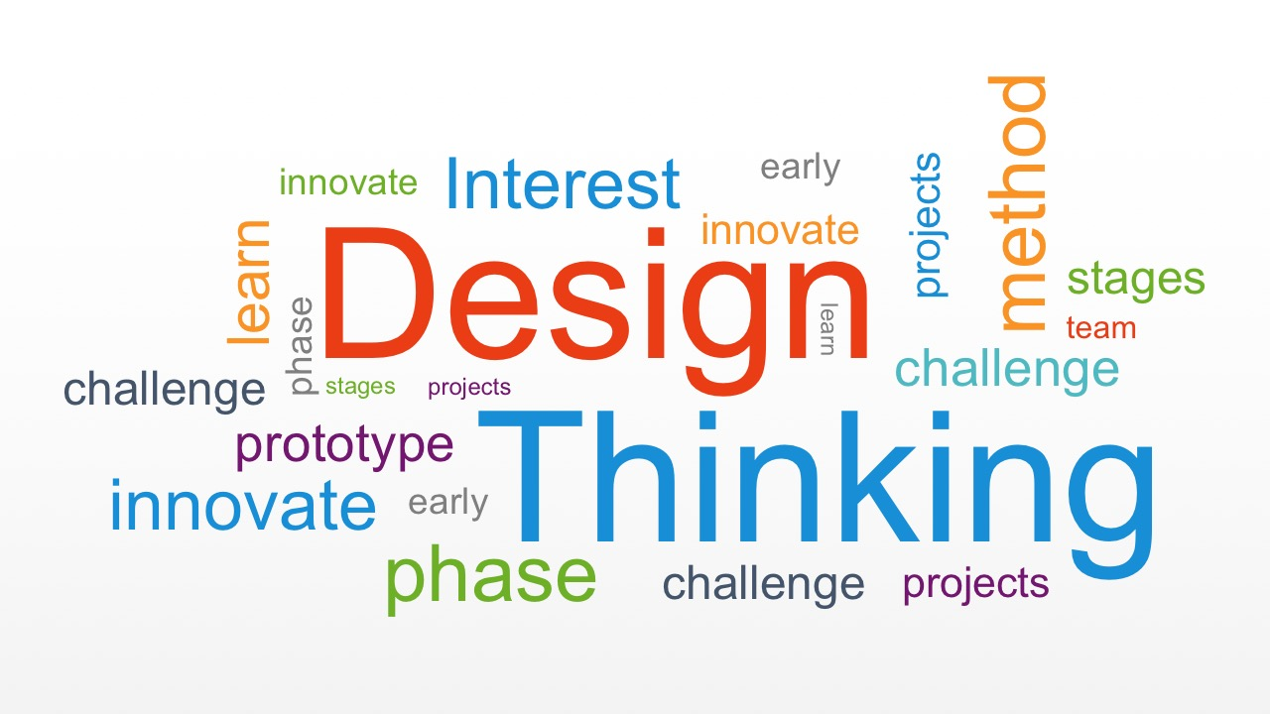

Slide 2
An iterative cyclic process
Empathise
Ideate
Define
Prototype
Test
The Design Thinking Proces by Stanford Design School

Slide 3
Empathise-A Recap
Immersion Activity
Engage with the users(collect data)
Observe them in their environment
Step into their shoes
Creating Personas
Hypothetical users closest to the real users.
Enable problem visualisation across a number of users

Slide 4
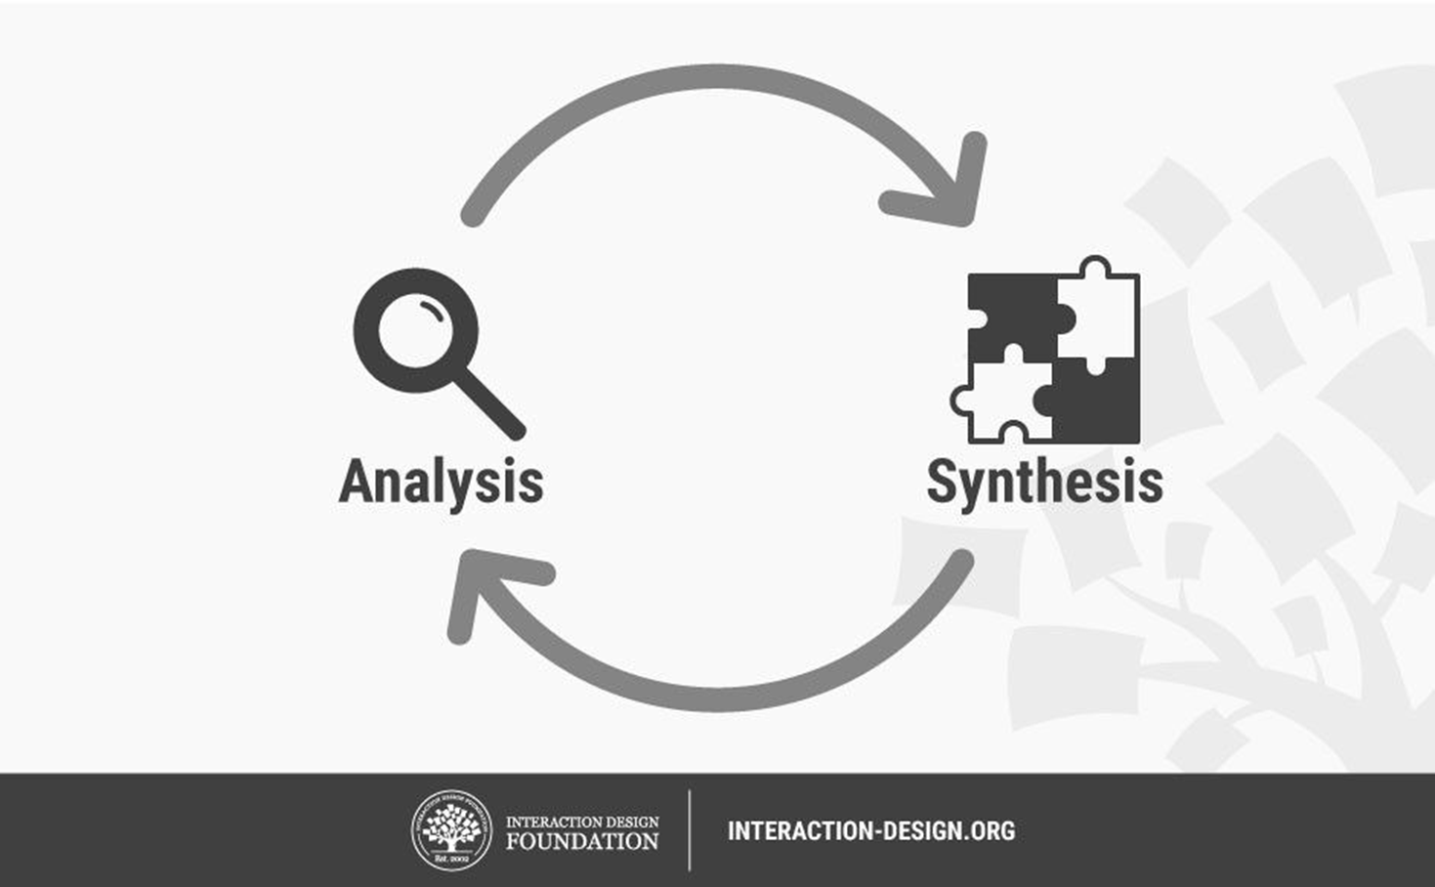

Slide 5

define: create the problem statement
Notes:
Facilitator Guide
Type of Screen : Discussion
Recommended Duration: 60 minutes
Aim and objective of this screen : To introduce the concept of creating personas
Say: In the year 2007, one industry which faced quite a lot of difficulty was the Food & Beverage industry. Restaurants and coffee shops were not making much profit, customer numbers were dwindling. Coffee shops wand restaurants were trying to come u with new ways of attracting their customers. They included new coffee beverages with exotic ingredients but unfortunately it did not produce any significant result.
One coffee shop did something different. They did not make any reforms based on their own understanding. It (Starbucks) reached out to the customers/ consumers and asked them what would make them visit the coffee shops frequently. In the first phase, the interacted with hundreds of customers who earlier visited coffee shops for a coffee drink.
These meetings were held with the purpose of understanding the customers needs clearly.
They (Starbucks) received a very interesting insight from the people they met. The ask was not primarily related to coffee.
Ask: What do you think was their ask ?
Do: Get responses from the students, Encourage them to share what ever comes to their minds. Encourage them to think out of the box.
Say: Customers said that they want the coffee shop to be a place where they can relax without feeling restricted . They wanted to have the feeling of belongingness .
Based on these inputs they (Starbuck) then created a strategy. They started building an atmosphere which was cosy and warm. They decided to give it a less formal look . They used warm woods and stone which are natural materials to make the counters .Plastics and metals were a big no .
Many a times one person visited the coffee shops. They (Starbucks) kept very big round tables at the shops, the reason being when we sit at big round tables the guests would have some one or the other sitting at some corner. This ensured inclusivity as it would not have small tables with a loner sitting at one corner .
They (Starbucks) did not want to sell cups of coffee they wanted to gift an experience to the customer.
This brought in considerable changes.
Customers started coming back to coffee shops for the warmth and the new experience.
Ask: What do you think they (Starbucks) did differently ?
Do: Get responses
Say: They combined their heads, hearts and hands. It helped them come up with an innovative solution.
They (Starbucks) used Design Thinking. For creating a wonderful customer experience.
Ask: Which coffee shop chain is this?

Slide 6
DESIGN THINKING: DEFINE
Define is the step which follows the Empathise level.
During this stage, Designers put together their findings and understanding that they have gathered in the Empathise level. In the Define stage they note down every observation and findings so that they may analyse them to define the core problems.
It is imperative that the problem statement should be defined from the user’s point of view.

Slide 7


Problem statement
Notes:
Facilitator Guide
Type of Screen: Lecture & discussion
Recommended Duration: 8 minutes
Aim and objective of this screen: Explain what is a problem statement and its purpose.
Do: Play the youtube video --FHIL | Stages of Design Thinking | REFRAME (1:55 mins). This video introduces the concept of problem statement in an easy and simple manner.
Ask: What did you see and hear in the video ?
Do: Let the students share their observations freely.

Slide 8

What is a problem statement?
Why is a problem statement needed?
A properly articulated problem statement talks about the user's need in a clear and simple language. If the problem statement is expressed accurately and clearly the design thinkers find it easier to create a product to suit the user's needs. Design thinking practitioners come up with designs / solutions on the basis of the problem statement.
What can go wrong if we begin with an incorrect problem statement…
If we come up with a wrong problem statement the solution/product will not be effective.

Slide 9
“If I were given one hour to save the planet, I would spend 59 minutes defining the problem and one minute resolving it,” -----Albert Einstein
Notes:
Facilitator Guide
Type of Screen: Lecture & discussion
Recommended Duration: 8 minutes
Aim and objective of this screen: Explain what is a problem statement and its purpose.
Say: An organization which manufactures packaging for food products were discussing ways to improve the food packaging. Senior executives were exchanging ideas . Everyone wanted to get imported material to make the packaging durable, airtight and safe. They procured imported material for the new packaging but the feedback from the consumers was not satisfactory.
Ask: Can anyone guess why the users were no happy with the new packaging ?
Do: Get responses from the students.
Say: This time the company asked the users and got a clear understanding that they could not open the packets easily they had to tear it open. Many a times the food dropped in trying to do so forcefully. The users want to open it easily and at the same time the packets should be safe.
Say: This time they had perforations and scissor marks with written instructions “open here” in one corner which could be easily opened. The feedback was satisfactory because the product was easy to use, safe and durable.
Say: This is an example of a clearly expressed problem statement.

Slide 10
A problem which is expressed from the organisational point of view is as follows “ The organisation must increase the market share of instant coffee so they will include the teenagers in the scope of their target
customers.”
A design thinker would define it from the user's point of view,
“Teenagers should be given a feel of an energising cup of coffee to help them keep awake and energetic during long hours of exam preparation”
In the Define stage the designers try and answer questions like, “ Can we think of a cup of coffee which would have a taste and toppings to attract the young generation to choose it ?"
PROBLEM
STATEMENTS

Slide 11

The four W method
Another way of writing the problem statement is based on the four W – Who, What, Where, and Why.
The same problem is expressed with the help of the four W’s :
“The college students who are disinterested about using the library because they find the place boring and the books inaccessible. This makes it a more difficult option of learning than the Internet. Our solution should help the students grow their interest in learning by making the place more user friendly and interesting.
We can try doing the same with the food packaging issue, It can be expressed this way.
The consumers find it difficult to tear open the packets of ready food products when they do not have access to scissors or knives because the packets do not have any perforation marks or tabs to reap it open. Our design solution should help the users to open the packets easily while they are away from scissors.

Slide 12





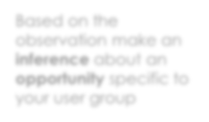

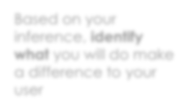
POV STATEMENT
We Met —
Who and what
moved you the most
We were amazed to realise that —
We wonder if this means —
A key observation you made from what you heard and saw
Based on the observation make an inference about an opportunity specific to your user group
It would change the world if —
Based on your inference, identify what you will do make a difference to your user

Slide 13
The 5 Why approach
Why is she not eating healthily? → She orders takeaway everyday.
Why does she order takeaway everyday? → Her fridge and cupboards are empty.
Why are the fridge and cupboards empty? → She hasn’t been grocery shopping in over a week.
Why hasn’t she been grocery shopping? → She doesn’t have time to go to the supermarket.
Why doesn’t she have time? → She works long hours and is exhausted.
Our young working professional struggles to eat healthily during the week because she is working long hours. Our solution should deliver a quick and easy way for her to procure ingredients and prepare healthy meals that she can take to work.”

Slide 14

Problem statement -User
“I am a college student. I know reading is a very good habit and it also helps me with my studies and personal growth. but I do not like to go to the college library, it is boring place and they do no allow us to flip through the pages to read the content.”

Slide 15
Problem statement POV of college administration
I
“We want the students to get good learning material and use the library as a place which enables growth .”

Slide 16
Problem statement- User Research
College students need a place for reading and learning which will attract them and in the process grow their interest in reading and other cultural activities.

Slide 17
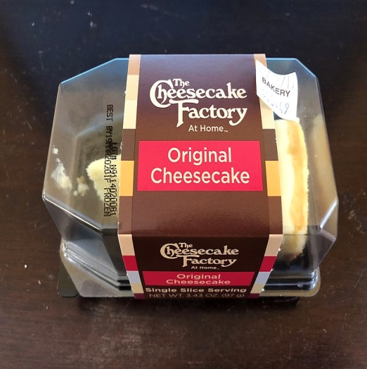

Food packaging
“This packet is so difficult to open and even if try to tear it, I can not open the packet easily. I have to look for either a pen nib or a sharp object to poke a hole and then tear it open.”
Point of View of the organisation which does the packaging : “We want the packets to be hygienic, leakproof, tamperproof, airtight and safe so that consumers do not come back with any complain regarding the food inside”
User research Point of View- “Consumers need a safe, hygienic, airtight packaging which is easy to use and keep the left over stored”

Slide 18





Problem statement
I want _____
As a ______
So that____
Notes:
Facilitator Guide
Type of Screen: Lecture & discussion
Recommended Duration: 5 minutes
Aim and objective of this screen: Explain what is a problem statement and its purpose.
Say : Now that we know why a problem statement is very important let us quickly understand how to write a good problem statement?
1) It should be human-centric and the focus should be on the user's needs.
2) It should be based on the understanding captured in the step-II ( Empathize )
3) It should not talk about the features /specifications of the product that you are going to design or about the business outcomes.
Do not begin with “The product has to be....” or " Our company should ....". We should always begin with the user's point of view: “College students need a place …”, as in the examples above.
Keep it open. Do not include the solution in the problem statement. It does not allow the design practitioners creative mind to look freely for a solution.
Do not include too many requirements in one problem statement; identify the priority and state the problem .

Slide 19
how to write a good problem statement?
1) It should be human-centric and the focus should be on the user's needs.
2) It should be based on the understanding captured in the step-I ( Empathize )
3) It should not talk about the features /specifications of the product that you are going to design or about the business outcomes.
Do not begin with “The product has to be....” or " Our company should ....". We should always begin with the user's point of view: “College students need a place …”, as in the examples above.
Keep it open. Do not include the solution in the problem statement. It does not allow the design practitioners creative mind to look freely for a solution.
Do not include too many requirements in one problem statement; identify the priority and state the problem .

Slide 20
A rECAP
dedicated to defining the user problem.
preceded by the empathize phase.
related to empathise through analysis and synthesis.
helps to kickstart ideation phase.
PoV statement matters!
Four Ws..who; what; where and why
Five Whys

