Slide 1

EmpowHer Design Thinking Project Idea
By Surabhi Mishra (051), Divija (056), Aniket Sahran (065) and Arpit Taneja (066)

Slide 2

Story of Charu
Charu is a 3nd year Undergraduate student at a college in India. She recently got to know about a major Internship Opportunity at Amazon, for women in Tech, whose deadline she almost missed.

Slide 3
Story of Charu
This made her wonder if she has been missing out on other important opportunities for women all this while.
Now that she had to prepare for her upcoming internship selection rounds, she wished she could get some resources as well as mentors to directly contact.

Slide 4

The Problem
In today's day and time, there are a lot of emerging opportunities for women.
But, there are millions of other girls like Charu, who either misses the important deadlines of these opportunities or wish that there was a well curated list of them with regular updating.

Slide 5

The Problem
It has also been found out through surveys that in the cases of sexual harassment at workplace or organization, nearly 3 in 4 claims of harassment go unreported
More than 38% of women have experienced sexual harassment at work.
Its as though, women have learnt to suffer silently as they fear retaliation or worse- not believing in their claims. All they need is a platform to give them VOICE

Slide 6

Our Solution
EmpowHER App
An app to empower women with the right guidance, opportunities, mentorship and most importantly give them a voice.

Slide 7


Some Features

Slide 8

Opportunities and Resources
User will get all the information about upcoming opportunities and recommended resources along the links to their website to get more info, deadlines to apply and description.
User can also upload details about new opportunities or resources and be able to earn points.

Slide 9

Find a Mentor
Users can view different mentors (from a variety of organizations and job experience) and book an appointment with them for a minimal charge.

Slide 10

A Safe Space
Users will a get a platform to write (either anonymously/not) about any kind of gender inequality or sexist experience they faced in their respective organization.
This way they can make their story reach out to a large number of people and get their support.
Users can read other’s story and can Upvote it.

Slide 11
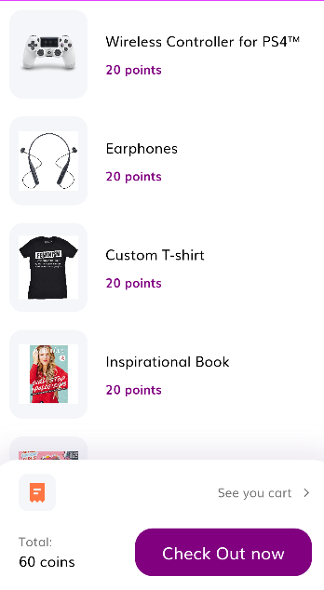
Redeem Points
Users will be able to earn points by uploading new valid resources and opportunities on the app.
They can redeem these points to buy things from the in-app store.
The store include gifts like books by powerful women, empowerment stickers, t-shirts etc.

Slide 12

Monetization Plan
We intended to generate revenue through the app by charging some amount of money for the mentor session from the users.
We can also generate revenue by putting in advertisements (of sanitary pads, women healthcare products etc.)
A part of the revenue will be used to buy the gifts in the redeem store to keep our idea running.

Slide 13


