Slide 1
ER DIAGRAM AND RELATIONAL TABLES Project : MANIGIFY Inventory management and Billing system
Khushi Sharma 102018045
Ashwit Sharma 102018046
Divija 102018056
CSBS_3

Slide 2
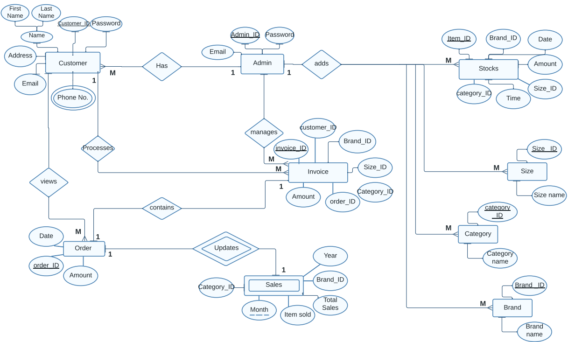
ER DIAGRAM

Slide 3
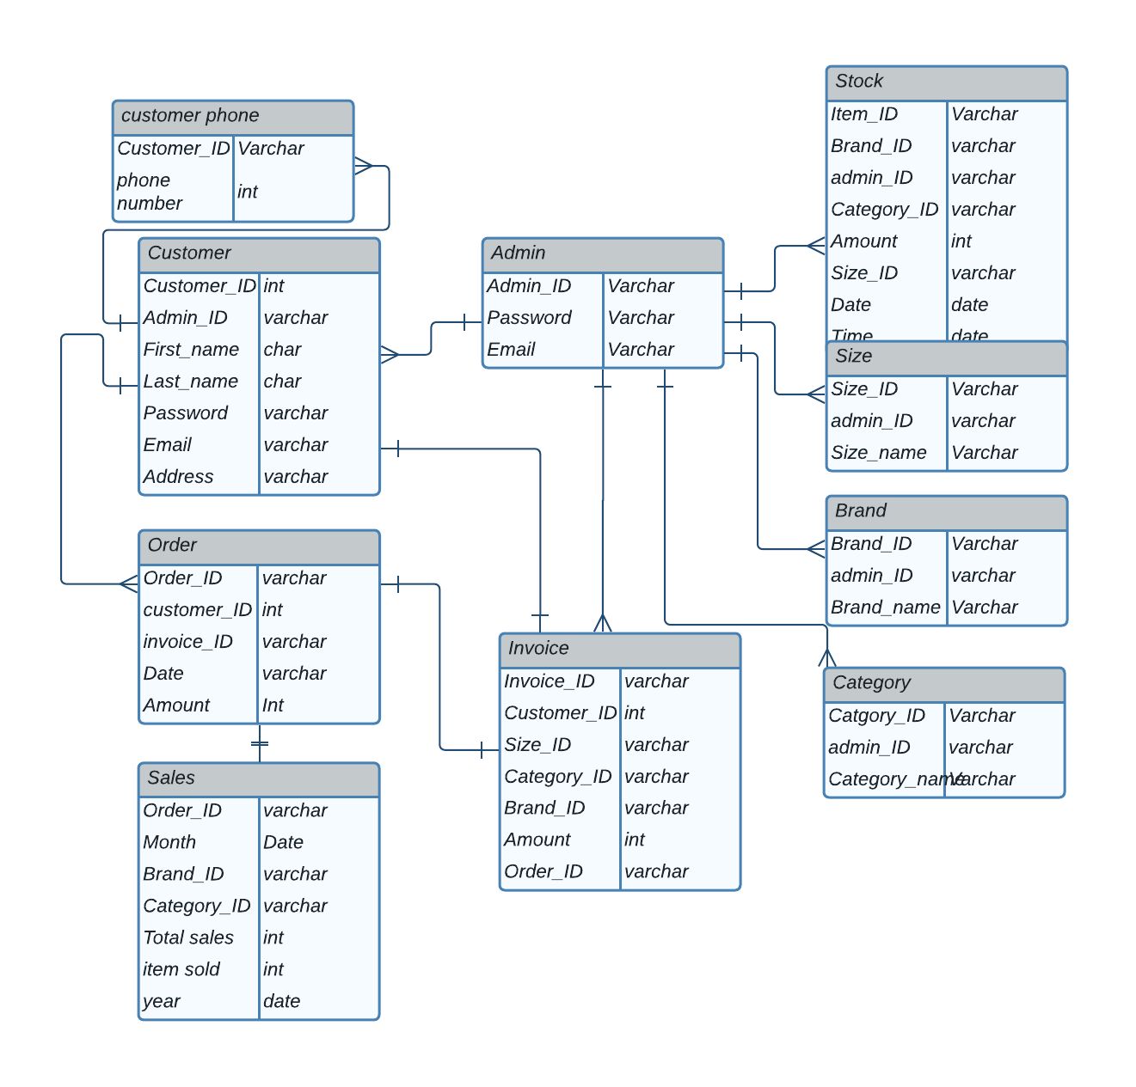
Relational Table

Slide 4
Customer Table
Field | Description | Type | Length
Customer_ID(PK) | Customer's Username | int | 8
First_Name | Customer's First Name | char | 25
Last_Name | Customer's Last Name | char | 25
Password | Customer's login password | varchar | 14
Email | Customer's email | varchar | 36
Address | Customer's Address | varchar | 365
Here Phone number is a multivariate attribute therefore we will have to create another table for it.
Field | Description | type | Length
Customer_ID(PK) | Customer's Username | int | 8
Phone_No | Customer’s Number | int | 12

Slide 5
Admin Table
Field | Description | Type | Length
Admin_ID(PK) | Admin's Username | varchar | 20
Password | Admin's login password | varchar | 14
Email | Admin's email | varchar | 36
Handling one to many relation, here Admin has one to many relationship with customer , invoice, size , brand and category => Taking the primary key of one type + customer table
Field | Description | Type | Length
Customer_ID(PK) | Customer's Username | int | 8
Admin_ID | Admin's Username | varchar | 20
First_Name | Customer's First Name | char | 25
Last_Name | Customer's Last Name | char | 25
Password | Customer's login password | varchar | 14
Email | Customer's email | varchar | 36
Address | Customer's Address | varchar | 365

Slide 6
Size table
Field | Description | Type | Length
Size_ID(PK) | Size's ID | varchar | 8
Size_name | SIze's Name | varchar | 50
After handling one to many relationship with admin
Field | Description | Type | Length
Size_ID(PK) | Size's ID | varchar | 8
Admin_ID | Admin's Username | varchar | 20
Size_name | SIze's Name | varchar | 50

Slide 7
Brand table
Field | Description | Type | Length
Brand_ID(PK) | Brand's ID | varchar | 8
Brand_name | Brand's Name | varchar | 50
After handling one to many relationship with admin
Field | Description | Type | Length
Brand_ID(PK) | Brand's ID | varchar | 8
Admin_ID | Admin's Username | varchar | 20
Brand_name | Brand's Name | varchar | 50

Slide 8
Category table
Field | Description | Type | Length
Category_ID(PK) | Category's ID | varchar | 8
Category_name | Category's Name | varchar | 50
After handling one to many relationship with admin
Field | Description | Type | Length
Category_ID(PK) | Category's ID | varchar | 8
Admin_ID | Admin's Username | varchar | 20
Category_name | Category's Name | varchar | 50

Slide 9
Stocks
Field | Description | Type | Length
Item_ID(PK) | Item's ID | varchar | 8
Brand_ID(FK) | Brand's ID | varchar | 50
Category_ID(FK) | Item's Category | varchar | 20
Amount | Item's Amount | int | 40
Size_ID(FK) | Item's Size ID | varchar | 20
time | time | Date | 8
Date | Item's Date | date | 8
Field | Description | Type | Length
Item_ID | Item's Username | varchar | 8
Admin_ID | Admin's Username | varchar | 20
Password | Admin's login password | varchar | 14
Email | Admin's email | varchar | 36

Slide 10
Order
Field | Description | Type | Length
Order_ID(PK) | Order's ID | varchar | 8
Order_date | Order's date | varchar | 50
Amount | Order's Amount | int | 20
Order has one to one relationship with invoice , and many to one with customer
Field | Description | Type | Length
Invoice_ID | Invoice's ID | varchar | 8
Customer_ID | Customer's Username | int | 8
Order_ID(PK) | Order's ID | varchar | 8
Order_date | Order's date | varchar | 50
Amount | Order's Amount | int | 20

Slide 11
Invoice
Invoice has one to one relation with customer and order ,many to one with admin
Field | Description | Type | Length
Invoice_ID(PK) | Invoice's ID | varchar | 8
Customer_ID | Customer's Username | varchar | 50
Admin_ID | Admin's Username | varchar | 20
Brand_ID(FK) | Brand's ID | varchar | 20
Category_ID(FK) | Category's ID | varchar | 400
Size_ID(FK) | Item's Size ID | varchar | 20
Order_ID(FK) | Order's ID | varchar | 30
Amount | Amount | Int | 10
Phone_number | Customer's Phone number | int | 12

Slide 12
Sales
Field​ | Description​ | Type​ | Length​
Brand_ID | Brand's ID​ | varchar | 8​
Items_sold | Item's Sold | int | 10
Month | Month | varchar​ | 12​
Total Sales | Total Sales of items | int | 14​
Year | Year | int | 36​
Sales is weak entity , i.e it doesn’t have any primary key and is dependent on order
Field​ | Description​ | Type​ | Length​
Order_ID(PK) | Order's ID | varchar | 8
Brand_ID | Brand's ID​ | varchar | 8​
Items_sold | Item's Sold | int | 10
Month | Month | varchar​ | 12​
Total Sales | Total Sales of items | int | 14​
Year | Year | int | 36​

