Slide 1
Introduction to Marketing
Basics of Marketing

Slide 2
Learning Objectives
The concept of Marketing
Core Marketing Concepts

Slide 3
American Marketing Association
Marketing is an organizational function and a set of processes for creating, communicating, and delivering value to customers and for managing customer relationships in ways that benefit the organization and its stakeholders.

Slide 4
American Marketing Association
Marketing management is the art and science of choosing target markets and getting, keeping, and growing customers through creating, delivering and communicating superior customer value.

Slide 5
The Chartered Institute of Marketing
Management process responsible for identifying, anticipating and satisfying customer requirements profitably.

Slide 6
The shortest definition!
Marketing is “Meeting needs profitably”

Slide 7
What is Marketed?
Goods
Services
Events
Experiences
Persons
Places
Properties
Organization
Information
Ideas

Slide 8
Company Orientation toward the Marketplace
The Production Concept: Consumers will prefer products that are widely available and inexpensive.
The Product Concept: Consumers favour products that offer the most quality, performance, or innovative features.
The Selling Concept: Consumers and businesses if left alone will not buy enough. Aggressive selling is required.

Slide 9
Cont.
The Marketing Concept: Customer-centered. To find the right product for your customers. The success of a business depends on the marketing efforts that deliver a better value proposition than its competitors.
The Societal Marketing Concept: It is a marketing concept that believes in giving back to society by producing better products that help the world be a better place.
The Holistic Marketing Concept: Everything matters.

Slide 10
Holistic Marketing
Relationship Marketing
Customers, employees, channel partners, shareholders
Integrated Marketing
4Ps: Product, price, promotion, place
Internal Marketing
marketing is everyone’s business!
Performance Marketing

Slide 11
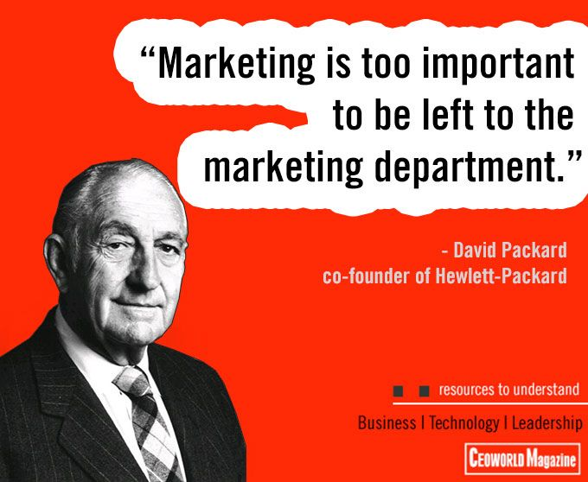
Internal Marketing

Slide 12
Markets
Market is defined as the collection of buyers and sellers who transact over a particular product or product class.
Types
Consumer Markets
Business Markets
Global Markets
Nonprofit and Governmental Markets

Slide 13
The Marketing Macro-environment
Demographic
Economic
Physical
Technological
Political-legal
Socio-cultural

Slide 14
Core Marketing concepts
Needs, Wants and Demands
Segmentation, Target Market, Positioning
Offerings and Brands
Value and Satisfaction
Marketing Channels
Supply Chain
Competition
Marketing Environment

Slide 15
Marketing Realities
Societal forces
Network IT
Globalization
Deregulation
Privatization
Competition
Industry Convergence
Retail transformation
Disintermediation and reintermediation

Slide 16
Consumer Capabilities
Increase in buying power
Variety of goods and services
Increased information
Ease of interaction and order placement
Comparison of offerings
Voice to influence peers

Slide 17
Company Capabilities
Use of IT and Internet
Better market research tools
Better communication tools
Target marketing
Increased customer reach
Product differentiation
Improvement in managerial function

Slide 18
Market Segmentation
…the process of dividing a target market of potential customers into segments with common characteristics.

Slide 19
Segmentation
Mass-marketing
Segment Marketing
Niche Marketing
Local Marketing
Individual

Slide 20
Segments
Identify, not create
Flexible Market Offering
Bases for market segmentation

Slide 21
Niche Marketing
More narrowly defined customer group seeking a distinct mix of benefits.
Ezee
Revolution clothing
Discord

Slide 22
An attractive niche
Distinct set of needs
Pay a premium
Small but actionable
Unlikely to attract many competitors
Economies through specialization

Slide 23
Local Marketing
Catering to needs and wants of local customer groups.
Bharatmatrimony ---- Punjabimatrimony……bengalimatrimony

Slide 24
Individual marketing
Segments of one
Customization
Dell
Asian paints
Galleria picture card

Slide 25
Bases for segmentation
Geographic
Country
Region
City
Rural/Urban

Slide 26
Demographic
Age
Life-stage
Gender
Income
Generation
Social class

Slide 27
Psychographic Segmentation
Psychographics: the science of using psychology and demographics to better understand consumers.

Slide 28
Psychographic Segmentation
People within the same demographic group may exhibit different psychographic profiles. (based upon their personality traits, values, attitudes and lifestyles)
Titan watches
Femina “woman of substance”

Slide 29
Behavioral Segmentation
Behavioral segmentation….divides people into different groups who have a specific behavioral pattern in common.

Slide 30
Behavioral Segmentation
Decision roles
Initiator
Influencer
Decider
Buyer
User

Slide 31
Behavioral Variables
Occasions
Benefits
User Status
non-users, ex-users, potential users, regular users
Usage Rate
light, medium, heavy
Buyer-readiness stage
unaware/ informed/ interested/ desirous/intend
Loyalty status

Slide 32
Effective Segmentation Criteria
Measurable
Substantial
Accessible
Differentiable
Actionable

Slide 33
Selecting segments
Single segment concentration
Selective specialization
Product specialization
Market specialization
Full market coverage

