Slide 1
Likelihood Ratio Tests
The origin and properties of using the likelihood ratio in hypothesis testing
Teresa Wollschied
Colleen Kenney

Slide 2
Outline
Background/History
Likelihood Function
Hypothesis Testing
Introduction to Likelihood Ratio Tests
Examples
References

Slide 3
Jerzy Neyman (1894 – 1981)
Jerzy Neyman (1894 – 1981)
April 16, 1894: Born in Benderry, Russia/Moldavia (Russian version:Yuri Czeslawovich)
1906: Father died. Neyman and his mother moved to Kharkov.
1912:Neyman began study in both physics and mathematics at University of Kharkov where professor Aleksandr Bernstein introduced him to probability
1919: Traveled south to Crimea and met Olga Solodovnikova. In 1920 ten days after their wedding, he was imprisoned for six weeks in Kharkov.
1921: Moved to Poland and worked as an asst. statistical analyst at the Agricultural Institute in Bromberg then State Meteorological Institute in Warsaw.

Slide 4
Neyman biography
1923-1924:Became an assistant at Warsaw University and taught at the College of Agriculture. Earned a doctorate for a thesis that applied probability to agricultural experimentation.
1925: Received the Rockefeller fellowship to study at University College London with Karl Pearson (met Egon Pearson)
1926-1927:Went to Paris. Visited by Egon Pearson in 1927, began collaborative work on testing hypotheses.
1934-1938: Took position at University College London
1938: Offered a position at UC Berkeley. Set up Statistical Laboratory within Department of Mathematics. Statistics became a separate department in 1955.
Died on August 5, 1981

Slide 5
Egon Pearson (1895 – 1980)
August 11, 1895: Born in Hampstead, England. Middle child of Karl Pearson
1907-1909: Attended Dragon School Oxford
1909-1914: Attended Winchester College
1914: Started at Cambridge, interrupted by influenza.
1915: Joined war effort at Admiralty and Ministry of Shipping
1920: Awarded B.A. by taking Military Special Examination; Began research in solar physics, attending lectures by Eddington
1921: Became lecturer at University College London with his father
1924: Became assistant editor of Biometrika

Slide 6
Pearson biography
1925: Met Neyman and corresponded with him through letters while Neyman was in Paris. Also corresponded with Gosset at the same time.
1933: After father retires, becomes the Head of Department of Apllied Statistics
1935: Won Weldon Prize for work done with Neyman and began work on revising Tables for Statisticians and Biometricians (1954,1972)
1939: Did war work, eventually receiving a C.B.E.
1961: Retired from University College London
1966: Retired as Managing Editor of Biometrika
Died June 12, 1890

Slide 7
Likelihood and Hypothesis Testing
“On The Use and Interpretation of Certain Test Criteria for Purposes of Statistical Inference, Part I,” 1928, Biometrika: Likelihood Ratio Tests explained in detail by Neyman and Pearson
  “Probability is a ratio of frequencies and this relative measure cannot be termed the ratio of probabilities of the hypotheses, unless we speak of probability a posteriori and postulate some a priori frequency distribution of sampled populations. Fisher has therefore introduced the term likelihood, and calls this comparative measure the ratio of the two hypotheses.

Slide 8
Likelihood and Hypothesis Testing
“On the Problem of the most Efficient Tests of Statistical Hypotheses,” 1933, Philosophical Transactions of the Royal Society of London: The concept of developing an ‘efficient’ test is expanded upon.
  “Without hoping to know whether each hypothesis is true or false, we may search for rules to govern our behavior with regard to them, in following which we insure that, in the long run of experience, we shall not be too often wrong”

Slide 9
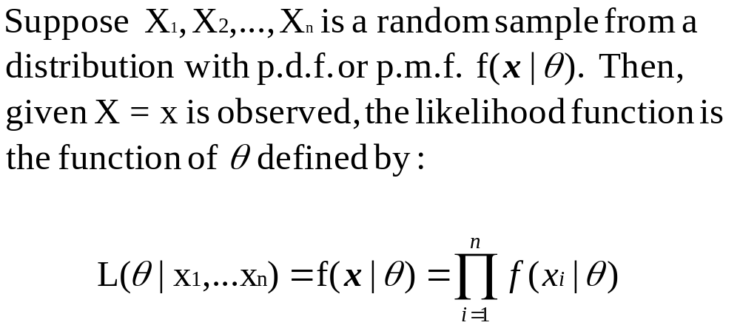

Likelihood Function

Slide 10
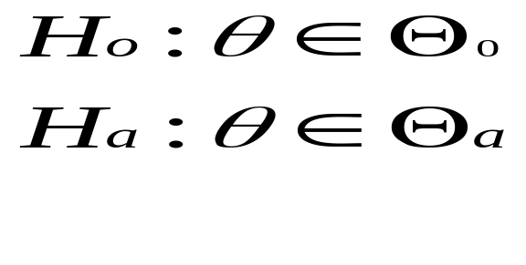
Hypothesis Testing
Define T=r(x)
R={x: T>c} for some constant c.

Slide 11
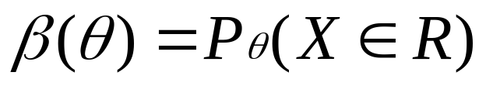
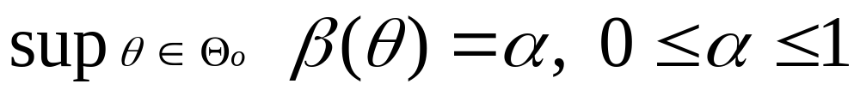
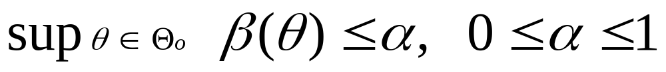
Power Function
The probability a test will reject H₀ is given by:
Size α test:
Level α test:

Slide 12
Types of Error
Type I Error:
  Rejecting H₀ when H₀ is true
Type II Error:
  Accepting H₀ when H₀ is false

Slide 13
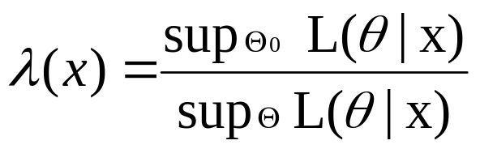
Likelihood Ratio Test (LRT)
LRT statistic for testing H_{0:} θ ∈ Θ₀ vs. H_{a:} θ ∈ Θ_{a} is:
A LRT is any test that has a rejection region of the form {x: λ (x) ≤ c}, where c is any number such that 0 ≤ c ≤ 1.

Slide 14
Uniformly Most Powerful (UMP) Test
Let φ be a test procedure for testing H_{0:} θ ∈ Θ₀ vs. H_{a:} θ ∈ Θ_{a}, with level of significance α₀. Then φ, with power function β(θ), is a UMP level α₀ test if:
    α(φ) ≤ α₀
    For every test procedure φ′ with α(φ′) ≤ α_{0,} we have β′(θ) ≤ β (θ) for every θ ∈ Θ_{a}.

Slide 15

Neyman-Pearson Lemma
Consider testing H_{0:} θ = θ₀ vs. H_{a:} θ = θ₁, where the pdf or pmf corresponding to θ_{i} is f(x|θ_{i}), i=0,1, using a test with rejection region R that satisfies
x∈R if f(x|θ₁) > k f(x|θ₀)
(1) and
x∈R^{c} if f(x|θ₁) < k f(x|θ₀),
for some k ≥ 0, and
(2)

Slide 16

Neyman-Pearson Lemma (cont’d)
Then
  Any test that satisfies (1) and (2) is a UMP level α test.
  If there exists a test satisfying (1) and (2) with k>0, then every UMP level α test satisfies (2) and every UMP level α test satisfies (1) except perhaps on a set A satisfying

Slide 17
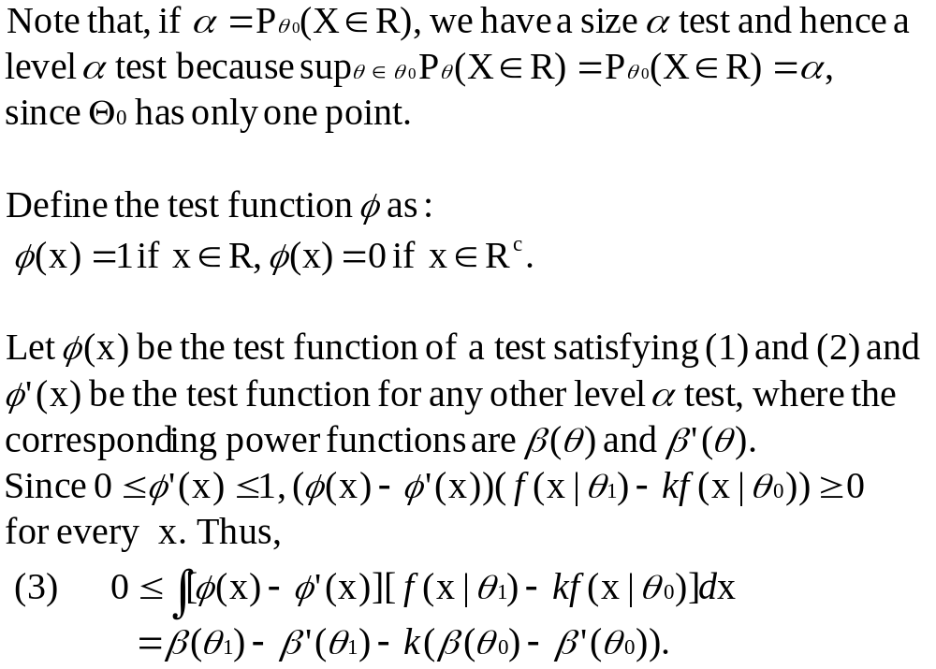
Proof: Neyman-Pearson Lemma

Slide 18
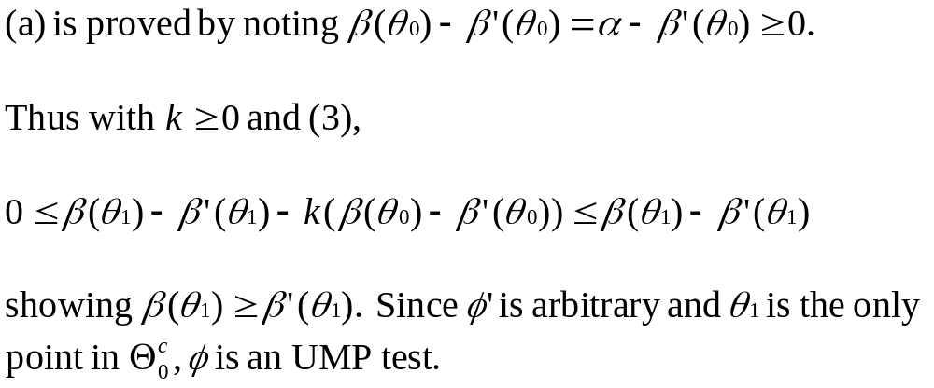
Proof: Neyman-Pearson Lemma (cont’d)

Slide 19
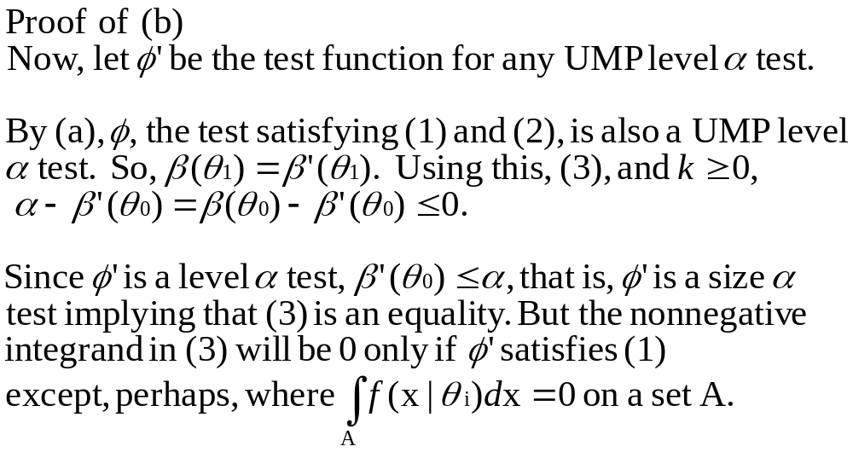
Proof: Neyman-Pearson Lemma (cont’d)

Slide 20
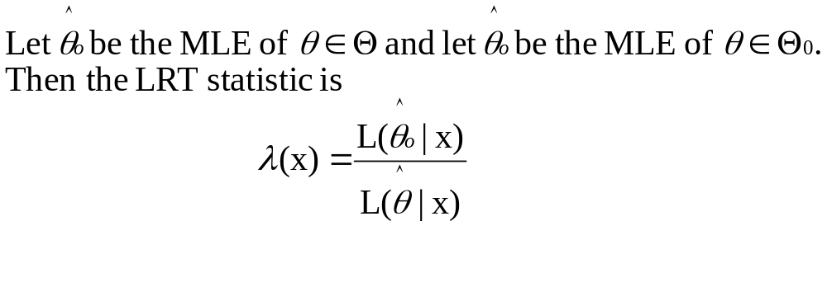
LRTs and MLEs

Slide 21
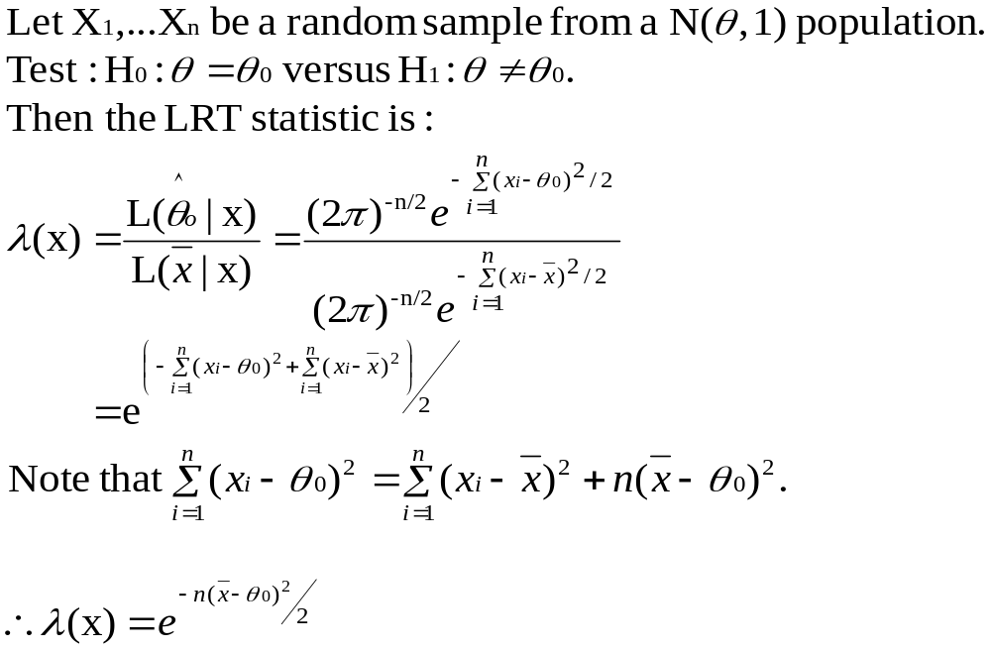
Example: Normal LRT

Slide 22
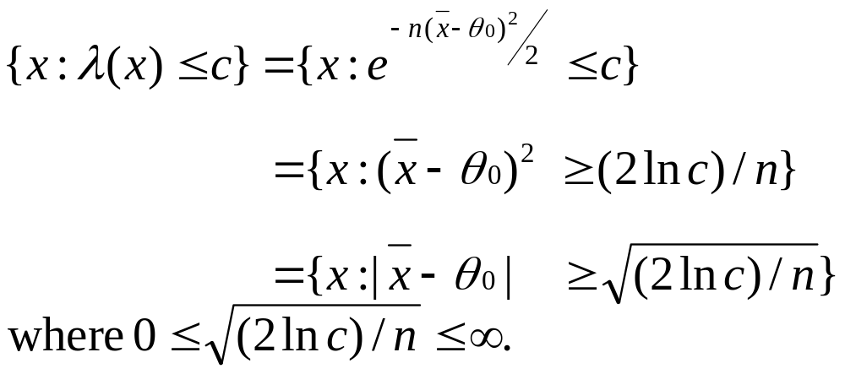
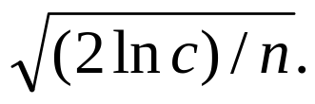
Example: Normal LRT (cont’d)
We will reject H₀ if λ(x) ≤ c. We have:
Therefore, the LRTs are those tests that reject H₀ if the sample mean differs from the value θ₀ by more than

Slide 23
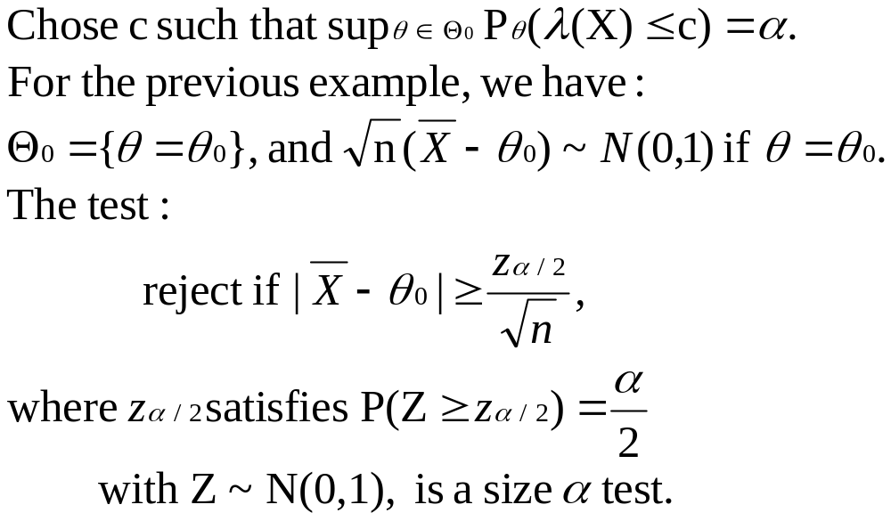
Example: Size of the Normal LRT

Slide 24
Sufficient Statistics and LRTs
Theorem: If T(X) is a sufficient statistic for θ, and λ*(t) and λ(t) are the LRT statistics based on T and X, respectively, then λ*(T(x))=λ(x) for every x in the sample space.

Slide 25
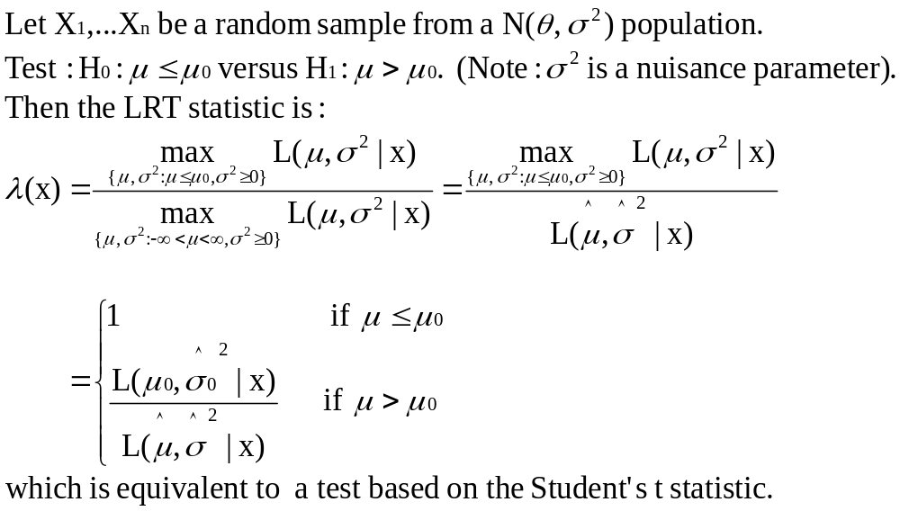
Example: Normal LRT with unknown variance

Slide 26
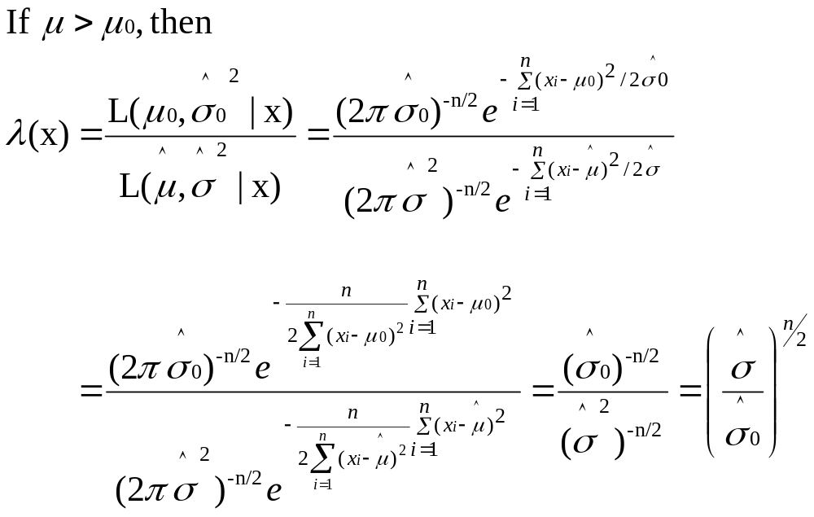
Example: Normal LRT with unknown variance (cont’d)

Slide 27
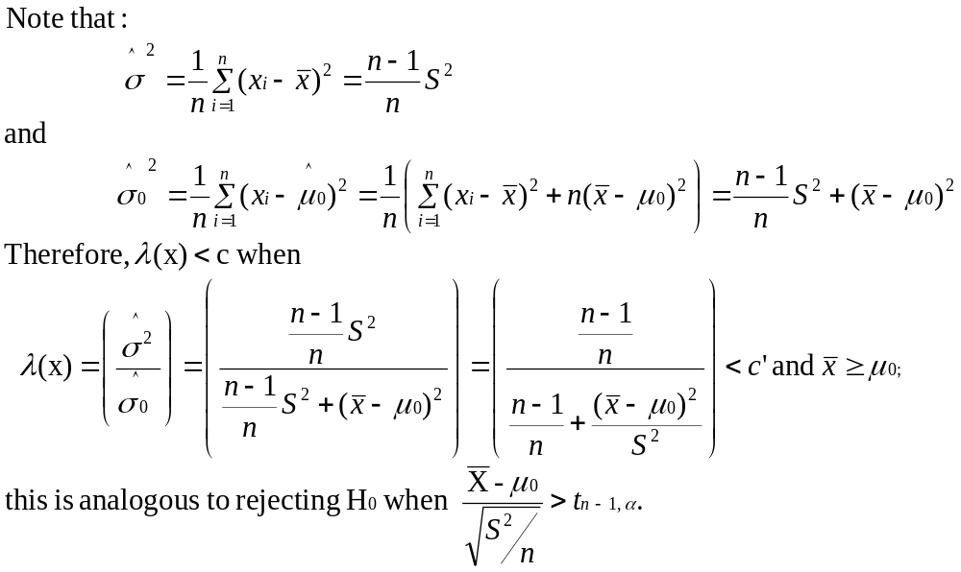
Example: Normal LRT with unknown variance (cont’d)

Slide 28
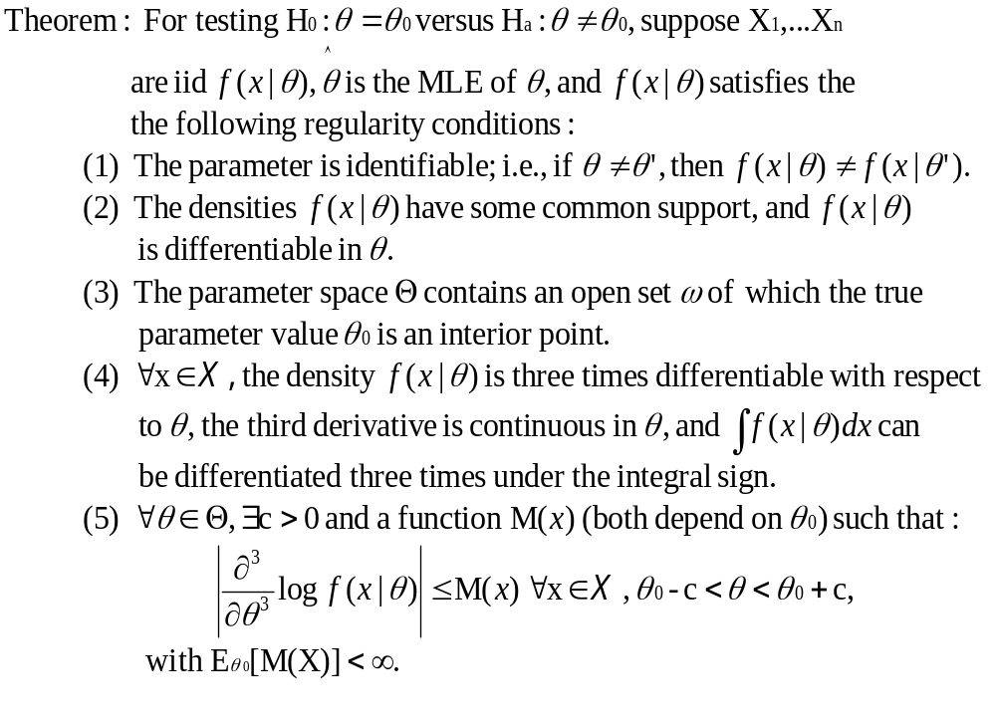
Asymptotic Distribution of the LRT – Simple H₀

Slide 29
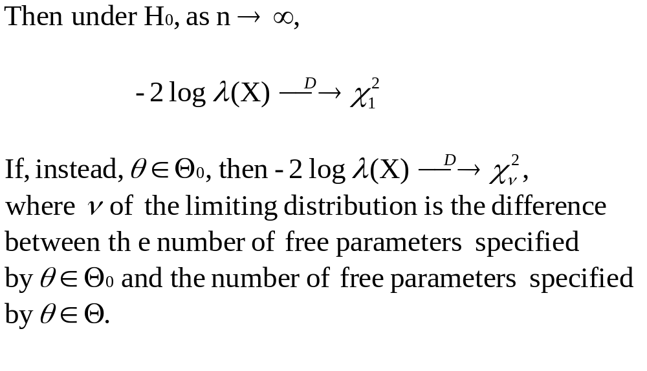
Asymptotic Distribution of the LRT – Simple H₀ (cont’d)

Slide 30
Restrictions
When a UMP test does not exist, other methods must be used.
  Consider subset of tests and search for a UMP test.

Slide 31
References
Cassella, G. and Berger, R.L. (2002). Statistical Inference. Duxbury:Pacific Grove, CA.
Neyman, J. and Pearson, E., “On The Use and Interpretation of Certain Test Criteria for Purposes of Statistical Inference, Part I,” Biometrika, Vol. 20A, No.1/2 (July 1928), pp.175-240.
Neyman, J. and Pearson, E., “On the Problem of the most Efficient Tests of Statistical Hypotheses,” Philosophical Transactions of the Royal Society of London, Vol. 231 (1933), pp. 289-337.
http://www-history.mcs.st-andrews.ac.uk/Mathematicians/Pearson_Egon.html
http://www-history.mcs.st-andrews.ac.uk/Mathematicians/Neyman.html

