Slide 1
Hashing Technique

Slide 2
Topics to Cover
  Hash Table
    Hash Functions
      The Division Method
      Midsquare Method
      Folding Method
    Collision Resolution Techniques
      Chaining (Open hashing)
      Open Addressing (Close hashing)
        Linear probing
        Quadratic probing
        Double hashing
    Perfect hashing
    Rehashing
    Complexity and Efficiency
Data Structures and Algorithms (Minor CSE)

Slide 3
A basic problem
We have to store some records and perform the following:
  add new record
  delete record
  search a record by key
Find a way to do these efficiently!
Data Structures and Algorithms (Minor CSE)

Slide 4
Unsorted array
Use an array to store the records, in unsorted order
  add - add the records as the last entry fast O(1)
  delete a target - slow at finding the target, fast at filling the hole (just take the last entry) O(n)
  search - sequential search slow O(n)
Data Structures and Algorithms (Minor CSE)

Slide 5
Sorted array
Use an array to store the records, keeping them in sorted order
  add - insert the record in proper position. much record movement slow O(n)
  delete a target - how to handle the hole after deletion? Much record movement slow O(n)
  search - binary search fast O(log n)
Data Structures and Algorithms (Minor CSE)

Slide 6
Linked list
Store the records in a linked list (unsorted)
  add - fast if one can insert node anywhere O(1)
  delete a target - fast at disposing the node, but slow at finding the target O(n)
  search - sequential search slow O(n)
  (if we only use linked list, we cannot use binary search even if the list is sorted.)
Data Structures and Algorithms (Minor CSE)

Slide 7
ARRAY
LINKED LIST
sorted unsorted sorted unsorted
Search
Insert
delete
O(log n) O(n) O(n) O(n)
O(n) O(1) O(n) O(1)
O(n) O(n) O(n) O(n)
Data Structures and Algorithms (Minor CSE)

Slide 8
More approaches
have better performance but are more complex
  Hash table
  Tree (BST, Heap, …)
Data Structures and Algorithms (Minor CSE)

Slide 9
Example
Consider vehicle parking at a parking shed.
By parking the vehicles closer to one another, a lot of space is saved and there is a room for a large number of vehicles. But taking a vehicle out of the shed is time consuming. This is what happens traditional search techniques. But in a residential parking, we go directly and take the vehicle out .The Hashing process is similar.
Data Structures and Algorithms (Minor CSE)

Slide 10
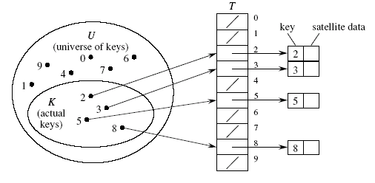
Array as table
It is also called Direct-address Hash Table.
• Direct addressing works well when the universe U of keys is
reasonably small.
• Each slot, or position, corresponds to a key in U.
• If there’s an element x with key k, then T [k] contains a pointer to x.
• Otherwise, T [k] is empty, represented by NIL.
Data Structures and Algorithms (Minor CSE)

Slide 11
Array as table(Con’t)
Store the records in a huge array where the index corresponds to the key
  insert - very fast O(1)
  delete - very fast O(1)
  search - very fast O(1)
But it wastes a lot of memory! Not feasible.
Data Structures and Algorithms (Minor CSE)

Slide 12
Hash function
function Hash(key: KeyType): integer;
Imagine that we have such a magic function Hash. It maps the key (studid) of the 1000 records into the integers 0..999, one to one. No two different keys maps to the same number.
H(‘0012345’) = 134
H(‘0033333’) = 67
H(‘0056789’) = 764
…
H(‘9908080’) = 3
Data Structures and Algorithms (Minor CSE)

Slide 13
Hash Table
0
name
score
To store a record, we compute Hash(stud_id) for the record and store it at the location Hash(stud_id) of the array. To search for a student, we only need to peek at the location Hash(target stud_id).
:
:
:
3
9908080
bill
49
:
:
:
67
0033333
betty
90
:
:
:
134
0012345
andy
81.5
:
:
:
764
0056789
david
56.8
:
:
:
999
:
:
:
Data Structures and Algorithms (Minor CSE)

Slide 14
Hash Table with Perfect Hash
Such magic function is called perfect hash
  insert - very fast O(1)
  delete - very fast O(1)
  search - very fast O(1)
But it is generally difficult to design perfect hash. (e.g. when the potential key space is large)
Data Structures and Algorithms (Minor CSE)

Slide 15
Hash function
A hash function maps a key to an index within in a range
Desirable properties:
  simple and quick to calculate
  even distribution, avoid collision as much as possible
function Hash(key: KeyType);
Data Structures and Algorithms (Minor CSE)

Slide 16
Hashing
The key field is changed into a small integer by the application of a function to the key
Hash function: the function used to transform the key into a small integer
Hash value: the derived small integer used as index
Data Structures and Algorithms (Minor CSE)

Slide 17
Hash Table
Hash table: one-dimensional structure consisting of indexed buckets where values stored according to index determined by hash value.
Every element of hash table should be initialised to “empty”
Data Structures and Algorithms (Minor CSE)

Slide 18
Graphical Representation of Hash Table
Hashtable [0]
Hashtable [1]
Hashtable [2]
. . .
. . .
Hashtable [n-2]
Hashtable [n-1]
v
Represents an empty bucket
v
Data Structures and Algorithms (Minor CSE)

Slide 19
Division Method
h(k) = k mod m
Certain values of m may not be good:
  When m = 2^{p} then h(k) is the p lower-order bits of the key
  Good values for m are prime numbers which are not close to exact powers of 2. For example, if you want to store 2000 elements, assuming 3 elements per slot then m=701 (m = hash table length) yields a hash function:
h(key) = k mod 701
Data Structures and Algorithms (Minor CSE)

Slide 20
Hashing to a Bucket
keyvalue3
Hashtable [0]
Hashfunction(keyvalue1)  2
Hashtable [1]
Hashfunction(keyvalue2)  n-1
keyvalue1
Hashtable [2]
Hashfunction(keyvalue3)  0
. . .
. . .
Hashfunction(keyvalue4)  n-2
keyvalue4
Hashtable [n-2]
keyvalue2
Hashtable [n-1]
v
Data Structures and Algorithms (Minor CSE)

Slide 21
A Hash Function
Hash(key) = (2 * int(key) modulus 10)
Cat
Dog
Elephant
Frog
(2* (3+1+20)) % 10 = 48 % 10 = 8
(2*(4+15+7)) % 10 = 52 % 10 = 2
(2*(5+12+5+16+8+1+14+20) )% 10 = 162 % 10 = 2
(2*(6+18+15+7)) % 10 = 92 % 10 = 2
Any problems with this function ?
Data Structures and Algorithms (Minor CSE)

Slide 22
Hash Function
Perfect hash function where each distinct key produces a different value: very rare
Collision: occurs when two keys hash to the same location
Collisions unavoidable:
  Number of keys > size of hash table
Collision avoidance: choose hashing function which will place keys uniformly over rows of the hash table
Data Structures and Algorithms (Minor CSE)

Slide 23
Solutions to Collision
The problem arises because we have two keys that hash in the same array entry, a collision. There are two ways to resolve collision:
Two classes:
  (1) Open hashing, i.e. separate chaining or close addressing
  (2) Closed hashing, i.e. open addressing
Difference has to do with whether collisions are stored outside the table (open hashing) or whether collisions result in storing one of the records at another slot in the table (closed hashing)
Hashing with Chaining: every hash table entry contains a pointer to a linked list of keys that hash in the same entry
Hashing with Open Addressing: every hash table entry contains only one key. If a new key hashes to a table entry which is filled, systematically examine other table entries until you find one empty entry to place the new key
Data Structures and Algorithms (Minor CSE)

Slide 24
Open Hashing
Each bucket in the hash table is the head of a linked list
All elements that hash to a particular bucket are placed on that bucket’s linked list
Records within a bucket can be ordered in several ways
  by order of insertion, by key value order, or by frequency-of access order
Data Structures and Algorithms (Minor CSE)

Slide 25
Open Hashing Data Organization
0
...
1
...
2
3
4
D-1
...
Data Structures and Algorithms (Minor CSE)

Slide 26
Chained Hash Table
One way to handle collision is to store the collided records in a linked list. The array now stores pointers to such lists. If no key maps to a certain hash value, that array entry points to nil.
0
1
nil
2
nil
3
4
nil
5
:
HASHMAX
nil
Key: 9903030
name: tom
score: 73
Data Structures and Algorithms (Minor CSE)

Slide 27
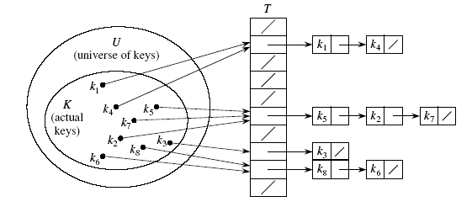
Chained Hash Table
Put all elements that hash to the same slot into a linked list.
• Slot j contains a pointer to the head of the list of all stored elements that hash to j
• If there are no such elements, slot j contains NIL.
Data Structures and Algorithms (Minor CSE)

Slide 28
Chaining: Disadvantages
Parts of the array might never be used.
As chains get longer, search time increases to O(n) in the worst case.
Constructing new chain nodes is relatively expensive (still constant time, but the constant is high).
Is there a way to use the “unused” space in the array instead of using chains to make more space?
Data Structures and Algorithms (Minor CSE)

Slide 29
Open Addressing (Close hashing)
An alternative to chaining for handling collisions.
    • Store all keys in the hash table itself.
    • Each slot contains either a key or NIL.
    • To search for key k:
      Compute h(k) and examine slot h(k).
      Examining a slot is known as a probe.
      If slot h(k) contains key k, the search is successful.
      If this slot contains NIL, the search is unsuccessful.
      There’s a third possibility: slot h(k) contains a key that is not k.
      We compute the index of some other slot, based on k and on which probe (count from 0: 0th, 1st, 2nd, etc.) we’re on. Keep probing until we either find key k (successful search) or we find a slot holding NIL (unsuccessful search).
Data Structures and Algorithms (Minor CSE)

Slide 30
How to compute probe sequences
Linear probing: Given auxiliary hash function h, the probe sequence starts at slot h(k) and continues sequentially through the table, wrapping after slot m − 1 to slot 0. Given key k and probe number i (0 ≤ i < m),
h(k, i ) = (h(k) + i ) mod m.
Quadratic probing: As in linear probing, the probe sequence starts at h(k). Unlike linear probing, it examines cells 1,4,9, and so on, away from the original probe point:
h(k, i ) = (h(k) + c₁i + c₂i²) mod m
Double hashing: Use two auxiliary hash functions, h₁ and h₂.
h₁ gives the initial probe, and h₂ gives the remaining probes:
h(k, i ) = (h₁(k) + ih₂(k)) mod m.
Data Structures and Algorithms (Minor CSE)

Slide 31
Linear probing
Associated with closed hashing is a rehash strategy:
“If we try to place x in bucket h(x) and find it occupied, find alternative location h₁(x), h₂(x), etc. Try each in order, if none empty table is full,”
h(x) is called home bucket
Simplest rehash strategy is called linear hashing
  h_{i}(x) = (h(x) + i) % D
In general, our collision resolution strategy is to generate a sequence of hash table slots (probe sequence) that can hold the record; test each slot until find empty one (probing)
Data Structures and Algorithms (Minor CSE)

Slide 32
Example Linear (Closed) Hashing
D=8, keys a,b,c,d have hash values h(a)=3, h(b)=0, h(c)=4, h(d)=3
Where do we insert d? 3 already filled
Probe sequence using linear hashing:
  h₁(d) = (h(d)+1)%8 = 4%8 = 4
  h₂(d) = (h(d)+2)%8 = 5%8 = 5*
  h₃(d) = (h(d)+3)%8 = 6%8 = 6
  etc.
  7, 0, 1, 2
Wraps around the beginning of the table!
0
b
1
2
3
a
4
c
5
d
6
7
Data Structures and Algorithms (Minor CSE)

Slide 33
Collision Handling - Linear Probing
Consider the data with keys: 24, 42, 34, 62, 73 into a table of size 10.
Hash function = key % 10
These entries can be placed into the table at the following locations,
 | 42 | 62 | 24 | 34 | 73
Data Structures and Algorithms (Minor CSE)

Slide 34
Collision Handling - Linear Probing
24 % 10 = 4. Position is free. 24 placed into element 4.
42 % 10 = 2. Position is free. 42 placed into element 2.
34 % 10 = 4. Position is occupied. Try next position(5). 34 placed into element 5.
62 % 10 = 2. Position is occupied. Try next position(3). 62 placed into element 3.
73 % 10 = 3. Position is occupied. Try next position(4), (5), Occupied, Try(6), 73 is placed into element 6.
 |  |  | 24
 | 42 |  | 24
 | 42 |  | 24 | 34
 | 42 | 62 | 24 | 34
 | 42 | 62 | 24 | 34 | 73
Data Structures and Algorithms (Minor CSE)

Slide 35
Clustering
Even with a good hash function, linear probing has its problems:
  The position of the initial mapping i ₀ of key k is called the home position of k.
  When several insertions map to the same home position, they end up placed contiguously in the table. This collection of keys with the same home position is called a cluster.
  As clusters grow, the probability that a key will map to the middle of a cluster increases, increasing the rate of the cluster’s growth. This tendency of linear probing to place items together is known as primary clustering.
  As these clusters grow, they merge with other clusters forming even bigger clusters which grow even faster.
Data Structures and Algorithms (Minor CSE)

Slide 36
Operations Using Linear Hashing
Test for membership: get(k)?
Examine h(k), h₁(k), h₂(k), …, until we find k or an empty bucket or home bucket
If no deletions possible, strategy works!
What if deletions?
If we reach empty bucket, cannot be sure that k is not somewhere else and now empty bucket was occupied when k was inserted
Need special placeholder deleted, to distinguish bucket that was never used from one that once held a value
May need to reorganize table after many deletions
Data Structures and Algorithms (Minor CSE)

Slide 37
Quadratic Probing: h(k, i ) = (h(k) + c₁i + c₂i ²) mod m
Quadratic probing eliminates the primary clustering problem of linear probing by examining certain cells away from the original probe point. In the following example, table size m = 8, and c1 = 0 , c2 = 1
k: A,P,Q B,O,R C,N,S D,M,T E,L,U F,K,N G,J,W,Z H,I,X,Y
h(k): 0 1 2 3 4 5 6 7
Action
Store A
Store C
Store D
Store G
Store P
Store Q
Delete P
Delete Q
Store B
Store R
Store Q
0
A
A
A
A
A
A
A
A
A
A
A
1
P
P
±
±
B
B
B
2
C
C
C
C
C
C
C
C
C
C
3
D
D
D
D
D
D
D
D
D
4
Q
Q
±
±
Q
5
R
6
G
G
G
G
G
G
G
G
7
# probes
1
1
1
1
2
3
2
3
1
3
3
Data Structures and Algorithms (Minor CSE)

Slide 38
Double Hashing
Double hashing: Use two auxiliary hash functions, h₁ and h₂. h₁ gives the initial probe, and h₂ gives the remaining probes:
h(k, i ) = (h₁(k) + ih₂(k)) mod m.
Quadratic probing solves the primary clustering problem, but it has the secondary clustering problem, in which, elements that hash to the same position probe the same alternative cells. Secondary clustering is a minor theoretical blemish.
Double hashing is a hashing technique that does not suffer from secondary clustering. A second hash function is used to drive the collision resolution.
Data Structures and Algorithms (Minor CSE)

Slide 39
Example of Double Hashing
Consider a hash table storing integer keys that handles collision with double hashing
  N = 13
  h(k) = k mod 13
  d(k) = 7 - k mod 7
Insert keys 18, 41, 22, 44, 59, 32, 31, 73
Data Structures and Algorithms (Minor CSE)

Slide 40
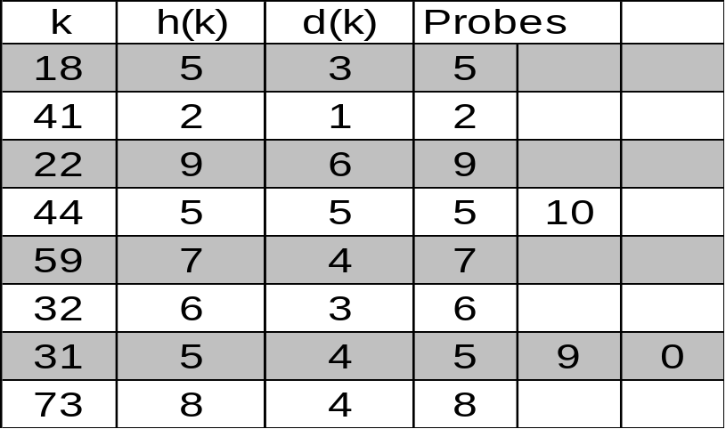
Double Hashing - Example
  N = 13
  h(k) = k mod 13
  d(k) = 7 - k mod 7
keys 18, 41, 22, 44, 59, 32, 31, 73
0
1
2
3
4
5
6
7
8
9
10
11
12
31
41
18
32
59
73
22
44
0
1
2
3
4
5
6
7
8
9
10
11
12
Data Structures and Algorithms (Minor CSE)

Slide 41
Rehashing
Hash Table may get full
  No more insertions possible
Hash table may get too full
  Insertions, deletions, search take longer time
Solution: Rehash
  Build another table that is twice as big and has a new hash function
  Move all elements from smaller table to bigger table
Cost of Rehashing = O(N)
  But happens only when table is close to full
  Close to full = table is X percent full, where X is a tunable parameter
CS/IS C363 Data Structures and Algorithms

Slide 42
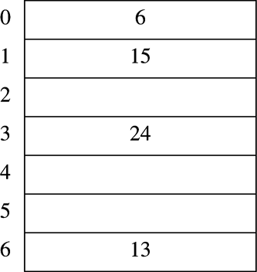
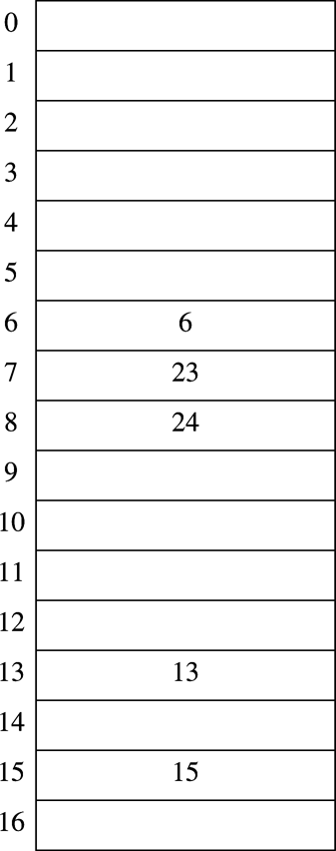
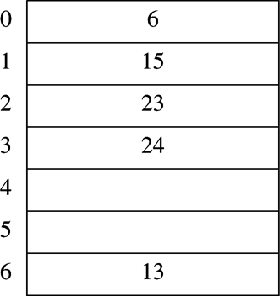
Rehashing Example
Original Hash Table
After Rehashing
After Inserting 23

Slide 43
END
Data Structures and Algorithms (Minor CSE)

