Slide 1
Trees

Slide 2

Linear lists are useful for serially ordered data
  (e₁,e₂,e₃,…,e_{n})
  Days of week
  Months in a year
  Students in a class
Trees are useful for hierarchically ordered data
  Joe’s descendants
  Corporate structure
  Government Subdivisions
  Software structure
Minor CSE: Data Structures

Slide 3

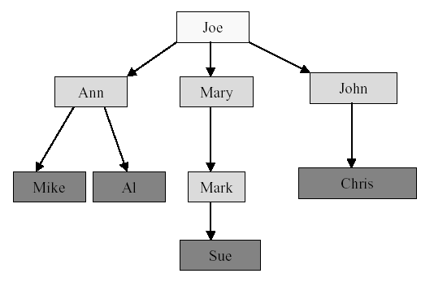
What are other examples of hierarchically ordered data?
Minor CSE: Data Structures

Slide 4

A tree t is a finite nonempty set of elements
One of these elements is called the root
The remaining elements, if any, are partitioned into trees, which are called the subtrees of t.
Minor CSE: Data Structures

Slide 5

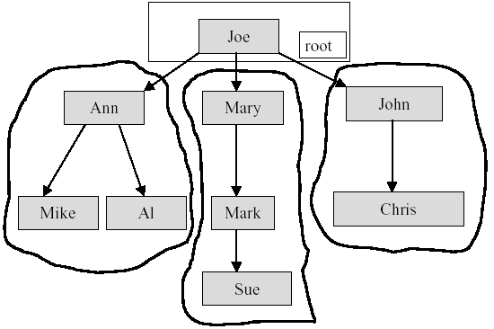
Minor CSE: Data Structures

Slide 6

The element at the top of the hierarchy is the root.
Elements next in the hierarchy are the children of the root.
Elements next in the hierarchy are the grandchildren of the root, and so on.
Elements at the lowest level of the hierarchy are the leaves.
Minor CSE: Data Structures

Slide 7

Leaves, Parent, Grandparent, Siblings,
Ancestors, Descendents
Leaves = {Mike,AI,Sue,Chris}
Parent(Mary) = Joe
Grandparent(Sue) = Mary
Siblings(Mary) = {Ann,John}
Ancestors(Mike) = {Ann,Joe}
Descendents(Mary)={Mark,Sue}
Minor CSE: Data Structures

Slide 8

Height of a node in a tree
  Length of the longest path from that node to a leaf
Depth of a node in a tree
  Length of the path from the root of the tree to the node
Minor CSE: Data Structures

Slide 9

Root is at level 1 and its children are at level 2.
Height = depth = number of levels
level 1
level 2
level 3
level 4
Minor CSE: Data Structures

Slide 10

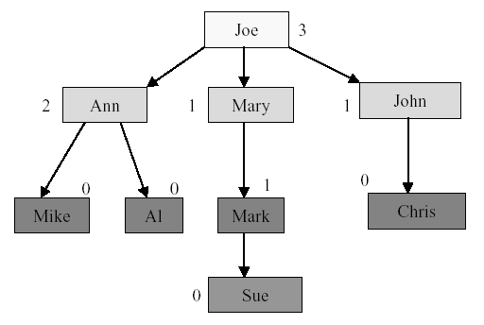
Node degree is the number of children it has
Minor CSE: Data Structures

Slide 11

Tree degree is the maximum of node degrees
tree degree = 3
Minor CSE: Data Structures

Slide 12

A finite (possibly empty) collection of elements
A nonempty binary tree has a root element and the remaining elements (if any) are partitioned into two binary trees
They are called the left and right subtrees of the binary tree
Minor CSE: Data Structures

Slide 13

A binary tree may be empty; a tree cannot be empty.
No node in a binary tree may have a degree more than 2, whereas there is no limit on the degree of a node in a tree.
The subtrees of a binary tree are ordered; those of a tree are not ordered.
a
a
- different when viewed as a binary tree
- same when viewed as a tree
b
c
c
b
Minor CSE: Data Structures

Slide 14

The drawing of every binary tree with n elements, n > 0, has exactly n-1 edges.
A binary tree of height h, h > 0, has at least h and at most 2^{h}-1 elements in it.
Minor CSE: Data Structures

Slide 15
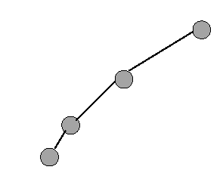
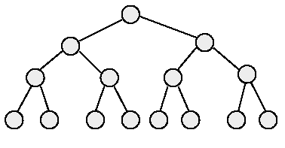
3. The height of a binary tree that contains n elements, n > 0, is at least ⎡(log₂(n+1))⎤ and at most n.
minimum number of elements
maximum number of elements
Minor CSE: Data Structures

Slide 16

Ordered v. unordered
Binary tree
Empty v non-empty
Full
Perfect
Complete
Minor CSE: Data Structures

Slide 17

Have a linear order on the children of each node
That is, can clearly identify a 1st, 2nd, …, k^{th} child
An unordered tree doesn’t have this property
Minor CSE: Data Structures

Slide 18

An ordered tree with at most two children for each node
If node has two child, the 1st is called the left child, the 2nd is called the right child
If only one child, it is either the right child or the left child
Two trees are not equivalent …One has only a left child; the other has only a right child
Minor CSE: Data Structures

Slide 19

Convenient to define an empty binary tree, written Λ, for use in this definition:
  A binary tree is either Λ or is a node with left and right subtrees, each of which is a binary tree.
Minor CSE: Data Structures

Slide 20

Has no nodes with only one child
  Each node either a leaf or it has 2 children
# leaves = #non-leaves + 1
Minor CSE: Data Structures

Slide 21

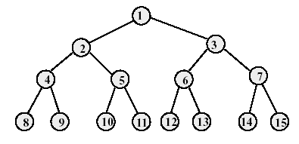
A full binary tree of height h has exactly 2^{h}-1 nodes.
Numbering the nodes in a full binary tree
  Number the nodes 1 through 2^{h}-1
  Number by levels from top to bottom
  Within a level, number from left to right
Minor CSE: Data Structures

Slide 22

Parent of node i is node ⎣(i/2)⎦, unless i = 1
Node 1 is the root and has no parent
Minor CSE: Data Structures

Slide 23
Left child of node i is node 2i, unless 2i > n,
where n is the total number of nodes.
If 2i > n, node i has no left child.
Minor CSE: Data Structures

Slide 24
Right child of node i is node 2i+1, unless 2i+1 > n, where n is the total number of nodes.
If 2i+1 > n, node i has no right child.
Minor CSE: Data Structures

Slide 25

A full binary tree in which all leaves have the same depth
Perfect binary tree of height h>0 has:
  2^{h} -1 nodes
  2^{h-1} leaves
  2^{h-1} -1 non-leaves
Interesting because it is “fully packed”, the shallowest tree that can contain that many nodes. Often, we’ll be searching from the root. Such a shallow tree gives us minimal number of accesses to nodes in the tree.
Minor CSE: Data Structures

Slide 26
Minor CSE: Data Structures

Slide 27

Perfect binary tree requires that number of nodes be one less than a power of 2.
Complete binary tree is a close approximation, with similar good properties for processing of data stored in such a tree.
Complete binary tree of height h:
  Add nodes from left at bottom level
Minor CSE: Data Structures

Slide 28

A complete binary tree of height 0 is any tree consisting of a single node.
A complete binary tree of height 1 is a tree of height 1 with either two children or a left child only.
For height h >= 2, a complete binary tree of height h is a root with two subtrees satisfying one of these two conditions:
  Either the left subtree is perfect of height h-1 and the right is complete of height h-1 OR
  The left is complete of height h-1 and the right is perfect of height h-2.
Minor CSE: Data Structures

Slide 29

Minor CSE: Data Structures

Slide 30
Start with a full binary tree that has at least n nodes
Number the nodes as described earlier.
The binary tree defined by the nodes numbered 1 through n is the n-node complete binary tree.
A full binary tree is a special case of a complete binary tree
Minor CSE: Data Structures

Slide 31

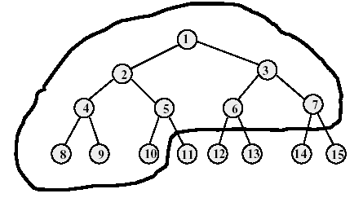
Complete binary tree with 10 nodes.
Same node number properties (as in full binary tree) also hold here.
Minor CSE: Data Structures

Slide 32

Forest
  A finite set of trees
  In the case of ordered trees, the trees in the forest must have a distinguishable order as well.
Minor CSE: Data Structures

Slide 33

Array representation
Linked representation
Minor CSE: Data Structures

Slide 34
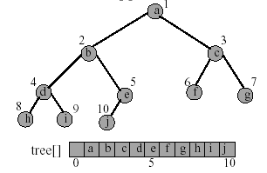
The binary tree is represented in an array by storing each element at the array position corresponding to the number assigned to it.
Minor CSE: Data Structures

Slide 35

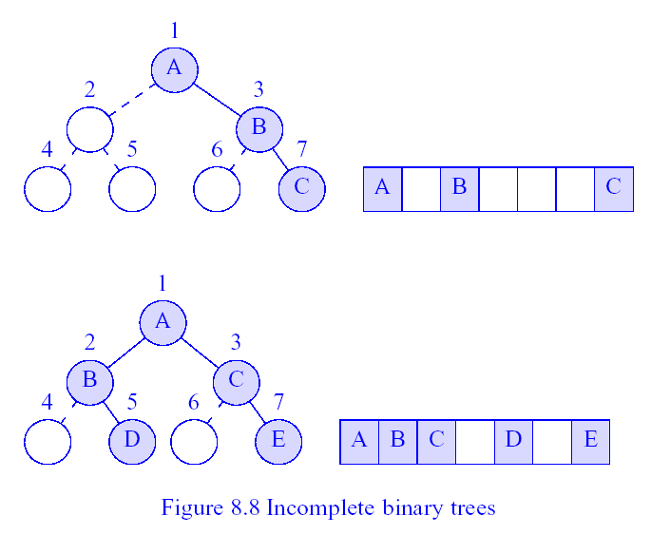
Complete binary tree with some missing elements
Minor CSE: Data Structures

Slide 36

The most popular way to present a binary tree
Each element is represented by a node that has two link fields (leftChild and rightChild) plus an element field.
Each binary tree node is represented as an object whose data type is binaryTreeNode.
The space required by an n node binary tree is n * sizeof(binaryTreeNode)
Minor CSE: Data Structures

Slide 37

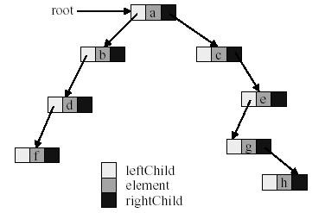
Minor CSE: Data Structures

Slide 38

Determine the height
Determine the number of nodes
Make a copy
Determine if two binary trees are identical
Display the binary tree
Delete a tree
If it is an expression tree, evaluate the expression
If it is an expression tree, obtain the parenthesized form of the expression
Minor CSE: Data Structures

Slide 39

Many binary tree operations are done by performing a traversal of the binary tree
In a traversal, each element of the binary tree is visited exactly once
During the visit of an element, all actions (make a copy, display, evaluate the operator, etc.) with respect to this element are taken
Minor CSE: Data Structures

Slide 40

Preorder
  The root of the subtree is processed first before going into the left then right subtree (root, left, right).
Inorder
  After the complete processing of the left subtree the root is processed followed by the processing of the complete right subtree (left, root, right).
Postorder
  The root is processed only after the complete processing of the left and right subtree (left, right, root).
Minor CSE: Data Structures

Slide 41

void preOrder(Tree *t)
{
if (t != NULL) {
visit(t); // visit tree root
preOrder(t->leftChild);// do left subtree
preOrder(t->rightChild);// do right subtree
}
}
Minor CSE: Data Structures

Slide 42

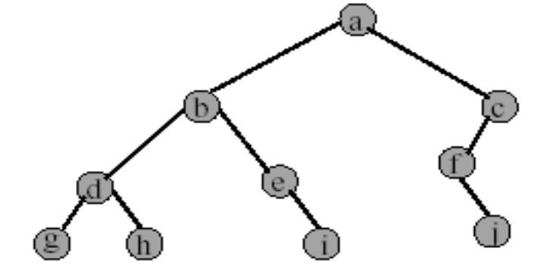
a b d g h e i c f j
Minor CSE: Data Structures

Slide 43

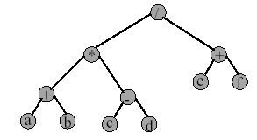
/ * + a b - c d + e f
Gives prefix form of expression.
Minor CSE: Data Structures

Slide 44

void inOrder(Tree *t)
{
if (t != NULL) {
inOrder(t->leftChild); // do left subtree
visit(t); // visit tree root
inOrder(t->rightChild); // do right subtree
}
}
Minor CSE: Data Structures

Slide 45

g d h b e i a f j c
Minor CSE: Data Structures

Slide 46

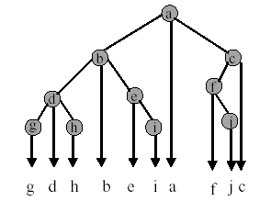
Minor CSE: Data Structures

Slide 47

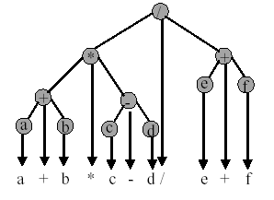
Gives infix form of expression, which is how we normally write math expressions. What about parentheses?
Fully parenthesized output of the above tree?
Minor CSE: Data Structures

Slide 48

void (Tree *t)
{
if (t != NULL) {
postOrder(t->leftChild); // do left subtree
postOrder(t->rightChild); // do right subtree
visit(t); // visit tree root
}
}
Minor CSE: Data Structures

Slide 49

g h d i e b j f c a
Minor CSE: Data Structures

Slide 50

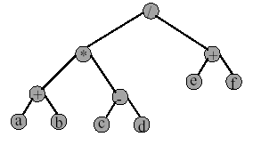
a b + c d - * e f + /
Gives postfix form of expression.
Minor CSE: Data Structures

Slide 51

The space complexity of each of the four traversal algorithm is O(n)
The time complexity of each of the four traversal algorithm is Θ(n)
Minor CSE: Data Structures

Slide 52
END
Minor CSE: Data Structures

