Slide 1
HYPERSPECTRAL IMAGE PROCESSING USING DEEP LEARNING TECHNIQUES
Team Details
R.DIVIJA(20EG105439)
V.MAHESH REDDY(20EG105448)
VISHNU VARDHAN(20EG105720)
Project Supervisor
Dr. P. Ratna Sekhar
Asst Professor Dept of CSE

Slide 2
Introduction
A Hyperspectral Image (HSI) is a digital image that encompasses a broad range of electromagnetic wavelengths, extending beyond the limited three bands (Red, Green, Blue) found in regular RGB images. HSIs consist of hundreds or even thousands of narrow and adjacent bands, covering an extensive spectrum.
A Hyperspectral Image (HSI) is formed by dividing the electromagnetic spectrum into narrow bands, creating numerous spectral channels. Each channel represents a specific wavelength range. In an HSI, every pixel has a unique spectral signature with intensity values reflecting the object's reflectance or radiance at different wavelengths. This spectral data facilitates identifying and analyzing materials and object characteristics in the captured image
Material Identification, Agriculture and Precision Farming, Defense and Surveillance, Medical Imaging are the applications.

Slide 3
Problem Statement
Problem Statement:
The problem here in the project aims to address the challenges posed by high dimensionality, redundancy, spectral mixing, and lack of texture and shape detail in unprocessed spectral and spatial data for remote sensing applications. remote sensing is facing challenges in accurately classifying materials and objects in hyperspectral images, leading to suboptimal results in various applications.
Illustration:
Before processing, hyperspectral images exhibit high dimensionality, containing hundreds or even thousands of spectral bands. This leads to redundancy and computational complexity, making it challenging to extract meaningful information. Additionally spectral mixing further complicate accurate classification. Furthermore, the lack of detailed texture and shape information hinders the precise identification of materials and objects in the image.

Slide 4
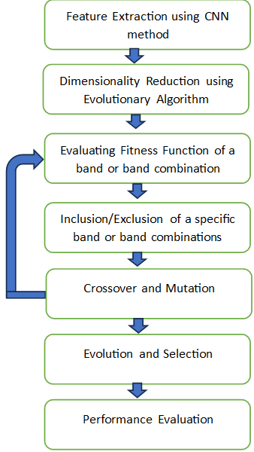
Proposed Method
Our proposed method involves combining Convolutional Neural Networks (CNNs) and Evolutionary Algorithms (EAs) to address the challenges of hyperspectral data.
First, CNNs are employed to extract hierarchical features from hyperspectral images. To tackle the computational difficulties arising from the abundance of spectral bands, EAs, including Genetic Algorithms and Differential Evolution, are used to identify an optimal subset crucial for effective classification.
The Evolutionary Algorithm iteratively refines band subsets through genetic operators such as crossover and mutation, prioritizing those yielding higher fitness, indicative of better classification. The process continues until a termination condition is met.
The final subset is then independently validated, evaluating the performance of the CNN classifier using the reduced feature space.

Slide 5
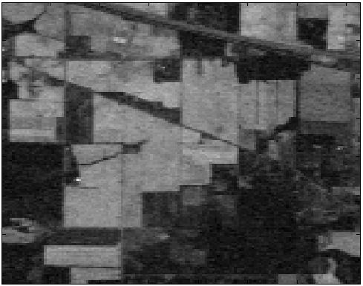
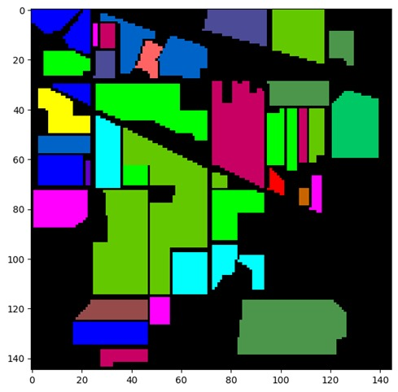
Proposed Method Illustration
After the image processing done the raw image is converted to Hyperspectral image and helps to process image easily.
Before image processing After image processing

Slide 6
Experiment Environment
DATASETS: Kaggle, GitHub
IDE: Google Colab
Language: Python
Dataset:https://www.kaggle.com/datasets/abhijeetgo/indian-pines-hyperspectral-dataset

Slide 7
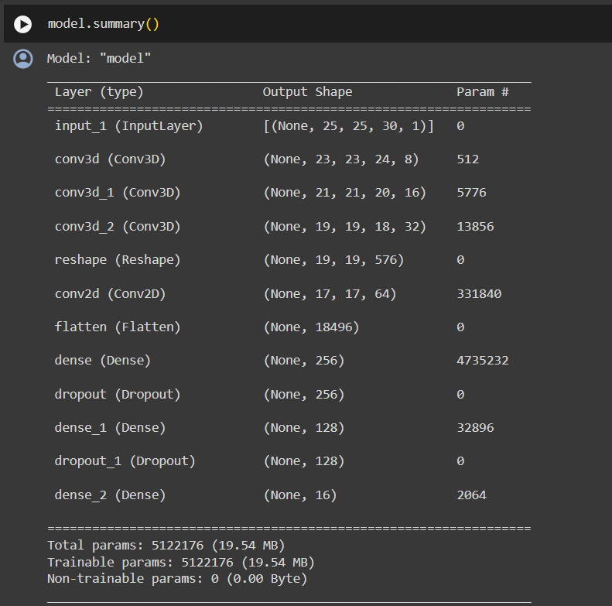
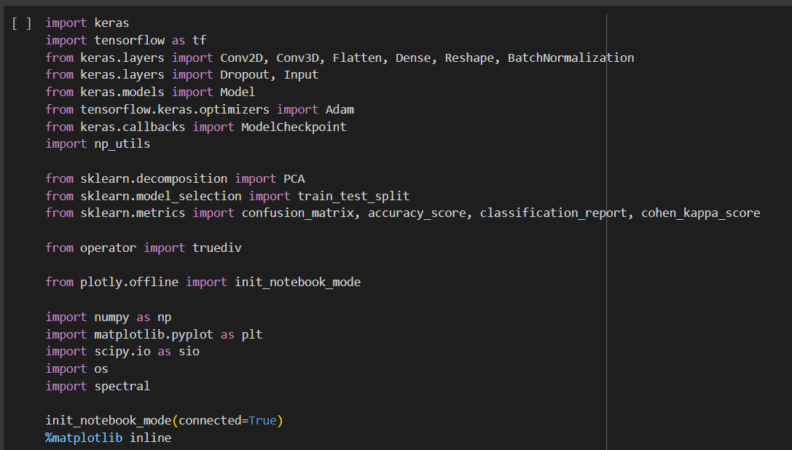
Experiment Screenshots

Slide 8
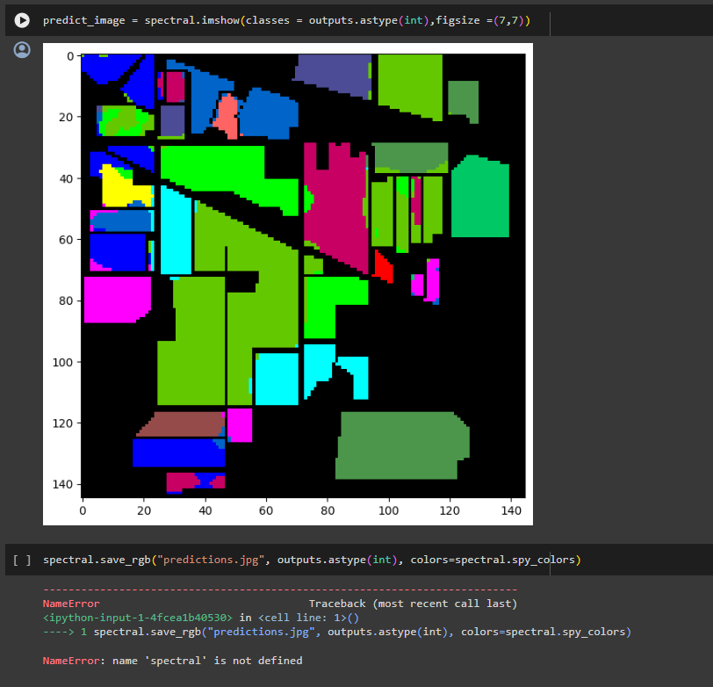
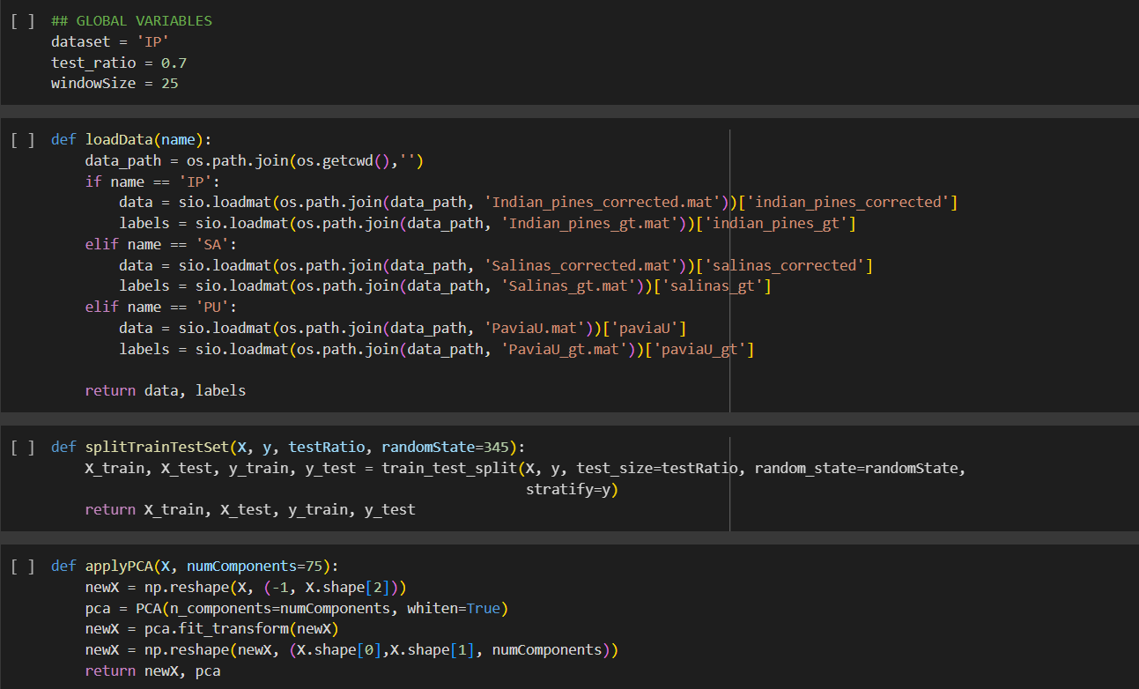
Experiment Screenshots

Slide 9
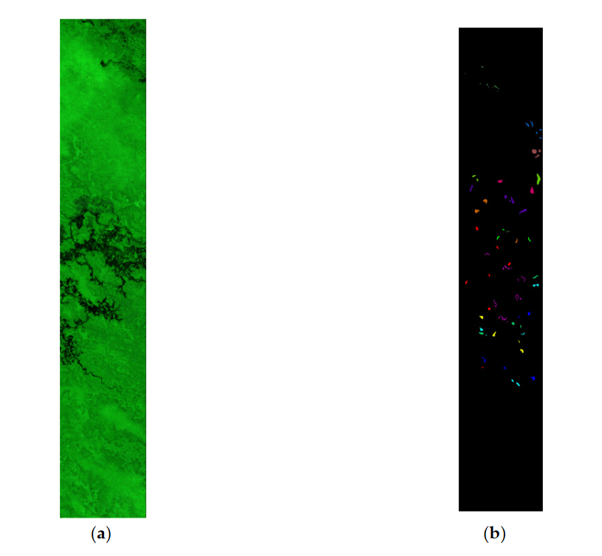
Experiment Results
Experiment 1:

Slide 10
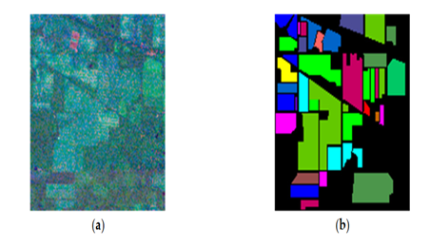
Experiment Results
Experiment 2:

Slide 11
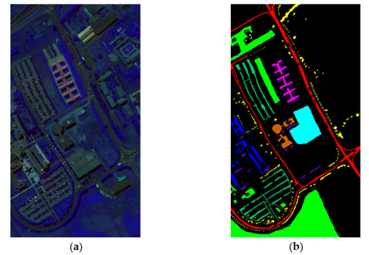
Experiment Results
Experiment 3:

Slide 12
Findings
Hyperspectral images (HSIs) contain hundreds or thousands of narrow bands, unlike RGB images, and each pixel has a unique spectral signature representing reflectance at different wavelengths.
Spectral data captures electromagnetic spectrum information, while spatial data relates to pixel location and layout in the image.
Deep learning techniques, particularly Convolutional Neural Networks (CNNs), efficiently process both spectral and spatial data in HSIs, handling their high dimensionality and complexity.
CNNs are effective for extracting features from spectral data, identifying distinct spectral signatures associated with different materials or conditions.
CNNs can also extract features from spatial data related to texture, shape, and spatial relationships, crucial for tasks like object detection and land cover classification.
The integration of deep learning with remote sensing technologies, especially in HSI processing, provides valuable insights for various applications, including land cover classification, agriculture monitoring, and environmental assessment.

Slide 13
Justification
Parameters Improved | Mathematical Formulas | Justification
Classification Accuracy | F1​-score=precision+recall2×precision×recall​ | Enhanced feature selection and extraction by evolutionary algorithms (EAs) and convolutional neural networks (CNNs) lead to more informative data, improving classification accuracy.
Spectral-Spatial Information | NA | The integration of CNNs and EAs allows for the extraction of both spectral and spatial features, enhancing the model's ability to understand the context and relationships within hyperspectral images.
Computational Efficiency | NA | Reduction in dimensionality of hyperspectral data through optimized band selection and feature extraction leads to improved computational efficiency, enabling faster processing.
Robustness | NA | The combined approach improves the model's robustness by enhancing its ability to generalize to new, unseen data, reducing overfitting and improving overall performance.

Slide 14
References
[1] K. Makantasis, K. Karantzalos, A. Doulamis and N. Doulamis, "Deep supervised learning for hyperspectral data classification through convolutional neural networks," 2015 IEEE International Geoscience and Remote Sensing Symposium (IGARSS), Milan, Italy, 2015, pp. 4959-4962, doi: 10.1109/IGARSS.2015.7326945.
[2] X. Jia, B.-C. Kuo, and M. Crawford, “Feature mining for hyperspectral image classification,” Proc. IEEE, vol. 101, no. 3, pp. 676–697, Mar. 2013.
[3] B. Pan, Z. Shi, Z. An, and Z. Jiang, “A novel spectral-unmixingbased green algae area estimation method for GOCI data,” IEEE J. Sel. Top. Appl. Earth Obs. Remote Sens., vol. 10, no. 2, pp. 437–449, Feb. 2017.
[4] Grewal, R., Kasana, S.S. & Kasana, G. Hyperspectral image segmentation: a comprehensive survey. Multimed Tools Appl 82, 20819–20872 (2023). https://doi.org/10.1007/s11042-022-13959-w.
[5] P. Liu, H. Zhang and K. B. Eom, "Active Deep Learning for Classification of Hyperspectral Images," in IEEE Journal of Selected Topics in Applied Earth Observations and Remote Sensing, vol. 10, no. 2, pp. 712-724, Feb. 2017, doi: 10.1109/JSTARS.2016.2598859

Slide 15
Thank you

