Slide 1
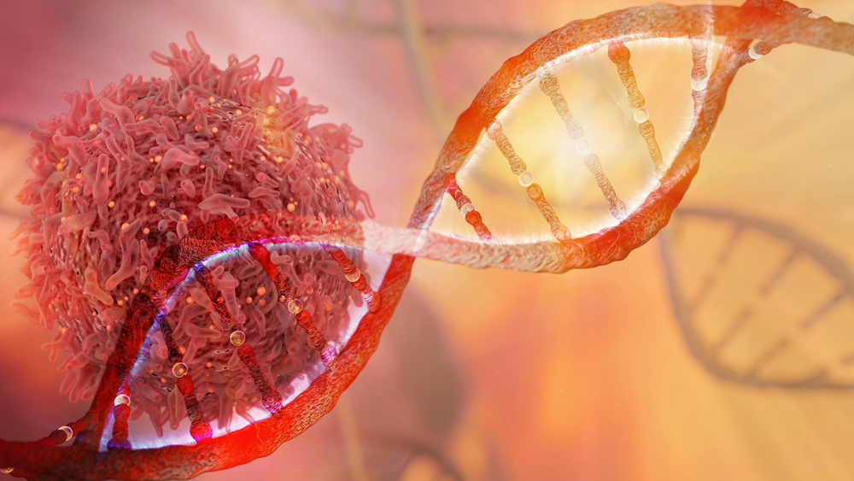
Cancer DNA changes

Slide 2

Time taken for report

Slide 3
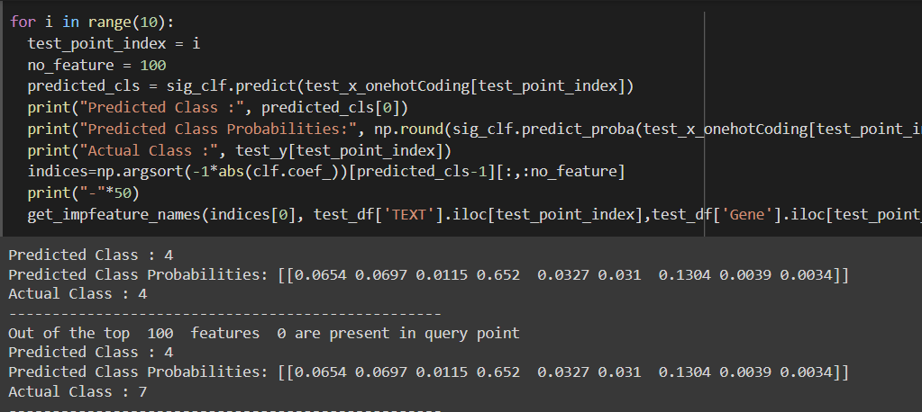
Class prediction

Slide 4
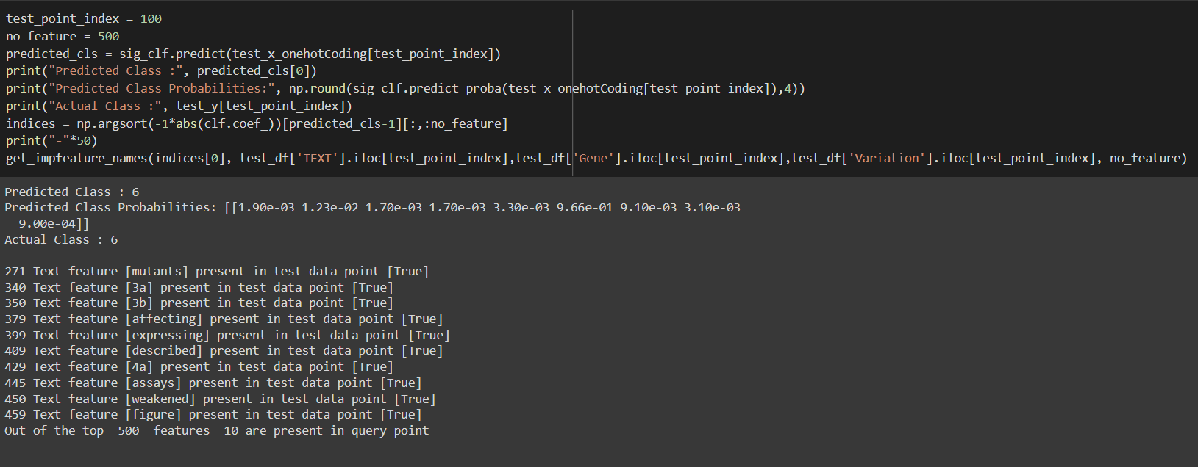
Business constraint

Slide 5

FISH TEST

Slide 6
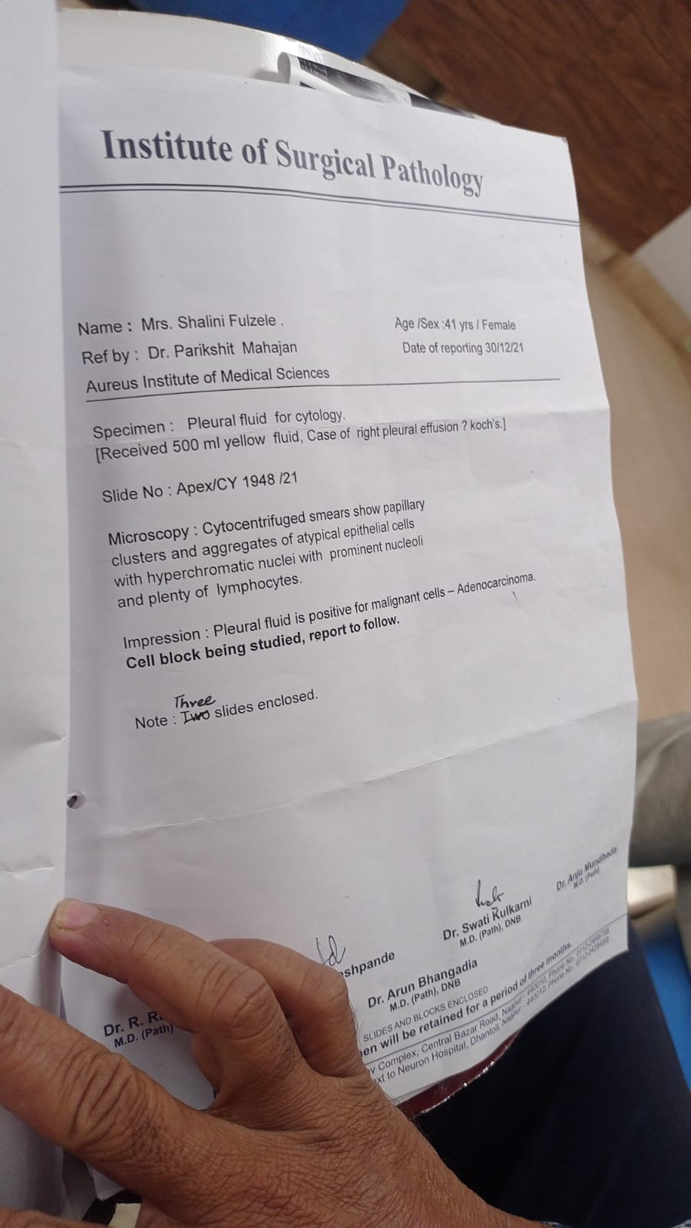
Test report biopsy

Slide 7
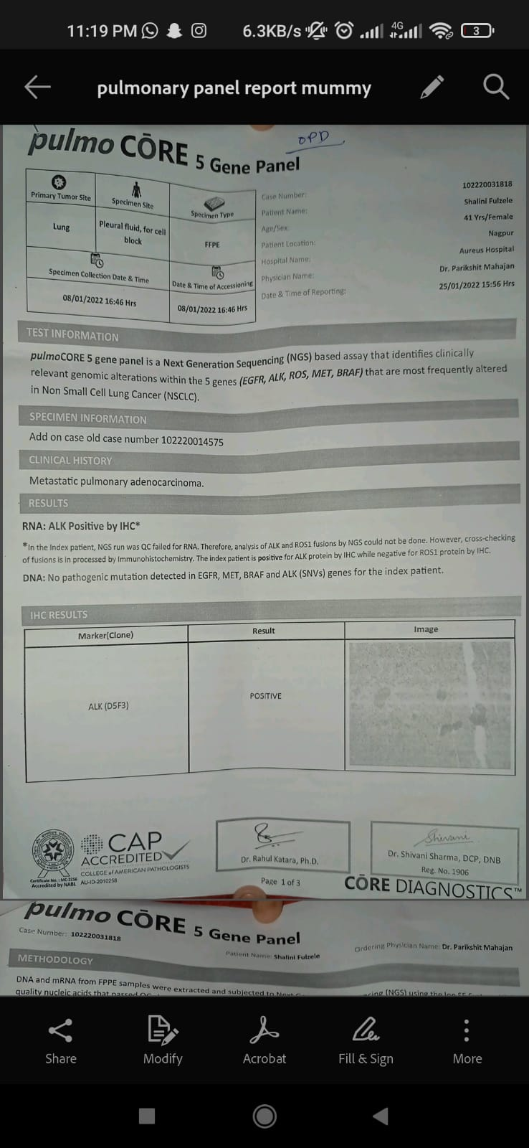
Cancer Gene panel report

Slide 8
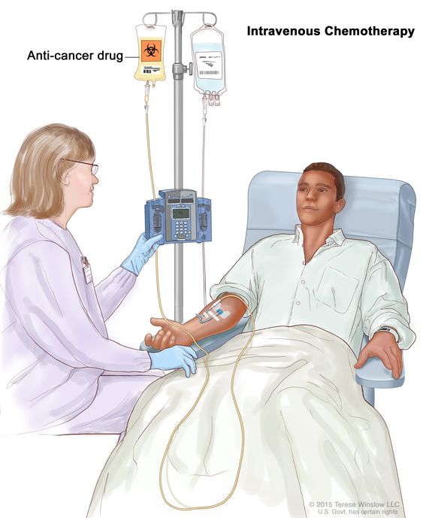
Chemotherapy
Chemotherapy is a type of cancer treatment that uses one or more anti-cancer drugs as part of a standardized chemotherapy regimen.

Slide 9
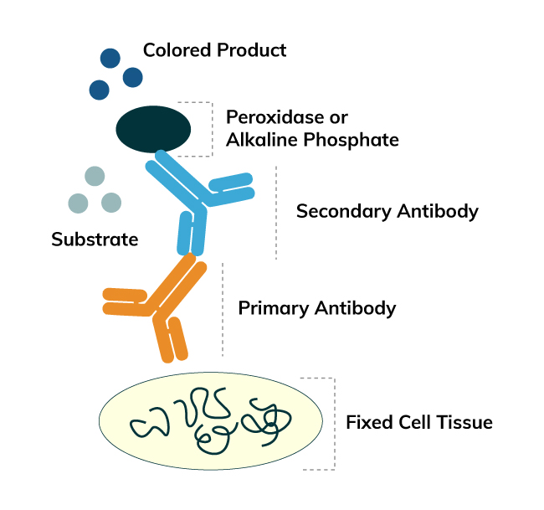

IHC Report
Immunohistochemistry (IHC) is a method of detecting proteins in/on cells. Proteins that bind to the target are added to the cells and then colored proteins are added. If the target is present, the color will be detected with a microscope or other machine.

Slide 10
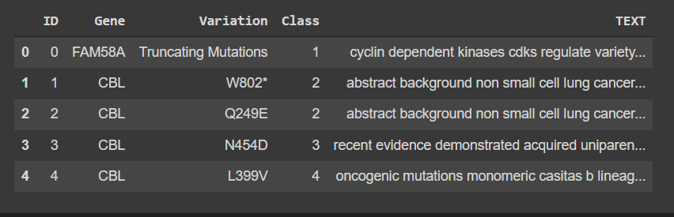
Data

