Slide 1

Customer Churn Analysis at Fit.ly
IBEKWE DIVINE UFOK

Slide 2
Outline
01. Project Overview
05. Key Findings
02. Data & Validation
06. Metric to Monitor
03. Data Cleaning
07. Recommendations
04. Exploratory Analysis
08. Conclusion

Slide 3
Project Overview & Business Goal
03
Business problem
Data brought together
Fit.ly has experienced increasing customer churn over the past two quarters.
• Account information
• Customer support activity
• User activity
The overall goal was to identify useful business insights rather than simply calculate numbers.
Goal
To understand what may be contributing to this problem and provide practical actions Fit.ly can take to combat the problem next quarter.

Slide 4
Data Validation
04
Account information
Customer support
User activity
• Missing values and duplicates checked
• Customer IDs and emails checked
• State values checked
• Plan categories checked
• Plan prices checked
• Churn status checked
• Date/time fields checked
• User IDs matched to accounts
• Channel and topic categories checked
• Resolution times reviewed
• Comments reviewed for missing values
• Event timestamps checked
• User IDs matched to accounts
• Event types checked
• Missing values and duplicates reviewed
Cross-dataset IDs were validated before analysis.

Slide 5
Data Cleaning & Preparation
05
Date and time standardization
Unclear support state field
Ticket and event timestamps were converted from text to Pacific-time datetime values.
The customer-support state field contained 0/1 values, but its meaning was not documented. It was therefore excluded rather than assigning an unsupported interpretation.
Irregular support channel values
Churn-status limitation (From Account Info)
The '-' entries in the channel column under customer support were treated as missing values (NaN).
286 of 400 customers have missing churn-status values. These were not assumed to mean confirmed non-churners, so churn findings are treated as provisional.
Derived churn indicator
A churned column was created from churn_status to support the analysis.
A separate churned column was created to identify records explicitly marked as churned. This produced 114 True values and 286 False values;
Comments (From Account Info)
Support comments: 872 of 918 are blank. They were kept, not removed, because comments can contain GDPR data-deletion requests.

Slide 6
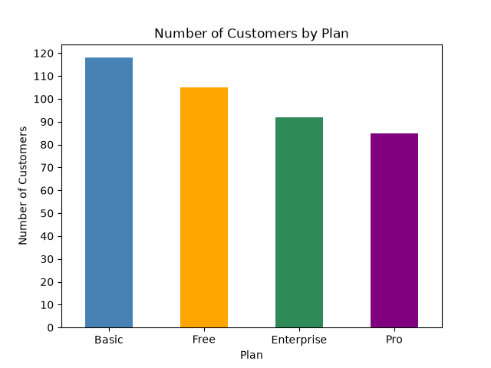
06
Exploratory Data Analysis(Plan distribution)
Plan distribution
Basic has the largest customer base with 118 customers, while Pro has the smallest with 85.
Plan counts
Basic — 118
Free — 105
Enterprise — 92
Pro — 85
What this tells us
This tells us that Basic represents the largest customer segment and is an important group for the business to monitor

Slide 7
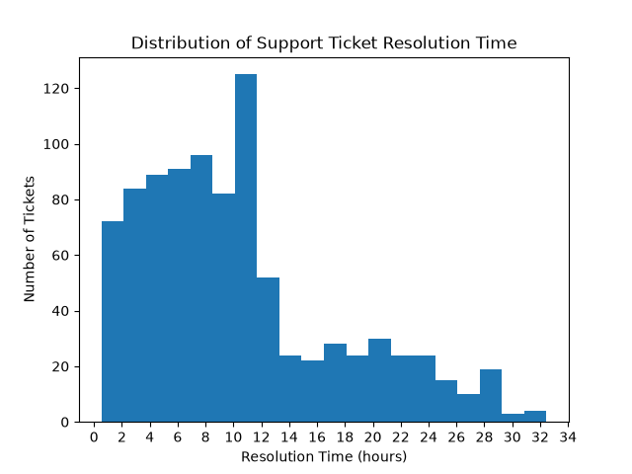
07
Customer Support Analysis
Resolution time
Support-ticket resolution times range from approximately 0.5 to 32.5 hours, with the highest concentration around 10–12 hours.
Why it matters
Longer resolution times can be examined alongside customer engagement and churn when more complete churn data is available.

Slide 8
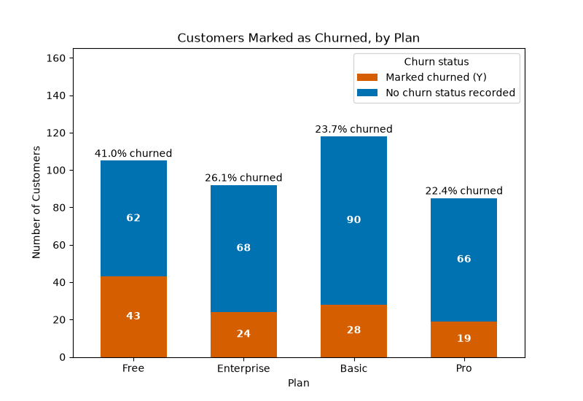
Churn Analysis
08
Share marked as churned
Free has the highest share of customers marked as churned (43 of 105, or 41.0%), well above the overall 28.5%. Pro has the lowest (19 of 85, or 22.4%)
Important limitation
Orange = marked churned; blue = no status recorded. These are not confirmed churn rates, as 286 customers have missing churn status.

Slide 9
Metric to Monitor & Recommendations
09
How to monitor
Recommendation 01
28.5%
Monitor monthly and compare the metric across plan type, customer engagement and support activity.
Improve churn-status recording so future churn rates can be measured reliably.
Customer Churn Rate
114 explicitly churned
÷ 400 customers
× 100 = 28.5%
Provisional estimate
Recommendation 02
Recommendation 03
Investigate the Free plan further because it has the highest share of customers marked as churned (41.0%).
Review longer support-resolution tickets and look for recurring issues.

Slide 10
Conclusion
The analysis shows that the Basic plan has the largest customer base, while Free has the highest share of customers explicitly recorded as churned (41.0%).
Most support tickets are resolved within 12 hours
However, because 286 customers have missing churn-status values, the actual churn rate and differences in churn between plans cannot be confirmed.
Focus next quarter: improve data quality →
monitor churn consistently →
investigate high-risk patterns.

