Slide 1
Namespace ? Dependency Injection Basic NG program Two way data binding Scope Services/ Other Services Event loop in JS Watcher/Digest Loop Arrays & Functions & Minification of JS Common directives Asynchronous JS and XML
Topics to Discuss

Slide 2
Directives or Custom Variables
Instruction to NG to manipulate the piece of the DOM
Directing what should happen in DOM
String and interpolation
Concatenating a string is called Interpolation
Example : var str = “jupiter” + “pluto”;

Slide 3
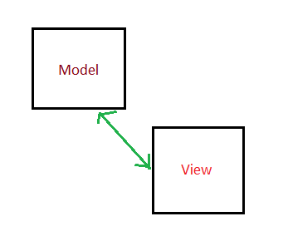
Two way Data binding
Update in view then Model update automatically
Update in model then view update automatically

Slide 4
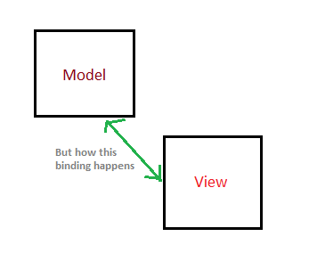
Two way Data binding

Slide 5
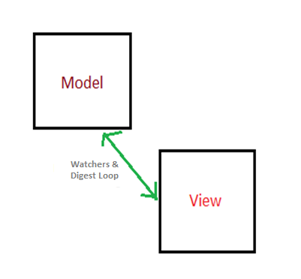
Two way Data binding

Slide 6
Event Loop
Key event
Mouse event
onClick
onChange

Slide 7
Watcher & Digest Loop
Extended version of event looping present in JavaScript

Slide 8
Minification
Shrinking the size of files for faster download.
For minified version of files , normally suffix of filename will be like *.min.* (for example angular.min.js)

Slide 9
Common directives
Ng-app
Ng-controller
Ng-repeat
Ng-click
Ng-model
Ng-show
Ng-hide
Ng-if
Ng-class
etc

Slide 10
Asynchronous JS and XML Http ,Factory Routing

