Slide 1
🎓 NELFUND NAVIGATOR
AI-Powered Student Loan Assistant for Nigerian Students.

Slide 2
🎯 The Problem
❌ Information Overload - 500+ pages of policy documents scattered across PDFs
❌ Confusion & Uncertainty - 'Am I eligible?' 'What documents do I need?'
❌ Misinformation - Social media rumors leading to wrong decisions
❌ Complex Language - Legal terminology that confuses students
💡 Students need simple, accurate answers - not 500-page PDFs

Slide 3
💡 Our Solution
🤖 Agentic RAG System - Smart document retrieval with conditional logic
💬 Natural Conversations - Ask in plain English, get document-backed answers
📚 Source Citations - Every answer includes references to official documents
🧠 Conversation Memory - Remembers context for intelligent follow-ups
🎯 Your Path to Higher Education Starts Here

Slide 4
🛠️ Technology Stack
Backend:
• FastAPI
• LangChain
• LangGraph
• OpenAI GPT-4
• ChromaDB
• JWT Auth
Frontend:
• React 18
• Vite
• Tailwind CSS
• React Router
• Axios

Slide 5
🏗️ System Architecture
User Question → Frontend (React) → Backend API (FastAPI)
→ Agent Classification (LangGraph) → Document Retrieval (Conditional)
→ LLM Generation (GPT-4) → Response + Sources
🗄️ Dual Database: chroma_users/ (user data) & chroma_db/ (documents)
🔒 Security: JWT tokens, bcrypt passwords, CORS protection

Slide 6
✨ Key Features
🏠 Interactive Homepage - Modern design with feature showcase
🔐 Secure Authentication - JWT tokens + bcrypt password hashing
💬 Chat Interface - Claude AI-inspired design
🌙 Dark/Light Mode - Theme toggle for comfortable use
📱 Mobile Responsive - Works perfectly on all devices

Slide 7
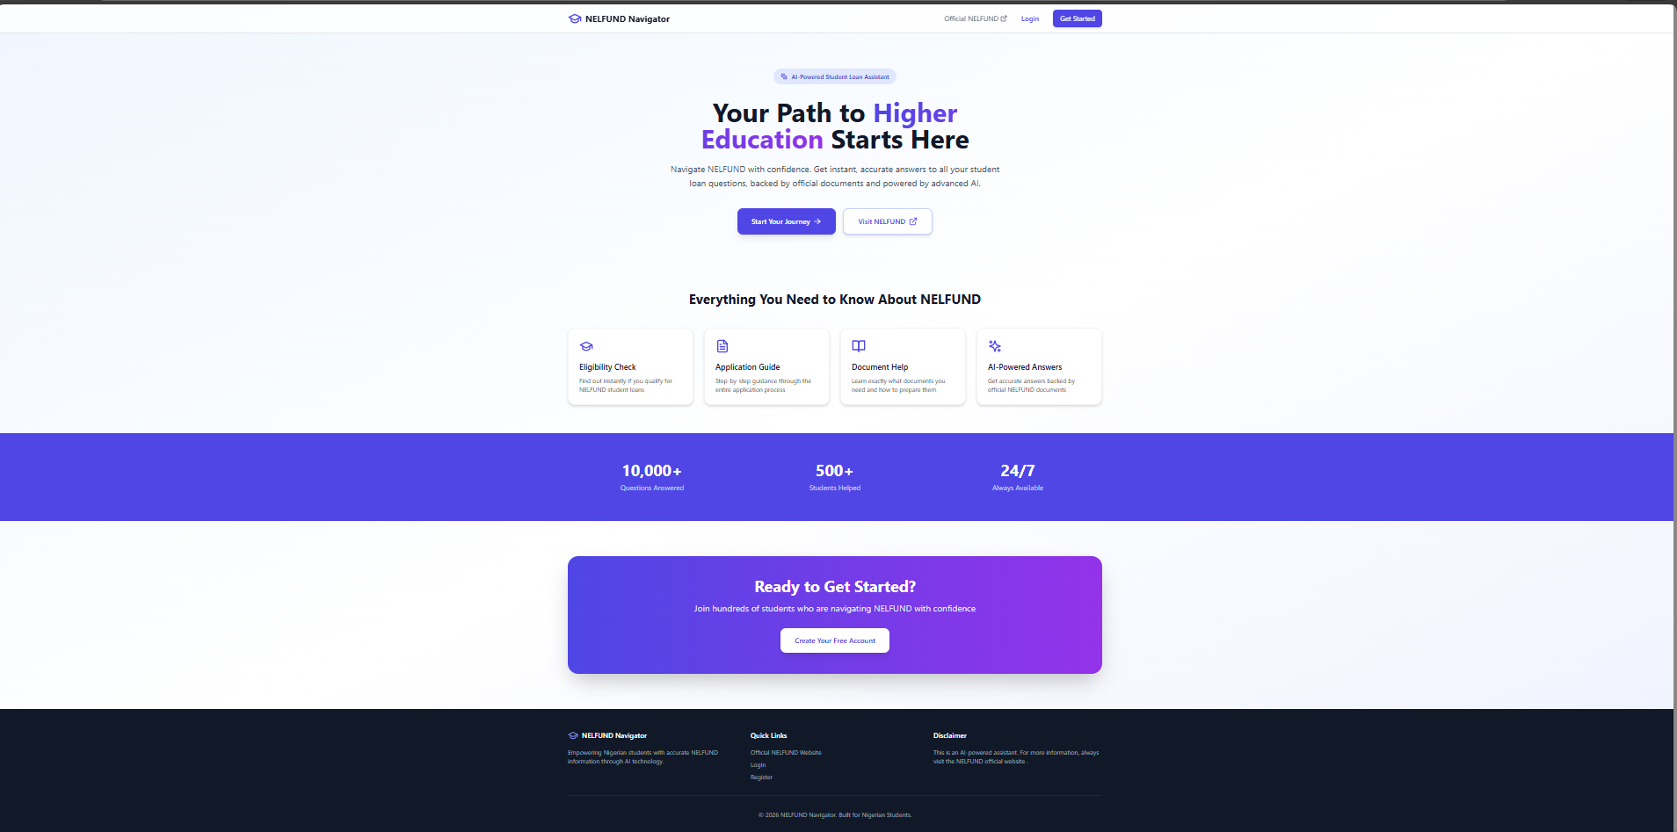

Slide 8
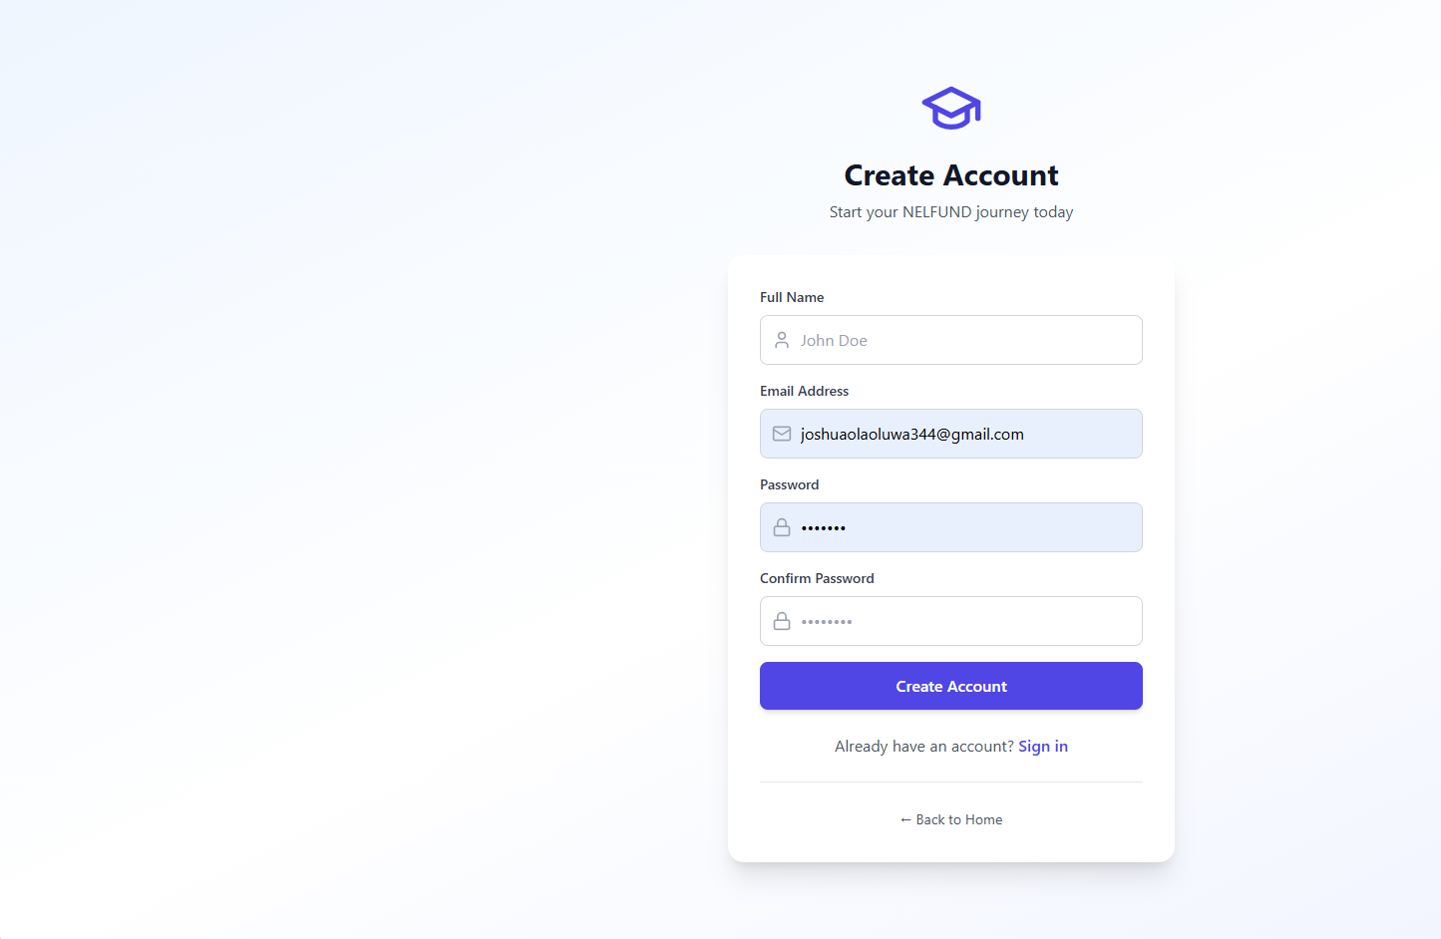

Slide 9
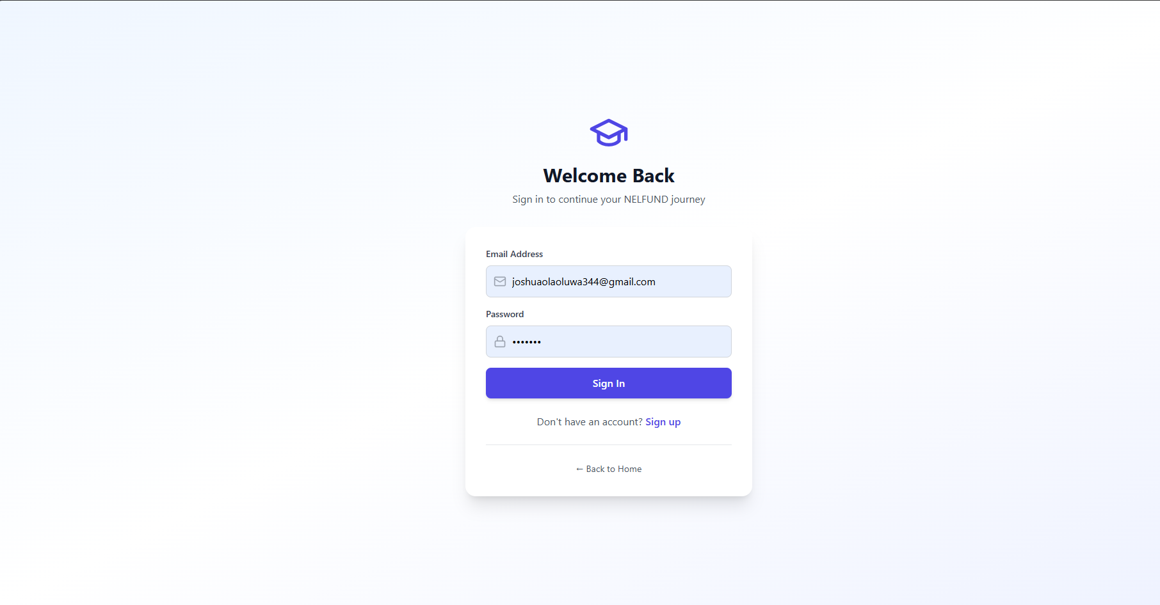

Slide 10
💬 Chat Interface Features
User Features:
• Collapsible sidebar
• Chat history
• Suggested prompts
• Source citations
• Session management
UX Elements:
• Typing indicators
• Message bubbles
• Auto-scroll
• Loading states
• Error handling

Slide 11
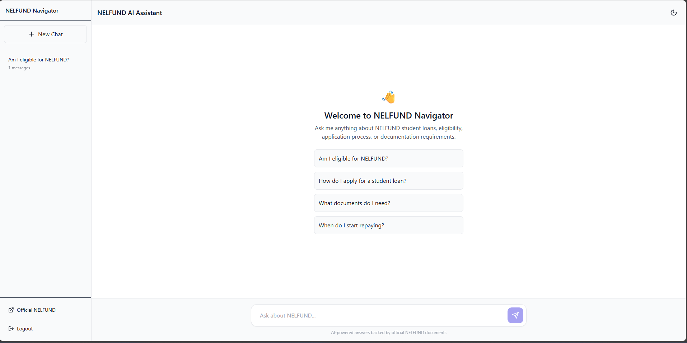

Slide 12
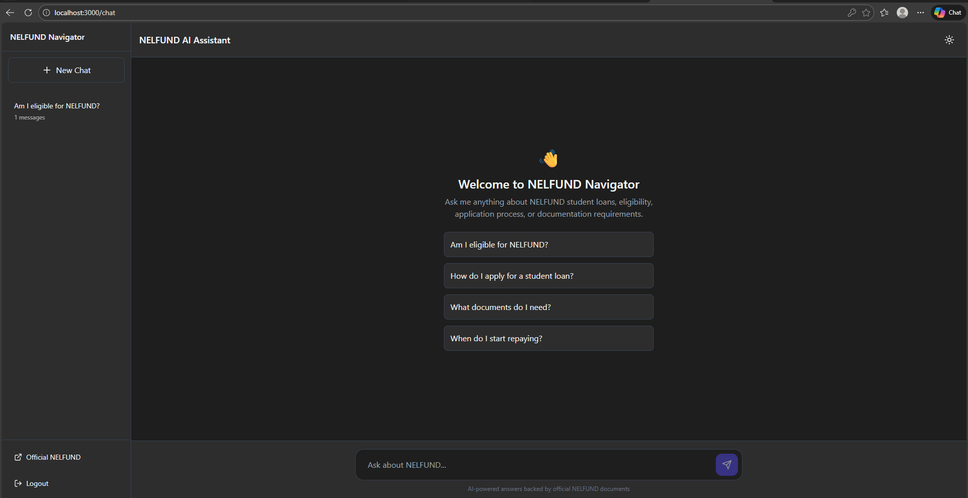

Slide 13
🤖 The Magic: Agentic Behavior
✓ Example 1: 'Hello' → No retrieval needed → Quick response
✓ Example 2: 'Am I eligible?' → Retrieve docs → Detailed answer with sources
✓ Example 3: 'What documents?' → Retrieve + Use context → Contextual response
🎯 This saves API costs and provides faster responses!
💡 The system THINKS before acting, not just blindly retrieving

Slide 14
📡 RESTful API
Authentication:
• POST /api/auth/register
• POST /api/auth/login
• GET /api/auth/me
Chat Operations:
• POST /api/chat
• GET /api/chat/history
• GET /api/chat/sessions
• DELETE /api/chat/session/{id}

Slide 15
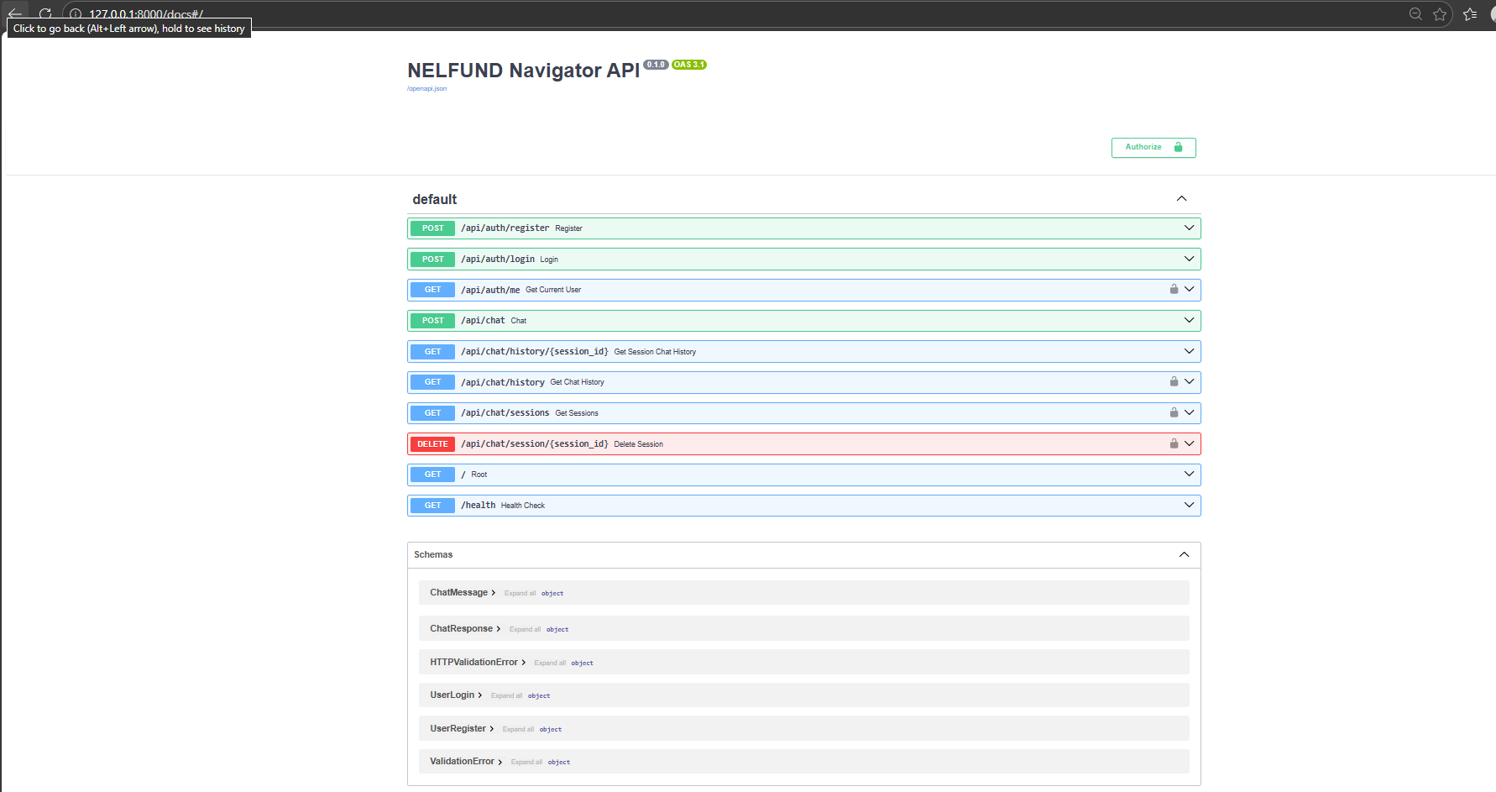

Slide 16
📊 Data & Processing
✓ 9 NELFUND PDF documents processed
✓ 45 total document pages
✓ 68 optimized chunks for retrieval
✓ 44,645 total characters processed
✓ OpenAI text-embedding-3-small for vector embeddings

Slide 17
🎨 User Experience Design
📱 Mobile-First Approach - All features work on mobile
🌙 Dark Mode - Reduced eye strain for late-night studying
💡 Smart Suggestions - Prompts to guide users
🔐 Per-User Data - Each student's chats are completely private
⚡ Fast Responses - Optimized queries and caching

Slide 18
🔐 Secure Authentication
Registration:
• Email validation
• Password hashing (bcrypt)
• User data storage
• Account creation
Login & Sessions:
• Email/password auth
• JWT token generation
• Auto-redirect to chat
• Session persistence

Slide 19
🏆 Key Achievements
✅ Agentic RAG system fully functional with conditional logic
✅ Full-stack implementation (Frontend + Backend + Database)
✅ 8 RESTful API endpoints with proper authentication
✅ Per-user chat storage and history retrieval
✅ Production-ready code with error handling

Slide 20
🌍 Real-World Impact
By The Numbers:
• 45 PDF pages processed
• 68 document chunks
• 9 NELFUND FAQs covered
• 24/7 availability
Student Benefits:
• Quick, accurate answers
• Reduced confusion
• Better access to info
• Higher success rate

Slide 21
Thank You! 🎓
NELFUND Navigator - Empowering Nigerian Students Through AI.

