Slide 1
Sales Performance Report: 2015-2016
Key Insights from Branch Data
United to Prevent Violence Against Women and Girls | www.cewhin.com

Slide 2
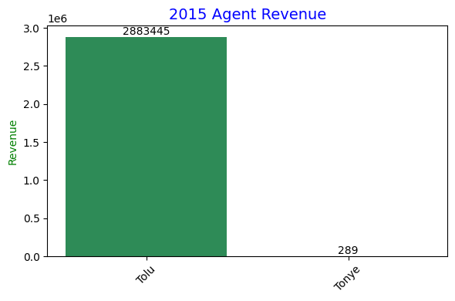
2015 Agent Performance
Tolu had the highest sales revenue
Total Rev: 2,883,445 / 21.08%
Tonye had the lowest sales revenue
Total Per: 289.12 / 2.79%
United to Prevent Violence Against Women and Girls | www.cewhin.com

Slide 3
2015 Product Performance
HP had the highest sales revenue
Total Par: 5,814 / 414 units
Lenovo had the lowest sales revenue
Total Par: 208.80 / 160 units
Average Price of the year 2015: 200.00
United to Prevent Violence Against Women and Girls | www.cewhin.com

Slide 4
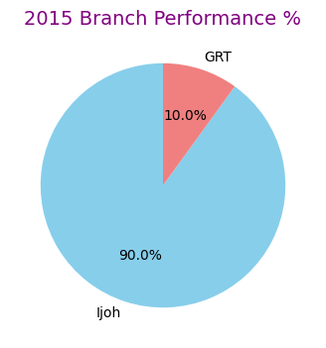
2015 Branch Performance
Ijoh is the highest performing branch
Total Rev: 7,305.56 / 70.45%
GRT is the lowest performing branch
Total Revenue: 808.38 / 7.8%
United to Prevent Violence Against Women and Girls | www.cewhin.com

Slide 5
2016 Agent Performance
Chinma had the highest sales revenue
Total Rev: 3,102 / 33.51%
Torbari had the lowest sales revenue
Total Rev: 57.71 / 0.62%
United to Prevent Violence Against Women and Girls | www.cewhin.com

Slide 6
2016 Product Performance
Apple had the highest performing sales
Total Per: 3,247 / 308 units
Apple had the lowest (note: possible data overlap; lowest units: 250 / 2 units)
Average price of 2016: 125.00
United to Prevent Violence Against Women and Girls | www.cewhin.com

Slide 7
2016 Branch Performance
GRA had the highest performance
Total Rev: 5,193 / 56%
Addah Town had the lowest performance
Total Rev: 231.12 / 2.5%
United to Prevent Violence Against Women and Girls | www.cewhin.com

Slide 8
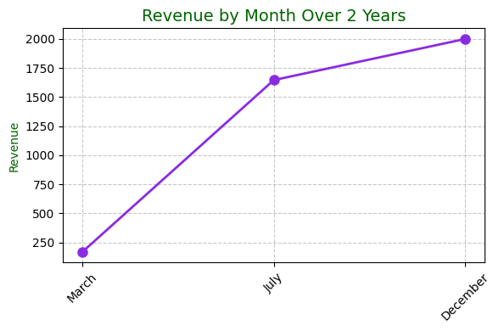
2016 Revenue by Month
July had the highest performance
Total Rev: 1,646
March had the lowest performance
Total Rev: 167.44
United to Prevent Violence Against Women and Girls | www.cewhin.com

Slide 9
Revenue by Branch (Overall)
Ijoh Branch has the highest sales revenue
Total Revenue: 11,139.07 / 56.73%
Town Branch has the lowest sales revenue
Total Revenue: 2,486.42 / 10.67%
United to Prevent Violence Against Women and Girls | www.cewhin.com

Slide 10
Noticeable Insights
Only 3 out of 11 agents sold Apple products (Tolu, Emeka, Chinma)
Only 5 out of 11 agents sold company products (Blessing, Ibrahim, Torbari, Chinma, Uche)
Only 5 out of 11 agents sold HP products – DELL (Emeka, China, George, Blessing, Tolu)
All 11 agents sold HP products
Only 8 agents out of 11 sold Lenovo products (Tolu, George, Blessing, Tonye, Uche, Chinedu, Ibrahim, Tunde)
No agent sold all 5 products
Blessing and Uche sold the highest number of distinct products (4)
Torbari and Tunde sold the lowest number of distinct products (2)
United to Prevent Violence Against Women and Girls | www.cewhin.com

Slide 11
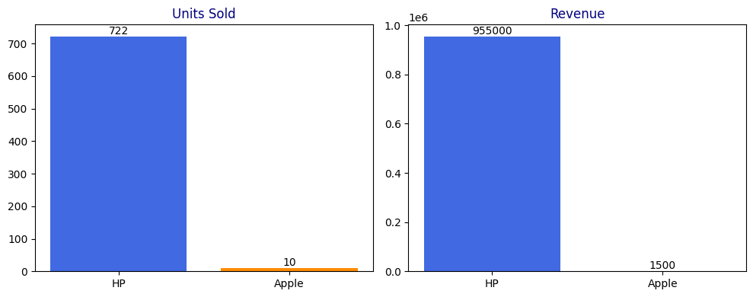
Over the 2 Years – Agent & Product Performance
Agent Performance:
Emeka had the highest sales revenue: 3,109.44 (15.84%)
Torbari had the lowest sales revenue: 536.75 (2.73%)
Product Performance:
HP has the highest sales revenue: 955k / 722 units sold
Apple has the lowest sales revenue: 1.5k / 10 units sold
United to Prevent Violence Against Women and Girls | www.cewhin.com

Slide 12
Over the 2 Years – Year Performance
2015 is the highest performing year
Total Revenue: 10,369.54
Units Sold: 943
2016 is the lowest performing year
Total Revenue: 9,258.39
Units Sold: MK (data unclear; possibly missing)
United to Prevent Violence Against Women and Girls | www.cewhin.com

Slide 13
Revenue by Month Over the 2 Years
December has the highest revenue by month
We have more sales in December than any other month
March has the least revenue by month
We have less sales in the month of March
United to Prevent Violence Against Women and Girls | www.cewhin.com

Slide 14
Thank You / Q&A
Summary: Key trends show strong performance in 2015, HP dominance, and seasonal peaks in December/July.
Contact: For more details, visit www.cewhin.com
United to Prevent Violence Against Women and Girls | www.cewhin.com

