Slide 1

TERPTRAK:
SMITH SCHOOL SUCCESS METRICS
Members:
Pranav Karmarkar
Divisha Gupta
Sandnya Patil
Aniruddha Shelke
Dec 6, 2023

Slide 2

BACKGROUND and DATA
This project aims to create an extensive database of various Smith School Programs and their rankings. The users of such a database would be potential incoming students, wanting an objective overview of each course. To compile this data, sources such as usnews.com, topuniversities.com, best-masters.us, etc. have been used.

Slide 3

MISSION STATEMENT
To provide a comprehensive report on the program rankings at the University of Maryland Smith School,
using diverse data sources to assist prospective students in their decision-making.
This endeavor aims to enhance academic excellence and improve the quality of education and services.

Slide 4
MISSION
OBJECTIVES
01
02
03
04
05
Collect and compile data of Smith School Program Rankings over the years.
Aggregate department information, encompassing the number of programs and faculty size.
Compile program details, including program duration, number of credits, program type, ranking, intake, and accreditation.
Collect data regarding courses, encompassing course name, credits, and intake.
Gather faculty information, such as faculty names, qualifications, years of experience, ratings, research publications, awards, and alumni status.

Slide 5
MISSION
OBJECTIVES
06
07
08
09
Acquire alumni data, including alumni names, graduation years and industry of employment.
Retrieve employer details, covering employer names, roles offered, number of alumni employed, industry, average salary offered, employment type, and sponsorship.
Analyze and interpret program rankings, accreditation, and other performance factors for graduate programs.
Present the deliverables and suite with a user-friendly interface in a timely manner.

Slide 6
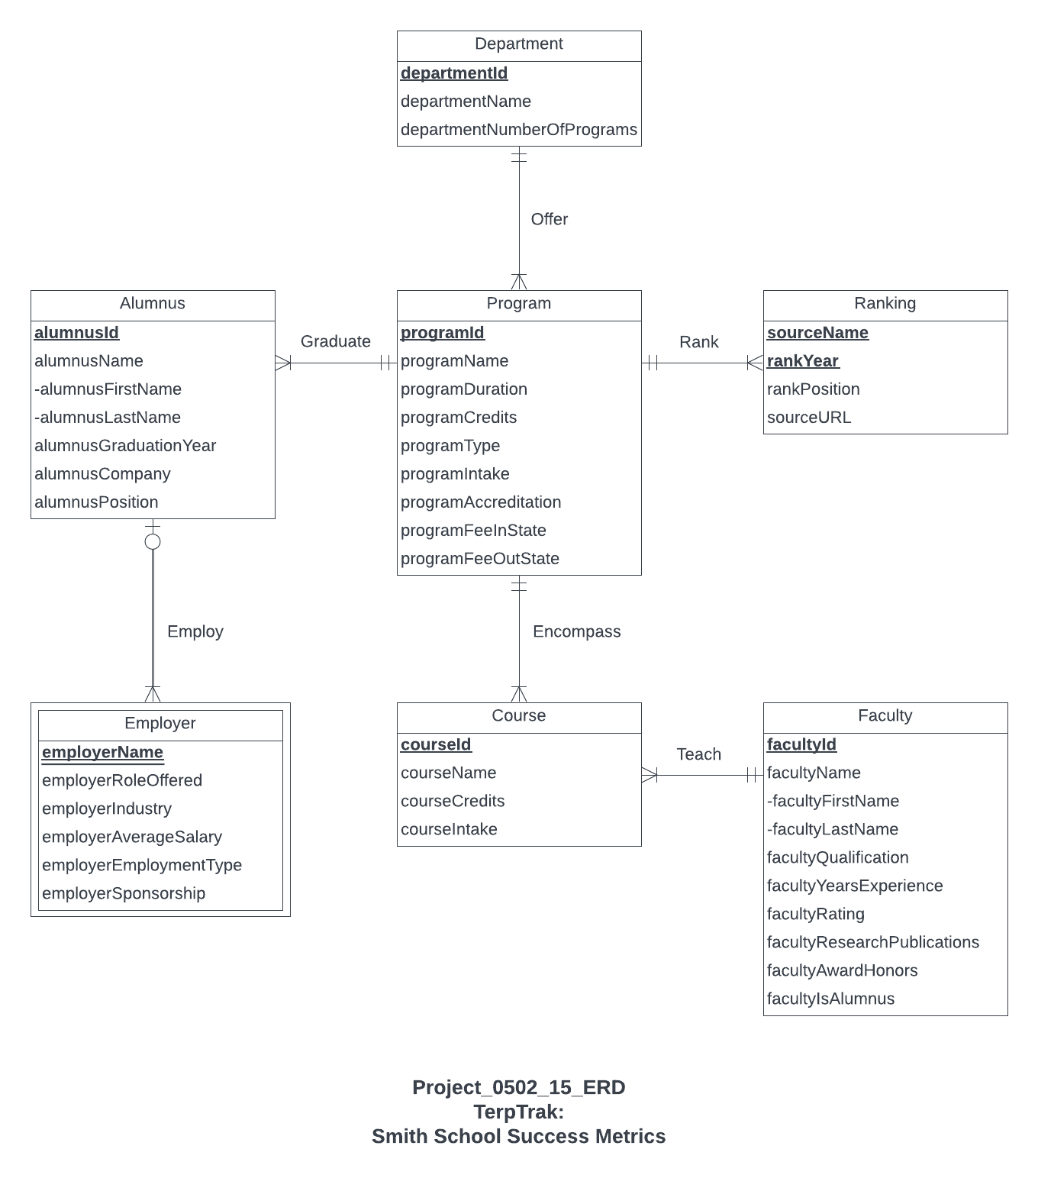
CONCEPTUAL DESIGN
(E.R. DIAGRAM)

Slide 7
LOGICAL DATABASE DESIGN: RELATIONAL SCHEMA
Department (departmentId, departmentName, departmentNumberOfPrograms)
Program (programId, departmentId, programName, programDuration, programCredits, programType, programIntake, programAccreditation, programFeeInState, programFeeOutState)
Ranking (sourceName, rankYear, programId, rankPosition, sourceURL)
Course (courseId, programId, courseName, courseCredits, courseIntake)
Faculty (facultyId, courseId, facultyFirstName, facultyLastName, facultyQualification, facultyYearsExperience, facultyRating, facultyResearchPublications, facultyAwardHonors, facultyIsAlumnus)
Alumnus (alumnusId, programId, alumnusFirstName, alumnusLastName, alumnusGraduationYear, alumnusCompany, alumnusPosition)
Employer (employerName, alumnusId, employerRoleOffered, employerIndustry, employerAverageSalary, employerEmploymentType, employerSponsorship)

Slide 8
PHYSICAL DATABASE DESIGN
(CREATE STATEMENT)
CREATE TABLE [TerpTrak.Program] (
programId CHAR(10) NOT NULL,
departmentId CHAR(20),
programName VARCHAR(100),
programDuration INT,
programCredits INT,
programType VARCHAR(10),
programIntake INT,
programAccreditation VARCHAR(20),
programFeeInState DECIMAL(9,2),
programFeeOutState DECIMAL(9,2)
CONSTRAINT pk_Program_programId PRIMARY KEY (programId),
CONSTRAINT fk_Program_departmentId FOREIGN KEY (departmentId)
REFERENCES [TerpTrak.Department] (departmentId)
ON DELETE CASCADE ON UPDATE CASCADE
);

Slide 9

BUSINESS
TRANSACTIONS
1. Which programs boast average salaries surpassing $75,000?

Slide 10
SELECT QUERY-
Which programs boast average salaries
surpassing $75,000?
SELECT
d.departmentName AS 'Department Name',
p.programId AS 'Program ID',
p.programName AS 'Program Name',
e.employeeAverageSalary AS 'Average Employee Salary',
e.employerName AS 'Employer Name',
e.employerRoleOffered AS 'Employer Offered Role',
e.employerIndustry AS 'Employer Industry'
FROM [TerpTrak.Department] d
JOIN [TerpTrak.Program] p ON d.departmentId = p.departmentId
JOIN [TerpTrak.Alumnus] a ON a.programId = p.programId
JOIN [TerpTrak.Employer] e ON e.alumnusId = a.alumnusId
WHERE e.employeeAverageSalary > 75000
;

Slide 11
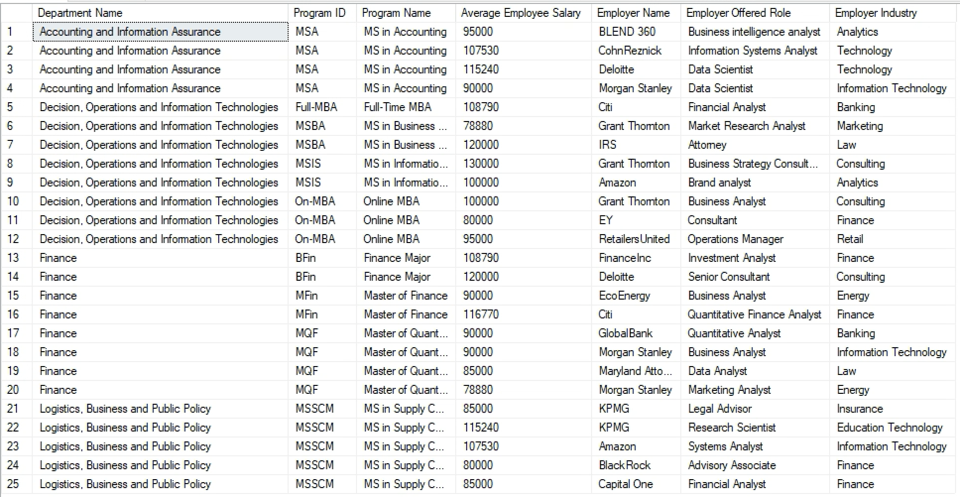

Slide 12
BUSINESS
TRANSACTIONS
2. Which programs have demonstrated the most significant improvement in their rankings over the past year?

Slide 13
SELECT d.departmentName AS 'Department Name’,
p.programName AS 'Program Name',
r1.rankYear AS 'Current Year',
r2.rankYear AS 'Previous Year',
r1.rankPosition AS 'Current Year Rank Position',
r2.rankPosition AS 'Previous Year Rank Position',
CONCAT( CASE
WHEN r2.rankPosition - r1.rankPosition > 0 THEN 'Improved by '
WHEN r2.rankPosition - r1.rankPosition < 0 THEN 'Deteriorated by ‘
ELSE 'No Change '
END,
ABS(r2.rankPosition - r1.rankPosition)) AS 'Rank Status',
r1.sourceName AS 'Source Name'
FROM [TerpTrak.Program] p
JOIN [TerpTrak.Ranking] r1 ON p.programId = r1.programId
AND r1.rankYear = ( SELECT YEAR(GETDATE()) AS currentYearMIN)
JOIN [TerpTrak.Ranking] r2 ON p.programId = r2.programId
AND r2.rankYear = ( SELECT YEAR(GETDATE())-1 AS currentYearMIN)
JOIN [TerpTrak.Department] d ON p.departmentId = d.departmentId
ORDER BY d.DepartmentName, p.ProgramName;
SELECT QUERY-
2. Which programs have demonstrated the most significant improvement in their rankings over the past year?

Slide 14
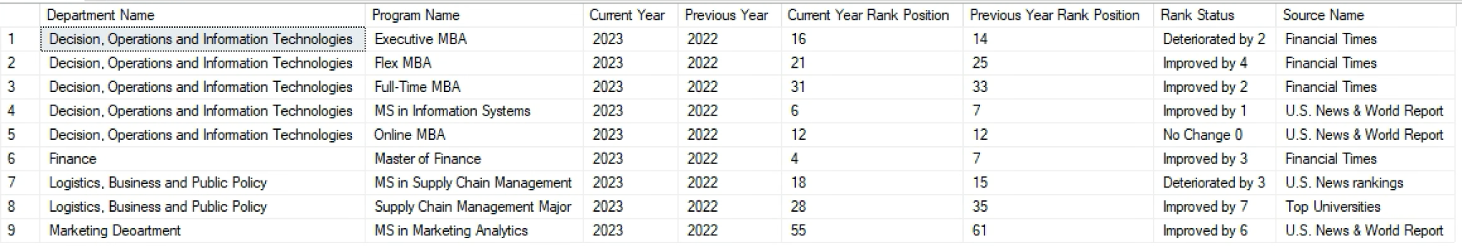
QUERY OUTPUT :

Slide 15
THANK
YOU!

