Slide 1
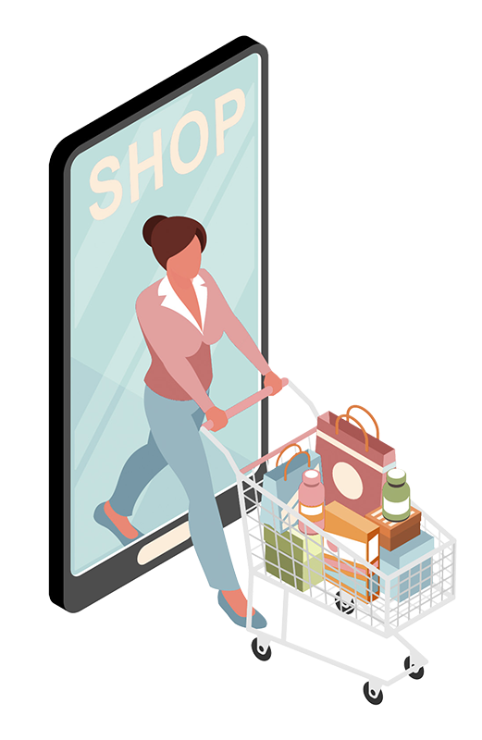
SMART BASKET! Shaping the Future
of Shopping
GROUP 9
DIVISHA GUPTA
PUNEETHA B
STUTI SHRIMAL

Slide 2
CONTENTS
INTRODUCTION
PROJECT OVERVIEW
BUSINESS PROBLEM
METHODOLOGY
RESULTS & SOLUTIONS
CONCLUSION

Slide 3
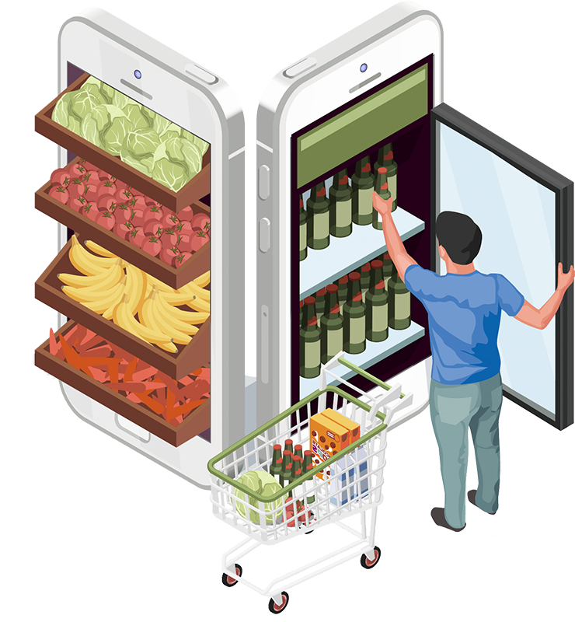
INTRODUCTION

Slide 4
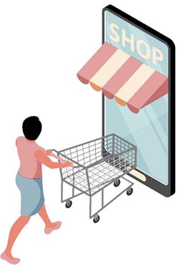


WHOA!
WITH
PROJECT OVERVIEW

Slide 5
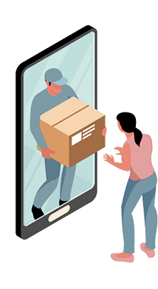
BUSINESS PROBLEM
—SOMEONE FAMOUS
“Refining our recommendation system to elevate customer engagement.” We aim to achieve this by strategically suggesting products aligned with the most popular category within each customer cluster, recommending complementary items related to their recent purchases, and introducing curated selections from unexplored categories. This initiative is designed to not only enhance the overall shopping experience but also to unlock untapped cross-selling potential, ultimately contributing to sustained revenue growth.

Slide 6
01
02
03
Reading CSV data - Department, Category, Products, Customer, Order, Items
Data Processing and Transformation
K-Means Clustering for Customer Segmentation
METHODOLOGY
04
05
06
Exploratory Data Analysis using SparkSQL
Writing CSV data to Neo4j Sandbox. Incorporating Cluster data to GraphDB
Building Product Recommendation using Graph DB

Slide 7
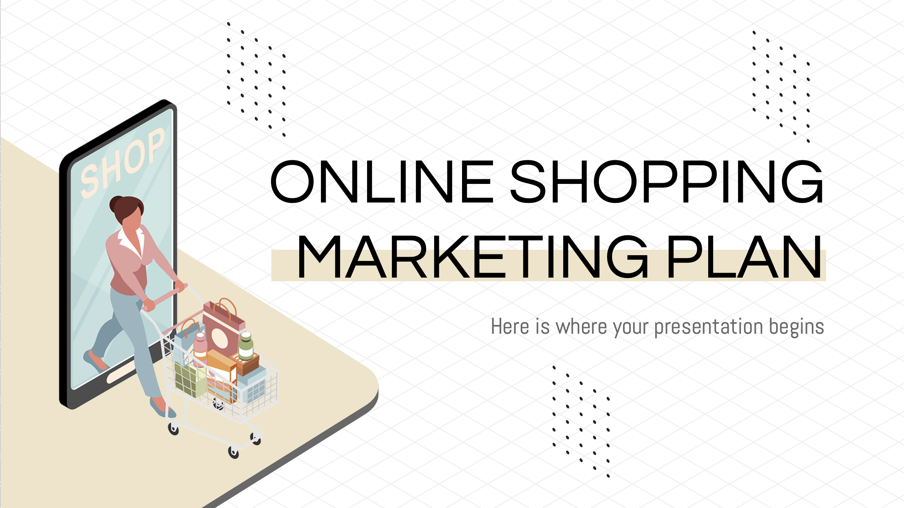
Results & Solutions

Slide 8
Recommend products from the most popular category within the customer's cluster
Cluster
Product ID
Product_Name
Orders
1
365
Perfect Fitness Perfect Rip Deck
20170
1
364
Total Gym 1400
36

Slide 9
Recommend products that are commonly bought together with the customer (ID-10351) last purchase
Product_Name
Orders
Nike Men's CJ Elite 2 TD Football Cleat
8706
Nike Men's Dri-FIT Victory Golf Polo
8388
O'Brien Men's Neoprene Life Vest
7725
Field & Stream Sportsman 16 Gun Fire Safe
6868

Slide 10
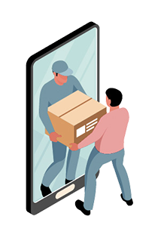
CONCLUSION

Slide 11

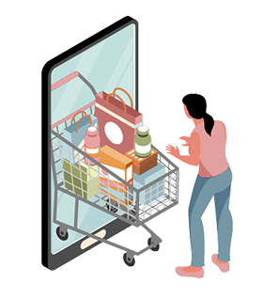
THANK YOU!!

