Slide 1
Volterra on FPGA
Dot Product/Product Function
By: Helly Bera

Slide 2
Weekly Work Summary - Week 1, 2
Focused on understanding the matlab code and running it on my PC.
Focused on understanding dot product and product functions.
Obtained the values from the MATLAB code.
Wrote the dot product function and tested it.

Slide 3
Weekly Work Summary - Week 3, 4
Product Function:
Used various parameters and flattened array inputs and outputs.
Initially used bitwidth of individual values as 16, but this resulted in overflow when testing using experimental values, so changed it to 32.
Used two different inputs for the d2 matrix(120x2 size).

Slide 4
Dot Product Function
% Dot product with 2nd order kernel
z2_val = (prod2_terms)' * h2;
Used various parameters and flattened array inputs and outputs.
Unpack the input and output arrays in variables declared as wire type (since they can be multidimensional matrices).
Initially used bitwidth of individual values as 16, but this resulted in overflow error when testing using experimental values, so changed it to 32.

Slide 5
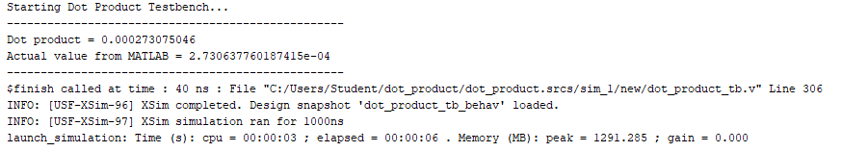
Dot product = 0.000273075046
Actual value from MATLAB = 2.730637760187415e-04
Absolute Error = 1.12699812585 * 10⁻⁸
Relative Error = 4.13 * 10⁻⁵

Slide 6
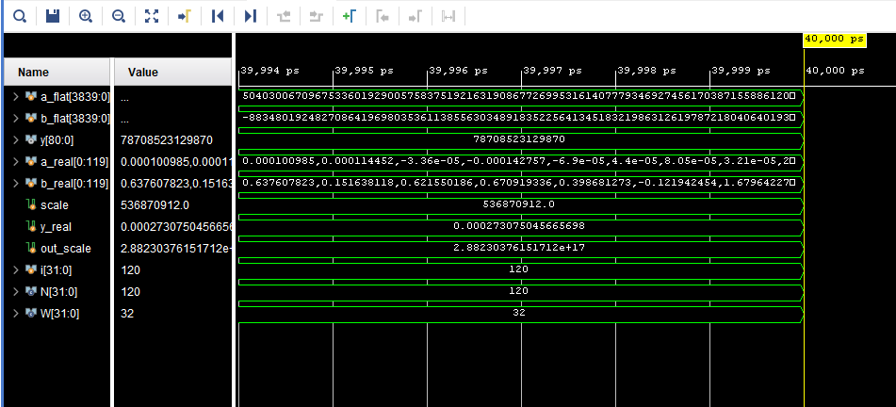

Slide 7
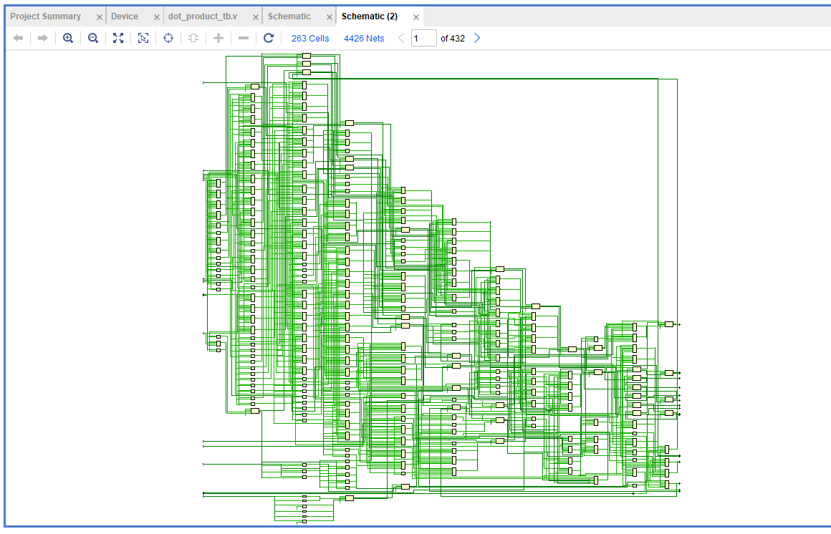

Slide 8
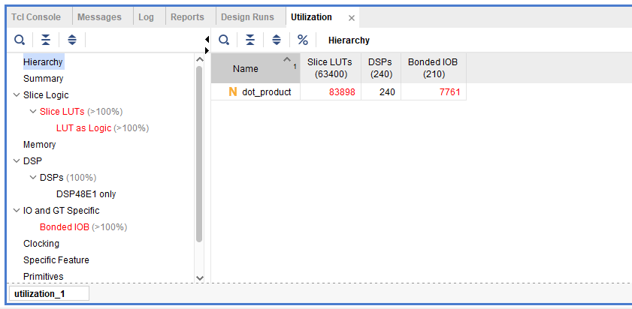

Slide 9
Product Function:
Tested it using integer values.
Then, tested it on experimental values of inputs : read them using a python script, stored them in the required format in a text file, and pasted in the testbench.
Handled floating-point values by converting them into scaled integers (fixed-point), performing integer arithmetic in hardware, and scaling the result back for comparison.

Slide 10
Product Function
% Calculate 2nd order terms
prod2_terms = prod(yy(d{2}),2);
yy → 15x1 double (column vector)
d → 1x3 cell array
d{2} is a 120x2 matrix containing index values from 1 to 15.
yy is 15x1, so indexing it gives a row vector if multiple indices are used.

Slide 11
Product Function
% Calculate 2nd order terms
prod2_terms = prod(yy(d{2}),2);
yy → 15x1 double (column vector)
Select the elements of yy whose indices are stored in the second cell of d, then multiply all of those selected elements together to produce a single scalar.
The second parameter ensures that it is done row wise across the columns.
Finally, produces a column vector as the output.

Slide 12
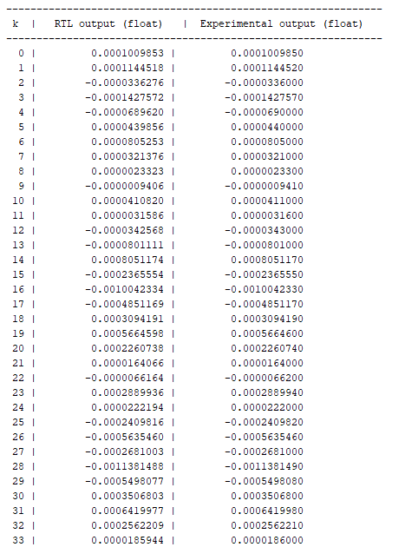
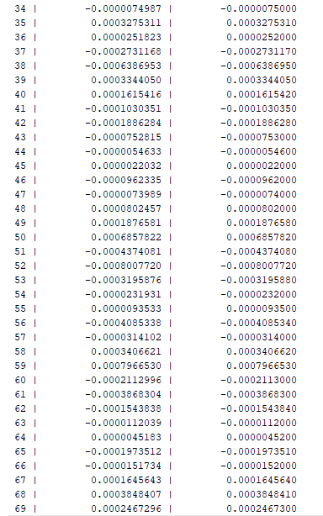

Slide 13
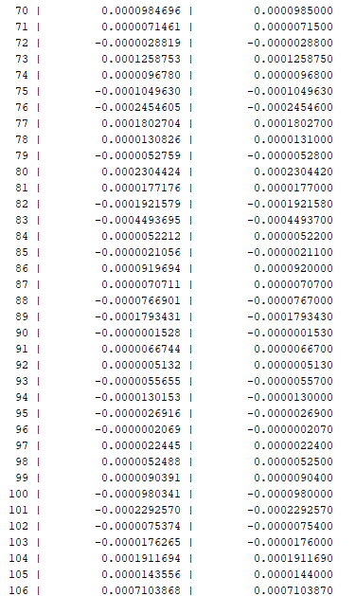
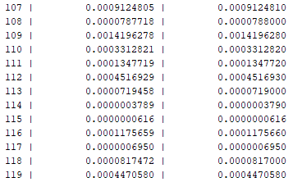
Mean Absolute Error: 6.9275 * 10⁻⁹
Root Mean Squared Error: 1.41216 * 10⁻⁸

Slide 14
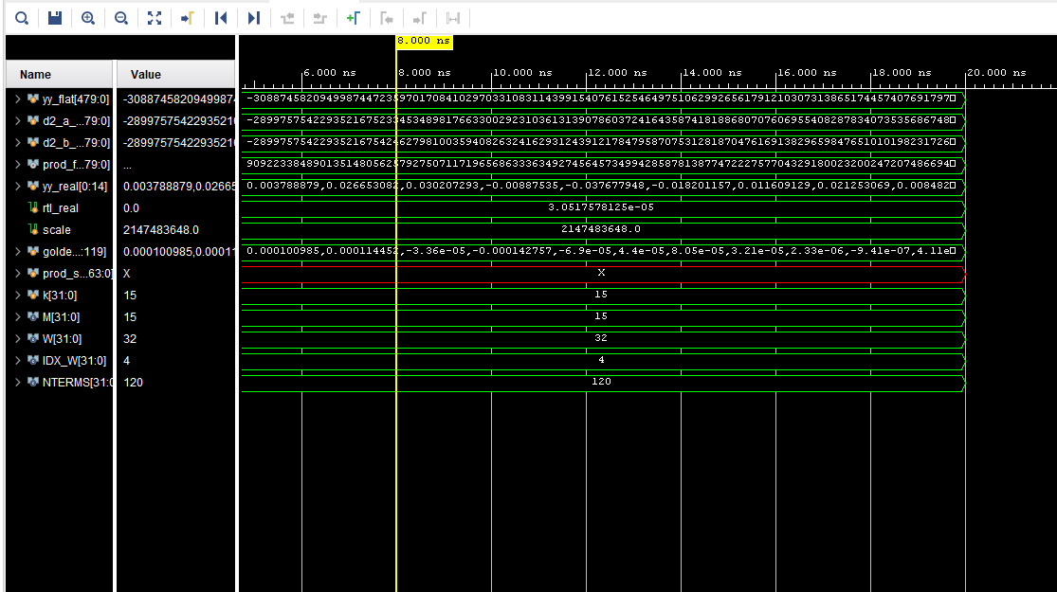

Slide 15
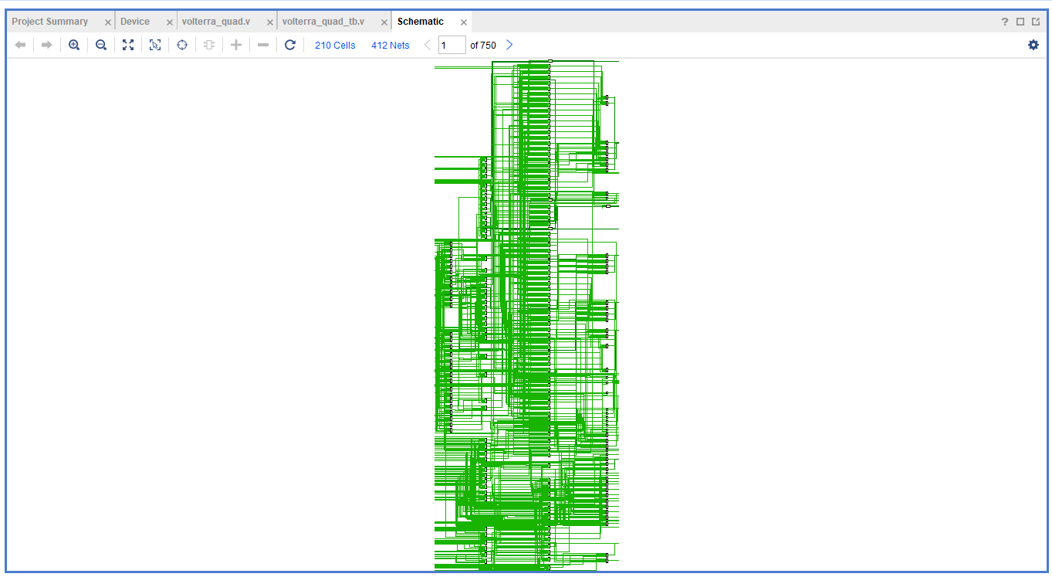

Slide 16
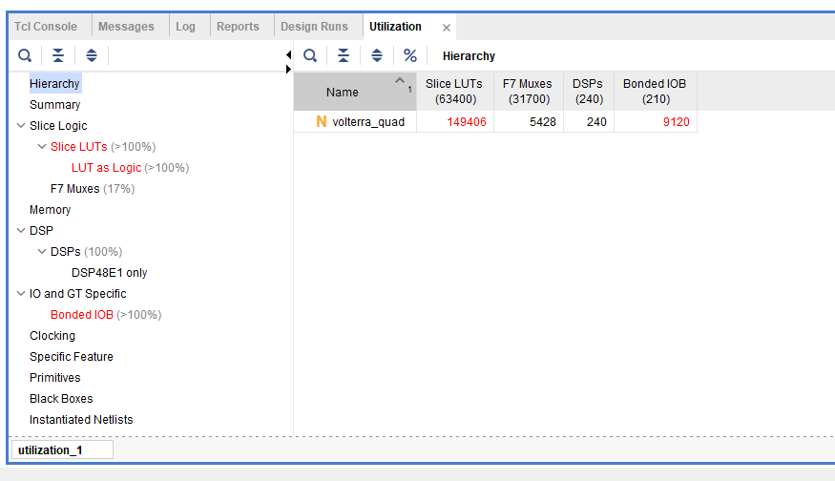

Slide 17
Work Summary - Present
Product(3 column) Function:
Modified the product(2 column) function (design and testbench) for this function.
Debugging the code and testbench since the error between the experimental and obtained values is very high.

