Slide 1
Data Pipeline Orchestration

Slide 2
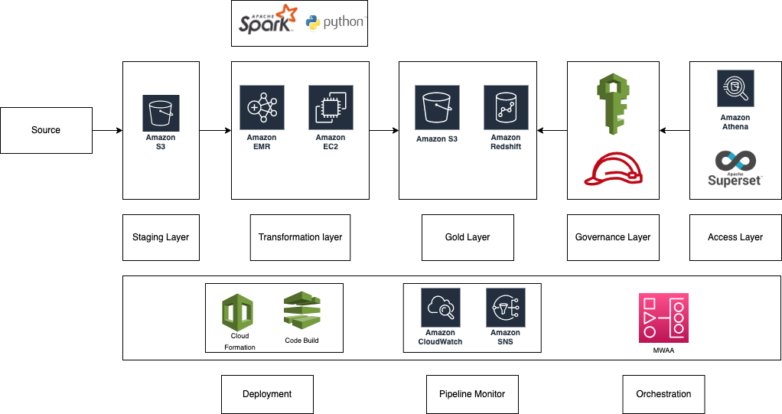

Notes:
The pipeline's architecture is organized into a number of tiers.
The staging layer receives a dump of all the source files.
The raw layer is transformed using Pyspark and result are stored in the gold layer.
The governance layer is in charge of controlling access to the gold layer. These guidelines are applied consistently, so there is no need to manually specify them for all security services.
This makes it easier to configure policies across services and offers reliable support for GDPR compliance and requirements. The pipeline is orchestrated using airflow(MWAA).
Cloudwatch is used to monitor and send alerts through SNS topic
Cloud formation and Code Build help in CD/CI

Slide 3
Design
How do you monitor and manage data quality issues?
All the logs are aggregated and sent to Cloudwatch
Alarms and dashboards are used to detect the anomaly
The monitor pipeline will run regularly on aggregated data to check against the business rule
How will you ensure the traceability of the data end-to-end?
Traceability is maintained by creating the data lineage
Data lineage is stored in Amazon Neptune
This lineage is used for checking the pipeline dependency for source data
How will you ensure and validate scalability and throughput performance?
EMR cluster size can be increased to handle the surge in data
Cluster size is calculated based on the input file size.

Slide 4
How will ensure that the data pipeline is as future-ready as possible: ingestion of raw data from banks, 3rd party data (market data, geospatial, text, photos, etc.)?
Pipelines with common transformation logic can be clubbed under one pipeline which can run based on metadata. We need to add metadata entry if a new pipeline needs to be configured(no need to create pipeline from scratch)
How will you ensure a proper development and deployment process for new features, improvements and fixes?
Cloud formation along with code build is used for CD/CI
Git hooks will be used to maintain the code quality
The governance layer ensures policies are consistently implemented, eliminating the need to manually configure them across security services.
Deletion engine – Scheduled pipelines will run to ensure the complete elimination of users’ data upon request.
Pseudonymise sensitive fields

