Slide 1


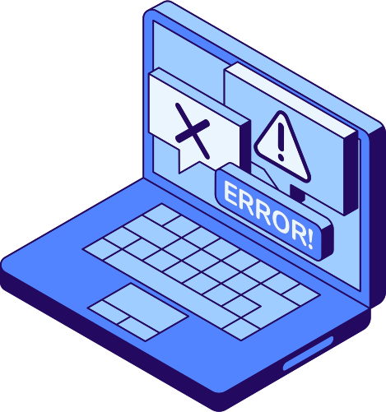
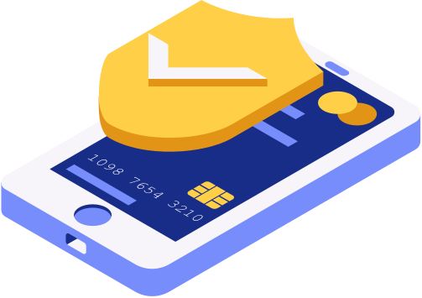

01/12
Divya Gunvant Khodankar
PHISHING AWARENESS
SIMULATION

Slide 2


02/12
Phishing Awareness
Phishing is a cyber attack where attackers impersonate trusted entities to steal sensitive information like passwords, credit cards, and personal data.
INTRODUCTION
Cybersecurity awareness is critical as 91% of cyber attacks begin with phishing emails, making employee education the first line of defense.
TO PHISHING
Social engineering exploits human psychology rather than technical vulnerabilities, manipulating trust to bypass security measures.

Slide 3





03/12
Phishing Awareness
PROJECT
OBJECTIVES
Simulate Phishing Attack
Promote Awareness
Create realistic phishing scenarios to test organizational vulnerability and measure response effectiveness.
Educate employees on recognizing phishing attempts and implementing security best practices.
Study User Behavior
Understand Techniques
Analyze how users interact with suspicious emails and identify common behavioral patterns and weaknesses.
Research and document various social engineering methods used in modern phishing campaigns.

Slide 4
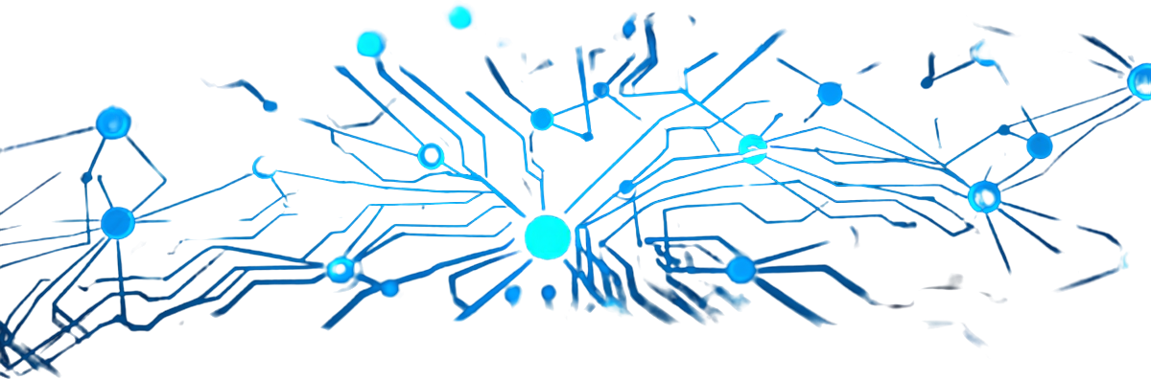

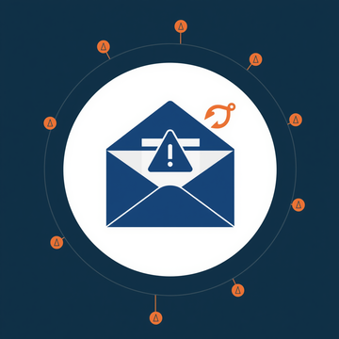


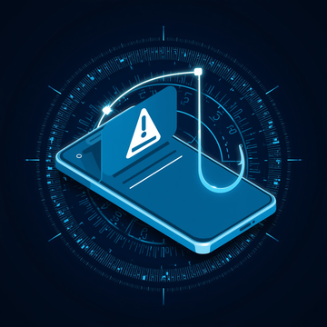
04/12
Phishing Awareness
COMMON
PHISHING TECHNIQUES
Email Phishing
Fake Login Pages
Fraudulent emails impersonating trusted sources to steal credentials, spread malware, or trick users into revealing sensitive information.
Counterfeit websites mimicking legitimate services to capture usernames, passwords, and other authentication credentials.
Spear Phishing
SMS Phishing
Targeted attacks using personalized information about specific individuals or organizations to increase credibility and success rates.
Phishing via text messages containing malicious links or urgent requests for personal data and financial information.

Slide 5





05/12
Phishing Awareness
Malicious Links
Attackers embed malicious URLs in emails that redirect users to fake websites designed to steal credentials or install malware.
ATTACK
Credential Harvesting
VECTORS
Fake login pages mimic legitimate sites to capture usernames and passwords, which attackers use for unauthorized access.
Attachment Attacks
Phishing emails often contain infected attachments like PDFs or Office documents that execute malicious code when opened.

Slide 6
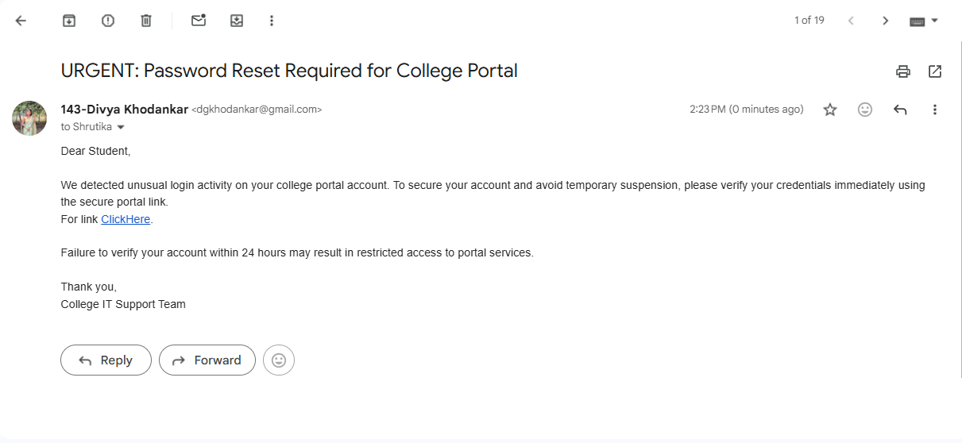
Simulated Phishing Email

Slide 7
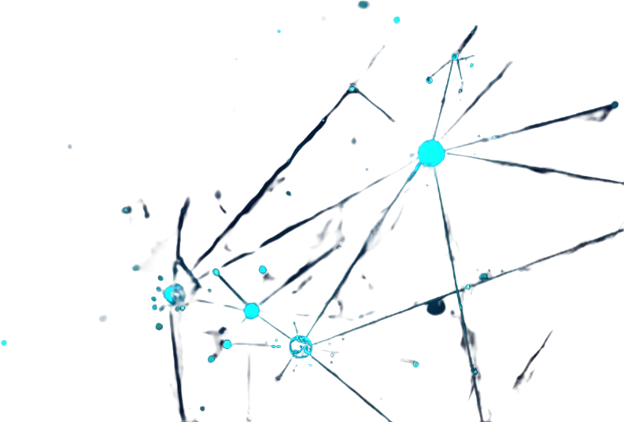



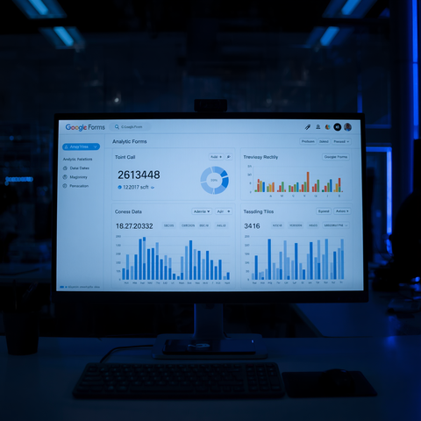
06/12
Methodology
SIMULATION
SETUP
Our phishing simulation leverages GitHub Pages to host convincing fake login pages that mimic legitimate services. User interactions and credential submissions are captured through Google Forms integration, enabling real-time data collection and analysis. This approach allows safe, controlled testing of user awareness without actual security risks.

Slide 8
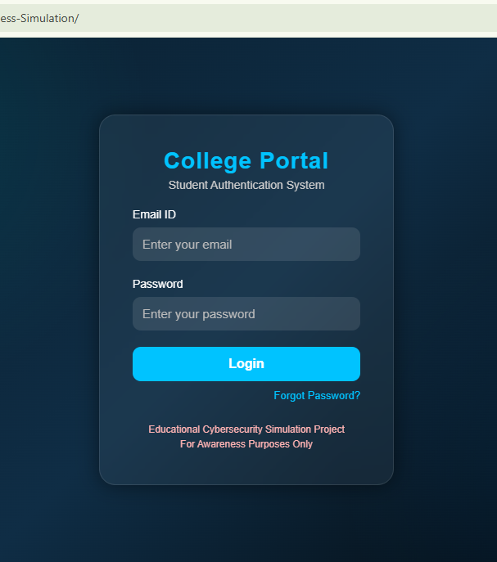

Project Development & Hosting

Slide 9




07/12
Phishing Awareness
User Awareness Analysis
USER
Participants interacted with the phishing awareness survey to evaluate phishing awareness and response behavior.
The simulation demonstrated how users react to suspicious emails, fake login pages, and social engineering techniques in a controlled environment.
BEHAVIOR ANALYSIS
Credential Submission
The phishing simulation demonstrated how users react to suspicious emails and fake login pages in a controlled awareness environment.

Slide 10
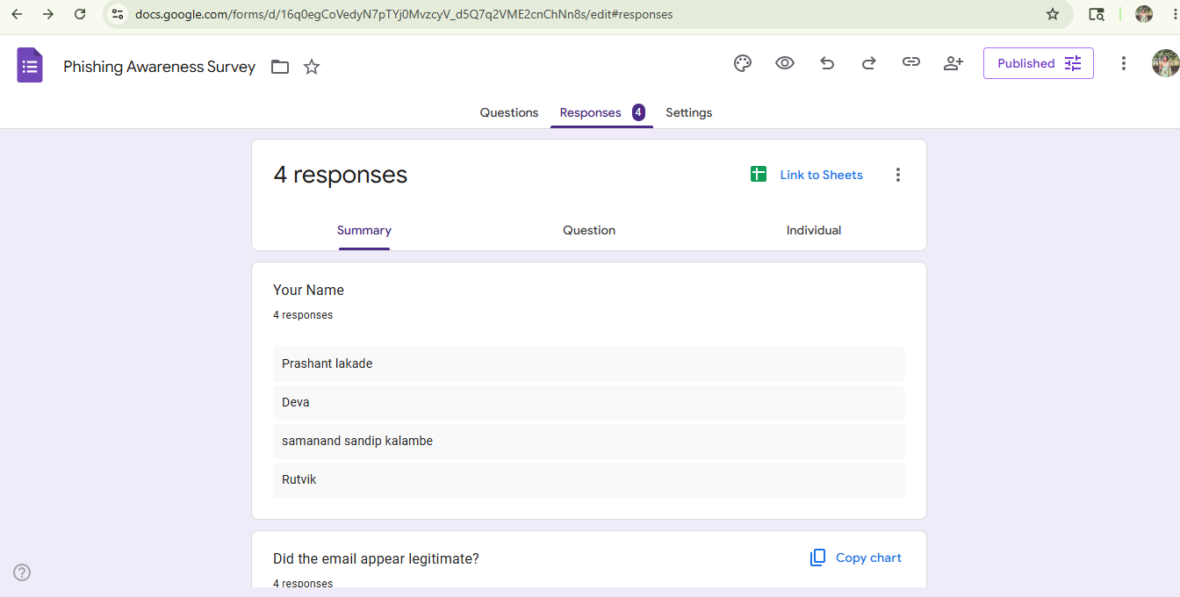
Participants interacted with phishing awareness survey
Responses analyzed for awareness patterns

Slide 11

08/12
Phishing Simulation
KEY
FINDINGS
01
02
03
Several participants interacted with the simulated phishing email and awareness survey.
The project demonstrated how fake login pages can appear convincing to users.
The simulation highlighted the importance of cybersecurity awareness and email verification.

Slide 12



09/12
Phishing Awareness
KEY
Technical Simulation Challenges
Creating realistic phishing scenarios while avoiding spam filters, maintaining GitHub hosting stability, and ensuring Google Forms data collection accuracy.
CHALLENGES
Ethical Considerations
Implementing phishing simulations requires careful navigation of technical hurdles and ethical boundaries to ensure effective yet responsible testing.
Balancing realistic social engineering techniques with participant consent, data privacy regulations, and institutional approval requirements.

Slide 13
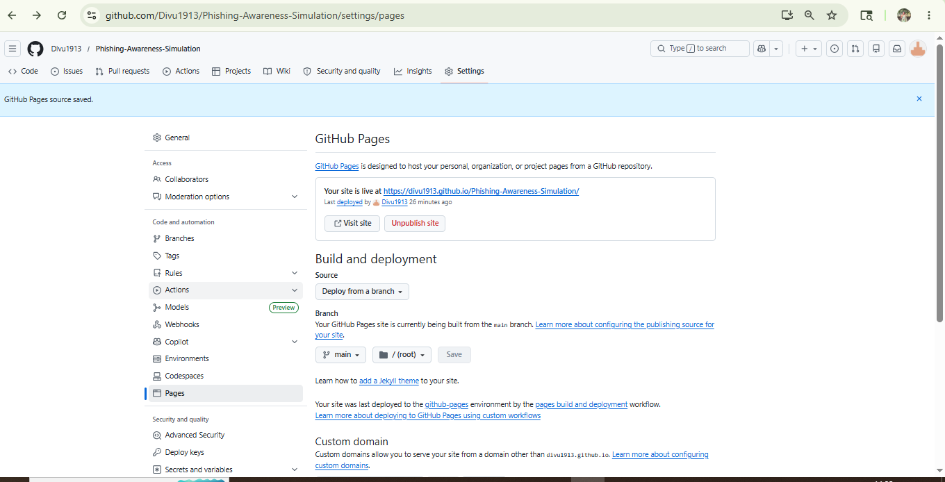
GitHub Pages Deployment & Hosting Configuration

Slide 14



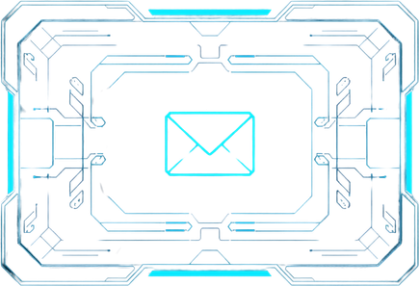
10/12
Phishing Awareness
PREVENTION
TIPS
Email Verification Techniques
Multi-Factor Authentication
Always verify sender addresses carefully. Check for misspellings and suspicious domains. Hover over links before clicking to preview URLs.
Enable MFA on all accounts. Use authenticator apps over SMS. Complete regular security awareness training programs.

Slide 15
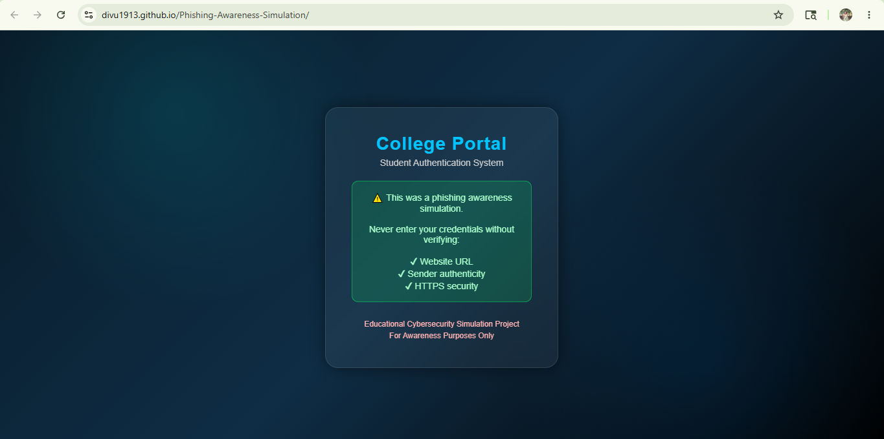

Slide 16


11/12
Phishing Awareness
Human Factor is the Weakest Link
Regular and continuous security training significantly reduces phishing success rates. Organizations that implement ongoing awareness programs see measurable improvements in threat detection.
KEY
TAKEAWAYS
Training Reduces Risk
Studies show that organizations with monthly training programs experience up to 70% reduction in successful phishing attempts compared to those with annual training only.

Slide 17





12/12
Phishing Awareness Simulation
THANK
Divya Gunvant Khodankar
YOU!
dgkhodankar@gmail.com
GitHub Repository
Cybersecurity awareness project simulation

