Slide 1


ASP.NET Core web app with user data protected by authorization.
Information Encoding Standards

Slide 2
Project Summary
ASP.Net core app created with the user data protected by authorization and to access this web app first user have to register him self to the web app and then by using the that Id user can access the the web app and it fully protected with authentication so there is no chance about the leak of data.

Slide 3
Group Details
Divya Gandabhai Chaudhari, Student ID: 200593020
Milina Corderio, Student ID :
Jesal Patel, Student ID:

Slide 4
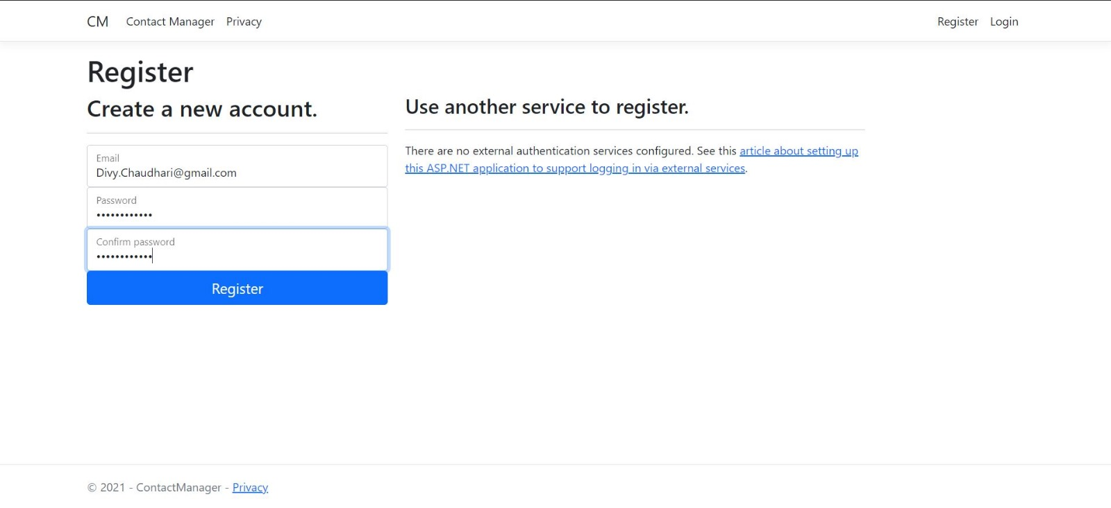
Part 1 Demonstration

Slide 5
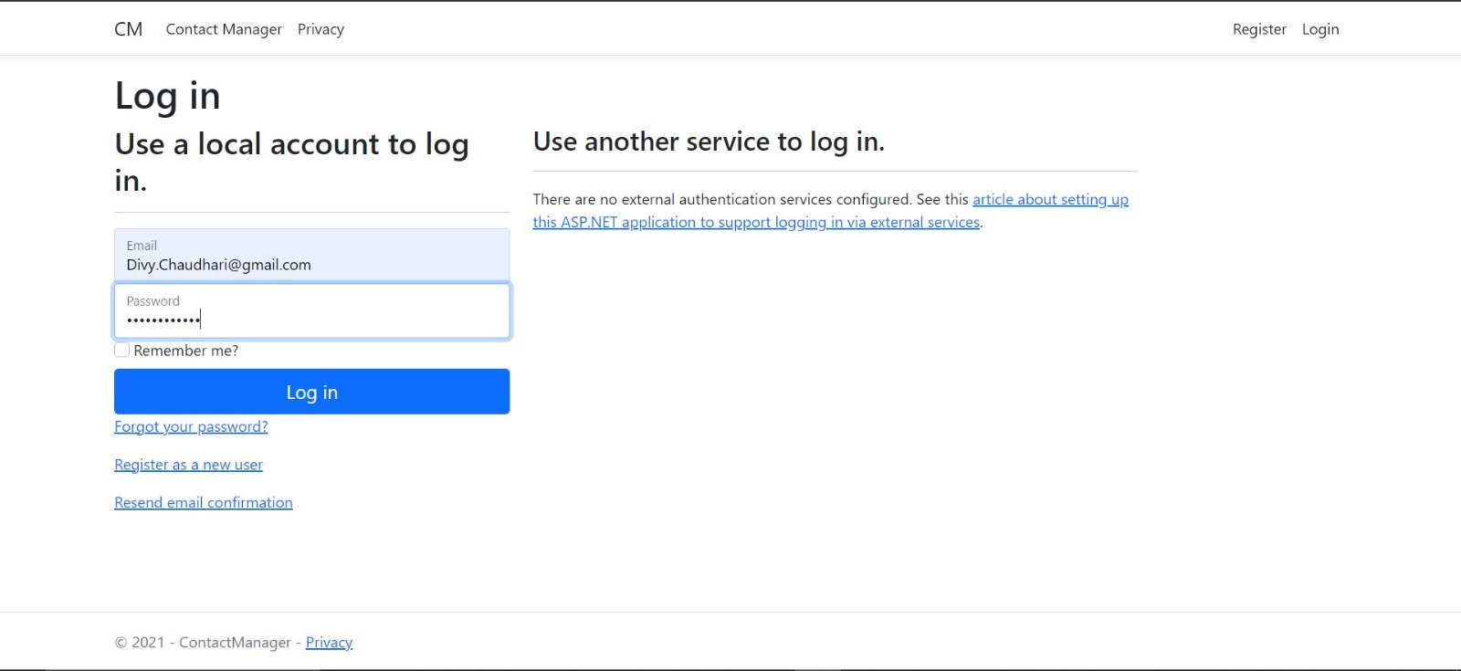



Slide 6
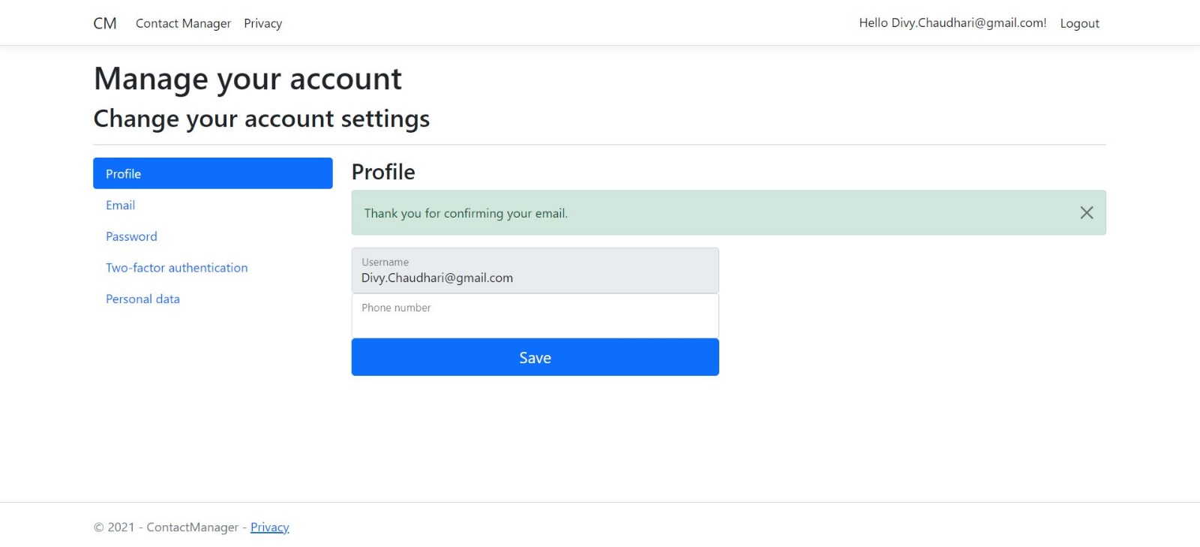

Slide 7
