Slide 1
GUJARAT TECHNOLOGICAL UNIVERSITY
NATIONAL SERVICE SCHEME
VISHWAKARMA GOVERNMENT ENGINEERING COLLEGE, CHANDKHEDA
NSS VGEC
NARAYANI
26th March to 29th March 2023

Slide 2
NARAYANI - Spreading Awareness
Under India's G-20 presidency, many institutions are organizing various events based on different themes.
The National Service Scheme (NSS) unit of Vishwakarma Government Engineering College organized "NARAYANI" from 26th March to 29th March 2023.
The main motto was to spread awareness about women’s rights and gender equality.
Various Competitions like poem writing, rangoli making, quiz, debate, elocution, etc. were involved.
Students from across the state supported the event as participants.
We successfully completed our motive to spread awareness.

Slide 3

Narayani Event Poster
Poster promoting the Narayani event at Vishwakarma Government Engineering College.

Slide 4
DAY - 1
Nukkad Natak - Encouraging Women's Empowerment
More than 60 volunteers involved in a street play.
The purpose of drama was to encourage women’s empowerment.
Volunteers showed problems like dowry, rapping, etc.

Slide 5
DAY - 1 (cont.)
They highlighted the fewer opportunities for women.

Slide 6
Content/Discussion Points
Awareness of women’s Empowerment
To understand women’s problems
Performance of Nukkad Natak

Slide 7
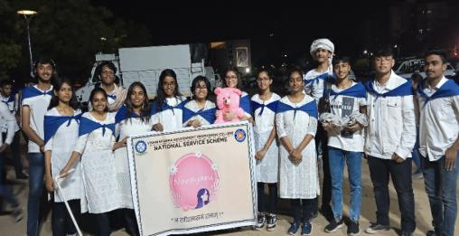
Nukkad Natak Glimpses
Photographs from the Nukkad Natak performance. 1) Drama team 2) Drama in the exhibition at
the riverfront 3) Drama at Sabarmati riverfront

Slide 8
DAY - 2
Further event details to be added here.
Images to be included to showcase the activities.

Slide 9
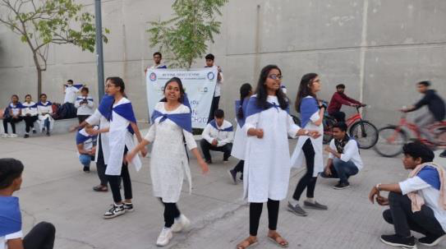
NSS unit of VGEC
Photograph of the NSS unit of Vishwakarma Government Engineering College.

Slide 10
Quiz and Poem Writing Competitions
NSS team's state-level 'NARAYANI' event.

Slide 11
Quiz and Poem Competition Details
Participants wrote poems on given topics.
Quiz questions covered women entrepreneurs, G-20, and women empowerment awareness.
Quiz helped participants gain general knowledge.
Poem writing improved writing skills.
Key Discussion Points:
* Improvement in writing skills and mental ability.
* Quiz completion enhances overall participation and general knowledge.

Slide 12
Quiz and Poem Competition Details (cont.)
* Promoting the thought of women’s empowerment.

Slide 13
Glimpses of the Event

Slide 14
Event Photos
Poem
Quiz

Slide 15
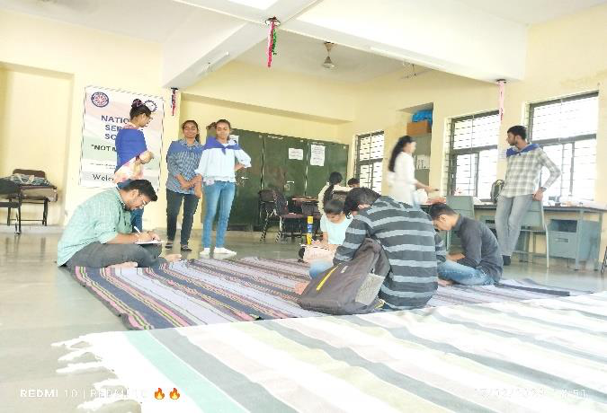
Quiz Competition Photo
A snapshot from the quiz competition during the event.

Slide 16
DAY-3
Debate and Rangoli Competition organized by the NSS team focusing on women's empowerment and gender equality.

Slide 17
Debate and Rangoli Competition Details
Rangoli competition showcased hands-free skills on colors with the theme of women empowerment.
The debate focused on women’s empowerment and gender equality.
Debate highlighted the current scenario of women’s empowerment in India.
Key Discussion Points:
* Colors are joyous, they teach us to be happy, and so does rangoli.

Slide 18
Debate and Rangoli Competition Details (cont.)
* Debate helped understand the problems of women and solutions.
* These competitions aided participant's overall development.

Slide 19
Glimpses of the Event

Slide 20
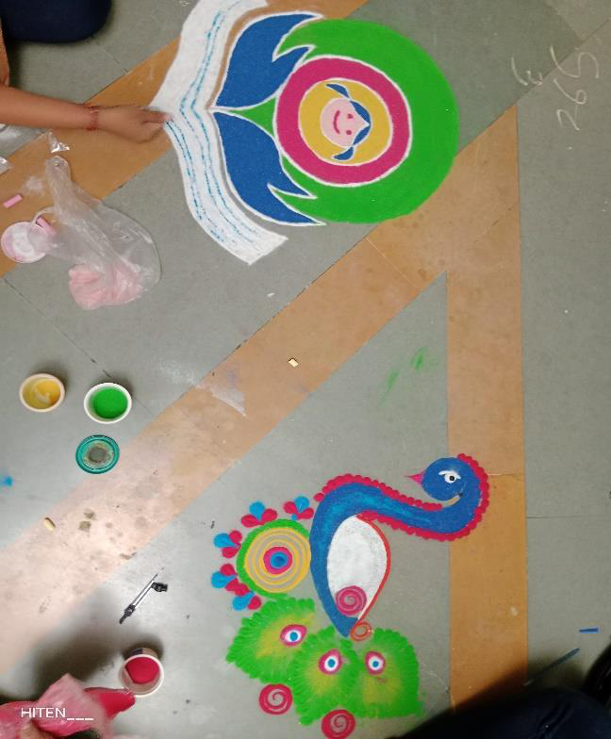
Rangoli Competition Photo
A colorful glimpse of the Rangoli competition, reflecting the theme of women's
empowerment.

Slide 21
Debate
A summary of Elocution Competition and Ending Ceremony

Slide 22
DAY - 4: Event Narayani Concludes
The event "NARAYANI" concluded with the Elocution competition and the Ending ceremony.
In the Elocution competition, participants delivered speeches on topics aimed at raising awareness and support for women's empowerment.
Students showed great enthusiasm and delivered their best.

Slide 23
DAY - 4: Event Narayani Concludes (cont.)
During the Ending ceremony, winners were awarded certificates and prizes. Faculties who contributed to the event "NARAYANI" by judging the competitions were also acknowledged with thank you gifts.
The event "NARAYANI" concluded with the National Anthem.

Slide 24
Key Discussion Points of the Event
The Elocution competition enhanced people's understanding of the concepts related to women's empowerment.
The event highlighted that supporting women's choices and amplifying their voices is an ongoing process that deserves recognition and attention from everyone.
Ultimately, the event celebrated the efforts of all women and encouraged their continued strength and determination.

Slide 25
Glimpses of the Event
Photographs capturing the essence of the Elocution competition.
Visual memories of the participants, their speeches, and the overall atmosphere of the event. Showcasing moments of empowerment and celebration.

Slide 26
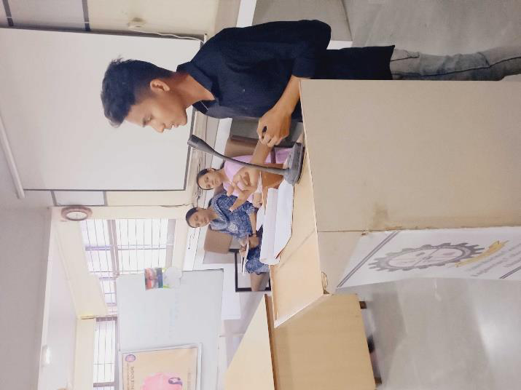
Elocution Competition
A snapshot from the Elocution competition, capturing a speaker sharing their perspective
on women's empowerment. This event was part of 'Narayani's' broader mission.

Slide 27
Ending Ceremony
Thank you for your participation!

Slide 28
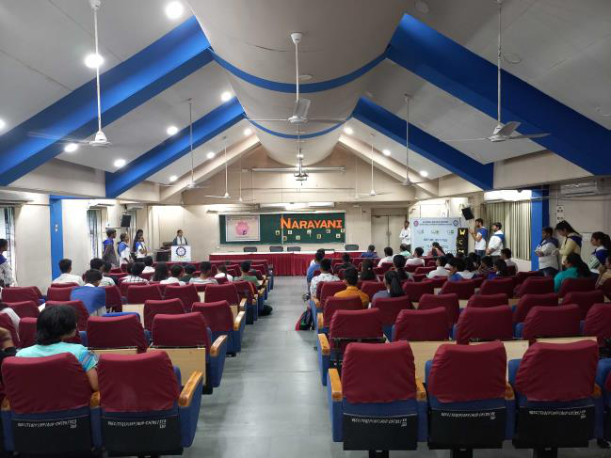
Congratulations!
We hope you enjoyed the event and found it valuable. We look forward to seeing you at
future events!

