Slide 1

Web Technology Project Presentation Agriculture Ecommerce website
Presented By:
Divy Patel—IU2141230167
Mit Patel—IU2141230189
Guided By:
Mr. Hiren Kumar Mer Sir

Slide 2

Contents
Introduction
System Design
Implementation
Results and Discussion
Conclusion
References

Slide 3
Introduction
Background of the project
Traditional agricultural practices often lack access to modern markets.
Limited market reach leads to lower profits for farmers.
Buyers face challenges in finding diverse, quality agricultural products.
E-commerce platforms have transformed various industries, enhancing efficiency and accessibility.

Slide 4
Introduction
Problem statement
Limited Market Reach for Farmers:
Farmers struggle to expand their customer base beyond local markets.
Lack of Access to Quality Products for Buyers:
Buyers face challenges in finding diverse and high-quality agricultural products.
Inefficient Transaction Methods:
Absence of secure and efficient payment gateways hampers smooth transactions.

Slide 5
Introduction
Limited Product Visibility: Buyers struggle to find diverse, high-quality agricultural products due to limited visibility and accessibility.
Market Fragmentation: Absence of a centralized platform leads to market inefficiencies, making it challenging for both buyers and sellers to connect effectively.

Slide 6
Introduction
Objectives and scope of the project
The objectives of our project is:
To provide all type of product at one store.
To provide quality and new generation product.
To provide a reliable platform where the farmers can trust.

Slide 7
Introduction
The scope of our project is:
Market is very huge but online store is less
No other store provide high quality and latest generation machine

Slide 8
Introduction
Significance of project
Economic Empowerment: Enabling farmers to increase their income by reaching a larger customer base.
Market Efficiency: Creating a centralized marketplace that streamlines agricultural trade processes, making transactions faster and more efficient.
Consumer Access: Providing consumers with a diverse range of agricultural products directly from producers, ensuring quality and freshness.

Slide 9
Introduction
Empowering Farmers: Provides a platform for farmers to reach a wider market, enabling them to sell their produce directly to consumers.
Enhancing Consumer Access: Offers buyers a convenient way to access diverse, high-quality agricultural products, fostering a direct producer-consumer relationship.

Slide 10
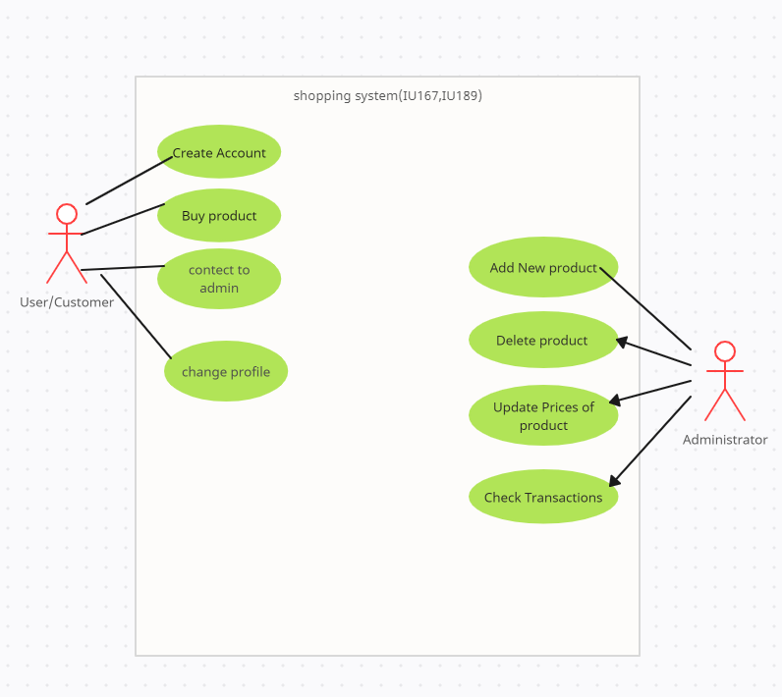
System Design
Use case diagram

Slide 11
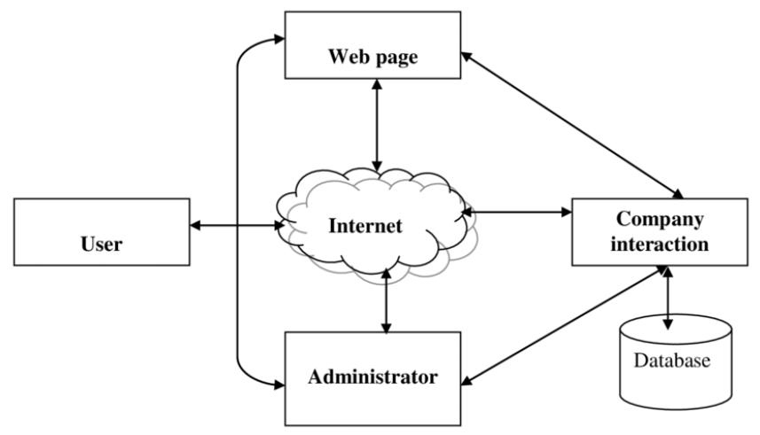
System Design
Block diagram

Slide 12
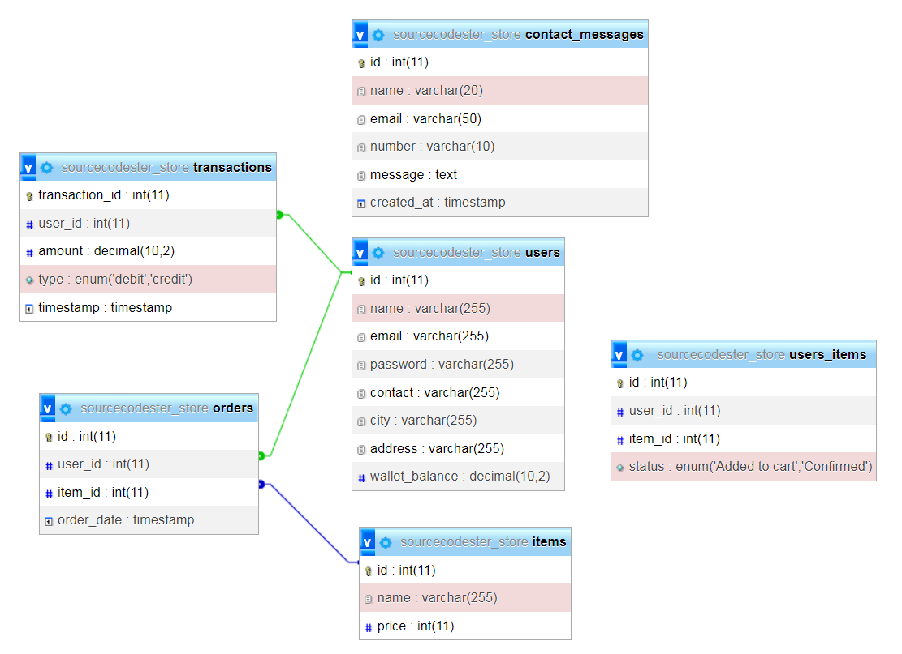
System Design
Database

Slide 13
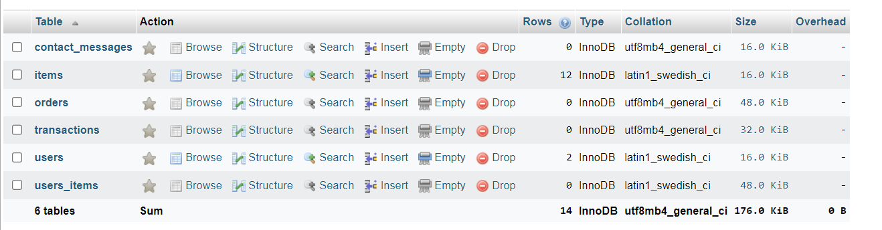
System Design
Database

Slide 14
Implementation
Testing Procedures:
For testing asked some friends to login with their account.
We asked them for reviews

Slide 15
Implementation
Challenges Faced:
We faced difficulties in UX designe,data security,scalability,mobile responsiveness.
Data security is still challenge because apply high security is very difficulty for us

Slide 16
Results and Discussion
this agriculture e-commerce website able to provid a best platform for farmers to showcase products and buyers to make purchases.
Received positive feedback from users regarding the user-friendly interface, product variety, and secure payment system.
We also provide user friendly features for enhancing buyer experience.

Slide 17
Results and Discussion
After a making project we archive many objectives like Provide all type of product,reliable platform,etc.
Identified areas for improvement based on user feedback, such as optimizing website performance and enhancing mobile responsiveness.

Slide 18
Conclusion
By achieving key objectives such as Provide quality products, enhancing user experiences, and ensuring secure transactions, the platform will make a positive impact on the agricultural community.
Moving forward, the project will continue to evolve, incorporating user feedback and embracing technological advancements to further contribute to the growth and sustainability of the agricultural industry.

Slide 19
References
Websites:
W3school----https://www.w3schools.com/
Bootstrap----https://getbootstrap.com/

Slide 20
THANK YOU

