Slide 1
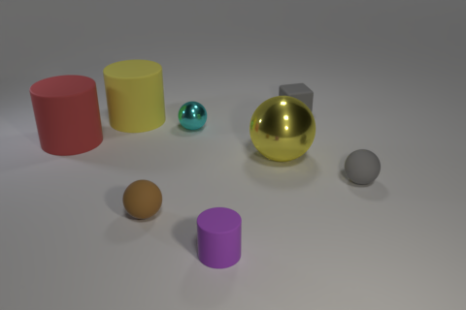
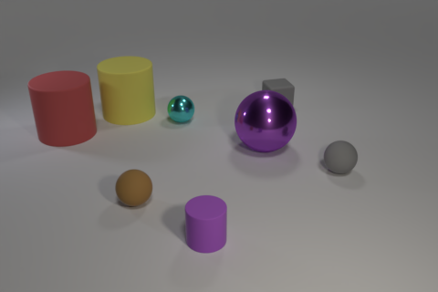
TYPES OF ACTIVATION PATCHING
Comparison | What changes | Question it isolates
Position only | Same image and answer meaning; move the correct option. | Can the model remap an option position to a new output label?
Content only | Edit the image so the answer meaning changes; keep its position fixed. | Does visual answer content transfer without changing the label?
Content + position | Change both the visual answer and its listed position. | Does the full content-to-label route transfer?
Example: content + position patching (CLEVR scene 047521)
Both runs: What color is the large sphere that is in front of the yellow cylinder?
Donor: original image
Recipient: edited image
A. yellow B. gray
C. red D. purple
Correct: A (yellow)
patch the
answer-token state
A. red B. purple
C. yellow D. gray
Correct: B (purple)
After patching, does the recipient print A, the donor's label, or C, where the donor's answer content "yellow" sits in the recipient?

