Slide 1
What Is the Price of
a Model's Eye?
Understanding How VLMs Answer Multiple Choice Questions
in Multimodal Settings
Divyanshu Giri | Rachit Mehta | Yashav Bhatnagar

Slide 2
INTRODUCTION

Slide 3
PROJECT OVERVIEW
How do mainstream vision-language models perform on formatted multiple-choice question answering tasks?
How do VLMs answer these MCQ questions, and where do those choices appear internally?
Which internal states and attention heads carry the visual answer content, map it onto an option, and write the answer symbol?
Datasets
CLEVR-MCQ-4
IconQA
M1–M7
M1-M7
Qwen
InternVL
LLaVA
PaliGemma
Qwen
InternVL
LLaVA
Problems we researched upon
1. Where does visual content travel?
2. Which components write the final symbol?
3. Does the route survive new models, alphabets, and datasets?

Slide 4
MODELS SELECTION
Qwen2.5-VL-7B
InternVL3.5-8B
LLaVA-OV-7B-SI
PaliGemma2-10B
Vision encoder
ViT
InternViT
SigLIP
SigLIP
Connector
patch-merging MLP
pixel shuffle + MLP
two-layer MLP
linear projection
Language decoder
Qwen2.5-7B
28 layers
Qwen3-8B
36 layers
Qwen2-7B
28 layers
Gemma2-9B
42 layers
We took 12 models from 4 families and conducted screening tests on a subset (24 CLEVR questions) of our task to choose the best model in each of the four families. We also had to limit ourselves to models which fit our available GPUs and expose decoder hooks for patching.
We extend the text-only analysis of Answer, Assemble, Ace (AAA), so we chose models whose results can be compared with the models AAA studied.

Slide 5
DATASET

Slide 6
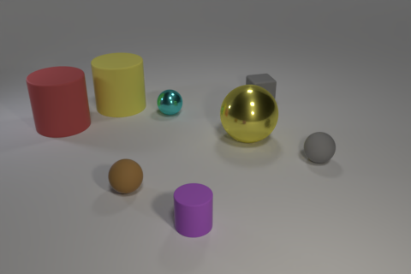
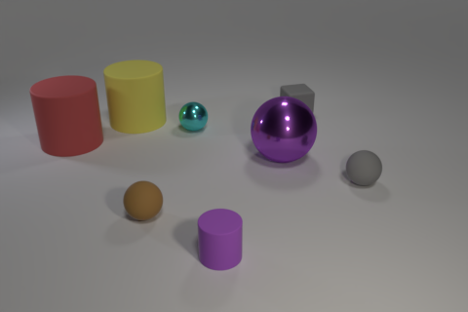
CLEVR COUNTERFACTUAL PAIRS
original: sphere is yellow
edited: sphere is purple
What color is the large sphere that is in front of the yellow cylinder?
A. yellow B. gray C. red D. purple
Respond with only the option label.
Answer:
Correct answer: A (original) → D (edited)
We took the CLEVR dataset.
Each image comes with detailed scene metadata: every object's shape, colour, size, material and position.
We made a single change in that metadata and re-rendered the image. This gives a counterfactual pair: the same question and options, but a different correct answer.
12 prompt variants per item
4 option orders (the correct answer in each position)
× 3 label sets: A/B/C/D, 1/2/3/4, Q/Z/R/X

Slide 7
TYPES OF ACTIVATION PATCHING
Comparison | What changes | Question it really asks
Position only | Keep the image and answer same but move the correct option. | Can the model remap an option position to a new output label?
Content only | Edit the image so the answer meaning changes while keeping its position fixed. | Does visual answer content transfer without changing the label?
Content + position | Change both the visual answer and its listed position. | Does the full content-to-label route transfer?
Example: content + position patching
Question: What color is the large sphere that is in front of the yellow cylinder?
Donor
Recipient
A. yellow B. gray
C. red D. purple
Correct: A (yellow)
patch the
answer-token state
A. red B. purple
C. yellow D. gray
Correct: B (purple)
After patching, does the recipient's answer move to the donor's correct option (A), or to the donor's correct answer "yellow", which is option C here?

Slide 8
EXPERIMENTAL SPLITS ON CLEVR
Behaviour
We measure accuracy under different option orders and label alphabets. No patching.
Discovery
We find the layers and heads that give the strongest patching effects, then freeze them.
Confirmation
We test the frozen discovery findings once, on new scenes.
Does the hypothesis transfer?
Split | CLEVR-MCQ-4
Calibration (hook and data checks) | 120 items
Screening (model selection) | 300 items
Behaviour | 256 items
Discovery | 160 pairs → 64 used
Confirmation | 128 pairs → 64 used
We keep these sets fixed for every model, and no scene appears in two splits. Each model uses the first 64 pairs in the set where it answers both donor and recipient correctly, since patching needs a correct starting point.
PaliGemma on CLEVR used all of its eligible pairs: 76 in discovery, 61 in confirmation.

Slide 9
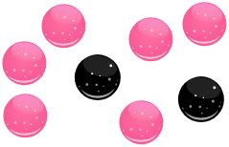
TRANSFER TO ICONQA
After running our experiments on the synthetic CLEVR dataset, we checked whether our results and hypotheses transfer to a second dataset, IconQA.
If you select a marble without looking, how likely is it that you will pick a black one?
A. unlikely B. probable C. certain D. impossible
Respond with only the option label.
Answer:
Accuracy, image + A/B/C/D (%) | Qwen | InternVL | LLaVA
Confirmation pairs | 99.2 | 95.1 | 95.1
The models solve this narrow task reliably when the image is present.
Scope. From IconQA's text-option multiple-choice questions we used one task, marble probability, and created counterfactual pairs for it as we did for CLEVR: 8 calibration, 64 discovery and 64 confirmation pairs, of which each model uses 32 correctly answered pairs per phase.

Slide 10
METHODOLOGY

Slide 11
ACTIVATION PATCHING
A prompt has four token groups
image tokens
question
option tokens
answer token
Different methods patch different sets of these tokens, at a chosen subset of layers and attention heads.
donor: answer A
recipient: answer D
1. Cache one donor activation
2. Insert it into the recipient run
3. Measure movement toward the donor answer
What color is the large sphere that is in front of the yellow cylinder?
A. yellow B. gray C. red D. purple
Respond with only the option label.
Answer:
s_{patched} − s_{recipient}
Recovery =
s_{donor} − s_{recipient}
Donor: the run we copy an internal activation from.
Recipient: the run we insert it into.
s is the logit difference between the two answers. 0: no movement; 1: full donor transfer.

Slide 12
LOGIT LENS VS. TUNED LENS
LOGIT LENS
TUNED LENS
What it does.
It takes the hidden state at the answer token after a layer and decodes it with the model's final unembedding matrix, as if that layer were the last one. No training.
What it is useful for.
To check, layer by layer, when the answer label, the content word or the requested alphabet becomes readable (M4, M5, M7).
Its limit.
Middle layers are not yet in the final embedding space, so information can be present but unreadable, and milestones can look later than they are.
How it differs.
Before decoding, it passes each layer's hidden state through a small learned translator that maps it into the final embedding space.
What it is useful for.
A more faithful layer-by-layer readout, so we can check whether a Logit Lens milestone is real or just an artefact of reading a middle layer as if it were the last.
What we did.
We trained one translator per layer for each model, teaching it to predict what the model finally outputs. We trained on separate CLEVR scenes that are never used for evaluation. After training, middle layers predict the final output far more closely than with the Logit Lens.

Slide 13
METHODS OVERVIEW
CAUSAL INTERVENTIONS
copy activations from a donor run into a recipient run
OBSERVATIONAL READOUTS
project internal states onto the vocabulary; nothing is patched
M1 When can a donor answer steer the output?
Patch the final-token state from a donor into a recipient, one layer at a time.
M2 Does attention or the MLP matter more?
Patch attention and MLP activations separately, to see which matters more.
M3 Do a few attention heads dominate?
Rank individual attention heads on discovery and freeze each top-k set.
M6 Which token groups carry the effect?
Patch image, question, option and label token groups separately. Identifies which tokens carry the transferable answer content.
M4 When is the answer label readable?
Project each residual state to the output vocabulary using the Logit Lens and the Tuned Lens.
M5 Is content readable before the symbol?
Compare the semantic answer word with its printed label through depth. Shows which becomes readable first at the final token.
M7 Do unfamiliar labels change the route?
Repeat behaviour and readouts across A/B/C/D, 1/2/3/4 and Q/Z/R/X. Tracks when the requested alphabet overtakes default A/B/C/D directions.

Slide 14
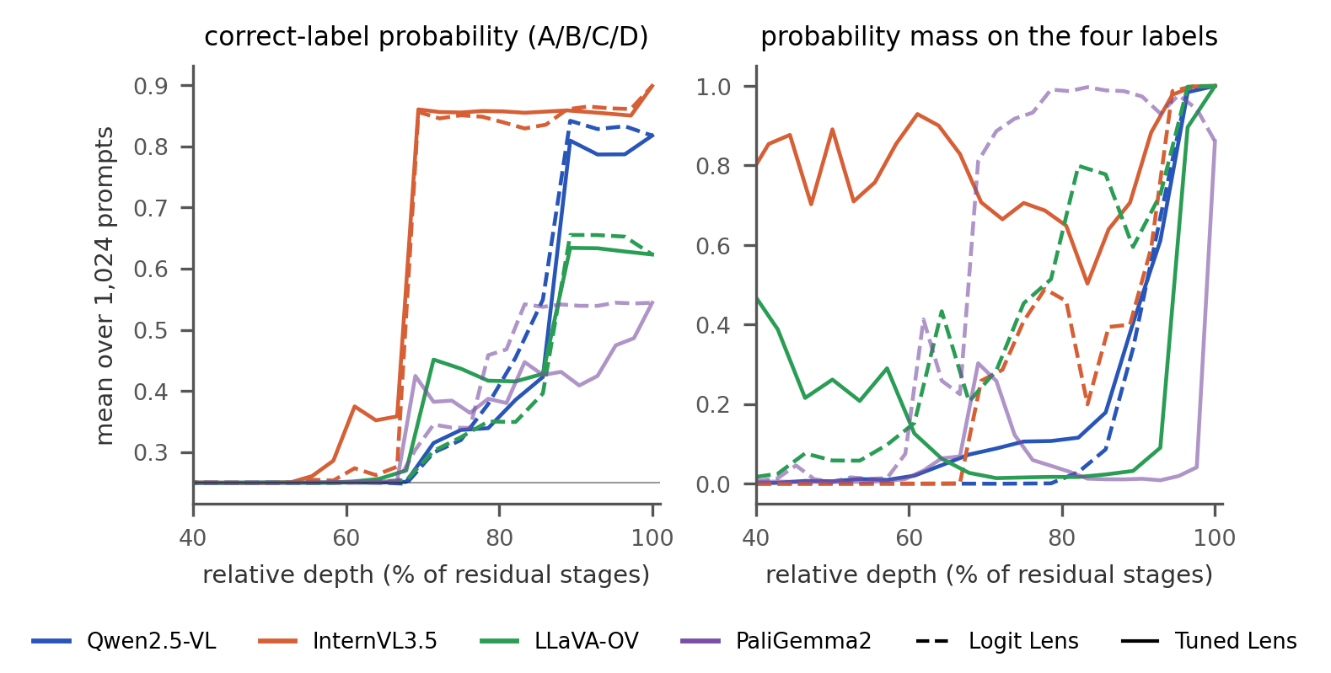
M4: WHEN IS THE ANSWER LABEL READABLE?
Question
At what depth does the model know which label to print?
What we did
At the final ("Answer:") token we project the residual state after every layer onto the vocabulary with both lenses, on the behaviour split and for all three alphabets. We track the probability of the correct label among the four shown labels, and how much of the vocabulary goes to those labels. "Readable" is the first stage where the correct-minus-wrong margin and its lower bound are above zero.
Results
First readable stage (A/B/C/D), Logit / Tuned: Qwen 22 / 20 of 28; InternVL 25 / 25 of 36; LLaVA 25 / 20 of 28; PaliGemma 35 / 35 of 42. The big jump in correct-label probability sits at the same stage under both lenses.
What we learned. In all four models the label decision is late (about 70–90% depth), and the Tuned Lens does not move it, so there is no hidden early answer. With rare letters the label becomes readable at the same depth or slightly later. Tuned Lens results are more consistent across models.

Slide 15
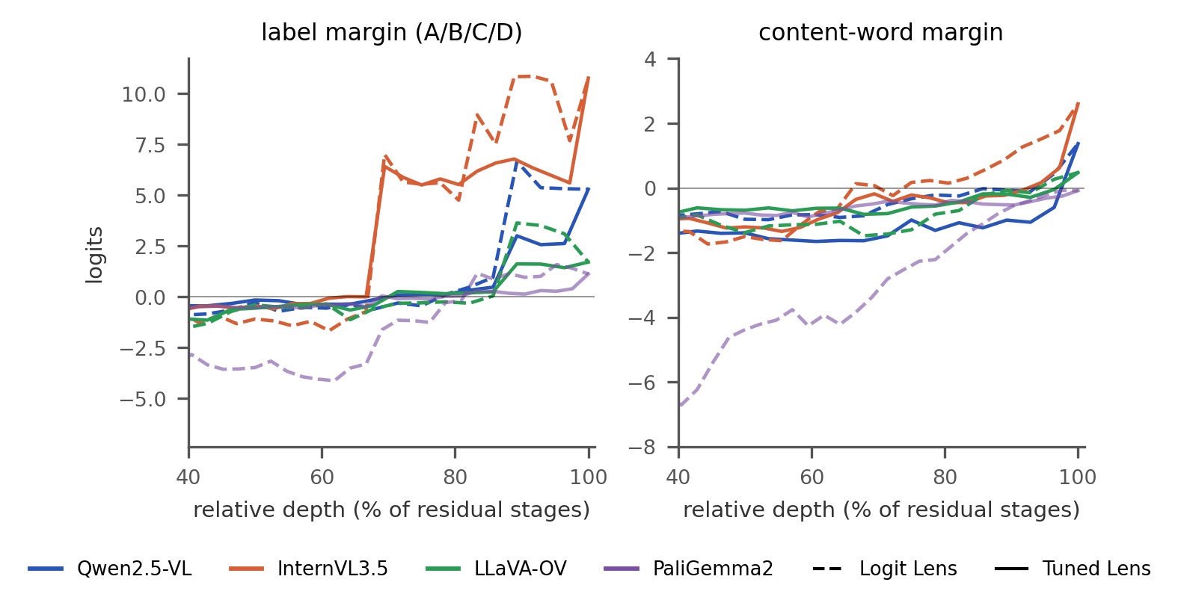
M5: IS CONTENT READABLE BEFORE THE SYMBOL?
Question
Does the answer token carry the answer's meaning first and then convert it to a symbol, or the reverse?
What we did
At every layer, using both lenses, we compare two margins at the answer token: the label margin (correct label vs. best wrong label) and the content-word margin (the correct answer word, e.g. "yellow", vs. the best wrong answer word).
Results
Content word first readable, Logit / Tuned: Qwen 27 / 28; InternVL 27 / 34; LLaVA 27 / 28; PaliGemma never (negative at every stage, −0.08 at its output). The label is readable earlier: 22, 25, 25 and 35 under the Logit Lens.
What we learned. At the answer token the label becomes readable before, or together with, the content word in every model, under both lenses: this position carries the symbol to print, not the answer word.

Slide 16
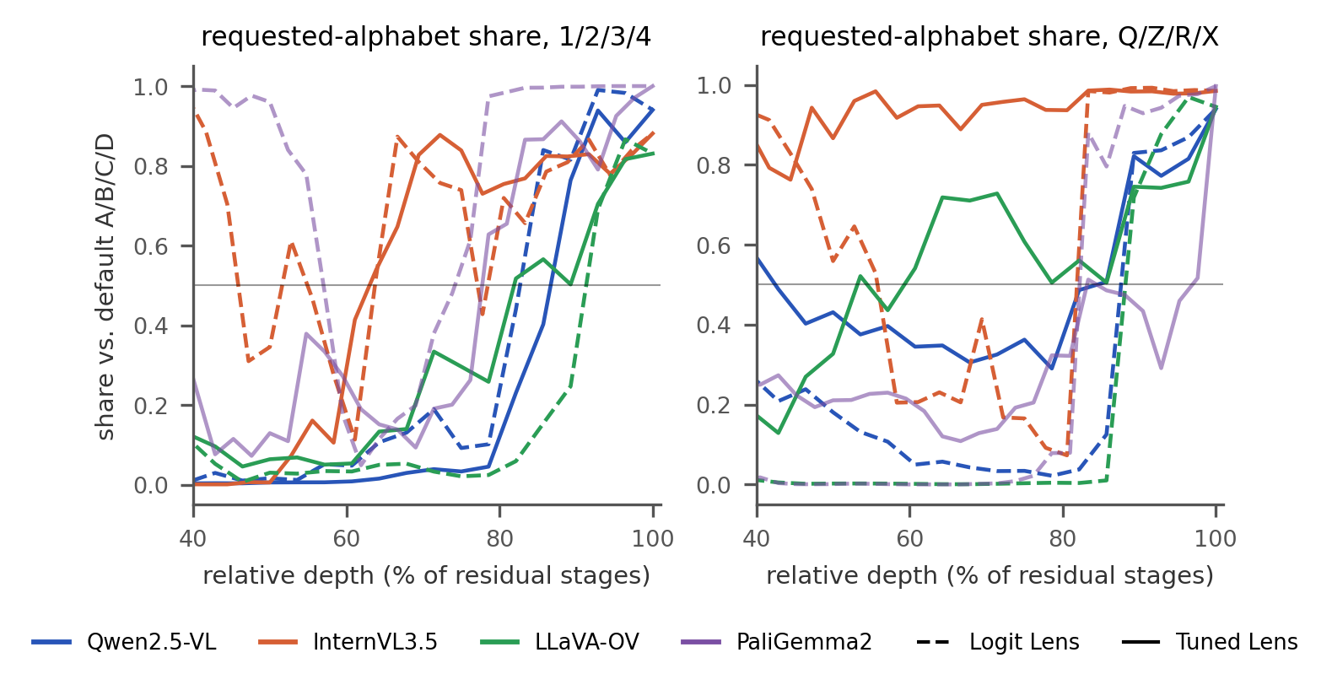
M7: DO UNFAMILIAR LABELS CHANGE THE ROUTE?
Question
Does the model first think in A/B/C/D and switch to the requested alphabet only at the end?
What we did
At every layer we repeat behaviour and both lens readouts with 1/2/3/4 and the rare letters Q/Z/R/X, and measure the share of probability on the requested labels versus the default A/B/C/D.
Results
Accuracy barely changes with the alphabet (A/B/C/D / numbers / rare: Qwen 84/80/82%, InternVL 91/78/86%, LLaVA 65/64/63%, PaliGemma 54/53/53%). Logit Lens: the rare alphabet holds almost no share until the decision, then jumps within a single stage: Qwen 0.13 → 0.83, InternVL 0.07 → 0.98, LLaVA 0.01 → 0.72, PaliGemma 0.08 → 0.88. Tuned Lens: in the same middle layers the share is already high (InternVL 0.89–0.96, LLaVA 0.44–0.73, Qwen 0.29–0.51; PaliGemma only 0.1–0.3), so the late jump is much smaller.
What we learned. The Logit Lens shows the requested alphabet appearing suddenly at the very end, while the Tuned Lens shows it building up gradually and gives it a much higher share in the middle layers. So the model has already chosen which alphabet to answer in well before the end. The model's own unembedding matrix just cannot recover that choice from the middle layers, while the trained Tuned Lens can.

Slide 17
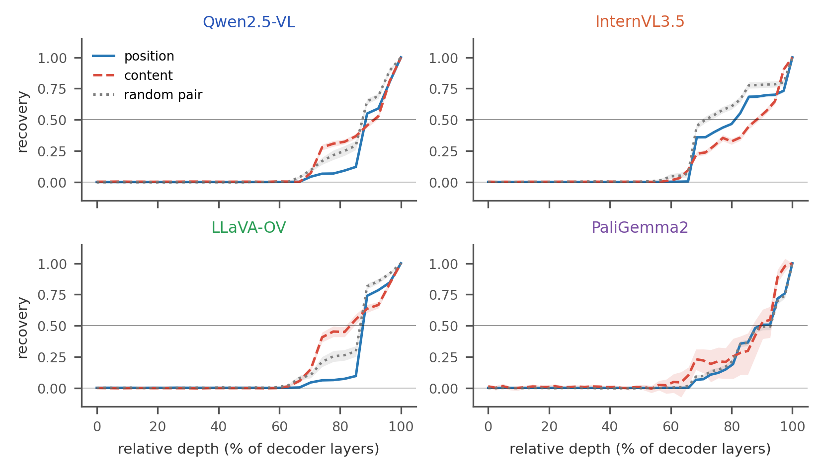
M1: WHEN CAN A DONOR ANSWER STEER THE OUTPUT?
Question
From which layer does the final token carry a portable answer?
What we did
At every layer we copy the donor's full residual state at the final token into the recipient and measure recovery toward the donor's answer (0 = none, 1 = full), for position, content and random-pair (control) contrasts. The transfer layer, the first with mean recovery ≥ 0.5, is frozen on discovery and re-tested on confirmation.
Results
Position / content transfer layer: Qwen 24 / 25; InternVL 29 / 31; LLaVA 24 / 23; PaliGemma 37 / 37. The exact order replicates in Qwen and InternVL, not in LLaVA or PaliGemma. Random pairs also cross 0.5 (layers 24, 25, 24, 39).
What we learned. In all four models the final token holds no answer until about 65–85% depth, then a portable answer state appears and fully transfers by the last layer. Random donors transfer as strongly, so it is a generic answer state, not specific to counterfactual pairs. This shows that towards the late layers, models encode a transferable answer symbol in the final token.

Slide 18
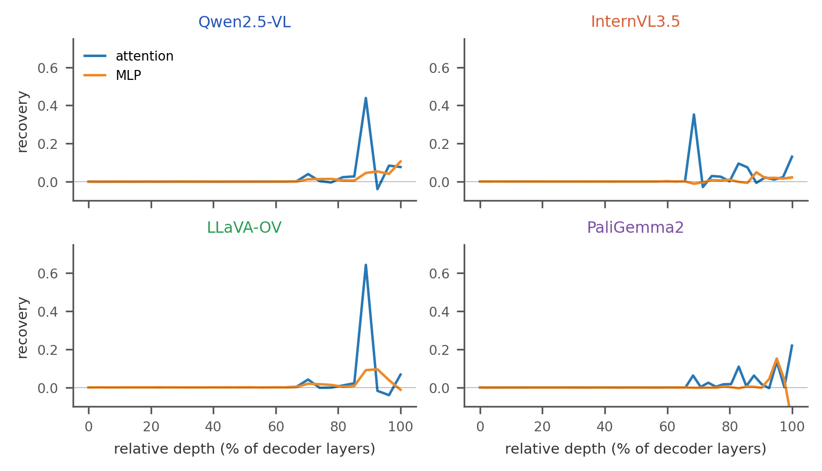
M2: DOES ATTENTION OR THE MLP MATTER MORE?
Question
Which component writes the answer into the final token?
What we did
At every layer, at the final token, we replace the attention output or the MLP output with the donor's (position contrasts) and measure recovery, as in the plot. As a second check, we replace each component's output with its output from an unrelated example, and measure how much the model's lead for its correct answer (correct-label logit minus the best wrong label) falls.
Results
Peak recovery, attention vs. MLP: Qwen 0.44 vs. 0.11, InternVL 0.35 vs. 0.05, LLaVA 0.64 vs. 0.10 (all at layer 24); PaliGemma 0.22 (L41) vs. 0.15 (L39). Replacing layer-24 attention this way cuts the correct answer's lead by 4.4, 5.6 and 5.0 logits; replacing the layer-24 MLP cuts it by only 0.5, 0.1 and 0.6 (PaliGemma: 2.3 for L41 attention vs. 1.4 for L39 MLP).
What we learned. Late answer transfer is attention-dominated in all four models: a late attention layer moves the answer into the final position. In the three Qwen-lineage models this is one sharp layer (24); PaliGemma spreads it over its last layers and gives the MLP a larger share.
Attention or MLP output patching replaces only the output of that module at one layer. Normal activation patching (M1) replaces the residual stream, i.e. the state after both the attention output and the MLP output have been added.

Slide 19
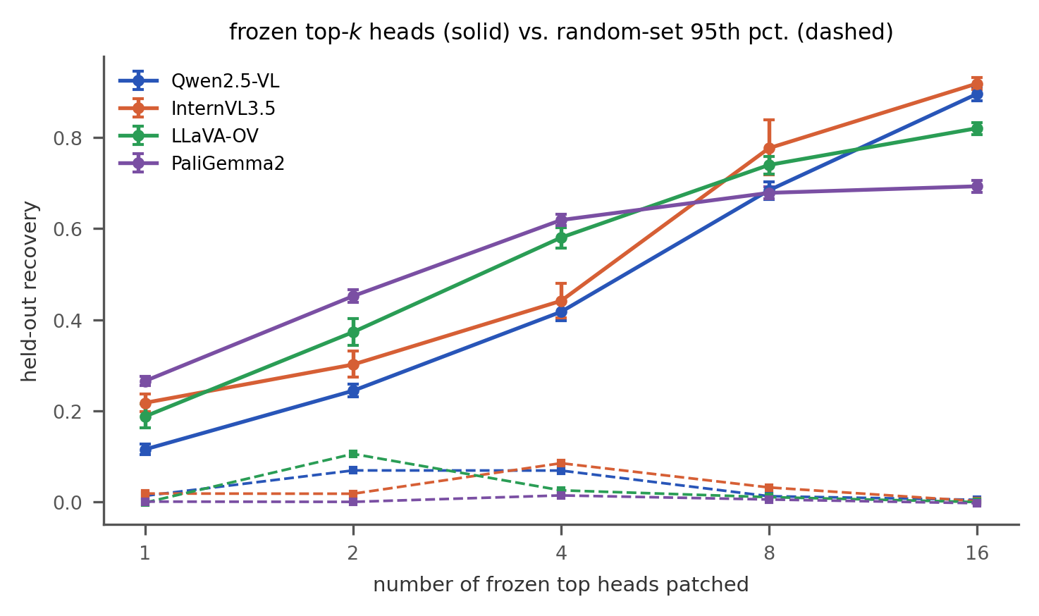
M3: DO A FEW ATTENTION HEADS DOMINATE?
Question
Is the late attention effect carried by a handful of heads?
What we did
In the four strongest attention layers (Qwen 19, 24, 26, 27; InternVL 24, 29, 30, 35; LLaVA 19, 23, 24, 27; PaliGemma 28, 34, 39, 41) we run the model patching one head at a time on discovery, rank the heads, and freeze the top-k sets (k = 1 to 16). On confirmation each set is compared with 20 random head sets of the same size and layers. The random baseline is their 95th percentile: the score that only the best 5% of random sets reach. "Sparse": four or fewer heads already recover at least 50% of the all-head effect.
Results
Top-4 heads vs. the random 95th percentile: 0.42 vs. 0.07 (Qwen), 0.44 vs. 0.09 (InternVL), 0.58 vs. 0.03 (LLaVA), 0.62 vs. 0.01 (PaliGemma), i.e. 53, 52, 71 and 93% of the all-head effect. Sparse in all but InternVL, which crosses the 50% line between phases.
What we learned. In every model a few frozen heads carry a large share of the answer transfer: even against the best 5% of random head sets, the selected top-k sets win by a large margin. These are consistent late "answer-mover" heads. How sparse they are varies by model, and they are useful heads, not a complete or unique circuit.

Slide 20
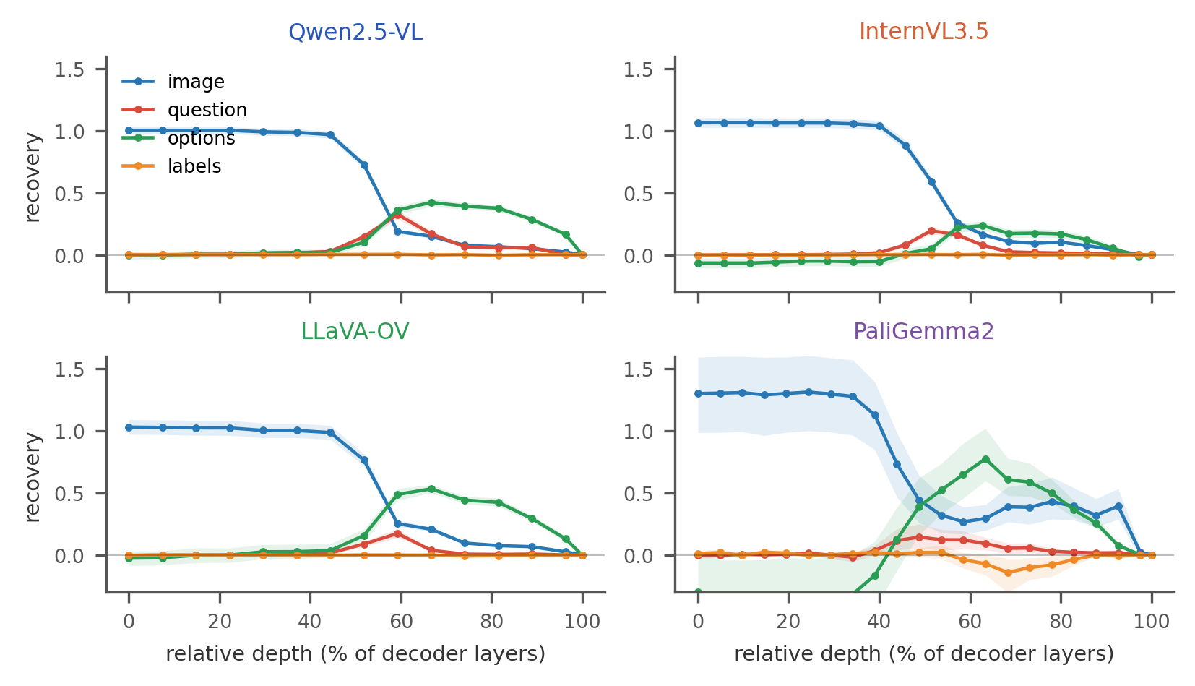
M6: WHICH TOKEN GROUPS CARRY THE EFFECT?
Question
Where in the prompt does the answer content live at each depth?
What we did
At every second layer, on content contrasts, we replace the residual states of one whole token group (image, question, option contents or option labels) with the donor's, and measure recovery at the output.
Results
Image tokens restore almost the full effect up to about 40–50% depth in all four models. Option contents then peak mid-depth: Qwen 0.42 (L18), InternVL 0.24 (L22), LLaVA 0.53 (L18), PaliGemma 0.77 (L26). Question tokens carry less; label tokens carry almost nothing.
What we learned. The answer content moves from the image tokens to the option and question tokens in the middle layers, and then to the final token (M1–M3). This staged route holds in all four models. PaliGemma's curves are noisier, so the route is broad, not edge-precise. The label tokens never carry the content.

Slide 21
ICONQA: DO RESULTS TRANSFER?
We re-ran our main methodology on 32 correctly answered IconQA pairs per phase (logit Lens only, changed prompt for PaliGemma). Notation: Qwen / InternVL / LLaVA / PaliGemma.
Method | On CLEVR | On IconQA | Transfers?
M4 Label readable | Late: stage 22 / 25 / 25 / 35 | Late again: stage 21 / 25 / 20 / 29 | Yes
M5 Content vs. label | Label first; content word at 27 / 27 / 27 / never | Label first; content word at 28 / 34 / never / 34 | Yes
M7 Alphabet | Logit Lens: sudden jump at the end | The same sudden late jump (e.g. Qwen rare letters 0.13 → 0.89 at stage 25) | Yes
M1 Final-token transfer | Late, portable; position first in Qwen, InternVL | Late again; content before position in InternVL, LLaVA and PaliGemma | Partly: late transfer yes, order no
M2 Attention vs. MLP | Attention dominates (layer 24) | Attention 0.46 / 0.25 / 0.67 / 0.24 vs. MLP 0.15 / 0.06 / 0.08 / 0.13 | Yes
M3 Heads | Top-4 carry 53 / 52 / 71 / 93% | IconQA top-4: 53 / 52 / 74 / 92%; CLEVR heads reused: 53 / 49.6 / 74 / 92% | Yes
M6 Token groups | Image early; options, question mid-depth | Image and option tokens at the input, question mid-depth; PaliGemma's image effect peaks late | Mostly; PaliGemma differs
What we learned. Almost everything transfers: late label readability, label before content, the late alphabet jump, attention-dominated answer writing and small answer-mover heads, even those chosen on CLEVR. The order of content and position does not.

Slide 22
EXTENDED EXPERIMENTS

Slide 23
OVERVIEW
S1 Does image information flow through the heads?
We keep the text fixed and change only the image. We restore early image states, copy the frozen top-4 heads, or clamp them.
S2 Can a wrong printed symbol be repaired?
A screen of saved records finds errors with the right content but the wrong symbol. S2 patches option states from a same-image donor to repair them.
S3 Do the heads route to specific image regions?
Block the heads' attention to the question-object or option-object region and compare with an equal-size control region.
S4 With image answer options, content or symbol?
Show the question and options as image panels. We test whether the heads move the donor's visual content or copy its printed symbol.
Main methods finds useful sites while new studies test how they connect. All four experiments run on CLEVR scenes with each model's own frozen top-4 heads, 20 random 4-head sets as control, one layer or site frozen on discovery and tested once on held-out scenes.
Models: Qwen, InternVL and LLaVA (PaliGemma not run).

Slide 24
DATA AND INPUTS
Study | Data | Input change | What we score
S1 | The same CLEVR counterfactual pairs, keeping only pairs where every direction also has its matched controls | Donor and recipient prompts are identical in text while only the image differs | Effect on the donor's answer (logits)
S2 | The model's own errors from the behaviour split (found by a screen of saved records), plus matched already-correct scenes as controls | The recipient is a wrong answer, the donor is the same image with the options rearranged | The recipient's truth margin and % of errors fixed
S3 | CLEVR scenes chosen from their scene graphs: two uniquely described objects, so the question can name either | Object bounding boxes are mapped onto the image tokens to form regions | Answer change when a region is blocked, minus a control region
S4 | Objects cropped from CLEVR scenes into one collage: a query panel above four option panels A–D | The options are images, not words. The query panel equals one option | Move toward the donor's content minus copying its symbol

Slide 25
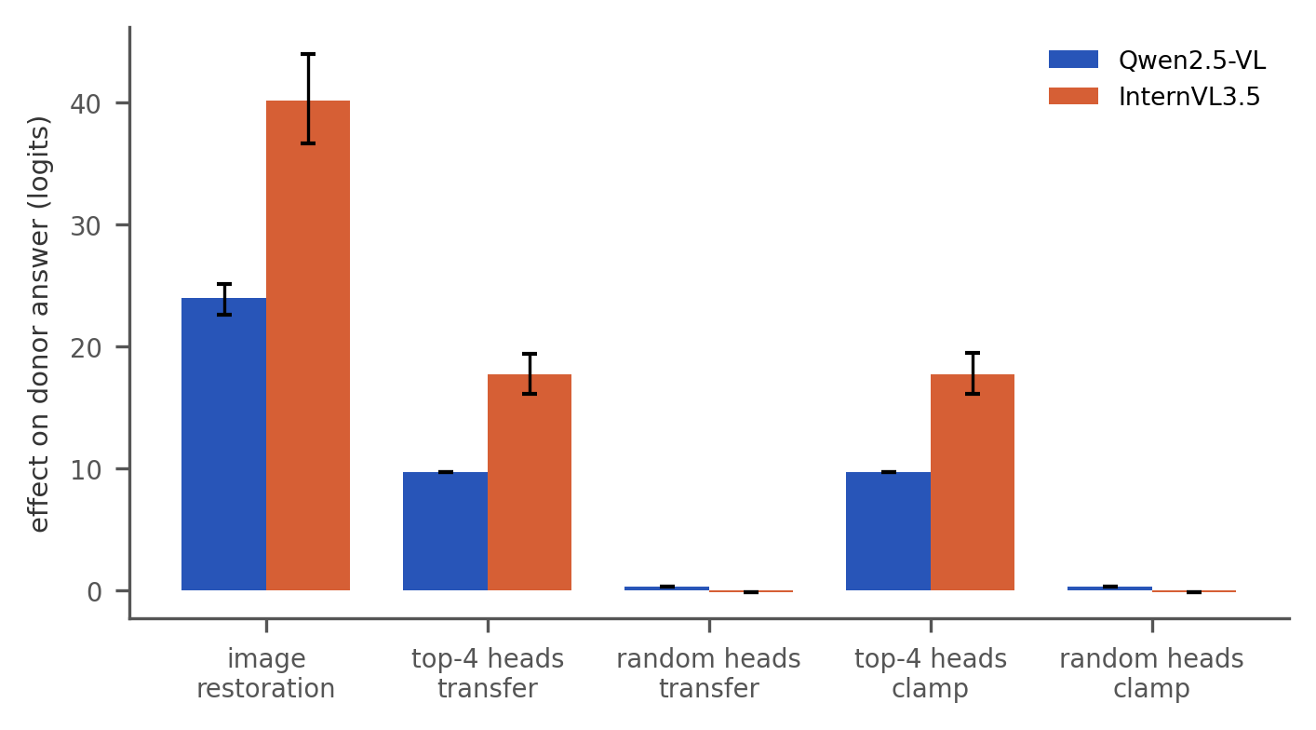
S1: DOES IMAGE INFORMATION FLOW THROUGH THE HEADS?
Question
With the prompt fixed and only the image changed, does restoring early image states bring back the donor's answer, and do the frozen heads carry that effect?
What we did
Donor and recipient share the exact same text and differ only in the image. We (1) replace all image-token states at layer 0 with the donor's, (2) copy only the frozen top-4 heads' outputs at the final token, and (3) restore the image while clamping those four heads to their recipient values. Heads are compared with 20 random 4-head sets from the same layers.
Results
Image restoration recovers the full donor effect: +24.0 logits in Qwen and +40.2 in InternVL (recovery 1.00). Copying the four heads moves the answer by +9.7 (Qwen) and +17.7 logits (InternVL), against about 0 for random heads; clamping them removes almost the same amount. LLaVA: we were not able to run it on this model in the stipulated time.
What we learned. The early image states carry essentially the whole answer, and the four frozen heads carry a large, selective share of it: copying them transfers it and clamping them blocks it.
How it differs from previous methods. Previously the methods tested image tokens (M6) and heads (M3) separately, and chose its heads on same-image contrasts. S1 changes only the image and tests in one run whether those heads carry its effect (copy) and are needed for it (clamp).

Slide 26
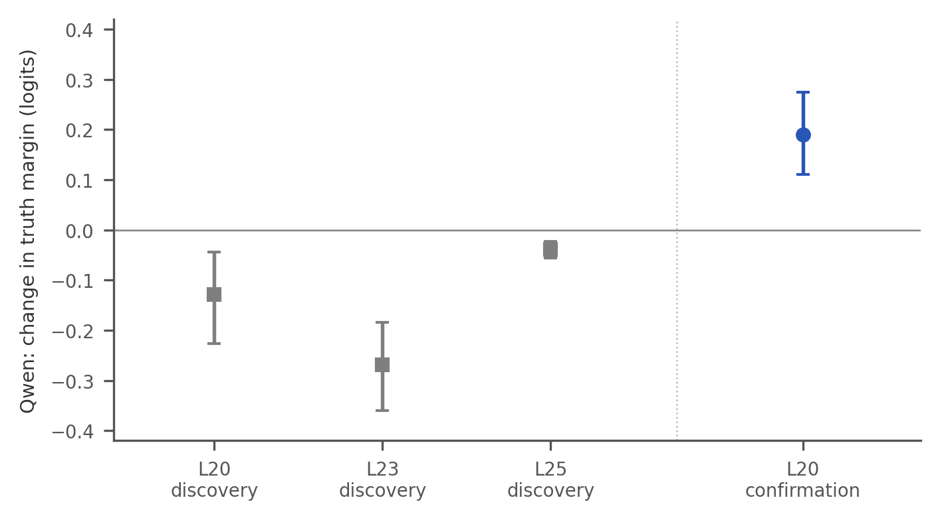
S2: CAN A WRONG PRINTED SYMBOL BE REPAIRED?
Question
The model sometimes "knows" the answer word but prints the wrong letter. Can patching fix the letter?
What we did
1. Errors: from saved records, take prompts where the lens favours the right word (e.g. "yellow", option C) but a wrong letter is printed.
2. Donor: the same image with the options reordered, answered correctly ("yellow" is now option A).
3. Patch: V1 copies only the donor's state over "yellow". V2 copies all four option words onto the same words in the recipient, keeping its letters. A real repair prints C (its own letter), not A (the donor's).
Results
V1 made the errors worse at every layer tried. V2 (layer 20) pushed 35 new errors (from scenes not used to choose the layer) toward the right letter (+0.19 logits on average), but fixed only about 1 in 8 (12.9%): the push is small, so only nearly-right errors flip. Correct cases were almost never harmed (2 of 72).
InternVL: no layer gave a valid repair. LLaVA: its readout matched the truth in only 72% of scenes, too weak to find such errors, so no repair was tested.
What we learned. Copying the right answer word alone does not fix the letter. Copying all four options helps a little, which suggests the model represents the options together. The repair is small: most errors stay wrong.
How it differs from previous methods. Previous methods only patched pairs the model answers correctly and asks where the answer travels. S2 starts from the model's own errors and asks whether patching can repair them.

Slide 27
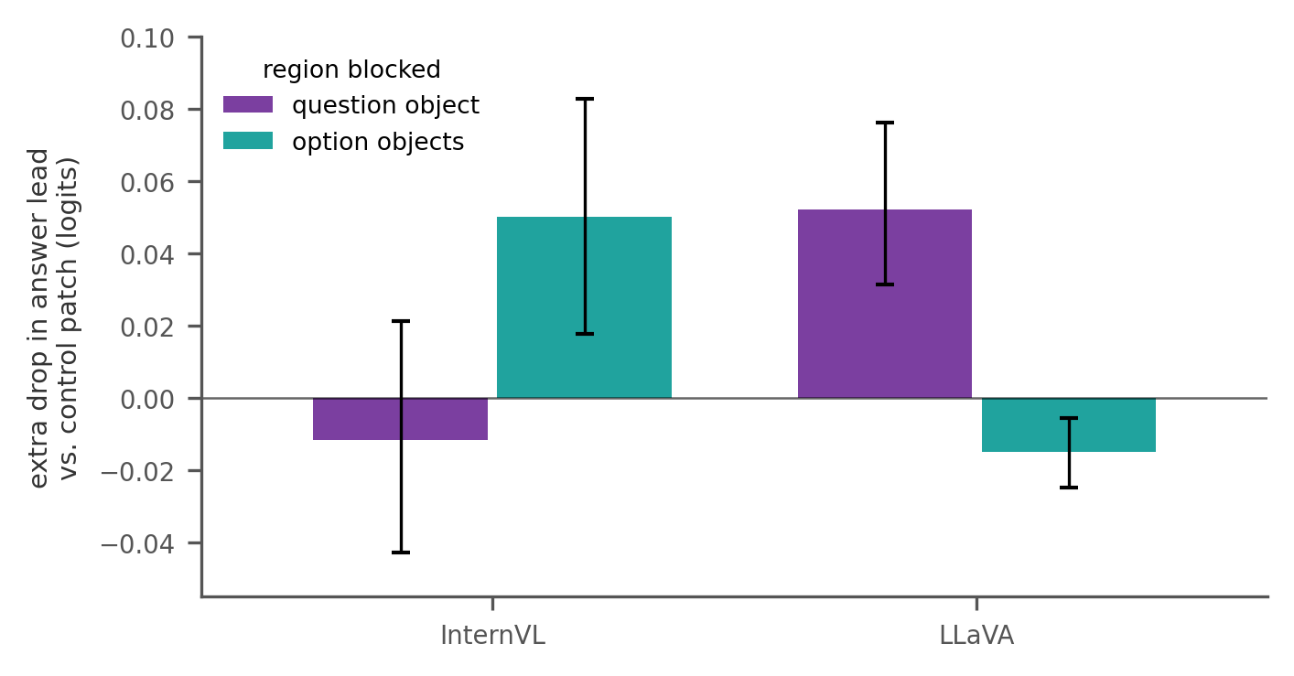
S3: DO THE HEADS ROUTE TO SPECIFIC IMAGE REGIONS?
Question
When the model answers, do the selected heads look at the object the question asks about, or at the objects that match the answer options?
What we did.
Main methods swapped all image tokens at once (M6), so it could not say which part of the image matters. S3 tests specific regions.
Regions.
In CLEVR scenes we mark two regions: the question object (the object the question names) and the option objects (the objects whose colours appear among the options).
Block.
We stop the frozen heads from looking at one region from the answer token, and measure how much the correct answer's lead drops.
Control.
We also block a patch of plain background with the same number of image tokens. Only harm beyond this patch counts.
Layer.
On a first set of scenes we tried several image layers and kept the one where erasing the region hurt most compared with the control (Qwen 8, InternVL 5, LLaVA 4). We then tested once on new scenes.
Results and what we learned. A region counts as used if, on the new scenes, blocking it hurts more than the background patch (95% interval above zero).
Qwen: neither region beat the background patch, even when blocking 16 heads.
InternVL: blocking the option objects hurt more (+0.05 logits); the question object did not.
LLaVA: the reverse: the question object hurt more (+0.05); the option objects did not.
The heads do read from specific objects, but which ones differs by model and the effects are small: there is no shared spatial route.

Slide 28
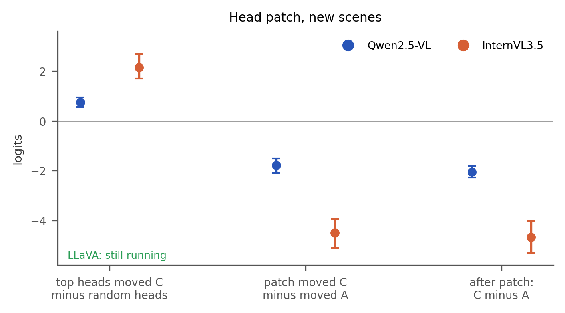
S4: WITH IMAGE ANSWER OPTIONS, CONTENT OR SYMBOL?
Question
When the answer options are pictures instead of words, do the frozen heads carry what the answer is, or just which letter the donor printed?
Donor: answer A
Recipient: answer D
query:
query:
patch
A
B
C
D
A
B
C
D
Prompt: "Which option image matches the query image? Respond with only its displayed symbol."
Results and what we learned. All numbers compare the model's scores (logits) for C, the letter of the donor's object in the recipient, and A, the donor's own letter.
Panel patch: C's score rose 1.60 more than A's (Qwen, first scenes): the picture content transfers.
Head patch: copying the top-4 heads raises C's lead more than copying random heads (+0.75 Qwen, +2.15 InternVL), so the heads matter. But A rises even more: C's gain minus A's gain is −1.79 and −4.49, and after the patch A is still ahead of C by 2.05 and 4.66.
Early picture tokens carry the object, but the answer heads carry the letter.
What we did
Unlike main methods, the options are pictures, and the query copies one of them. Donor and recipient show the same objects in different orders. Two separate patches:
Panel patch: copy the donor's hidden states for one picture (its query, or the option showing its answer) into the matching recipient picture, at layer 0; everything else stays.
Head patch: copy only the frozen top-4 heads' outputs at the answer token.
If the content moves, the recipient answers C; if the symbol moves, A.

Slide 29
CONCLUSION

Slide 30
CONCLUSIONS
HOLDS ACROSS MODELS
DEPENDS ON THE MODEL, OR FAILS
1 A staged route to the answer
Image tokens carry the answer early (layer 0), option and question tokens carry it in the middle, and a late attention layer writes it to the answer token at about 65–85% depth. This holds in all four models and on IconQA.
2 A few answer-mover heads
Small frozen head sets beat the best 5% of random head sets in every model. In S1, copying only the top-4 heads moves the answer by +9.7 (Qwen) and +17.7 logits (InternVL), against about 0 for random heads.
3 The label is decided late
The label becomes readable at about 70–90% depth under both lenses. The Tuned Lens shows the requested alphabet is already chosen in the middle layers.
4 Model-specific details
Transfer layers, the order of content and position, InternVL's head sparsity and the image region the heads read (InternVL: option objects; LLaVA: question object; Qwen: neither).
5 Binding content to a symbol
Repair is small: copying all four options fixes only 12.9% of Qwen's errors. With picture options the heads copy the donor's letter, not its object (after patching, C minus A: −2.05 Qwen, −4.66 InternVL).
6 Transfer to IconQA
Almost every CLEVR finding transfers, including the CLEVR-chosen heads; only the content/position order does not.
Overall. VLMs answer MCQs through one shared set of causally useful sites, from image tokens to option tokens to a few late heads that write the symbol, but how the visual content gets bound to the printed letter is still open.

Slide 31
LIMITATIONS
Data One synthetic dataset
Most causal work uses CLEVR. The IconQA check covers one edited, class-imbalanced task template (32 confirmation pairs per model), so findings may not carry over to natural images or expert questions.
Pairs Correct-only pairs
Each model is patched only on pairs it answers correctly on both sides, which can bias the results towards easy cases.
Models Shared backbones
Qwen, InternVL and LLaVA all use Qwen-lineage language models. PaliGemma2 adds a Gemma backbone only as an exploratory run (54.4% accuracy, 76/61 pairs), so a shared route is not universality.
Claims Useful sites, not a circuit
Patched sites are causally useful for the tested contrast; they are not a complete or minimal circuit.
Readouts Lenses measure readability
Logit Lens and Tuned Lens show when information is readable, not that the model uses it. Our Tuned Lens is likely under-trained.
Compute Long, shared runs
All methods took 5.5 (Qwen) to 34 hours (LLaVA) per model on shared mixed-GPU clusters, which limited how many models and studies we could run.

Slide 32
LIMITATIONS IN STRETCH GOALS
 | Qwen | InternVL | LLaVA | PaliGemma2
S1 image restoration | strong positive | strong positive | not run in time | not run
S2 error repair | all-option narrow positive | no layer passed discovery | readout too unreliable | not run
S3 spatial routing | no selective edge | option-region sensitivity | question-region sensitivity | not run
S4 visual options | symbol-copy pattern | symbol-copy pattern | running | not run
IconQA reduced Methods | complete; order unstable | complete | complete | changed prompt

Slide 33
FUTURE WORK
1 Comprehensive Model Families
Test it on more model families like, Llama, Molmo, Muse, Kimi to estimate the generalization of our results on more backbones.
2 Beyond one template
Extend to other IconQA tasks, natural images and native (unedited) counterfactual pairs.
3 From sites to a circuit
Use path patching to connect image tokens, option tokens and the answer-mover heads into one tested route, and train the Tuned Lens longer.
4 Running on robust datasets
If there is decent amount of compute, we should test the transferability of results on larger and more robust dataset like MMMU and MMMU-pro.

Slide 34
APPENDIX

Slide 35
DATASET SCALE
Unit | CLEVR-MCQ-4 | IconQA subset
Items | 1,252: 676 single images + 288 pairs × 2 | 272: 136 pairs × 2, plus 136 same-answer control images
Prompt variants | 17,328 = 1,252 × 12 + 576 × 4 | 4,352 = 272 × 12 + 272 × 4
Directed contrasts | 14,400 = 288 pairs × 50 | 2,448 = 136 pairs × 18
Reasoning families | 9 | 1 (marble probability)
Side note: specificity controls
Comparisons that should not carry the answer effect. A real effect should be larger for the matched counterfactual donor than for these.
Distractor-identity control
Reorder the wrong options; the image and correct answer stay fixed.
Does the effect depend on which incorrect answers are present?
Random patching control
Copy the activation from a different, unrelated scene.
Is the patch carrying the relevant fact, or merely disturbing the model?
Prompt variants. Every item has 12 variants: 4 option orders × 3 label sets (A/B/C/D, 1/2/3/4, Q/Z/R/X). Each pair image adds 4 distractor-identity variants for the specificity control.
Directed contrasts. A contrast is one donor → recipient patch; each direction counts separately. CLEVR uses the 288 discovery + confirmation pairs, each giving 50: 16 position, 8 content, 8 content + position, 16 distractor-identity and 2 random. IconQA keeps a reduced 18 per pair: 4 of each of the four types and 2 random.

