Slide 1
Backend-Node Server Example

Slide 2
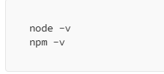
Setup Node.js
First, you need to have Node.js installed on your machine. You can download it from Node.js official website.
After installation, you can verify it by running:

Slide 3
Setup MongoDB
Use a cloud-based solution like MongoDB Atlas.
For a quick start, let’s use MongoDB Atlas:
Sign up on MongoDB Atlas.
Create a cluster.
Create a database user and whitelist your IP address.
Get the connection string.

Slide 4
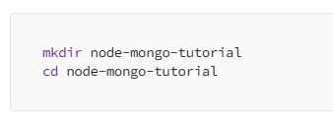
Create a Node.js Application
Create a new directory for your project and navigate into it:

Slide 5

Initialize a new Node.js project

Slide 6

Install the necessary packages
Express: A minimal and flexible Node.js web application framework.
Mongoose: An ODM (Object Data Modeling) library for MongoDB and Node.js.
Body-Parser: Middleware to parse incoming request bodies.

Slide 7
Connect to MongoDB
Create a file named app.js in your project directory.
In this file, you will set up the Express app and connect to MongoDB.

Slide 8
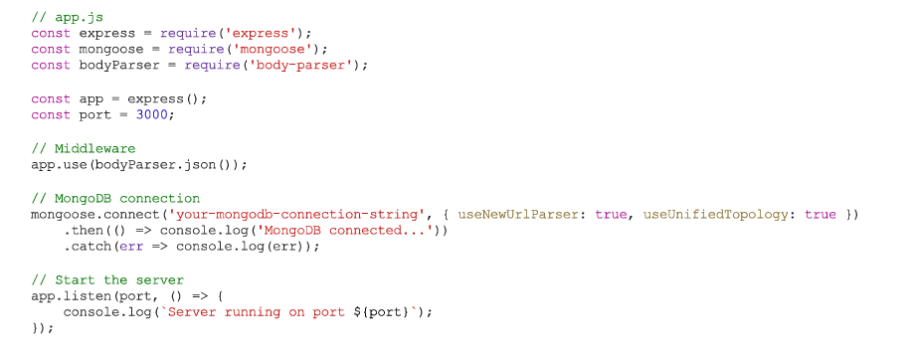
Connect to MongoDB
Create a file named app.js in your project directory.
In this file, you will set up the Express app and connect to MongoDB.
to use the new Server Discovery
and Monitoring engine

Slide 9
Create a Schema and Model
Mongoose uses schemas to define the structure of the data in MongoDB.
Create a new directory named models and inside it, create a file user.js

Slide 10
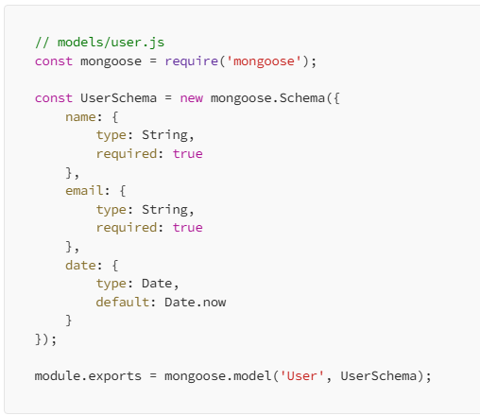
Create a Schema and Model

Slide 11
Create Routes
Routes are used to define endpoints for your application.
Create a new directory named routes and inside it, create a file user.js.

Slide 12
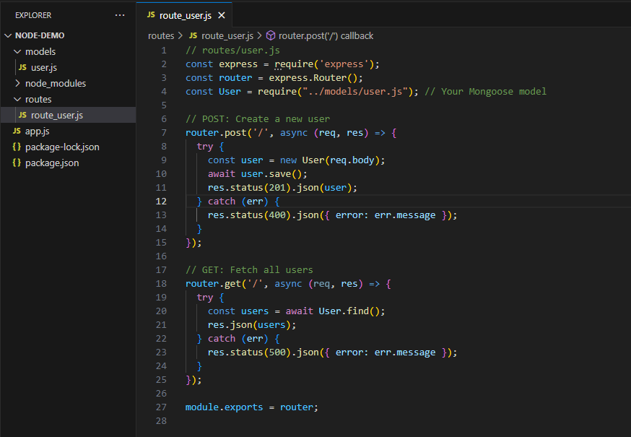
Create Routes

Slide 13
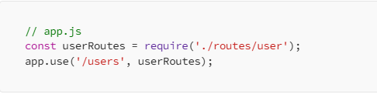
IMPORT THE ROUTE
In app.js, import the routes:

Slide 14

Test Your Application
Start your server:

Slide 15
Testing
Use a tool like Postman to test your API endpoints:
Create a User: Make a POST request to http://localhost:3000/users with a JSON body containing name and email.
Get All Users: Make a GET request to http://localhost:3000/users

