Slide 1
API

Slide 2
Overview
API (Application Programming Interface) is a set of rules and protocols that allows one software application to interact with another. It defines how different software components should communicate with each other.
APIs allow developers to access specific functionalities of an application, service, or platform without knowing its internal implementation

Slide 3
Types of APIs
Open APIs (Public APIs)
Access: Available to everyone
Use Case: Public services like Google Maps API, Twitter API
Example Methods:
GET /weather?city=London — Get weather data for a city
POST /register — Register a new user

Slide 4
Types of APIs
Internal APIs (Private APIs)
Access: Used within an organization
Use Case: Connecting internal services like HR systems and payroll
Example Methods:
GET /employee/details — Fetch internal employee data

Slide 5
Types of APIs
Partner APIs
Access: Shared with specific partners under agreement
Use Case: Payment gateways, travel booking systems
Example Methods:
POST /bookings/create — Create a booking (used by partners)

Slide 6
Types of APIs
Composite APIs
Access: Usually internal, but can be any
Use Case: Combines multiple API calls into one
Example: One API call to fetch user profile, orders, and history

Slide 7
API Types Based on Protocol
1. REST API (Representational State Transfer)
Most common web API type
Methods:
GET: Retrieve data
POST: Create new data
PUT: Update existing data
DELETE: Remove data
Example: GET /users/101 — Fetch user with ID 101

Slide 8
API Types Based on Protocol
2. SOAP API (Simple Object Access Protocol)
XML-based protocol
More strict and secure than REST
Methods: Uses request and response envelopes
Example: SOAP service to transfer funds in banking apps

Slide 9
API Types Based on Protocol
3. GraphQL API
Query language for APIs
Client can specify exactly what data is needed

Slide 10
API Types Based on Protocol
4. gRPC (Google Remote Procedure Call)
Uses Protocol Buffers instead of JSON
High performance; ideal for microservices
Example: gRPC service for streaming video or chat

Slide 11
API Routes
API Routes are the URL paths that define how clients (like web or mobile apps) interact with an API. Each route corresponds to a specific functionality or resource and is usually combined with an HTTP method to perform actions like reading, creating, updating, or deleting data.

Slide 12
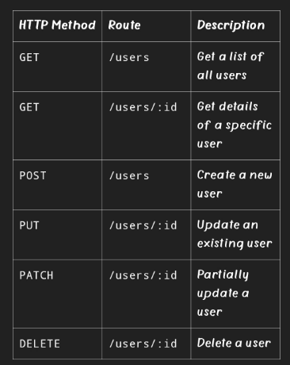
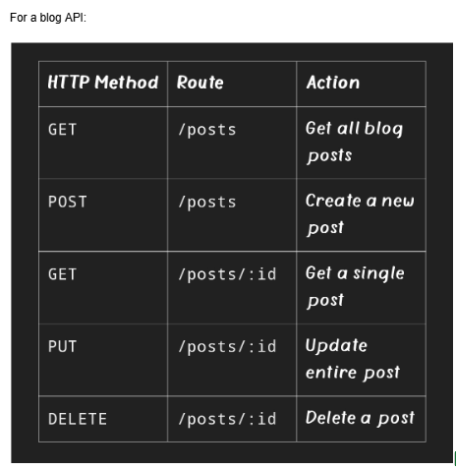

Slide 13
API Routes
Nested Routes:
Sometimes APIs have nested routes for related resources.
Example: Comments on a blog post
GET /posts/:postId/comments — Get all comments on a post
POST /posts/:postId/comments — Add a comment to a post

