Slide 1
Backend-Node Server Example

Slide 2
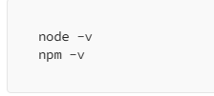
Setup Node.js
First, you need to have Node.js installed on your machine. You can download it from Node.js official website.
After installation, you can verify it by running:

Slide 3
Setup MongoDB
Use a cloud-based solution like MongoDB Atlas.
For a quick start, let’s use MongoDB Atlas:
Sign up on MongoDB Atlas.
Create a cluster.
Create a database user and whitelist your IP address.
Get the connection string.

Slide 4
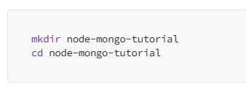
Create a Node.js Application
Create a new directory for your project and navigate into it:

Slide 5

Initialize a new Node.js project

Slide 6

Install the necessary packages
Express: A minimal and flexible Node.js web application framework.
Mongoose: An ODM (Object Data Modeling) library for MongoDB and Node.js.
Body-Parser: Middleware to parse incoming request bodies.

Slide 7
Connect to MongoDB
Create a file named app.js in your project directory.
In this file, you will set up the Express app and connect to MongoDB.

Slide 8
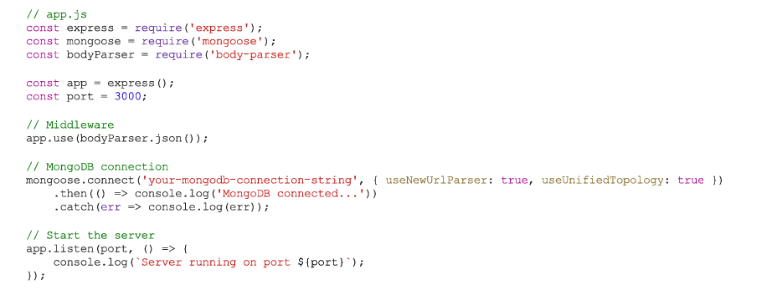
Connect to MongoDB
Create a file named app.js in your project directory.
In this file, you will set up the Express app and connect to MongoDB.

Slide 9
Create a Schema and Model
Mongoose uses schemas to define the structure of the data in MongoDB.
Create a new directory named models and inside it, create a file user.js

Slide 10
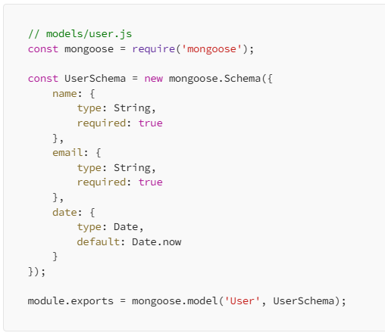
Create a Schema and Model

Slide 11
Create Routes
Routes are used to define endpoints for your application.
Create a new directory named routes and inside it, create a file user.js.

Slide 12
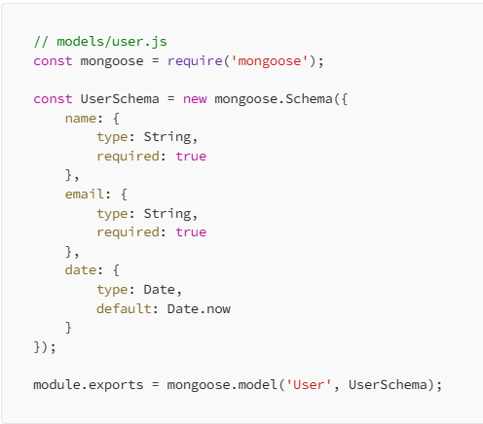
Create Routes

Slide 13
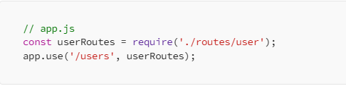
IMPORT THE ROUTE
In app.js, import the routes:

Slide 14

Test Your Application
Start your server:

Slide 15
Testing
Use a tool like Postman to test your API endpoints:
Create a User: Make a POST request to http://localhost:3000/users with a JSON body containing name and email.
Get All Users: Make a GET request to http://localhost:3000/users

