Slide 1
Introduction to Advance PHP
BY • Divya Bagul

Slide 2
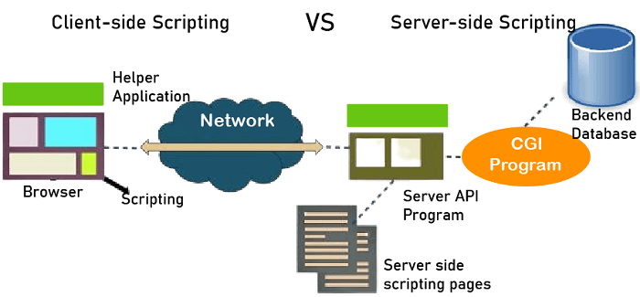
Overview
PHP stands for Hypertext Preprocessor.
server-side scripting language
create dynamic web pages.
PHP is considered a server-side scripting language because it operates on the server before a webpage is sent to the user's browser.
What we do with PHP ?
Handling Form, Validations
Use Authentication, Session management
Communicate with Database and manipulate Data.

Slide 3
Will Cover Topics
Print statement, echo
DataTypes and Variables.
Constant.
Strings, Arrays.
Operations
Conditional statements
Loops
Functions
Regular expressions
OOPs Concept in PHP
Form handling
Mysql
Phpmyadmin
Connection to Database
Perform some data manipulation with mysql and php
cookie
Session

Slide 4
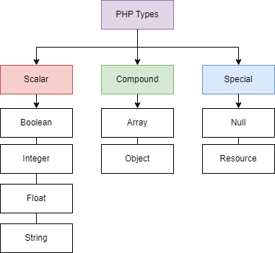
Progress - Topic area 2
Printing statement
print(“text/variable”)
echo “text/variable” or echo(“text/variable”)
Data Types
Type of information that can be stored and manipulated
Scalar - Holds a single value.
Compound - Holds more than one value.
Special - Null means No Value.
Variables
One type of container
One name that holds data in page or application

Slide 5
Constants
Constants are like variables, except that once they are defined they cannot be changed or undefined.
That value cannot change during the execution of the script.
constant name starts with a letter or underscore (no $ sign before the constant name)..
Case -sensitive .
define(name, value, case-insensitive)

Slide 6
String - sequence of characters
Ucfirst() - convert the first letter in upper case - ucfirst(string)
lcfirst() - convert the first letter in lower case - lcfirst(string)
ucwords() - convert the first letter of the word in upper case - ucwords(string)
strlen() - find the length of strings - strlen(String)
str_replace() - replace some of the characters in a string with some other. - str_replace(Search, Replace, string)
strpos() - searches for a specific text within a string - strpos("Hello world!", "world");
strrev() - reverses a string. - strrev("Hello world!");
strtolower() - convert string to lowercase- strtolower(str);
strtoupper() - convert string to uppercase - strtoupper(str)
str_word_count() - count words from the string or sentence - str_word_count(string);

Slide 7
Trim() -trimming the white space from the start and end of the strings. - trim(str)
ltrim() , rtrim()
strip_tags() - clear the HTML tags. - strip_tags(String, Allow-Tags-optional)
str_repeat() - repeat the string - str_repeat(str)

Slide 8
Array - stores multiple values in one single variable
array(
key => value,
key2 => value2,
Key3 => value3,
…)
Indexed arrays - Arrays with a numeric index
$employee = array("Peter", "Ben", "Joe");
Associative arrays - Arrays with named keys
$employee = array("Peter"=>"35", "Ben"=>"37", "Joe"=>"43");
Multidimensional arrays - Arrays containing one or more arrays
$cars = array (
array("Peter",petter@gmail.com,18),
array("Ben",ben@gmail.com,13),
);

Slide 9
Array Functions
count() - Number of elements in an array - count(array)
array_push() - inserts elements to the end of an array - array_push($array,"element1","element2");
array_pop() - Deletes the last element of an array - array_pop(array);
array_merge() - Merges one or more arrays into one array - array_merge(array1,array2)
array_unique() - Removes duplicate values from an array - array_unique(array);
in_array() - Searches an array for a specific value - in_array(value,array);
array_replace()- replaces the values of the first array with the values from another array - array_replace(array1,array2)
array_chunk() - splits an array into chunks of new arrays - array_chunk($array,2)
array_sum() ,array_keys(), array_key_exists()
sort() ,krsort(),krsort()

Slide 10
Conditional Statements -
Used to perform operations based on some condition.
if statement - Executes some code if one condition is true
if (expr)
Statement //code execute when condition true
if...else statement - Executes some code if a condition is true and another code if that condition is false
if (expr)
Statement //code execute when condition true
else
Statement //code execute when condition false

Slide 11
Conditional Statements -
Used to perform operations based on some condition.
if...elseif...else statement - Executes different codes for more than two conditions
if (expr)
Statement //code execute when condition true
esleif (expr2)
Statement //code execute when condition this condition true
else
Statement //code execute when condition all conditions are false
Switch Statement - variable to be tested for equality against a list of values (cases).
Execute one statement from multiple conditions

Slide 12
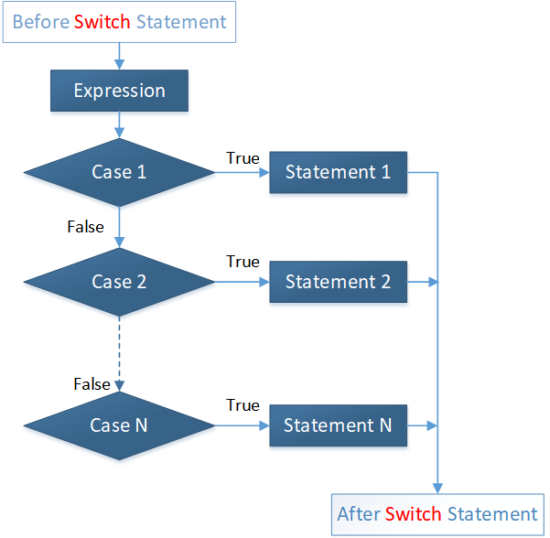
switch (n) {
case label1:
code to be executed if n=label1;
break;
case label2:
code to be executed if n=label2;
break;
...
default:
code to be executed if n is different from all labels;
}

Slide 13
PHP Loops
Used to execute the same block of code again and again, as long as a certain condition is true.
For loop - Loops through a block of code a specified number of times.
Used when you know the number of iterations
for(initialization; condition; increment/decrement){
//code to be executed
}
foreach - foreach loop loops through a block of code for each element in an array.
foreach ($array as $value) {
//code to be executed
}

Slide 14
PHP Loops
Used to execute the same block of code again and again, as long as a certain condition is true.
While loop - Executes a block of code repeatedly until the condition is FALSE. Once the condition gets FALSE, it exits from the body of loop.
While loop also called an Entry control loop
while(condition){
//code to be executed
}
foreach - Loops through a block of code once, and then repeats the loop as long as the specified condition is true.
do{
//code to be executed
}while(condition);

Slide 15
PHP Functions - Function is a piece of code that can be reused many times
Create a functions
function functionname(){
//code to be executed
}
Call a function
functionname();
Functions with argument
Information passed in function
function functionname($msg){
//code to be executed
}
functionname (“Hello world”);
function sendMsg(){
echo "Hello PHP Function";
}
sendMsg();
function sendMsg($msg){
echo "Hello PHP Function";
}
sendMsg(“Hello PHP”);

Slide 16
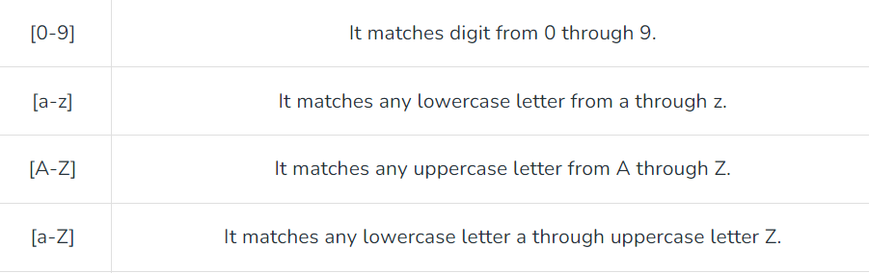
Regular Expression - Sequence of characters that forms a search pattern
It allows you to search a specific string inside another string
Regular expressions are case sensitive

Slide 17
Class and Object

Slide 18
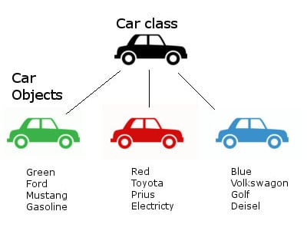
Class and Object
<?php
class Car{
// Properties
public $Color;
// Methods
function set_color($name) {
$this->Color = $name;
}
function get_color() {
return $this->Color;
}
}
?>
<?php
class Car{
// code here...
}
?>

Slide 19

XAMPP
XAMPP is an open-source software package that provides a local web server environment for testing and development.
XAMPP is a completely free, easy to install Apache distribution containing MariaDB, PHP, and Perl
It is mainly used for web application testing on a localhost web server

Slide 20
Mysqli functions
mysqli_connect() function opens a new connection to the MySQL server.
mysqli(host, username, password, dbname, port);
mysqli_connect_error() function returns the error description from the last connection error, if any
mysqli_real_escape_string(connection, escapestring)function escapes special characters in a string for use in an SQL query.
mysqli_num_rows($query)Return the number of rows in result set
mysqli_fetch_assoc() function fetches a result row as an associative array.

Slide 21
Cookies
Cookies are small pieces of data that are stored in the user's browser. They are often used to store information about the user or their browsing session.
set cookies using the setcookie() function.
$name = subject;
$value = 'english';
$expire = time() + 60*60*24*3; // 3 days from now
$path = '/route';
$domain = 'www.example.com';
$secure = isset($_SERVER['HTTPS']); // or use true/false
$httponly = true;
setcookie($name, $value, $expire, $path, $domain, $secure, $httponly);

Slide 22
Sessions
Sessions are a way to store information across multiple pages during a user's visit to a website.
sessions are managed using the $_SESSION superglobal array.
To start a session in PHP, you use the session_start() function. Here's an example:
sessions are stored on the server, and a session ID is stored in a cookie on the user's browser to identify the session.

Slide 23
Thank You

