Slide 1
Maverick web hogs
Theme 4: Experience
Divya Dayashankar Jaiswal: btbtc18114_divya@banasthali.in
Aditi Raizada:btbtc18107_aditi@banasthali.in
Ananya Singh:btbtc18110_ananya@banasthali.in
Atulya Bajpai:btbtc18190_atulya@banasthali.in

Slide 2
Problem Statement
Devise innovative ways to ensure we suggest right size and fit across different product categories and keep the returns due to sizing and fit issues to the minimum.

Slide 3
Solution deep-dive
Technologies used:
Neural Network
Python (OpenCV, Tensorflow, Keras)
HTML, JavaScript
Core components needed:
Camera

Slide 4
Methodology
Frontend
A webpage/mobile app which will take user images and height as input.
Backend
Computes other dimension from user input like
Shoulder Length
Arm Length
Thigh Length
Knee to Ankle Length
Hip distance
Waist circumference

Slide 5
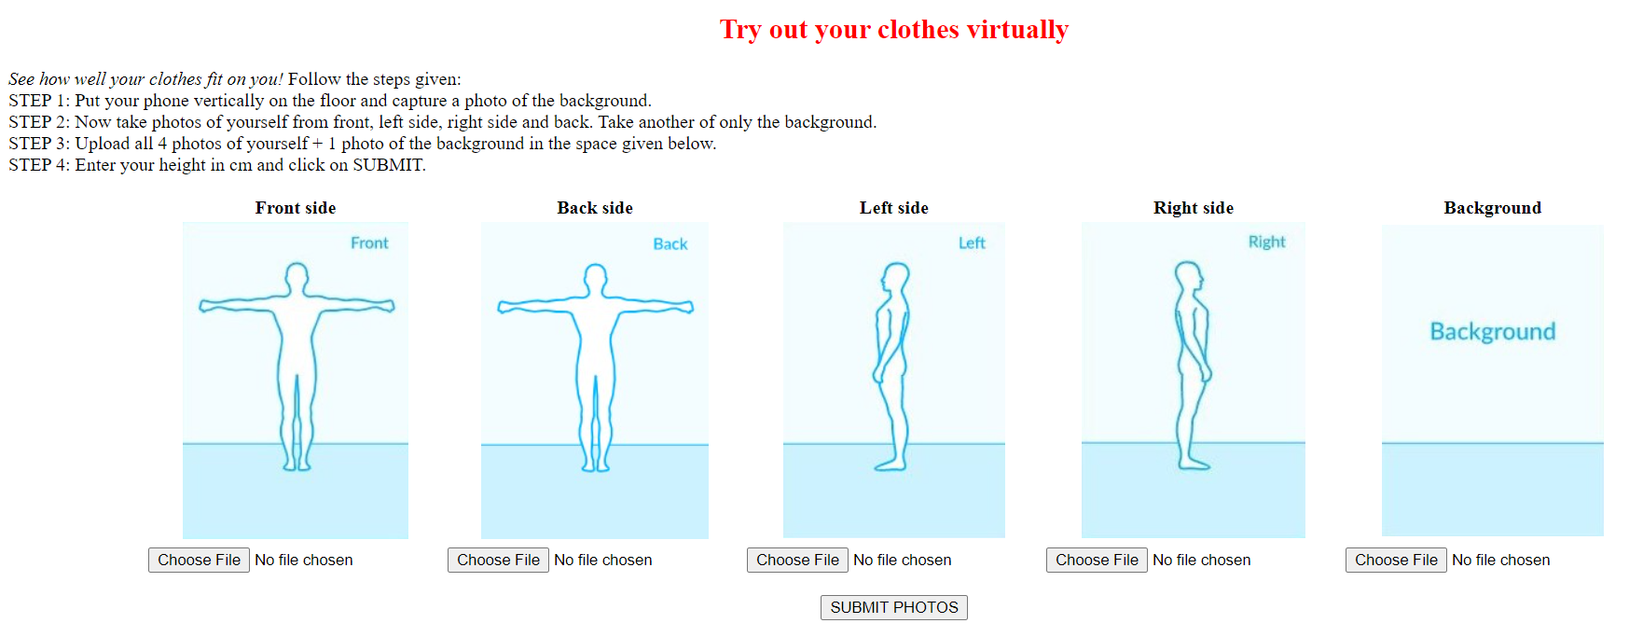
Frontend UI

Slide 6
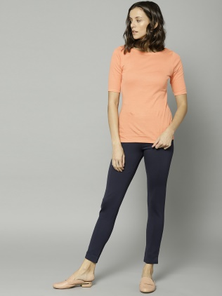

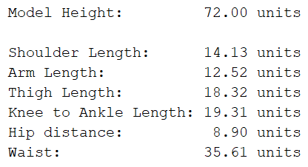
Backend
Read image
Detect keypoints on image
Estimate body dimension
Return result to front end

Slide 7


