Slide 1
Collections

Slide 2
Limitations of array:
Array is indexed collection of fixed number of homogeneous data elements
Arrays can hold homogeneous data only
Once we created an array no chance of increasing or decreasing size of array
Ex:
Student[ ] s=new Student[100];
S[0]=new Student();
S[1]=new Student();
S[2]=new Customer(); compilation error
To overcome the above limitations of array the sun people are introduced collections concept

Slide 3
To overcome the limitations in Array we should go for collections concept.
Collections are growable in nature that is based on our requirement we can increase (or) decrease the size hence memory point of view collections concept is recommended to use.
Collections can hold both homogeneous and heterogeneous objects.
Every collection class is implemented based on some standard data structure
Hence for every requirement ready-made method support is available being a programmer we can use these methods directly without writing the functionality on our own

Slide 4
Collections:
collection can hold both homogeneous data and heterogeneous data
collections are growable in nature
Memory wise collections are good. Recommended to use.
Performance wise collections are not recommended to use .

Slide 5
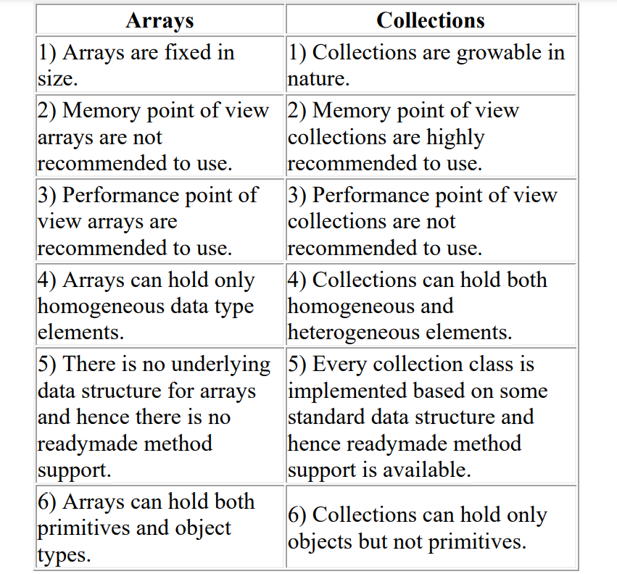

Slide 6
Introduction to Collections Framework
“The Collections Framework provides a well-designed set of interfaces and classes for storing and manipulating groups of data as a single unit, a collection.” -java.sun.com
The standard data structure in Java can be implemented in Java using some library classes and methods. These classes are present in java.util package.
The collection framework is comprised of collection classes and collection interfaces.
Collection is a group of objects which are designed to perform certain task. These tasks are associated with data structures.

Slide 7
The collection classes are the group of classes used to implement the collection interfaces. Various collection classes are…
LinkedList
ArrayList
AbstractSet
EnumSet
HashSet
PriorityQueue
TreeSet
Vector
HashTable ..etc

Slide 8
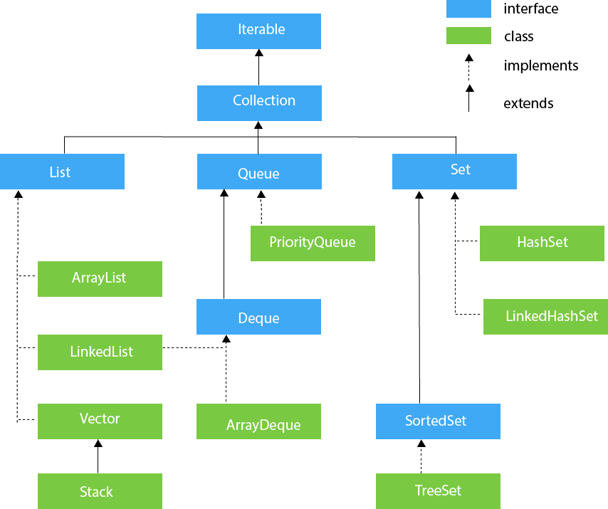

Slide 9
Collection - interface
If we want to represent a group of "individual objects" as a single entity then we should go for collection.
In general we can consider collection as root interface of entire collection framework.
Collection interface defines the most common methods which can be applicable for any collection object.
There is no concrete class which implements Collection interface directly.

Slide 10
Collection Interface Methods
Method | Description
add(Object) | This method is used to add an object to the collection.
addAll(Collection c) | This method adds all the elements in the given collection to this collection.
clear() | This method removes all of the elements from this collection.
contains(Object o) | This method returns true if the collection contains the specified element.
containsAll(Collection c) | This method returns true if the collection contains all of the elements in the given collection.
equals(Object o) | This method compares the specified object with this collection for equality.
hashCode() | This method is used to return the hash code value for this collection.
isEmpty() | This method returns true if this collection contains no elements.
iterator() | This method returns an iterator over the elements in this collection.
max() | This method is used to return the maximum value present in the collection.
parallelStream() | This method returns a parallel Stream with this collection as its source.
remove(Object o) | This method is used to remove the given object from the collection. If there are duplicate values, then this method removes the first occurrence of the object.
removeAll(Collection c) | This method is used to remove all the objects mentioned in the given collection from the collection.
removeIf(Predicate filter) | This method is used to remove all the elements of this collection that satisfy the given predicate.
retainAll(Collection c) | This method is used to retain only the elements in this collection that are contained in the specified collection.
size() | This method is used to return the number of elements in the collection.
spliterator() | This method is used to create a Spliterator over the elements in this collection.
stream() | This method is used to return a sequential Stream with this collection as its source.
toArray() | This method is used to return an array containing all of the elements in this collection.

Slide 11
List -interface
It is the child interface of Collection.
If we want to represent a group of individual objects as a single entity where "duplicates are allow and insertion order must be preserved" then we should go for List interface.
We can differentiate duplicate objects and we can maintain insertion order by means of index hence "index play very important role in List“
All list interface methods build based on index.

Slide 12
Methods in List interface
boolean add(int index,Object o);
boolean addAll(int index,Collection c);
Object get(int index);
Object remove(int index);
set(int index,Object new);//to replace
int indexOf(Object o);
Returns index of first occurrence of "o".
int lastIndexOf(Object o);
ListIterator listIterator();

Slide 13
ArrayList

Slide 14
ArrayList
Introduced in 1.2 version.
ArrayList supports dynamic array that can be grow as needed.it can dynamically increase and decrease the size.
Duplicate objects are allowed.
Null insertion is possible.
Heterogeneous objects are allowed.
The under laying data structure is growable array.
Insertion order is preserved.

Slide 15
Constructors:
1) ArrayList a=new ArrayList();
Creates an empty ArrayList object with default initial capacity "10" if ArrayList reaches its max capacity then a new ArrayList object will be created with
New capacity=(current capacity*3/2)+1

Slide 16
2)ArrayList a=new ArrayList(int initialcapacity);
Creates an empty ArrayList object with the specified initial capacity

Slide 17
Vector

Slide 18
Vector
The underlying data structure is resizable array (or) growable array.
Duplicate objects are allowed.
Insertion order is preserved.
Heterogeneous objects are allowed.
Null insertion is possible.
Implements Serializable, Cloneable and RandomAccess interfaces.
Every method present in Vector is synchronized and hence Vector is Thread safe.

Slide 19
Vector specific methods:
To add objects:
add(Object o);-----Collection
add(int index,Object o);-----List
addElement(Object o);-----Vector

Slide 20
To remove elements:
remove(Object o);--------Collection
remove(int index);--------------List
removeElement(Object o);----Vector
removeElementAt(int index);-----Vector
removeAllElements();-----Vector
clear();-------Collection

Slide 21
To get objects:
Object get(int index);---------------List
Object elementAt(int index);-----Vector
Object firstElement();--------------Vector
Object lastElement();---------------Vector

Slide 22
Constructors:
Vector v=new Vector();
Creates an empty Vector object with default initial capacity 10.
Once Vector reaches its maximum capacity then a new Vector object will be created with double capacity.
That is "newcapacity=currentcapacity*2"

Slide 23
2) Vector v=new Vector(int initialcapacity);
3) Vector v=new Vector(int initialcapacity, int incrementalcapacity);
4) Vector v=new Vector(Collection c);

Slide 24
Stack

Slide 25
Stack
It is the child class of Vector.
Whenever last in first out(LIFO) order required then we should go for Stack.

Slide 26
Constructor:
It contains only one constructor.
Stack s= new Stack();

Slide 27
Methods:
Object push(Object o)
To insert an object into the stack.
Object pop()
To remove and return top of the stack.
Object peek()
To return top of the stack without removal.
boolean empty()
Returns true if Stack is empty.

Slide 28
import java.util.Stack; public class StackDemo { public static void main(String[] args) { Stack s=new Stack(); System.out.println("Elements in stack :"+s); s.push("A"); s.push("B"); s.push("C"); s.push("D"); s.push("E"); System.out.println("Elements in stack :"+s); s.pop(); System.out.println("Elements in stack :"+s); System.out.println("Top element in stack :"+s.peek()); System.out.println("Search A element in stack :"+s.search("A")); System.out.println("Search F element in stack :"+s.search("F")); System.out.println("Search A element in stack :"+s); } }
Output:
Elements in stack :[]
Elements in stack :[A, B, C, D, E]
Elements in stack :[A, B, C, D]
Top element in stack :D
Search A element in stack :4
Search F element in stack :-1
Search A element in stack :[A, B, C, D]

Slide 29
import java.util.Scanner; import java.util.Stack; public class Ex5 { public static void main(String[] args) { Stack<Integer> st=new Stack<Integer>(); int choice=0; int position; Scanner scr=new Scanner(System.in); while(true) { System.out.println("Stack Operations"); System.out.println("1.Push an element"); System.out.println("2.Display stack"); System.out.println("3.Pop an element"); System.out.println("4.Search an element"); System.out.println("Enter your choice"); choice=scr.nextInt(); switch(choice) { case 1: System.out.println("Enter an element"); Integer i=scr.nextInt(); st.push(i); break; case 2: System.out.println("Elements in stack :"+st); break; case 3: System.out.println("Top element popped.."); Integer obj = st.pop(); System.out.println("Popped element= "+obj); break;
case 4: System.out.println("Which an element ? "); Integer ele=scr.nextInt(); position = st.search(ele); if(position==-1) System.out.println("Element not found"); else System.out.println("Position of the element is:= "+position); break; default: return; } } } }
Output:
Stack Operations
1.Push an element
2.Display stack
3.Pop an element
4.Search an element
Enter your choice
1
Enter an element
10
Stack Operations
1.Push an element
2.Display stack
3.Pop an element
4.Search an element
Enter your choice
1
Enter an element
20
Stack Operations
1.Push an element
2.Display stack
3.Pop an element
4.Search an element
Enter your choice
2
Elements in stack :[10, 20]
Stack Operations
1.Push an element
2.Display stack
3.Pop an element
4.Search an element
Enter your choice

Slide 30
LinkedList:
The underlying data structure is double LinkedList.
If our frequent operation is insertion (or) deletion in the middle then LinkedList is the best choice.
If our frequent operation is retrieval operation then LinkedList is worst choice.
Duplicate objects are allowed.
Insertion order is preserved.
Heterogeneous objects are allowed.
Null insertion is possible.

Slide 31
Methods in LinkedList
void addFirst(Object o);
void addLast(Object o);
Object getFirst();
Object getLast();
Object removeFirst();
Object removeLast();

Slide 32
Constructors:
LinkedList l=new LinkedList();
Creates an empty LinkedList object.
LinkedList l=new LinkedList(Collection c);
To create an equivalent LinkedList object for the given collection.

Slide 33
Cursors

Slide 34
The 3 cursors of java:
If we want to get objects one by one from the collection then we should go for cursor.
There are 3 types of cursors available in java. They are:
Enumeration
Iterator
ListIterator

Slide 35
Enumeration:
We can use Enumeration to get objects one by one from the legacy collection objects.
We can create Enumeration object by using elements() method.
public Enumeration elements();
Enumeration e=v.elements();

Slide 36
Enumeration interface defines the following two methods
public boolean hasMoreElements();
public Object nextElement();

Slide 37
Example: import java.util.*; class EnumerationDemo { public static void main(String[] args) { Vector v=new Vector(); for(int i=0;i<=10;i++) { v.addElement(i); } System.out.println(v);//[0, 1, 2, 3, 4, 5, 6, 7, 8, 9, 10] Enumeration e=v.elements(); while(e.hasMoreElements()) { Integer i=(Integer)e.nextElement(); if(i%2==0) System.out.println(i);//0 2 4 6 8 10 } } }

Slide 38
Limitations of Enumeration:
We can apply Enumeration concept only for legacy classes and it is not a universal cursor.
By using Enumeration we can get only read access and we can't perform remove operations.
To overcome these limitations they introduced Iterator concept in 1.2v.

Slide 39
Iterator:
We can use Iterator to get objects one by one from any collection object.
We can apply Iterator concept for any collection object and it is a universal cursor.
While iterating the objects by Iterator we can perform both read and remove operations.
We can get Iterator object by using iterator() method of Collection interface. public Iterator iterator(); Ex: Iterator itr=c.iterator();

Slide 40
Iterator interface defines the following 3 methods.
public boolean hasNext();
public object next();
public void remove();

Slide 41
Ex:
import java.util.ArrayList; import java.util.Iterator; public class IteratorEx { public static void main(String[] args) { ArrayList al=new ArrayList(); for (int i=0;i<100;i++) { al.add(i); } System.out.println("ArrayList Elements:"+al); Iterator i=al.iterator();
while (i.hasNext()) { int n=(int)i.next(); if(n%2!=0) i.remove(); } System.out.println("Even ArrayList Elements:"+al); } }
Output:
ArrayList Elements:[0, 1, 2, 3, 4, 5, 6, 7, 8, .. 99]
Even ArrayList Elements:[0, 2, 4, 6, 8, 10, ..98]

Slide 42
Limitations of Iterator:
Both enumeration and Iterator are single direction cursors only. That is we can always move only forward direction and we can't move to the backward direction.
While iterating by Iterator we can perform only read and remove operations and we can't perform replacement and addition of new objects.
To overcome these limitations sun people introduced listIterator concept

Slide 43
Enumeration | Iterator
Introduced in Java 1.0 | Introduced in Java 1.2
Legacy Interface | Not Legacy Interface
It is used to iterate only Legacy Collection classes. | We can use it for any Collection class.
It supports only READ operation. | It supports both READ and DELETE operations.
It’s not Universal Cursor. | It is a Universal Cursor.
Lengthy Method names. | Simple and easy-to-use method names.

Slide 44
ListIterator:
ListIterator is the child interface of Iterator.
By using listIterator we can move either to the forward direction (or) to the backward direction that is it is a bi-directional cursor.
While iterating by listIterator we can perform replacement and addition of new objects in addition to read and remove operations

Slide 45
By using listIterator method we can create listIterator object.
public ListIterator listIterator();
ListIterator itr=l.listIterator();

Slide 46
ListIterator interface defines the following 9 methods.
public boolean hasNext();
public Object next(); forward
public int nextIndex();
public boolean hasPrevious();
public Object previous(); backward
public int previousIndex();
public void remove();
public void set(Object new);
public void add(Object new);

Slide 47
Ex:
import java.util.LinkedList; import java.util.ListIterator; public class MyLinkedList { public static void main(String[] args) { LinkedList<String> ll=new LinkedList<String>(); ll.add("A"); ll.add("B"); ll.add("C"); ll.add("D"); ll.add("E"); ListIterator li=ll.listIterator(); System.out.println("LinkedList elements in forward direction.."); while (li.hasNext()) { System.out.println(li.next()); } System.out.println("LinkedList elements in backward direction.."); while (li.hasPrevious()) { System.out.println(li.previous()); } } }
Output:
LinkedList elements in forward direction..
A
B
C
D
E
LinkedList elements in backward direction..
E
D
C
B
A

Slide 48
Comparison of Enumeration Iterator and ListIterator ?
Property | Enumeration | Iterator | ListIterator
1) Is it legacy ? | Yes | no | no
2) It is applicable for ? | Only legacy classes. | Applicable for any collection object. | Applicable for only list objects.
3) Moment? | Single direction cursor(forward) | Single direction cursor(forward) | Bi-directional.
4) How to get it? | By using elements() method. | By using iterator()method. | By using listIterator() method.
5) Accessibility? | Only read. | Both read and remove. | Read/remove/replace/add.
6) Methods | hasMoreElement() nextElement() | hasNext() next() remove() | 9 methods.

Slide 49
Generic classes

Slide 50
Generic Class
JDK 1.5 introduces several extensions to the Java programming language. One of these is the introduction of generics.
Using generics it is possible to create a single class that automatically works with different types of data.
A Generic class simply means that the items or functions in that class can be generalized with the parameter(example T) to specify that we can add any type as a parameter in place of T like Integer, Character, String, Double or any other user-defined type.

Slide 51
Generics
Advantage of Java Generics:
There are mainly 3 advantages of generics. They are as follows
1) Type-safety:
We can hold only a single type of objects in generics. It doesn’t allow to store other objects.
Ex: List list = new ArrayList();
list.add(10);
list.add("10");
With Generics, it is required to specify the type of object we need to store.
List<Integer> list = new ArrayList<Integer>();
list.add(10);
list.add("10");// compile-time error

Slide 52
2) Type casting is not required: There is no need to typecast the object.
Ex:
List list = new ArrayList();
list.add("hello");
String s = (String) list.get(0);//typecasting
After Generics, we don't need to typecast the object.
List<String> list = new ArrayList<String>();
list.add("hello");
String s = list.get(0);

Slide 53
3) Compile-Time Checking:
It will check the type at compile time so problem will not occur at runtime.
The good programming strategy says it is far better to handle the problem at compile time than runtime.
Example:
List<String> list = new ArrayList<String>();
list.add("hello");
list.add(32);//Compile Time Error

Slide 54
Example:
import java.util.ArrayList; import java.util.Collections; public class SortNames { public static void main(String[] args) { ArrayList<String> al=new ArrayList<String>(); al.add("Bhaanu"); al.add("Chandhu"); al.add("Divya"); al.add("Abhi"); al.add("Eesha"); System.out.println("Before sorting"); System.out.println("---------------------"); for (String name:al) System.out.println(name); Collections.sort(al); System.out.println("Before sorting"); System.out.println("---------------------"); for (String name:al) System.out.println(name); } }

Slide 55
User defined Generic class
Example:
public class Ex1 { public static void main(String[] args) { MyClass<String> m1=new MyClass<String>("100"); System.out.println("Generic class is returning :"+m1.getInfo()); MyClass<Double> m2=new MyClass<Double>(10.25); System.out.println("Generic class is returning :"+m2.getInfo().getClass()); } } class MyClass<T> { T t; MyClass(T t) { this.t=t; } public T getInfo() { return t; } }

Slide 56
Example:
public class Ex2 { public static void main(String[] args) { Show<Float> s=new Show<Float>(10.5f); System.out.println(s.getInfo()); Show<Integer> s1=new Show<Integer>(10); System.out.println(s1.getInfo()); }
} class Show<T extends Number> { T t; Show(T t) { this.t=t; } public T getInfo() { return t; } }

Slide 57
Random class

Slide 58
Random class in Java?
In Java, Random class is a part of java.util package.
The generation of random numbers takes place by using an instance of the Java Random Class.
This class provides different methods in order to produce random numbers of type boolean, integer, double, long, float, etc.

Slide 59
Constructors used in a Java Random class
This class contains two constructors that are mentioned below:
Random(): this constructor helps in creating a new random generator
Random(long seed): this constructor helps in creating a new random generator using specified seed

Slide 60
Methods
Method | Functionality
nextDouble() | Returns the next pseudo-random number that is a double value between the range of 0.0 to 1.0.
nextBoolean() | Returns the next pseudo-random which is a Boolean value from random number generator sequence
nextFloat() | Returns the next pseudo-random which is a float value between 0.0 to 1.0
nextInt() | Returns the next pseudo-random which is an integer value from random number generator sequence
nextInt(Int n) | Returns the next pseudo-random which is an integer value between 0 and the specified value from random number generator sequence
nextBytes(byte[] bytes) | Generates random bytes and places them into a byte array supplied by the user
Longs() | Returns an unlimited stream of pseudorandom long values
nextGaussian() | Helps in returning the next pseudo-random, Gaussian (precisely) distributed double value with mean 0.0 and standard deviation 1.0 from this random number generator’s sequence

Slide 61
Example:
import java.util.Random; public class RandomDemo { public static void main(String[] args) { Random rnd=new Random(); System.out.println("Random boolean :"+rnd.nextBoolean()); byte b[]=new byte[10]; rnd.nextBytes(b); System.out.print("Random bytes : "); for (byte n:b) { System.out.print(n+" "); } } }
Output:
Random boolean :false
Random bytes : -36 74 119 70 -65 117 -58 127 121 -5

Slide 62
StringTokenizer

Slide 63
StringTokenizer
The string tokenizer class allows an application to break a string into tokens.
The tokenization method is much simpler than the one used by the StreamTokenizer class
The set of delimiters (the characters that separate tokens) may be specified either at creation time or on a per-token basis.
An instance of StringTokenizer behaves in one of two ways, depending on whether it was created with the returnDelims flag having the value true or false:

Slide 64
StringTokenizer methods
int | countTokens()Calculates the number of times that this tokenizer's nextToken method can be called before it generates an exception.
boolean | hasMoreElements()Returns the same value as the hasMoreTokens method.
boolean | hasMoreTokens()Tests if there are more tokens available from this tokenizer's string.
Object | nextElement()Returns the same value as the nextToken method, except that its declared return value is Object rather than String.
String | nextToken()Returns the next token from this string tokenizer.
String | nextToken(String delim)Returns the next token in this string tokenizer's string.

Slide 65
Example:
StringTokenizer st = new StringTokenizer("this is a test");
while (st.hasMoreTokens())
{
System.out.println(st.nextToken());
}
prints the following output:
this
is
a
test

Slide 66
StringTokenizer is a legacy class that is retained for compatibility reasons although its use is discouraged in new code.
It is recommended that anyone seeking this functionality use the split method of String or the java.util.regex package instead.
The following example illustrates how the String.split() can be used to break up a string into its basic tokens:
Example:
String[] result = "this is a test".split("\\s");
for (int x=0; x<result.length; x++)
System.out.println(result[x]);
Output:
this
is
a
test

Slide 67
Scanner class

Slide 68
Scanner class
Scanner is a class in java.util package used for obtaining the input of the primitive types like int, double, etc. and strings.
It is the easiest way to read input in a Java program, though not very efficient if you want an input method for scenarios where time is a constraint.
To create an object of Scanner class, we usually pass the predefined object System.in, which represents the standard input stream. We may pass an object of class File if we want to read input from a file.
To read entire line of Strings we can use nextLine().
To read a single character, we use next().charAt(0). next() function returns the next token/word in the input as a string and charAt(0) function returns the first character in that string.

Slide 69
Methods
boolean hasNext( ) boolean hasNext(Pattern pattern)
boolean hasNext(String pattern) boolean hasNextBigDecimal( )
boolean hasNextBigInteger( ) boolean hasNextBigInteger(int radix)
boolean hasNextBoolean( ) boolean hasNextByte( )
boolean hasNextByte(int radix) boolean hasNextDouble( )
boolean hasNextFloat( ) boolean hasNextInt( )
boolean hasNextInt(int radix) boolean hasNextLine( )
boolean hasNextLong( ) boolean hasNextLong(int radix)
boolean hasNextShort( ) boolean hasNextShort(int radix)
String next( ) String next(String pattern)
boolean nextBoolean( ) byte nextByte( )
double nextDouble( ) int nextInt( )
String nextLine( ) long nextLong()
short nextShort( )

Slide 70
Calendar class

Slide 71
Calendar class
Calendar class in Java is an abstract class that provides methods for converting date between a specific instant in time and a set of calendar fields such as MONTH, YEAR, HOUR, etc.
It inherits Object class and implements the Comparable, Serializable, Cloneable interfaces.
As it is an Abstract class, so we cannot create an instance. Instead, we will have to use the static method Calendar.getInstance() to instantiate and implement a sub-class..
java.util.Calendar is an abstract base class for extracting detailed information such as year, month, date, hour, minute and second from a Date object.
Subclasses of Calendar can implement specific calendar systems such as Gregorian calendar, Lunar Calendar and Jewish calendar.
Currently, java.util.GregorianCalendar for the Gregorian calendar is supported in the Java API.

Slide 72
Methods
Calendar provides no public constructors.
static Calendar getInstance( ) : Returns a Calendar object for the default locale and time zone.
int get(int calendarField) : Returns the value of one component of the invoking object.
The component is indicated by calendarField.
Examples of the components that can be requested are Calendar.YEAR, Calendar.MONTH, Calendar.MINUTE.

Slide 73
final Date getTime( ) : Returns a Date object equivalent to the time of the invoking object.
final void set(int year, int month, int dayOfMonth) : Sets various date and time components of the invoking object.
final void setTime(Date d) : Sets various date and time components of the invoking object. This information is obtained from the Date object d.

Slide 74
METHOD | DESCRIPTION
abstract void add(int field, int amount) | It is used to add or subtract the specified amount of time to the given calendar field, based on the calendar’s rules.
int get(int field) | It is used to return the value of the given calendar field.
abstract int getMaximum(int field) | It is used to return the maximum value for the given calendar field of this Calendar instance.
abstract int getMinimum(int field) | It is used to return the minimum value for the given calendar field of this Calendar instance.
Date getTime() | It is used to return a Date object representing this Calendar’s time value.</td

Slide 75
The Current Date is:Tue Aug 28 11:10:40 UTC 2018
Example:
import java.util.*;
public class Calendar1 {
public static void main(String args[])
{
Calendar c = Calendar.getInstance();
System.out.println("The Current Date is:" + c.getTime());
}
}
Output:
The Current Date is:Tue Aug 28 11:10:40 UTC 2022

Slide 76
Example:
import java.util.*;
public class Calendar3 {
public static void main(String[] args)
{
// creating calendar object
Calendar calendar = Calendar.getInstance();
int max = calendar.getMaximum(Calendar.DAY_OF_WEEK);
System.out.println("Maximum number of days in a week: " + max);
max = calendar.getMaximum(Calendar.WEEK_OF_YEAR);
System.out.println("Maximum number of weeks in a year: " + max);
}
}
Output:
Maximum number of days in a week: 7
Maximum number of weeks in a year: 53

Slide 77
Example:
import java.util.Calendar; public class Ex20 { public static void main(String[] args) { String[] month={"Jan","Feb","Mar","Apr","May","Jun","Jul","Aug","Sep","Oct","Nov","Dec"}; Calendar calendar=Calendar.getInstance(); System.out.println("Calendar Type:"+calendar.getCalendarType()); System.out.println("Time Zone :"+calendar.getTimeZone().getID()); System.out.print("Date:"); System.out.print(month[calendar.get(Calendar.MONTH)]); System.out.print(" "+calendar.get(Calendar.DAY_OF_MONTH)); System.out.print(" "+calendar.get(Calendar.YEAR)); }
}
Output:
Calendar Type:gregory
Time Zone :Asia/Calcutta
Date:Jun 16 2022

Slide 78
MAP

Slide 79
Map properties
If we want to represent a group of objects as "key-value" pair then we should use Map interface.
Both key and value are objects only.
Duplicate keys are not allowed but values can be duplicated
Each key-value pair is called "one entry".
Map interface is not child interface of Collection and hence we can't apply Collection interface methods here.
Map interface defines the following specific methods.

Slide 80
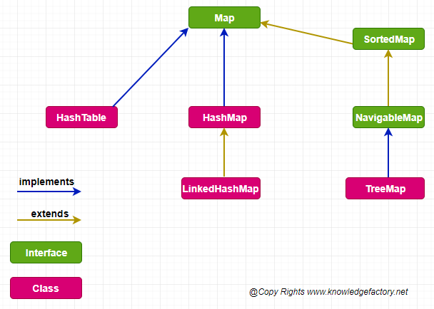

Slide 81
HashMap:

Slide 82
HashMap:
The underlying data structure is Hashtable.
Duplicate keys are not allowed but values can be duplicated.
Insertion order is not preserved and it is based on hash code of the keys.
Heterogeneous objects are allowed for both key and value.
Null is allowed for keys(only once) and for values(any number of times).
It is best suitable for Search operations.

